Slide 1

AIM-AHEAD Introductory Courses in AI/ML Concepts
Module 3: Handling Non-linearity, Model Complexity, and Regularization
Adapted from the Health Informatics and Data Science Masters Degree Program, Georgetown University

Slide 2
Model Complexity
Overfitting vs underfitting

Slide 3
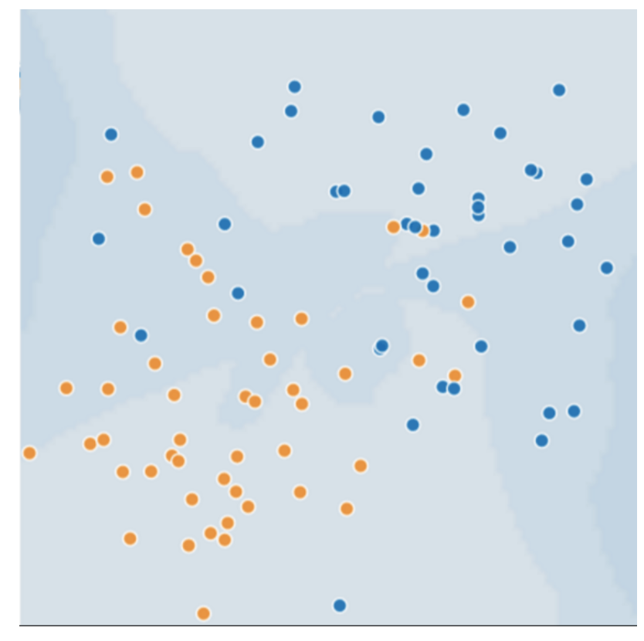
Generalization: Perils of Overfitting
Consider the following 2D feature (say age=x1 and tumor_size=x2), where
Blue dots represent malignant tumors
Orange dots represent benign
What would a best model with very low loss look like?
Notes:
To illustrate model overfitting, let’s consider an example where samples are in a 2D feature space.
Very simple, we have data on patients; their age and tumor size.
Each patient is plotted on a 2D plane, and labeled according to whether the tumor is benign (orange) or malignant (blue).
When we train our model, a key component is defining the “loss”. A simple way of thinking about loss is that is defines how well a model prediction matches the true data.
When we think of model performance, we think in terms of minimizing “loss” on a the training data.
So a model with the minimum loss, will generate a decision boundary the perfectly separates the labels in the 2D plane.

Slide 4
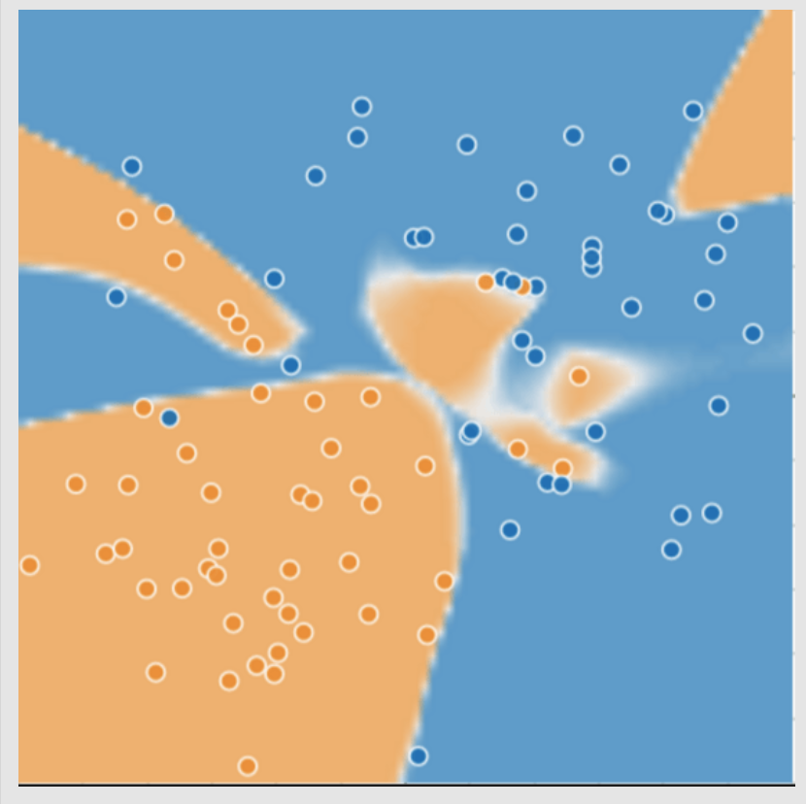
Generalization: Perils of Overfitting
Complex model for distinguishing the two classes (malignant vs benign)
First glance this trained model seems to be doing an excellent job!
What about new unseen data?
Notes:
In the case of this hypothetical dataset, this will result in a highly complex decision boundary.
The decision boundary defines regions of the 2D feature space that nearly perfectly separates the benign and malignant labels.
However, such a complex model can run into problems when extended to new samples.

Slide 5
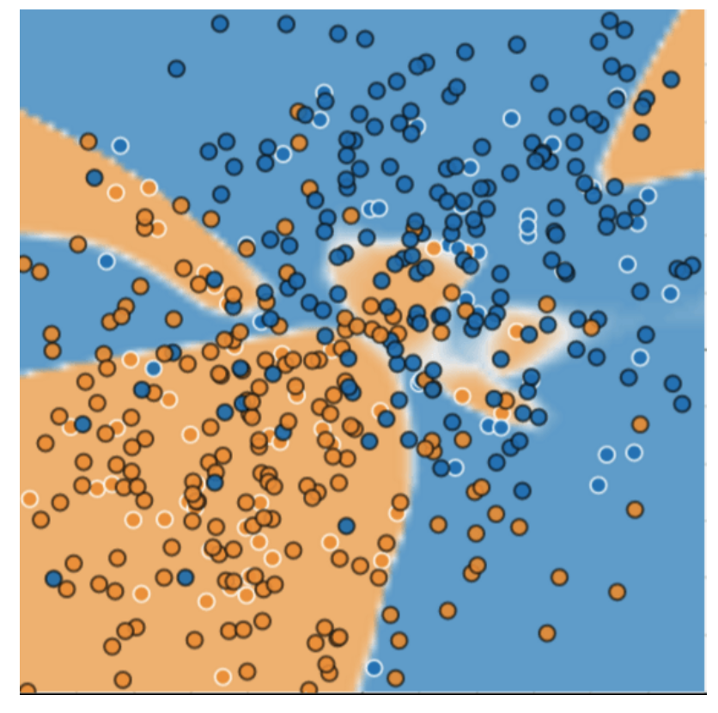
Complex model: new data
Complex model did a bad job predicting on new data
Adapted poorly new data
miscategorized much of the new data
Overfits the peculiarities of the data it trained on.
A simple model might have been better!
Notes:
Here, we project data from more patients onto the 2D plane.
The complex model does a relatively good job at predicting benign samples, but a poor job of predicting if a tumor will be malignant.
The result is a lot of miscategorized predictions, and we can see that the model is overfit to the training data.
A simple model where the 2D plane is separated by a line, actually does a much better job at predicting the labels.

Slide 6
Model overfitting
Overfit model gets a low loss during training but does a poor job predicting new data.
Overfitting is caused by making a model more complex than necessary.
In ML, we have to decide between:
Fitting our data well: Specific model
Fitting the data as simply as possible: General model
Notes:
To reiterate, an overfit model will have a low loss on the data used to train the model, but will not perform well predicting labels for new data.
This is caused by making a model more complex than it needs to be.
When developing our models, we need to made a decision fitting the data we have really well, while keeping the model as simple as possible.
What we decide will impact if we have a specific model, that is useful within the specific context of the training data, or a general model that performs well on data collected elsewhere.

Slide 7
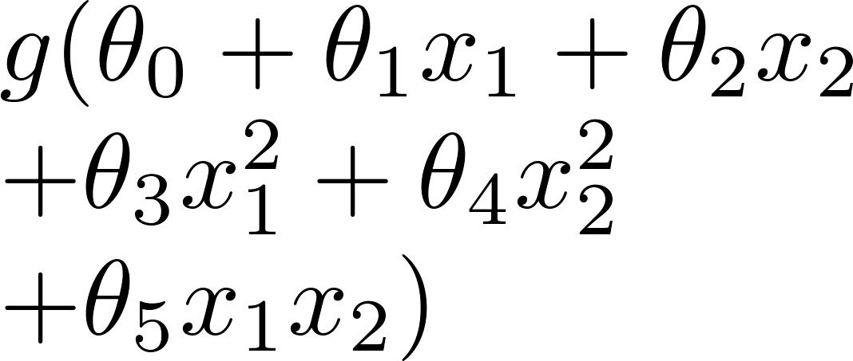
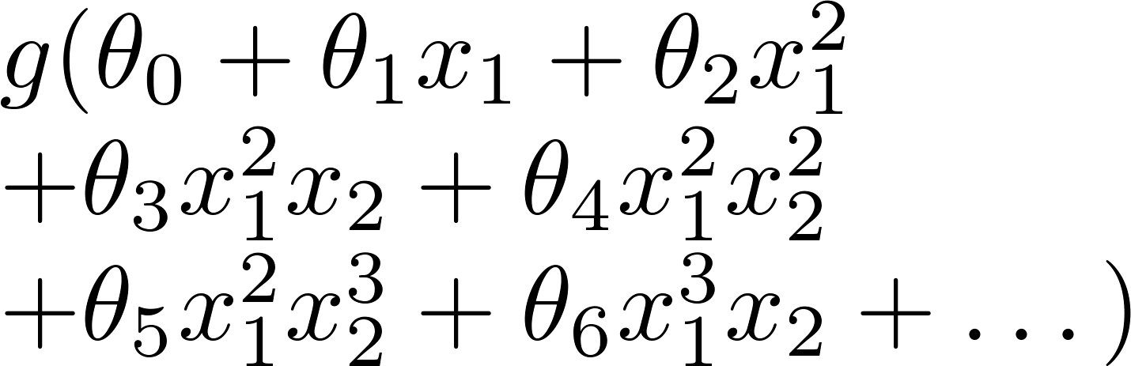
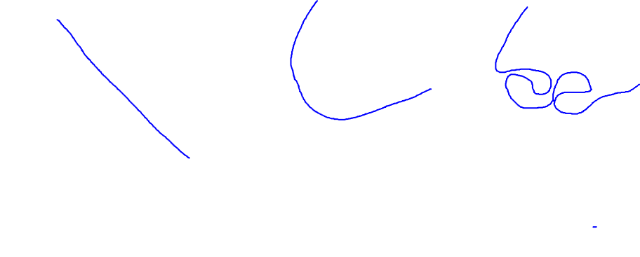
Example: Logistic regression
x₂
x₂
x₂
x₁
x₁
x₁
( = sigmoid function)
Underfit
About right!
Overfit
Why these different boundaries and how do we select the right one?
Notes:
Let’s look at defining different logistic regression models for the same dataset.
The first, is just the linear combination of the input features.
The second is a more complex model, where second order polynomial combinations of the input variables are included.
And the third is even more complex, including many higher order polynomial features.
After we train theses models, we can draw the decision boundary.
The boundary’s are different because we increased the dimensions of the features space. When the boundary is projected back into 2D feature space, it warps to better separate the labels.
The first model underfits the data, and the third model overfits the data.
We can select the right model by looking at the trade off between how many labels fall on the wrong side of the decision boundary with how “curvy” it is.
The first model is ok, but incorrectly separates about half of the data points. It is underfit.
The third model perfectly separates the data, but is incredibly complex in the 2D feature space. It is overfit.
The second model does a good job of separating the labels, and is the best model of the three.
The first one seems to do a reasonably good job.

