Slide 1

AIM-AHEAD Introductory Courses in AI/ML Concepts
Orientation
Adapted from the Health Informatics and Data Science Masters Degree Program, Georgetown University

Slide 2
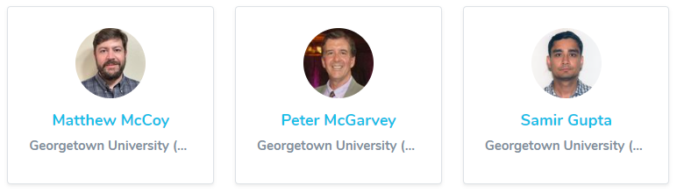
Introductions
Innovation Center for Biomedical Informatics (ICBI)
Georgetown University Medical Center
Course Directors:

Slide 3
Course Objectives and Expectations
Participants should be …
comfortable writing and executing code in a python notebook
Interested in understanding the high level concepts behind AI/ML
Participants will learn to apply basic machine learning algorithms to example datasets, and extend those methods to their own data. This includes...
Formatting data into appropriate formats for model training and validation.
Training and evaluating predictive classification models
how to tune and improve model performance

Slide 4
Course Structure
The course has five modules:
Introduction to Classification
Unsupervised Learning: K-means Clustering
Handling Non-linearity, Model Complexity, and Regularization
Model Selection, Hyperparameter Tuning, and Evaluation
Introduction to Neural Networks

Slide 5
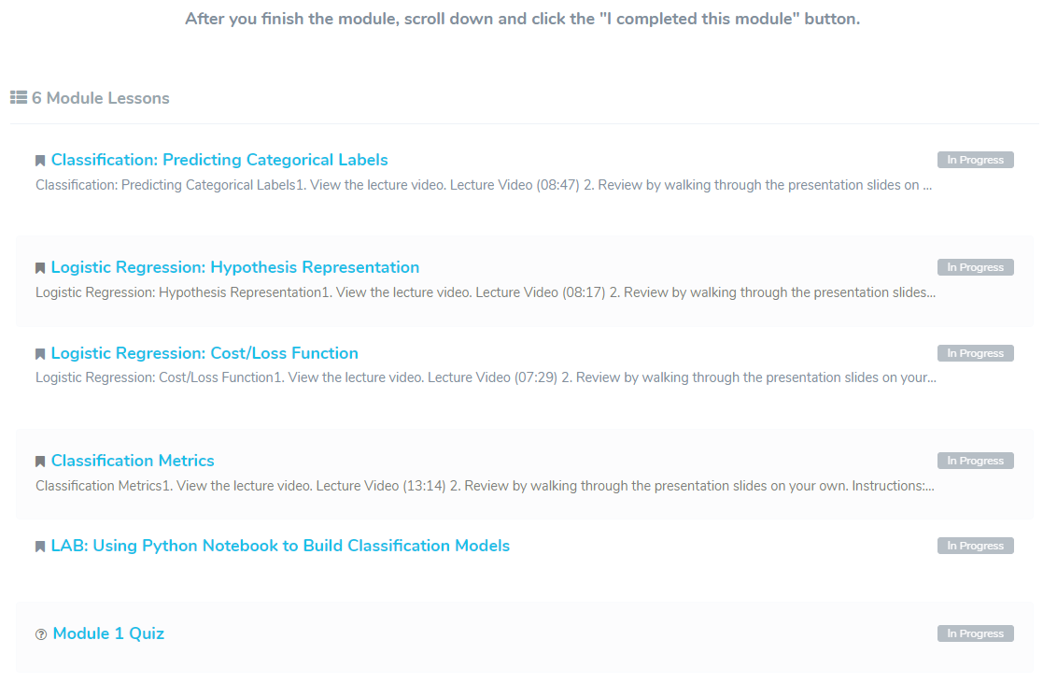
Course Structure
Course Modules include…
Content lessons
Recorded lecture
Annotated slides
Practical coding example
Google colab notebook
Quiz
demo

Slide 6

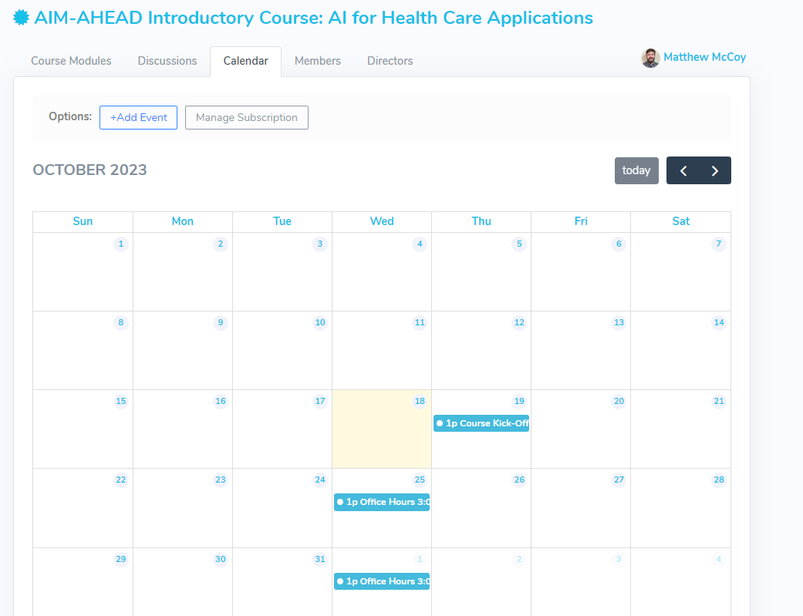
Engagement
We can interact across a variety of forums…
AIM-AHEAD Connect Group
Start threads for help with specific questions
General discussion about applying methods to your research
Virtual Office Hours: Review of discussion topics as well as individual support to clarify content
Check the course calendar for schedule
Sessions will be recorded and made available for those who could not attend.

