Slide 1

AIM-AHEAD Introductory Courses in AI/ML Concepts
Module 2: Unsupervised Learning
Adapted from the Health Informatics and Data Science Masters Degree Program, Georgetown University

Slide 2
Unsupervised Learning
Predicting Categorical Labels

Slide 3
Example: Labeled Data
Age | Tumor size (1-5) | pathogenic variants? (Y/N) | Clump thickness (1-10) | y=Malignant? (LABEL)
20 | 5 | N | 2 | N
55 | 3 | Y | 6 | Y
35 | 4 | Y | 3 | Y
70 | 2 | Y | 6 | N
25 | 3 | N | 1 | N
47 | 5 | Y | 6 | Y
.. |  | .. | .. | ..
Notes:
First, lets start with a dataset of patient tumors.
Each record has:
the patient age at diagnosis
the size of the tumor on a scale of 1-5
the presence or absence of known pathogenic variants,
the “clump thickness” on a scale of 1-10
As features.
And each record also has an associated label indicating if the tumor was malignant or not.

Slide 4

Labeled Data: Supervised Learning
y=1
y=0
Malignant (y = 1)
Benign (y = 0)
Age
(x₂)
x: New point (y=0)
Tumor Size (x₁)
Notes:
If we plot the tumor size vs. the age from our dataset,
And then apply the label in the form of a red X for malignant tumors and a blue circle for benign tumors
We can see that there seems to be a separation of our labels around a decision boundary, which can be visualized as a line.
Benign labels, also given the label value y = 0, fall below and to the left of this line.
Malignant labels, also given the label value y = 1, fall above and to the right of this line.
We can learn where the decision boundary line falls from the training data,
and a prediction about the malignancy can be made by seeing there a new point falls with respect to the boundary.
This is known as supervised learning because we use the known labels in our dataset to learn the decision boundary.

Slide 5


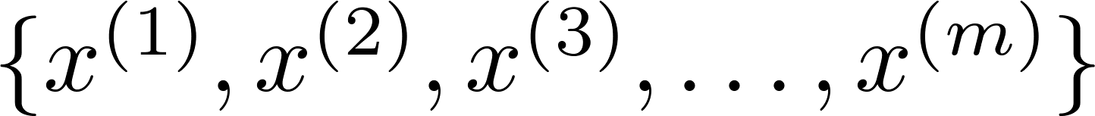
Unsupervised learning: Clustering
Where clustering can be applied?
Training set:
Notes:
Unsupervised learning is applied when the label on the dataset is not known.
A common approach is to cluster the data.
Clustering takes the many features of a training dataset and groups them together by their similarity.
The points on the plot represent two of the features from entries in our dataset.
Points that are close together are said to be in the same cluster.

Slide 6
AIM-AHEAD Introductory Courses in AI/ML Concepts
Module 2: Unsupervised Learning
Adapted from the Health Informatics and Data Science Masters Degree Program, Georgetown University

Slide 7
K-means Algorithm
Finding structures in feature space

Slide 8
K-means
K-means is clustering algorithms
Group data points into groups/clusters
Iterative algorithm:
Select/update cluster centers (Centroid)
Assign data points to cluster
Notes:
The K-means Algorithm is one of many ways to view higher order structure, or clustering, within a dataset.
The number of clusters, k, is chosen as an input by the user.
The objective of the algorithm is assign each datapoint to one of the k clusters.
It does this by iterating between two steps.
The first selects or updates the center of each cluster in the high dimensional feature space.
Next each data point is assigned the same cluster as the nearest centroid.
The process repeats by updating the center of the cluster updating the cluster assignment for the data points.
The process repeats until the cluster membership stabilizes.

Slide 9
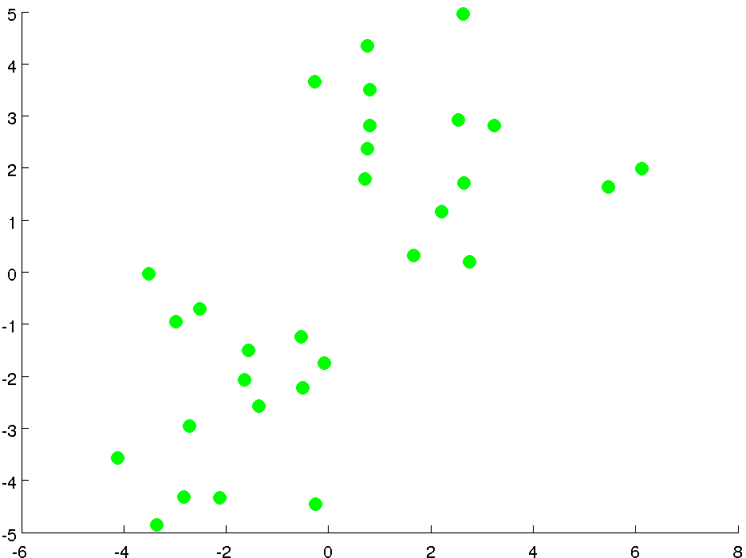
2D unlabeled feature space
Notes:
Lets look at an example of the K-means algorithm in action.
To begin we have an unlabeled dataset.
To help with visualization, our example has only 2 features so it can be plotted in 2D space.
Three features would require a 3D plot, and even larger numbers cannot be visualized.
But the idea is the same… in that higher dimensional space, each entry in our dataset is represented by a single point.

Slide 10
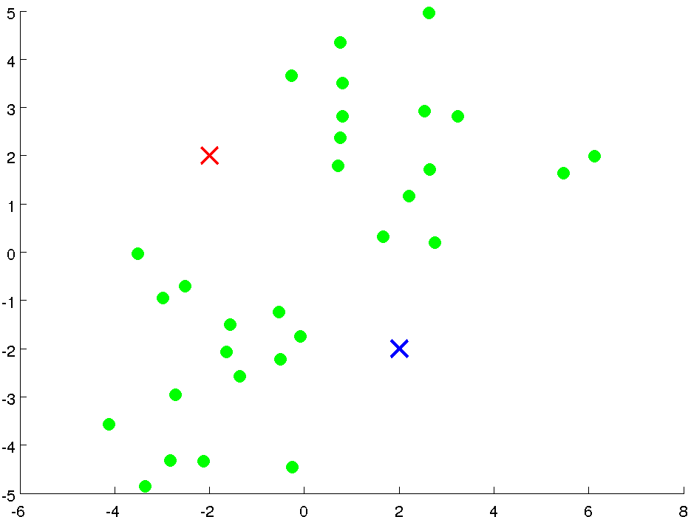
Initialization
Cluster centroids:
Randomly select two points
Notes:
If we want to see how our data separates into 2 clusters
We begin by randomly selecting the location of our 2 cluster centers.
These are represented by the red and blue X.

Slide 11
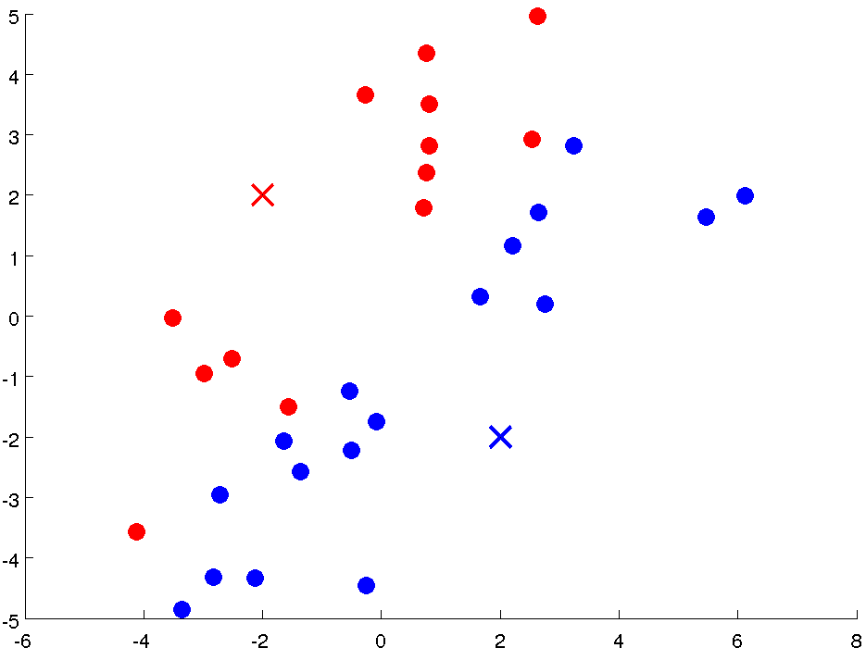
Iteration 1: Cluster Assignment
Assign points based
on distance to centroid
Notes:
We then assign each datapoint to the nearest cluster, based on the distance from the cluster centroid.
The red dots were assigned to the red cluster
The blue dot

Slide 12
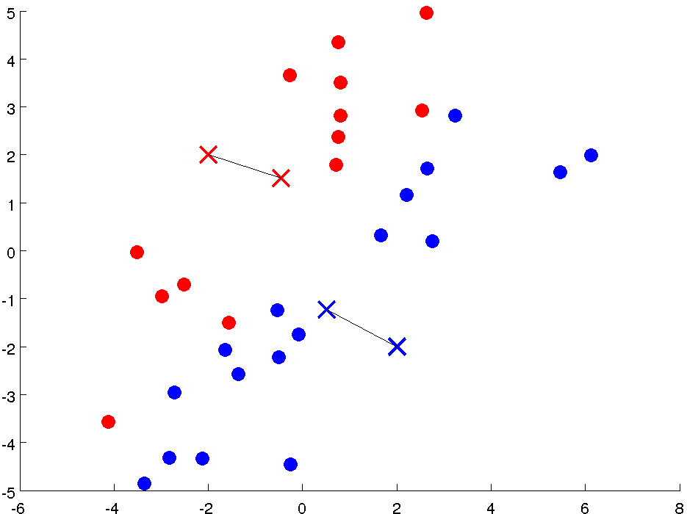
Iteration 1: Move Centroid
Compute new centroids
Notes:
Next we update the position of the cluster centroid.
The red centroid shifts down and to the right.
The blue centroid shifts up and to the left.

Slide 13
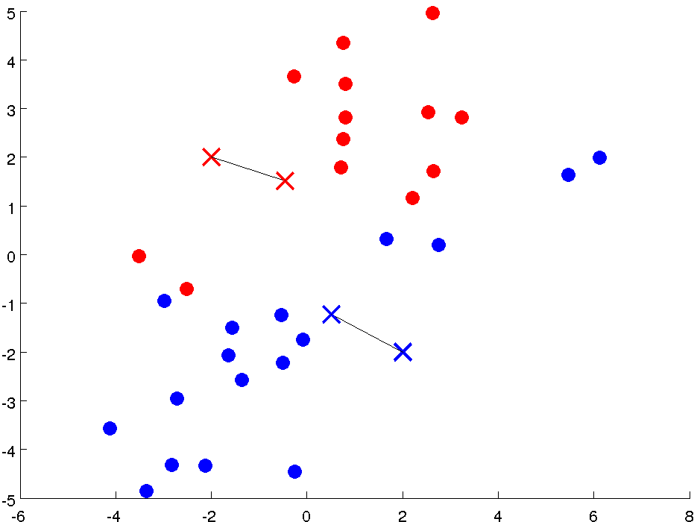
Iteration 2: Cluster Assignment
Assign points based
on distance to centroid
Notes:
Once again, we reassign the datapoints a cluster based on their distance to each cluster centroid.
Those closest to the new red centroid are assigned to the red cluster.
Those closest to the new blue centroid are assigned to the blue cluster.

Slide 14
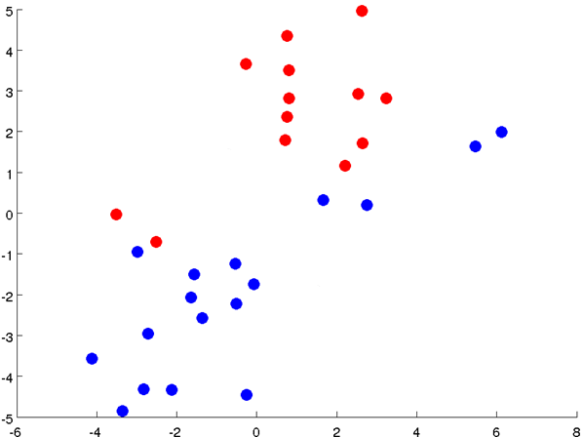
Iteration 2: Move Centroid
Compute new centroids
Notes:
Once again we update the position of the cluster centroid.
The red cluster center moves up and to the right and the blue cluster center moves down and to the left.

Slide 15
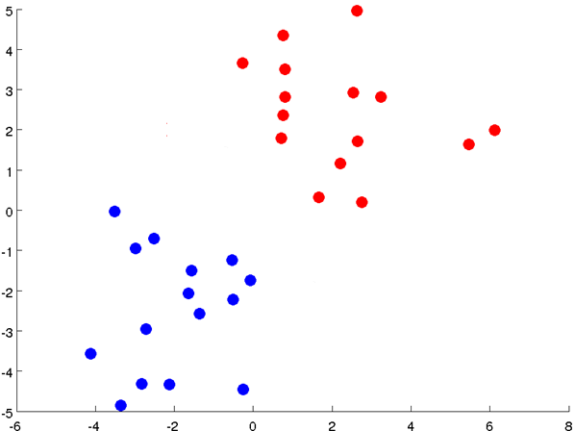
Iteration3: Cluster Assignment
Assign points based
on distance to centroid
Notes:
Once again the datapoints are reassigned to the red and blue clusters.

Slide 16
Iteration 3: Move Centroid
Compute new centroids
Notes:
And the centroids are updated.

Slide 17
Iteration4: Cluster Assignment
Assign points based
on distance to centroid
Notes:
The algorithm is complete when the reassignment of clusters stopes changing.

Slide 18
K-means Visualization
http://tech.nitoyon.com/en/blog/2013/11/07/k-means/
Notes:
Check out this website to play around with visualization of different numbers of data points and clusters.

Slide 19
K-means Algorithm
Formal Definition

Slide 20

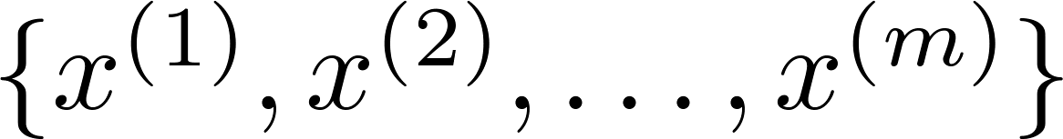
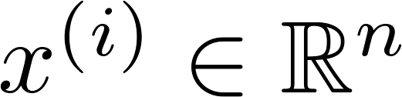
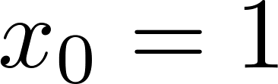
K-means algorithm
Input:
(number of clusters)
Training set
(drop convention)

Slide 21

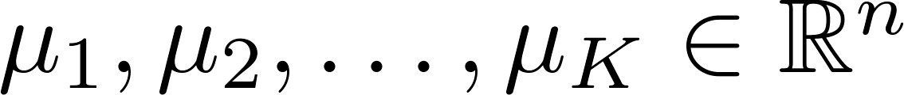
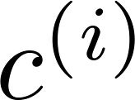
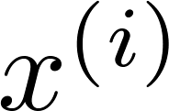

K-means algorithm
Randomly initialize cluster centroids
Repeat {
for = 1 to
:= index (from 1 to ) of cluster centroid
closest to
for = 1 to
:= average (mean) of points assigned to cluster
}
Cluster Assignment
Move Centroids

Slide 22
AIM-AHEAD Introductory Courses in AI/ML Concepts
Module 2: Unsupervised Learning
Adapted from the Health Informatics and Data Science Masters Degree Program, Georgetown University

Slide 23
Clustering Optimization Objective
Question: How would quantify the quality of a particular clustering

Slide 24

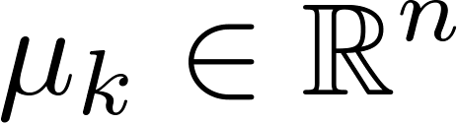

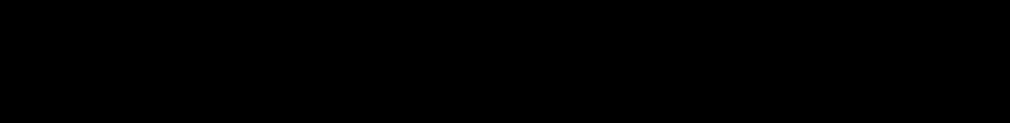
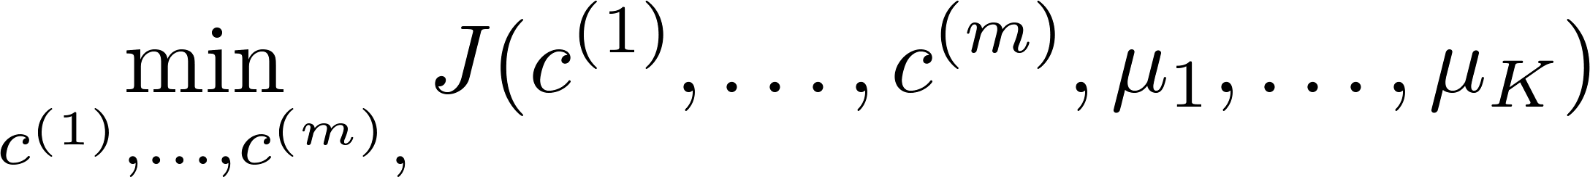

K-means optimization objective
= index of cluster (1,2,…, ) to which example is currently assigned
= cluster centroid ( )
= cluster centroid of cluster to which example has been assigned
Optimization objective:
Distortion Function
Notes:
Change numbers to LATEX as well

Slide 25
Random Initialization
Selecting the initial centroids

Slide 26
K-means algorithm
Randomly initialize cluster centroids
Repeat {
for = 1 to
:= index (from 1 to ) of cluster centroid
closest to
for = 1 to
:= average (mean) of points assigned to cluster
}
Cluster Assignment
Move Centroids
Question: How do we select initial centroid?

Slide 27

Random initialization
Should have
Randomly pick training
examples.
Set equal to these
examples.
Question: Issue with random selection?
Notes:
LATEX font

Slide 28
Local optima
Solution?

Slide 29
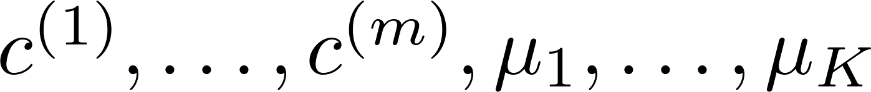
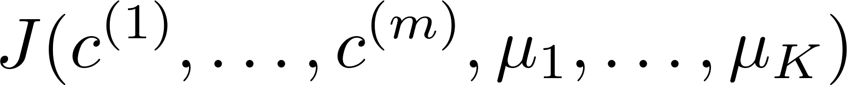
Random initialization: Run K-mean multiple times
For i = 1 to 100 {
Randomly initialize K-means.
Run K-means. Get .
Compute cost function (distortion)
}
Pick clustering that gave lowest cost

Slide 30
Local optima
Lowest cost

Slide 31
Number of Clusters
How do we know how many clusters are there in the feature space?

Slide 32
What is the right value of K?
# of clusters= 2, 3, or 4 …

Slide 33
K=2

Slide 34
K=3

Slide 35
K=4

Slide 36
What is the right value of K?
# of clusters= 2, 3, or 4 …
How do we decide K?

Slide 37

Choosing the value of K
Elbow method:
Elbow
Cost function
Cost function
Elbow??
(no. of clusters)
(no. of clusters)

Slide 38
Choosing the value of K
Sometimes, you’re running K-means to get clusters to use for some later/downstream purpose.
The downstream application can help you determine clusters
Evaluate K-means based on a metric for how well it performs for that later purpose.

Slide 39
Choosing the value of K
Sometimes, you’re running K-means to get clusters to use for some later/downstream purpose. Evaluate K-means based on a metric for how well it performs for that later purpose.
E.g.
Gene Expression Tumor Clustering
Gene B
Gene B
Gene A
Gene B

Slide 40
Choosing the value of K
E.g.
Gene Expression Tumor Clustering
Gene B
Gene B
Gene A
Gene B
3 types of tumors: normal, breast, lung
4 types of tumors: normal, breast, lung, pancreatic

