Slide 1
HIDS-506: AI for Health Applications
Model Selection and Evaluation, Hyperparameter tuning,
Samir Gupta, PhD

Slide 2
Model Selection and Hyperparameter tuning

Slide 3
Best model and hyperparameters to deploy
Given a training, test dataset and a classification task, you will need to select:
The best model (Logistic regression, Support Vector Machines, Random Forest etc.)
Best hyperparameters for each model
What are the different hyperparameters that we learned?
Learning rate : for gradient descent convergence
Regularization: for model complexity
Polynomial degree: for feature crosses

Slide 4
Best model and hyperparameters to deploy
The best model (Logistic regression, Support Vector Machines, Random Forest etc.)
Best hyperparameters for each model
Learning rate : α = 0.01, 0.05, 0.1, 1, 10 …
Regularization: L1 or L2, λ value = 0.001, 0.05, 0.1, 1, 5, 10 …
Polynomial degree: degree = 2, 3 , 4 ..
Suppose Logistic regression is the best model with:
α = 0.01
L2, λ value = 0.5
degree = 3
How do we select which model and set of parameters is the best?

Slide 5
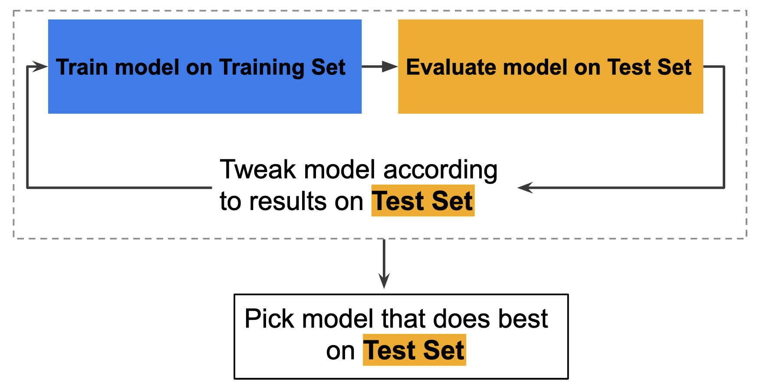
Model selection and Hyperparameter tuning
Fit all possible combinations on training set
Return the best combination (model, parameter), which has the best result on the test set
Possible Issue?

Slide 6
Issue
"Tweak model” => selecting best hyperparameters (learning rate) or some processing: removing features
At the end of this workflow, you pick the model that does best on the test set.

Slide 7
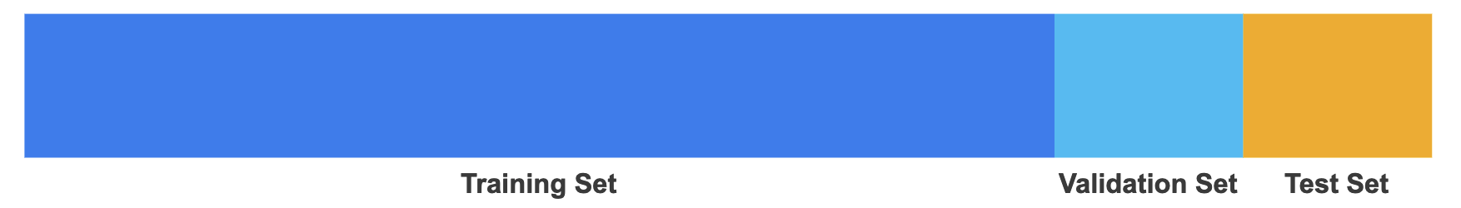
Solution: Another partition
This is fine, but test set is generally not used to tweak the model
General advice: Need fewer exposures to the test set
Solution: Another partition
Evaluate and tweak using results on the Validation set
Confirm results on test set and deploy model

Slide 8
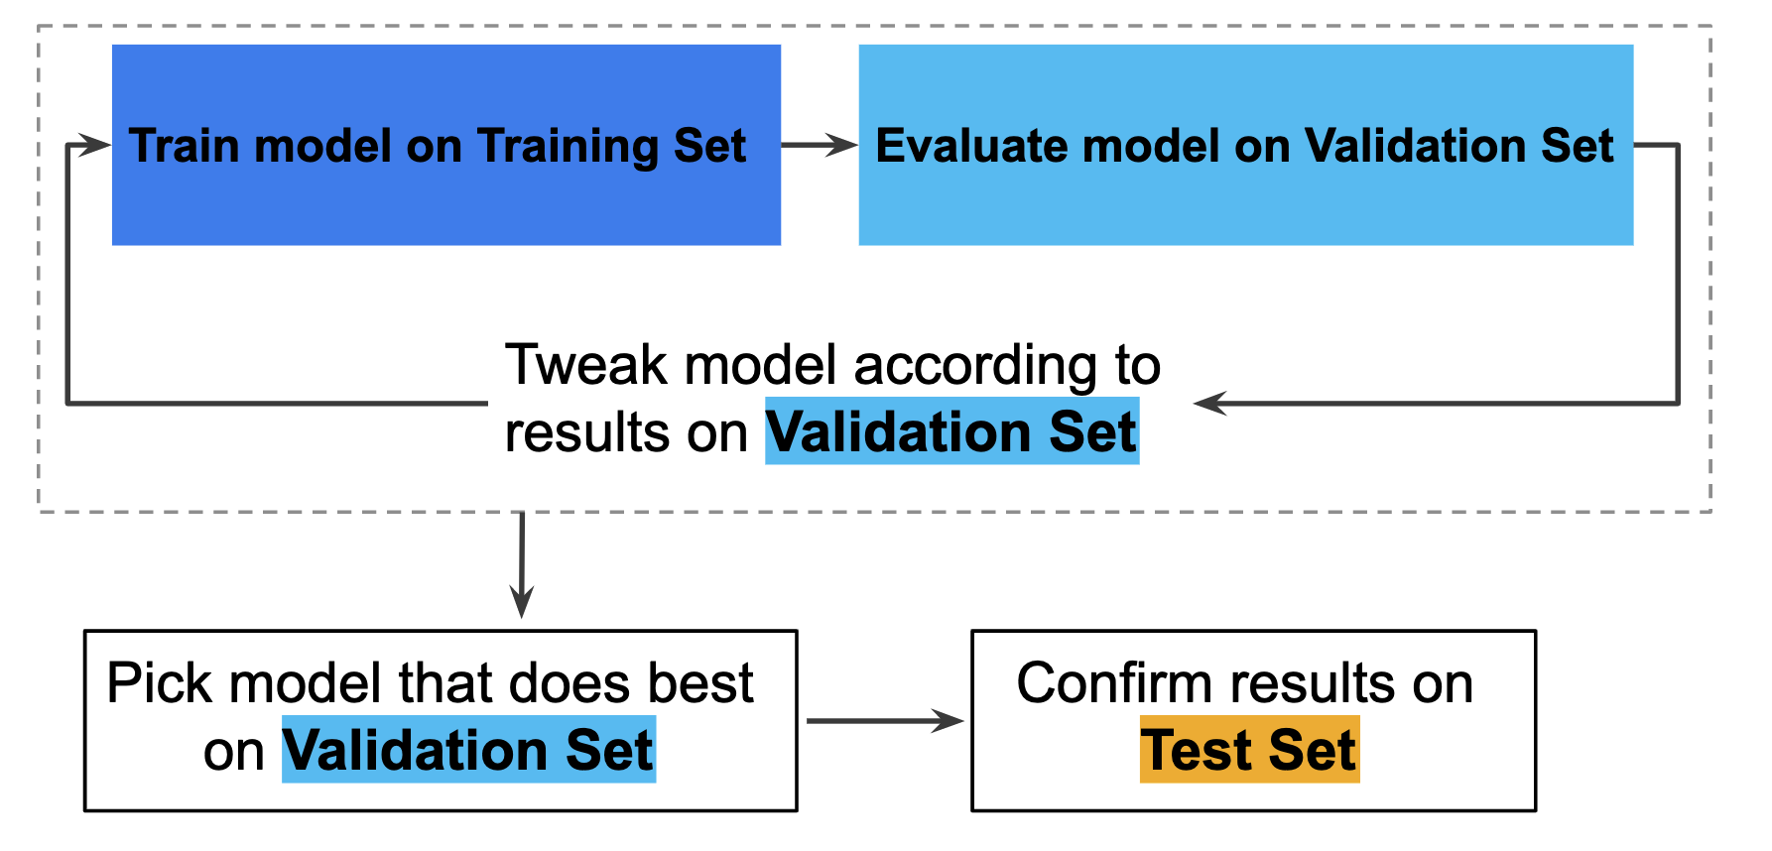
Improved Workflow

Slide 9
Validation set
Is a random X % (say 20%) of the dataset as Validation enough to evaluate and pick models?
If your dataset is small, this might not be sufficient to properly evaluate your models and parameters
Solution: k-fold cross-validation
Split your dataset randomly into k groups
Train on k-1 groups and validate on the remaining 1 group
Do this k times (n= number of samples)
Return mean metric across the k iterations

Slide 10

Example: 5 fold cross validation

Slide 11
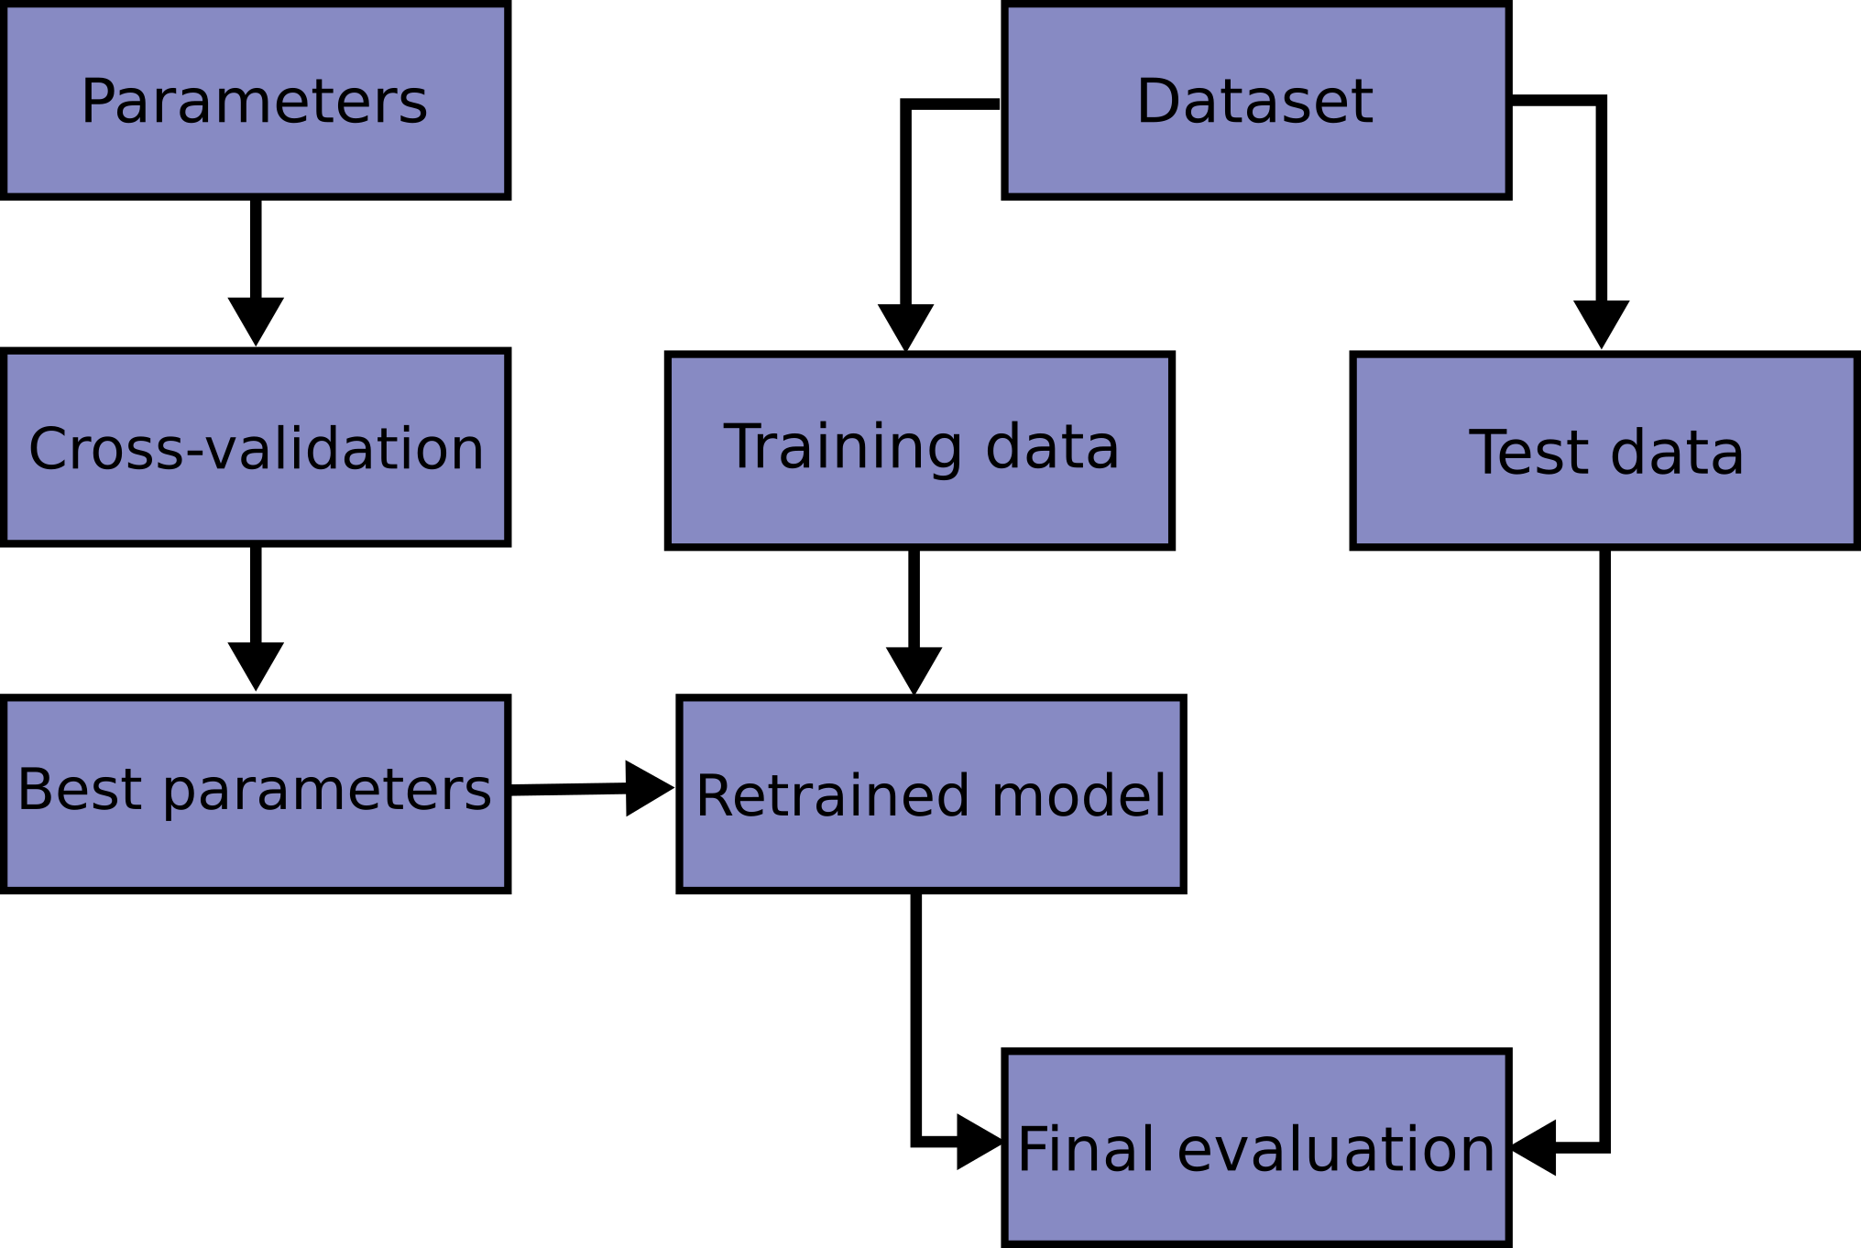
Typical Workflow

