Slide 1
HIDS-506: AI for Health Applications
Handling Non-linearity, Model Complexity, Regularization
Samir Gupta, PhD

Slide 2
Handling non-linear feature space
Encoding non-linearity: Feature crosses

Slide 3
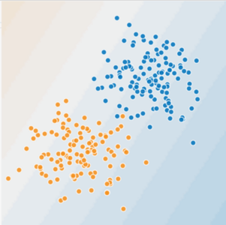
Is this a linear problem?
Can you draw a line that neatly separates the two classes?

Slide 4
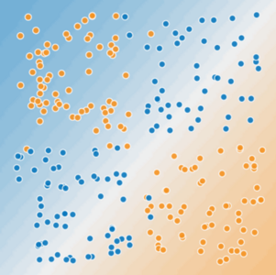
Is this a linear problem?
Can you draw a line that neatly separates the two classes?

Slide 5
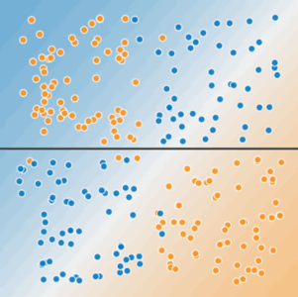
Non-linear data
A single line can't separate the two classes.

Slide 6
Non-linear data
To solve the nonlinear problem shown here, we need to create a feature cross.
A feature cross is a synthetic feature that encodes nonlinearity in the feature space by multiplying two or more input features together.
x₃ = x₁ * x₂
We treat this newly minted feature cross just like any other feature. The linear formula becomes:
y = θ₀ + θ₁*x₁ + θ₂*x₂ + θ₃*x₃
x2
x1

Slide 7
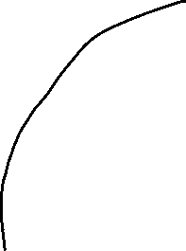
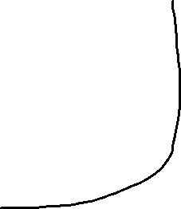
Non-linear data
With this feature cross,
x₃ = x₁ * x₂
We can learn a non-linear separation boundary
Is this true?
x2
x1

Slide 8
Non-linear data
But, θ₀ + θ₁*x₁ + θ₂*x₂ + θ₃*x₃
is still an equation a linear boundary (line, … etc.)
Logistic Regression can only learn linear boundaries
So, how does this work?
x2
x1

Slide 9
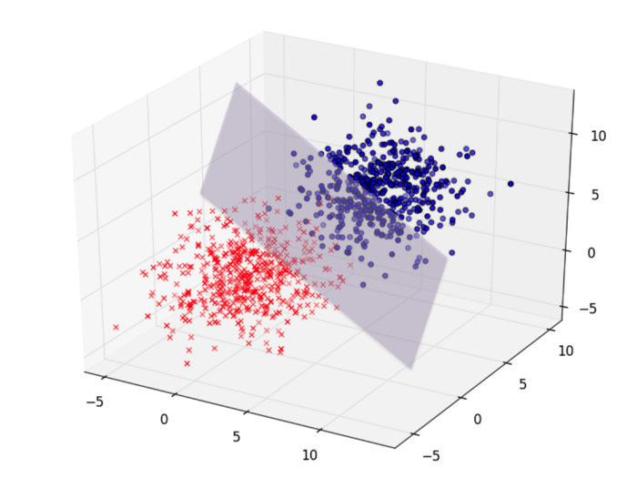
Non-linear data
Without feature cross we had two features:
(x_{1,} x₂ ) => 2-dimensional feature space
With feature cross: x₃ = x₁ * x_{2,} ; three features
(x₁, x₂, x₃) => 3-dimensional feature space
In this 3D feature space, the problem is linearly separable by a ?
Plane whose equation is:
y = θ₀ + θ₁*x₁ + θ₂*x₂ + θ₃*x₃
x3
x2
x1

Slide 10
Higher order feature space
A feature space (R) with say n features (x₁, x₂, x₃… x_{n}) that is not linearly separable in N dimension
Can be linearly separable in a higher dimension say (m)
This higher dimension feature space can be obtained by feature crosses
R^{N} => R^{M} (where m > n)
Higher order polynomials
x1^2, x1*x2, x1*x3, x1^2 * x3 ….
Degree of the polynomial is hyperparameter, which you tune

Slide 11
Model Complexity
Overfitting vs underfitting

Slide 12
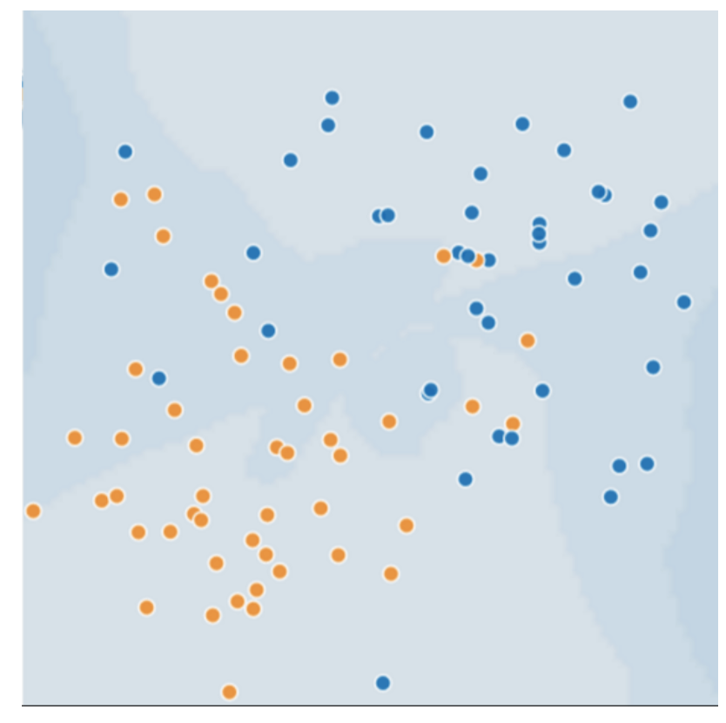
Generalization: Perils of Overfitting
Consider the following 2D feature (say age=x1 and tumor_size=x2), where
Blue dots represent malignant tumors
Orange dots represent benign
What would a best model with very low loss look like?

Slide 13
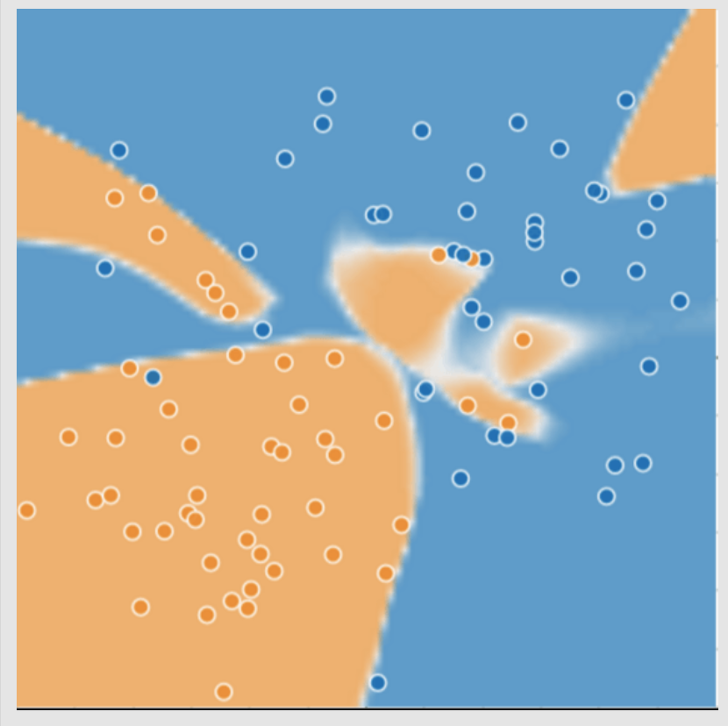
Generalization: Perils of Overfitting
Complex model for distinguishing the two classes (malignant vs benign)
First glance this trained model seems to be doing an excellent job!
What about new unseen data?

Slide 14
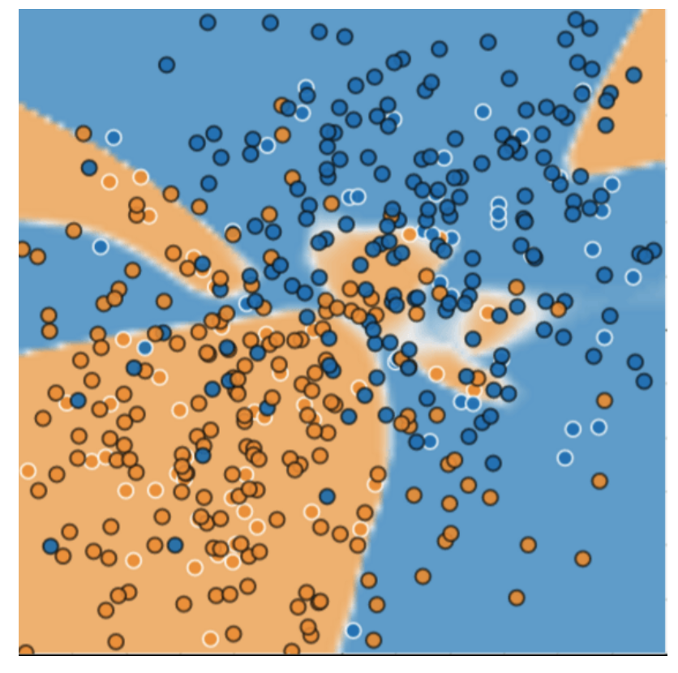
Complex model: new data
Complex model did a bad job predicting on new data
Adapted poorly new data
miscategorized much of the new data
Overfits the peculiarities of the data it trained on.
A simple model might have been better!

Slide 15
Model overfitting
Overfit model gets a low loss during training but does a poor job predicting new data.
Overfitting is caused by making a model more complex than necessary.
In ML, we have to decide between:
Fitting our data well: Specific model
Fitting the data as simply as possible: General model

Slide 16
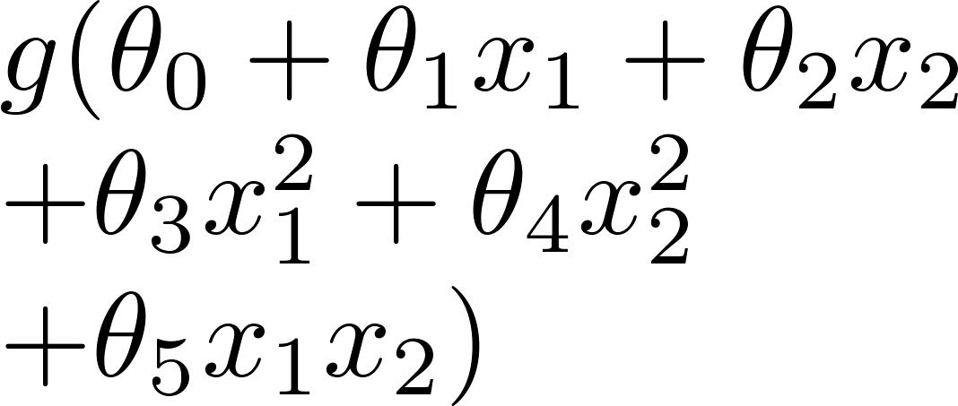
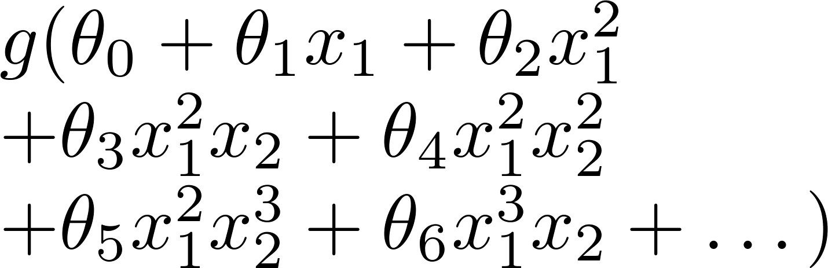
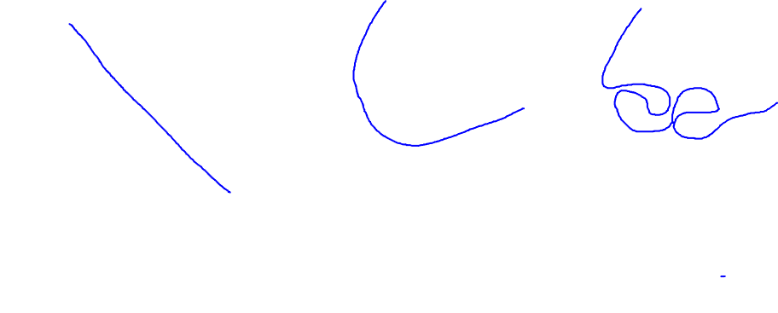
Example: Logistic regression
x₂
x₂
x₂
x₁
x₁
x₁
( = sigmoid function)
Underfit
About right!
Overfit
Why these different boundaries and how do we select the right one?

Slide 17
Addressing Overfitting
Options:
Reduce the number of features - Manually select which features (with synthetic features) to keep
- Not always possible
Regularization
Keep all the features, but reduce magnitude/values of parameters θj .
Works well when we have a lot of features, each of which contributes a bit to predicting .

Slide 18
Example: Logistic regression
x₂
x₂
x₂
x₁
x₁
x₁
( = sigmoid function)
Underfit
About right!
Overfit
Make unwanted weights θj tend to zero i.e. penalize them

Slide 19
Penalize complex models
Model's ability to generalize to new data based on factors such as:
the complexity of the model
the model's performance on training data
We could prevent overfitting by penalizing complex models: Regularization

Slide 20

Penalize complex models
In other words, instead of simply aiming to minimize loss:
we'll now minimize loss+complexity:
We need a way to quantify model complexity

Slide 21
Model complexity quantification
Two common ways:
Model complexity as a function of the weights of all the features in the model : L2
Model complexity as a function of the total number of features with nonzero weights: L1

Slide 22
L2 regularization
Model complexity is a function of weights
Feature weight with a high absolute value is more complex than a feature weight with a low absolute value.
w_{i} is same as θ_{i}

Slide 23
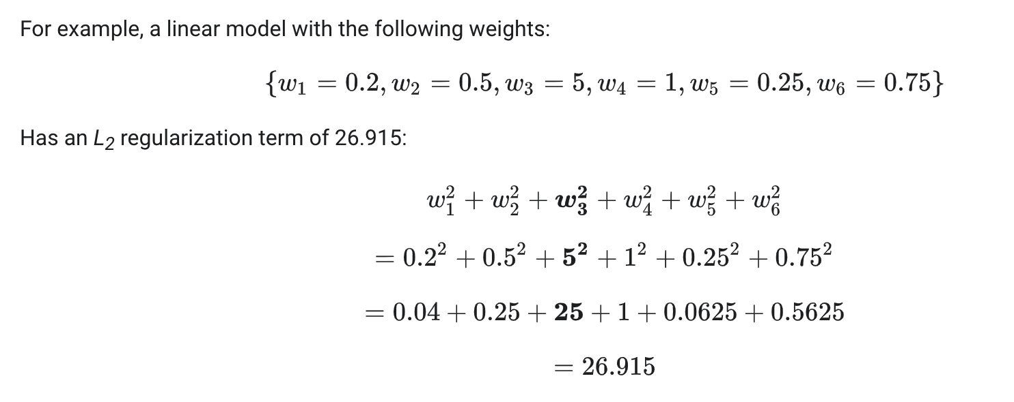
L2 regularization
Weights close to zero have little effect on model complexity, while outlier weights can have a huge impact.

Slide 24
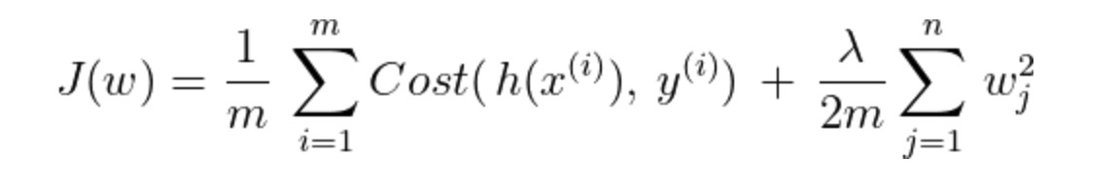
L2 regularization : Lambda
Overall impact of the regularization term by multiplying its value by a scalar known as lambda (also called the regularization rate)
Performing L₂ regularization has the following effect on a model
Encourages some weights values toward 0 (but not exactly 0)

Slide 25
Example: Logistic regression
x₂
x₂
x₂
x₁
x₁
x₁
( = sigmoid function)
Underfit: High lambda
About right!
Overfit: low lambda

