Slide 1


Slide 2
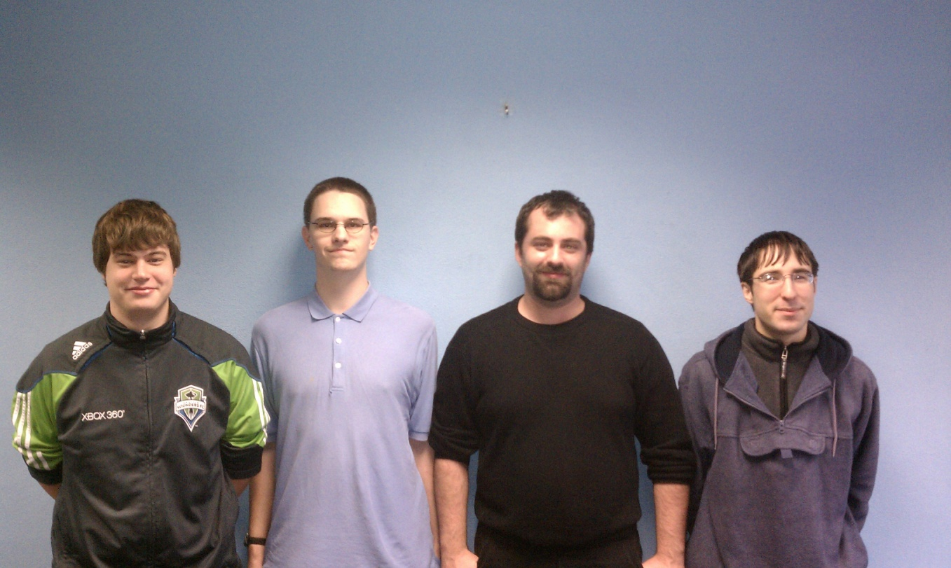
The Team
Development Team:
Scott Beddall
Brett Hitchcock
Chaylo Laurino
Alex Nilson
Advisor:
Greg Donohoe
Sponsors:
Don Moreaux
Marj Sanderson
Idaho Department of Health and Welfare

Slide 3
The Need
Situation 1

Slide 4
The Need
Situation 1 (cont)

Slide 5
The Need
Situation 1 (final)

Slide 6
Objective
"Develop a web-based Time, Accounting, and Reporting System for the Idaho Department of Health and Welfare"
TARS is meant to replace the IDHW's current system: Mariner.
Why? Mariner currently requires an exorbitant license fee. TARS is being built and documented publically; there will be no license fee.

Slide 7
High Level Specifications
Microsoft Internet Information Services (IIS)
SQL Server 2008
Authenticate to Active Directory
Must satisfy the list of requirements presented by the IDHW.

Slide 8
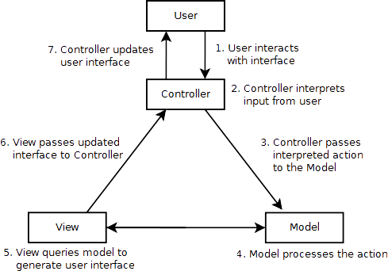
Final Design: Model-View-Controller

Slide 9
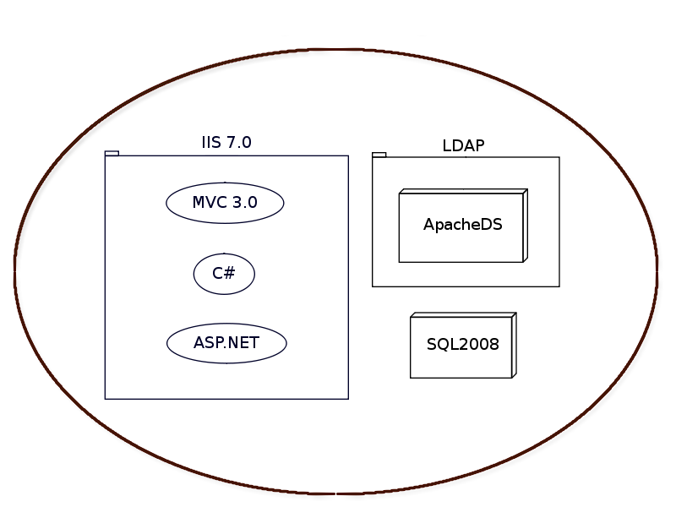
Project Learning

Slide 10
Development Risks
LDAP vs Active Directory Authentication
DirectoryServices.Protocols vs DirectoryServices
Reconfigurable Views
Technically, extremely difficult and time consuming. Insufficient time to implement and test.
Visual Design
We aren’t designers!

Slide 11
Deliverables
A prototype, working version of TARS - Lacking in complete visual design - Incomplete unit and security testing - No tested interface for I-Time

Slide 12
Deliverables (cont)

Slide 13
Project Resources
In addition to completing a prototype, we are doing our best to ensure the next team will be able to complete this project.
By this, we mean:
Tutorials (Video, Written, Diagrammed)
Documentation
- Software Design Document
- Our Journals
Test Cases
SQL and LDAP Config Dump Files
Most importantly, our GitHub account!

Slide 14
Questions?
Check us out on GitHub: github.com/ICBM

