Slide 1




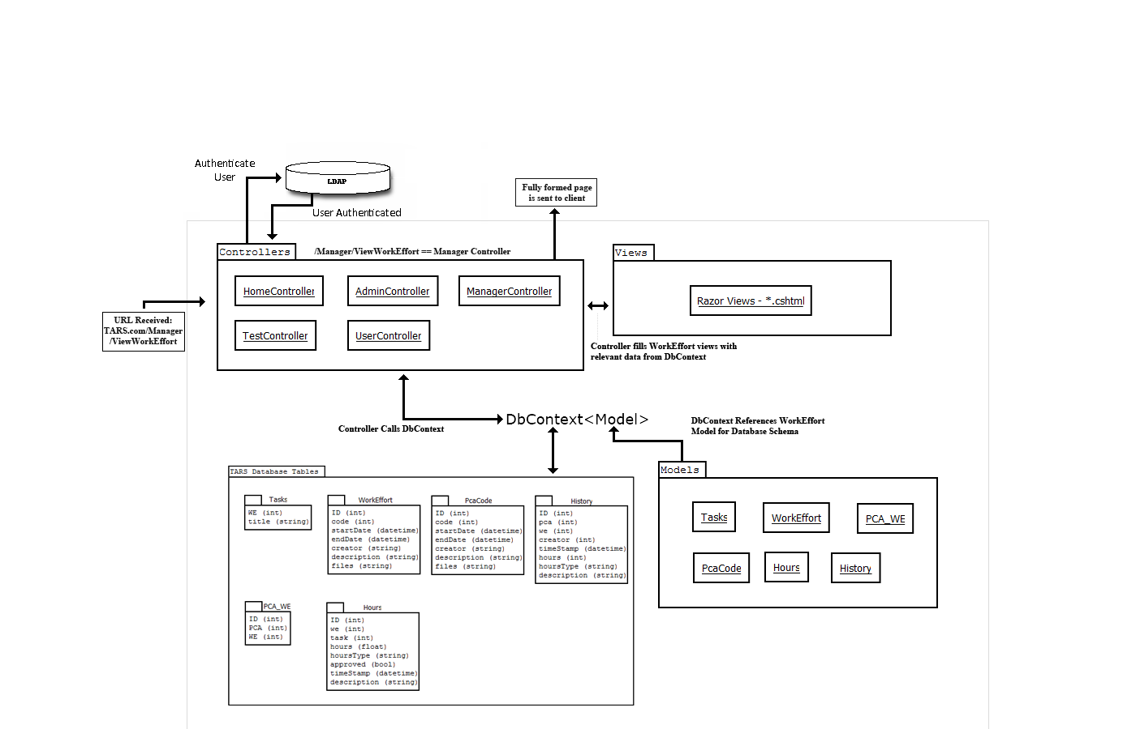
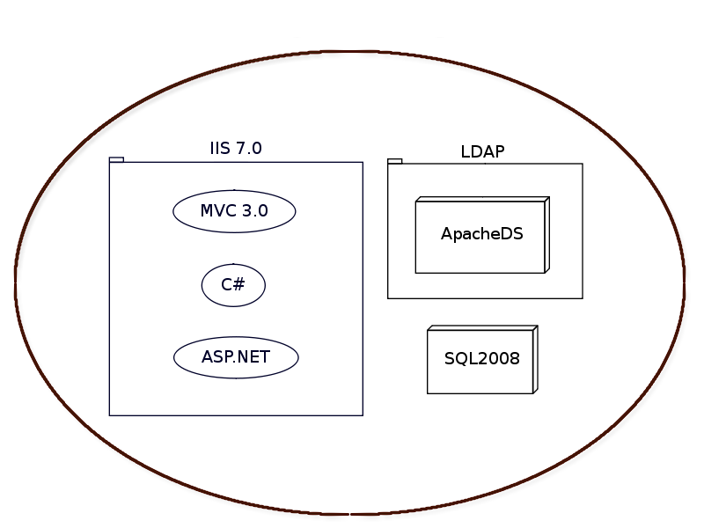
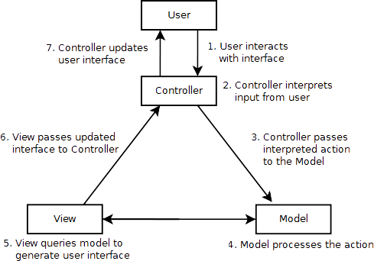
2011
Project Definition (the what)
Our Team The Problem The Requirements
Team Picture goes here
“Develop a prototype web-based Time, Accounting, and Reporting System for the Idaho Department of Health and Welfare.”
TARS is meant to replace the IDHW's current system: Mariner.
Why?
Mariner currently requires an exhorbitant license fee. TARS is being built and documented publically on GitHub. There will be NO license fee.
The IDHW only needs time management functionality, the high cost Mariner system is being severely underused.
Must be Compatible with Microsoft IIS
Database must use SQL Server 2008
Must Authenticate users using Active Directory
Must Satisfy the list of requirements presented by the Stakeholders.
Development Team:
Scott Beddall
Brett Hitchcock
Chaylo Laurino
Alex Nilson
Advisor:
Greg Donohoe
Sponsors:
Don Moreaux
Marj Sanderson
Idaho Department
of Health and Welfare
Project Solution (the how)
Learn Design Solve
MVC Concept
TARS is built using the Model-View-Controller Design Pattern.
The MVC pattern provides many advantages, including:
- Security through modularity
- Ease of maintenance
- Data driven content generation
Project Learning
The TARS team members had used none of these technologies before accepting this project.
Learning had to take place before any development could occur.
Demo Entity Relationship Diagram
Prototype functionality as of today.

