Slide 1


Embedded Linux Device Drivers
Aleksandar Pejić
Andrija Prčić
Balkan Computer Congress 2014
September 7th, Novi Sad, Serbia

Slide 2

Agenda
About Embedded Systems
Hardware Specifics of Embedded Systems
Embedded Linux
Linux Device Driver Architecture
Workshop

Slide 3
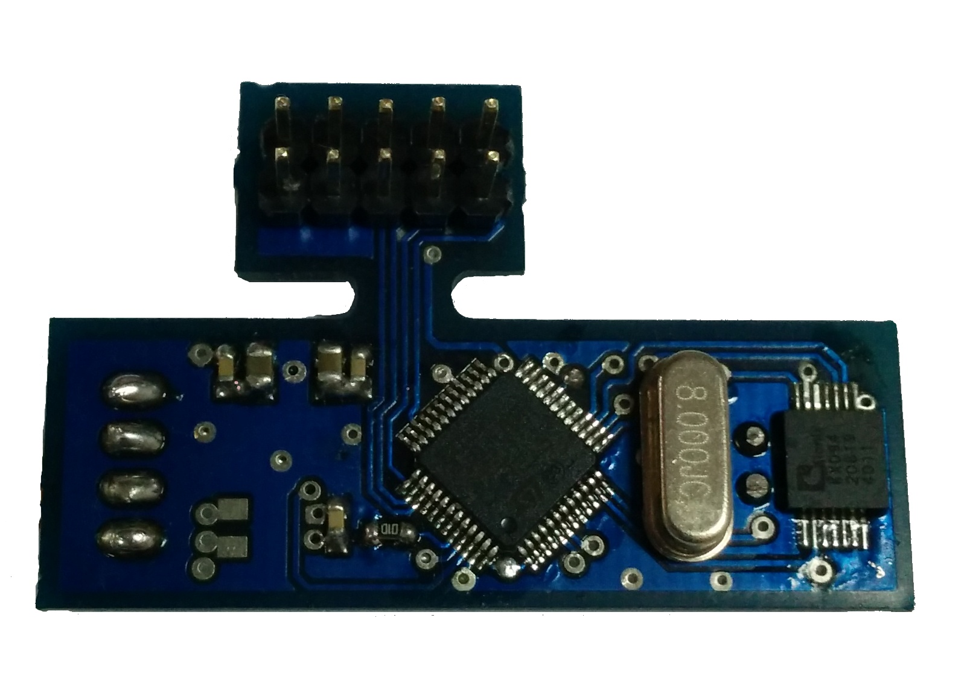
Embedded Systems
Dedicated function
Based on microcontrollers
Optimization
Variety of applications

Slide 4
Hardware Specifics
On-Chip peripherials
Many CPU architectures
Word length 8 to 32 bit
Cheap development boards
SoC

Slide 5
Peripherials
Serial Communication Interfaces
Synchronous Serial Communication
Universal Serial Bus
Networks
Fieldbuses
Timers
Discrete IO (GPIO)
Analog to Digital / Digital to Analog

Slide 6

Embedded Linux
Purpose-built
Lightweight and optimized
Kernel and minimal userspace
Buildroot
Initramfs

Slide 7
Linux Device Drivers
User process
The Role of the Driver
Classes of Devices
Memory mapping
Interrupt Handling
Time routines
/dev/xxx
User space
Kernel space
Device driver
Physical
device

Slide 8
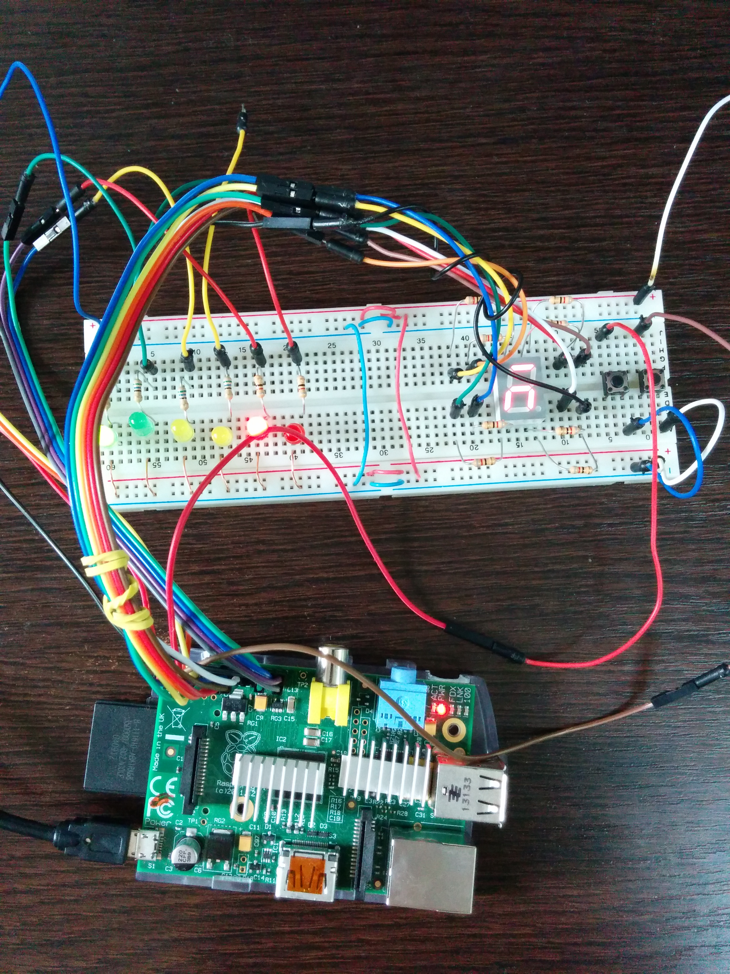
Workshop
Raspberry Pi
Protoboard
  Some LEDs
  Push Buttons
  7 segment display
Buildroot (rpi-buildroot)
Custom Linux Kernel module

Slide 9

Workshop sources
https://github/ICBTech
git clone https://github.com/icbtech/rpi-buildroot
git clone https://github.com/icbtech/BalCCon2k14

Slide 10

Buildroot
make raspberrypi_defconfig
make nconfig
make
Internet connection required (first build)
Takes 15 minutes on Core i7 3770

Slide 11
Questions?
Aleksandar Pejić
aleksandar.pejic@icbtech.rs
Andrija Prčić
andrija.prcic@icbtech.rs

