Slide 1
Job Hunting:
Escape from the Pile!
Jimmy Renfro, M.Ed.
Assistant Director, Career Services
Lauren Griffin, M.S.
Student Development Coordinator,
Career Services

Slide 2
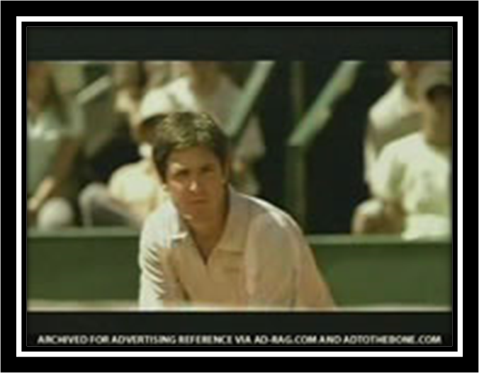
Tennis, anyone?

Slide 3
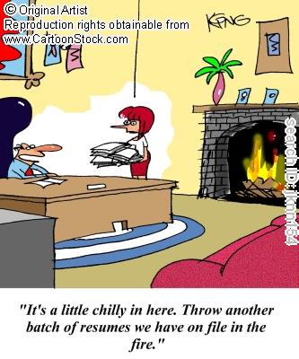
How some employers see it…

Slide 4
Format
CV or Not CV? That is the question!

Slide 5
The Curriculum Vitae
Literally means “Life Story.”
More of an exhaustive listing of all educational and work experiences and accomplishments.
Includes more detailed history of research, publications, organizations, and community service.
Not specific to a particular job/position.
Does not tell employer what you are applying for.
More commonly used in academia and medicine.

Slide 6
Preparing a Resume
Open a Word Document and pick a readable font 10-12 pt. (Times New Roman, Arial, Palatino Linotype)
Put your Full Name at the Top of the Page
Add your Contact Information (this is your Address, Phone, E-mail)
Add your About Me = “Objective” (What kind of job do I want?)
Add your School(s) = “Education”
Add your Work = “Employment”
    “Led organization of over 100 people to success”
    “Facilitated improvement in efficiency by 36%”
Add your Interests = “Involvement”
Add any Specialized Computer or Technical Skills
Add any Leadership or Volunteer Experience

Slide 7
Do’s & Don’ts
Do’s
Put your name & page # at the top of each page
Begin phrases with action verbs
Provide detail about your accomplishments (focus on results)
Provide insight into your work ethic & how you will be as a colleague
Don’ts
Give reasons why you left a job
Include personal information (SSN, DOB, picture, etc.)
Lie or “exaggerate”
Begin phrases with “I”
Use complete sentences
Include references

Slide 8
Format Counts
Use bullets, indents, bold, italics with intent
Consistency counts! Difference between:
2005-2007 and
2005– 2007
NEEDS TO GET YOU OUT OF THE PILE!

Slide 9
Types of Resumes
Chronological
Functional/Skill Based

Slide 10
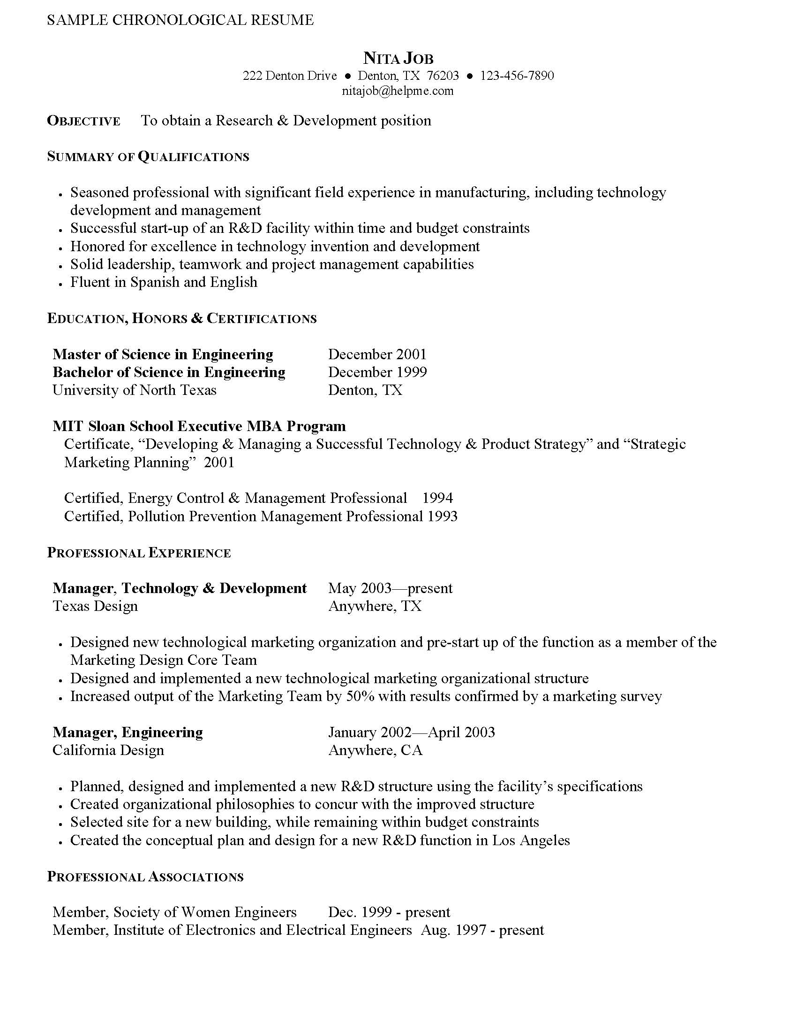
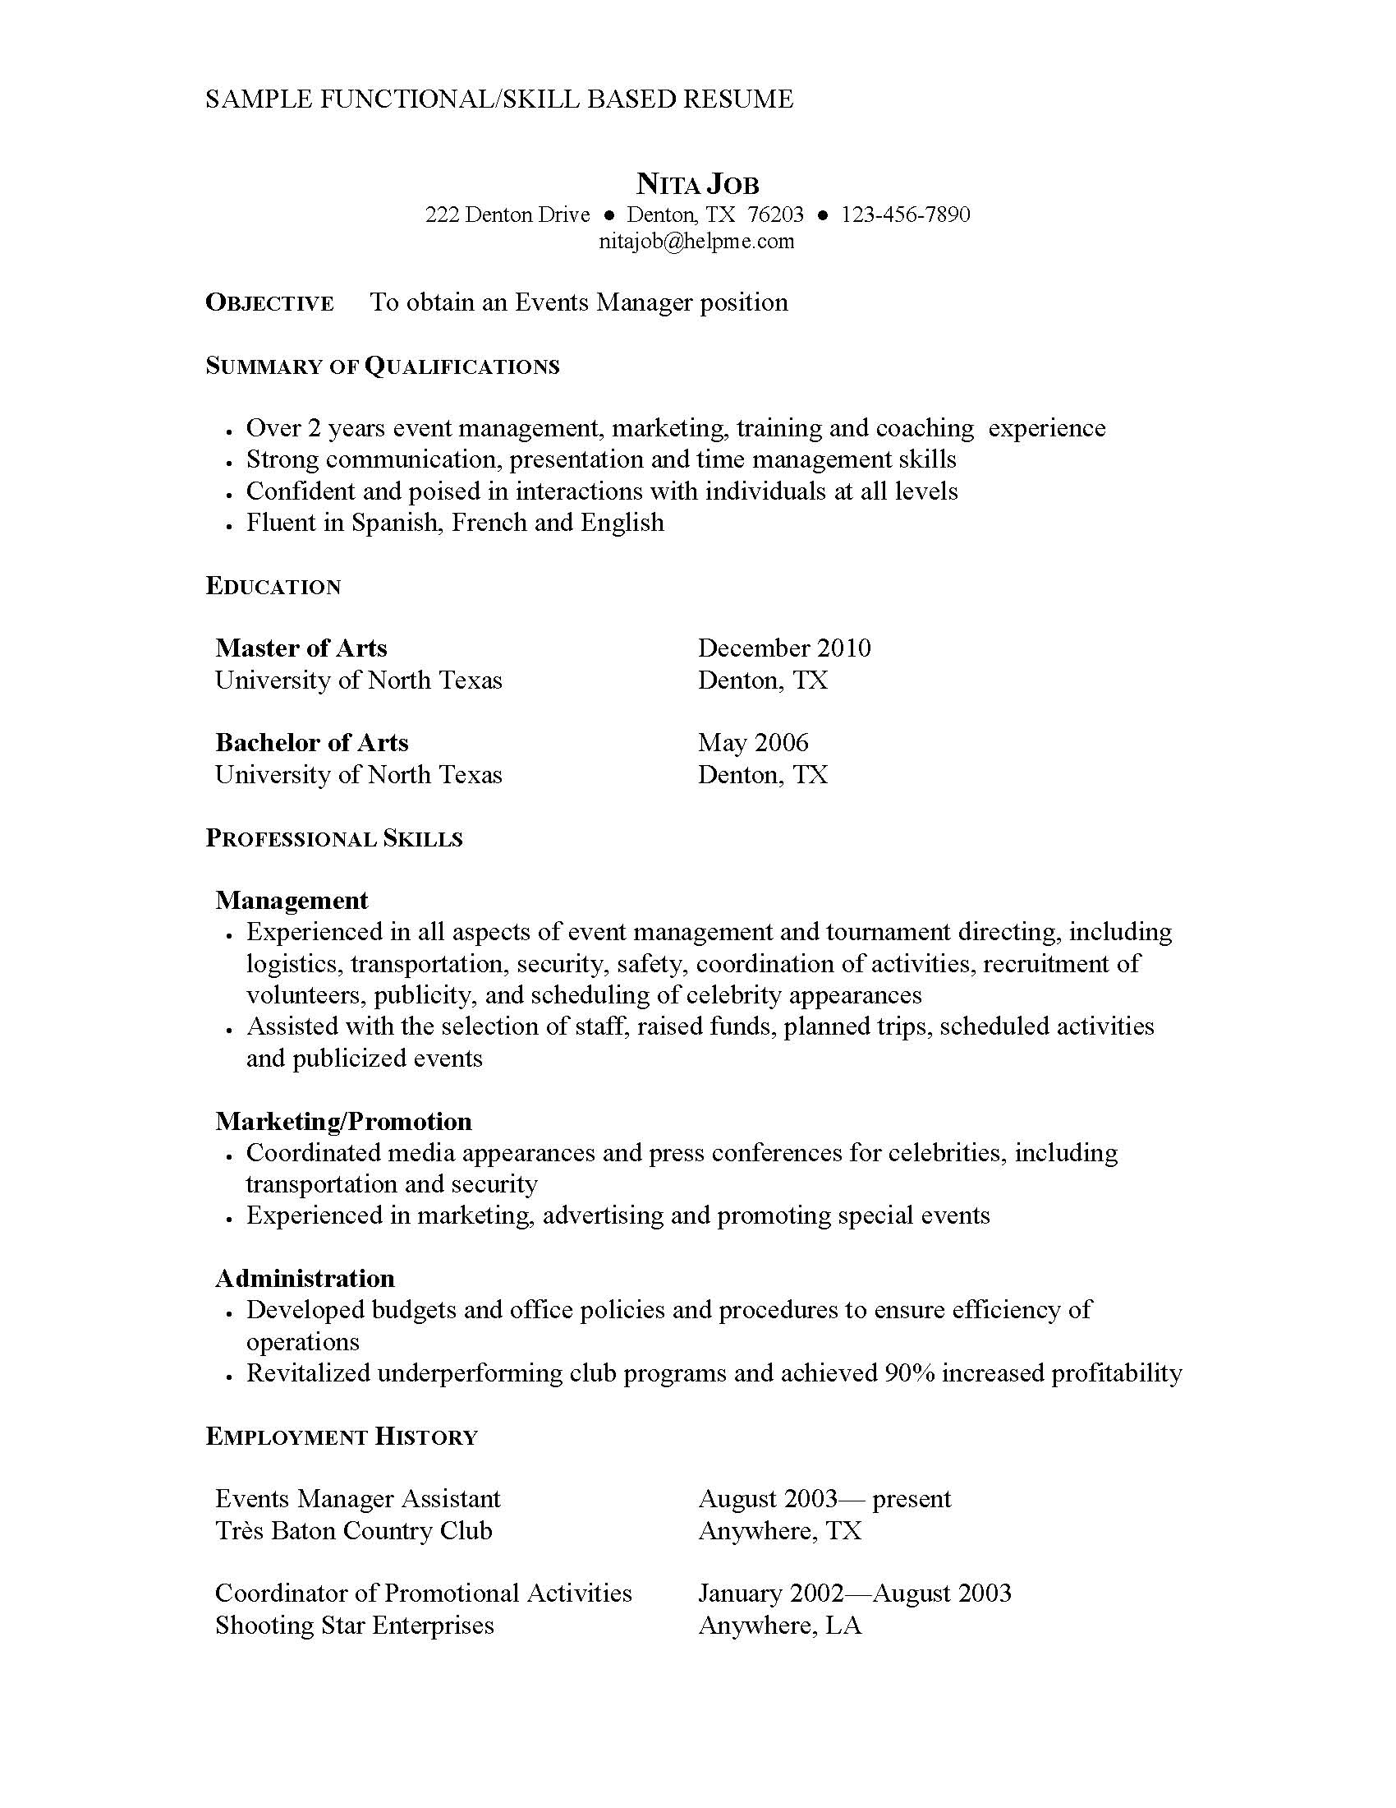
Samples

Slide 11
Accomplishments/Results
Develop accomplishments/results statements, using the SOAR method:
S tatement of action: What did you do?
O ccurrence of Action: Daily, weekly, monthly, yearly...?
A mount of Action: 19, 50, over 100...?
R esults of Action: Increased, decreased, saved, taught,
implemented...?

Slide 12
Examples
Selected as freshman orientation counselor; acclimated 150 new students to college environment.
Innovated blood drive volunteer system, which increased student participation by 20%.
Overhauled social organization recruitment program, which achieved national record for 75% membership increase.
Cartoonist for small newspaper which publishes 4 times a week.
Initiated leadership change program for 140 middle and senior level managers.
Led 8 member project team that collected leadership data from 500 employees.
Formulated banking method that decreased teller outage by 60%.
Maintained 40% net profit margin in retail sales over two year period.
Redesigned paint system resulting in annual savings of $60,0000.
Trained over 200 insurance agents in the legal, ethical, and regulatory aspects of insurance and securities sales.
Increased departmental sales by 25% in first three months as manager.

Slide 13
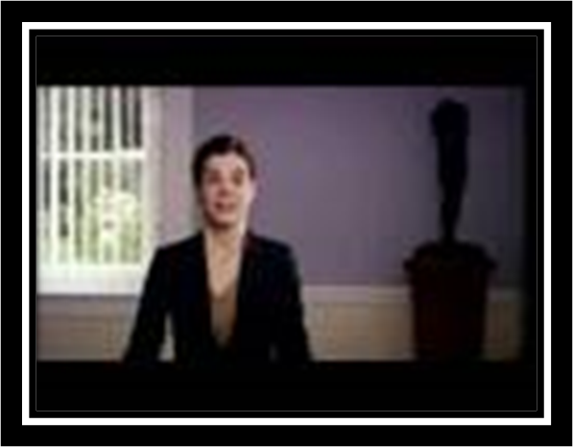
Please don't…

Slide 14
The Curriculum Vitae
http://www.hsc.unt.edu/departments/StudentAffairs/CareerServices/CV.cfm

Slide 15
Questions
?

Slide 16
Functions of a Cover Letter
Introduces yourself
Tells the employer what type of position you are seeking
Gives you an opportunity to impress the prospective employer by showcasing your knowledge about the company and/or its industry and express how your skills, interests, and/or experience match the needs of the organization
Entices the reader to learn more about you by reading your resume
Provides or expands your resume objective and shows how well you express yourself
Serves as a small window into your personality that makes the employer feel he or she simply must get to know you better.

Slide 17
Anatomy of a Cover Letter
First (Introductory) Paragraph
  Introduce yourself/why I am seeking you
  What I am seeking/type of position
Second (Selling) Paragraph(s)
  What I can do you for you today
  Matching qualifications/knowledge of company
Final (Closing) Paragraph
  What I want: An interview!
  Specific, direct, and persistent

Slide 18
Types of Cover Letters
Invited Cover Letter is written in response to an advertised opening, whether in a newspaper, trade publication, on the Internet, or on the company's web page.
Uninvited or Cold–Contact Cover Letter is a letter written to a targeted organization you are interested in working for but have not publicly advertised an open position (see Informational Interview).
Referral Letter is an extremely effective type of cover letter that springs from networking efforts. The referral letter uses a name-dropping tactic as early as possible in the letter to attract the reader's attention and prompt an interview.

Slide 19
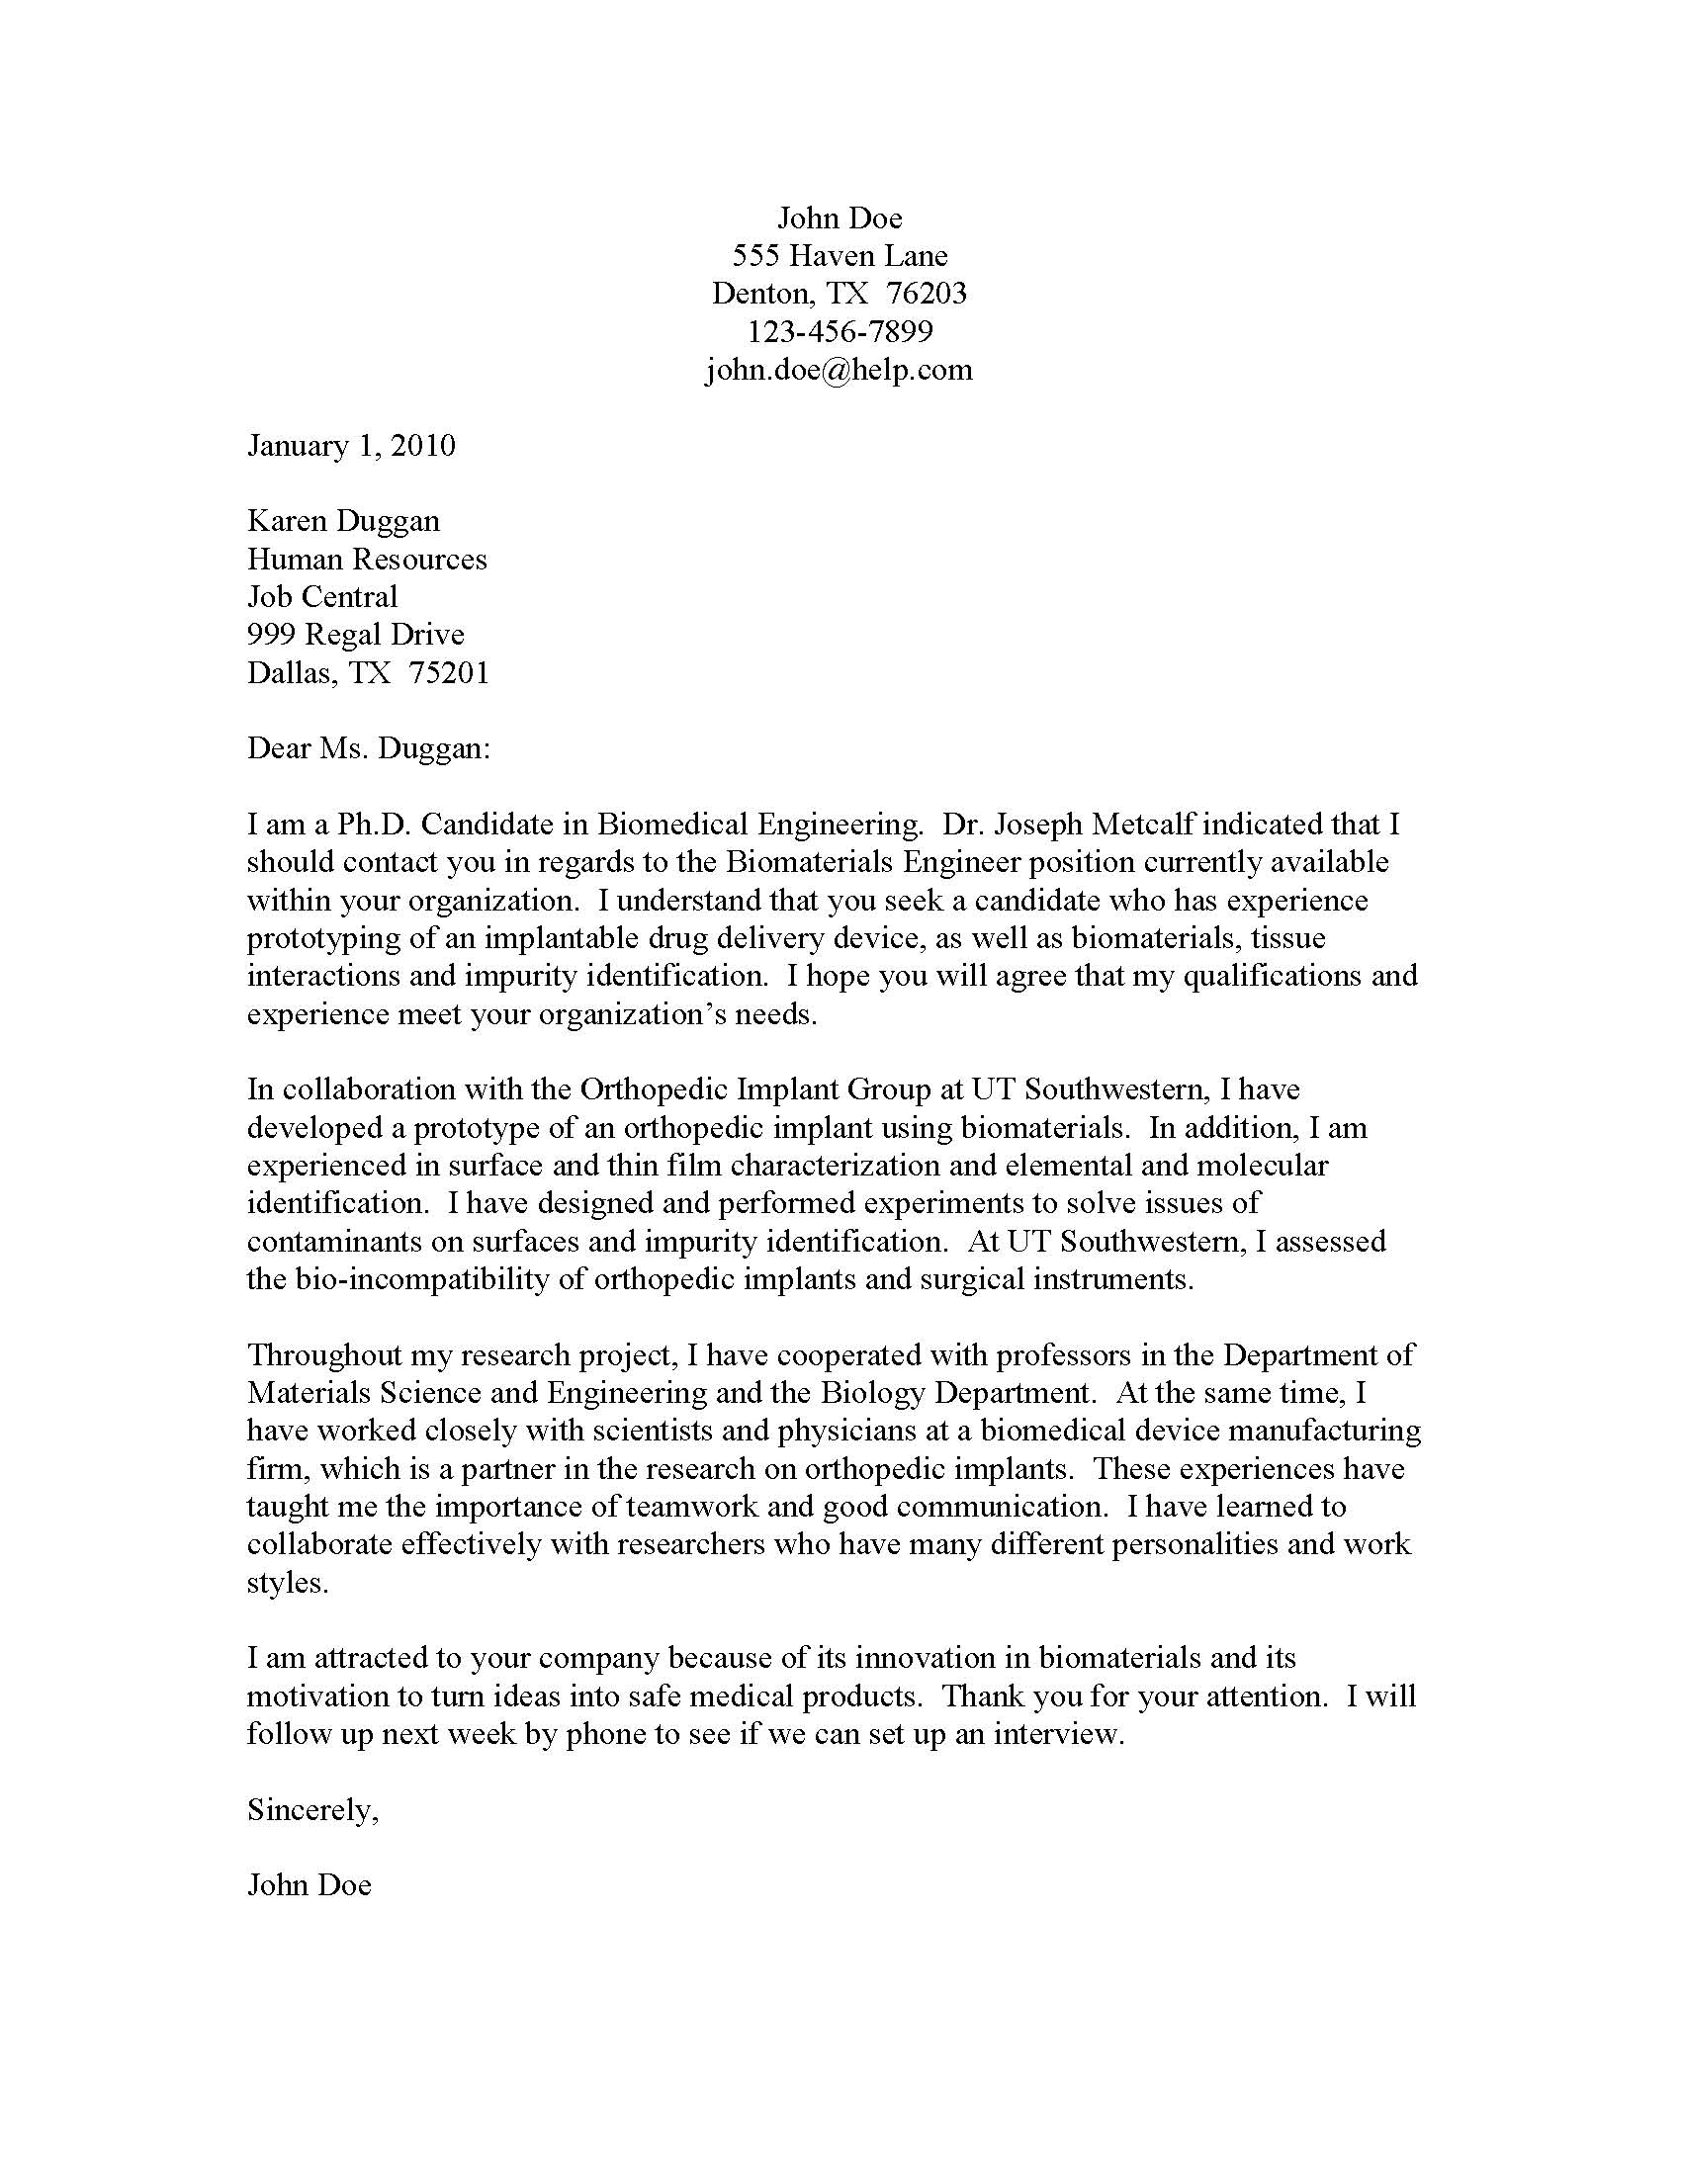
Sample Cover Letter

Slide 20
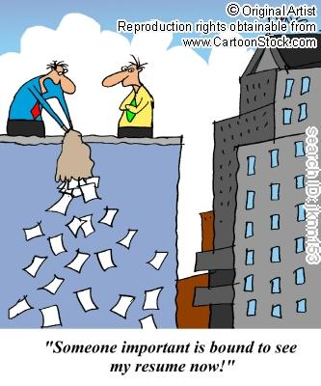
Narrowing Your Search

Slide 21
Reality Check
1 in 200 resumes result in a job offer.

Slide 22
Class Assignment
CV *or* Resume
  Organization/readability (absence of cluttering graphics)
  Action verbs/industry terms
  Specific/Quantifiable accomplishments
  Clear job seeking/career path
  Succinct
Cover Letter
  Readable/organized (clear message)
  References job/organization
  Engaging/personable/inviting
  Summarizes qualifications
  Asks for interview

Slide 23
Contact
For Job Search, Interviewing and Professionalism information, please contact:
  Jimmy Renfro
  Assistant Director, Career Services
  (817) 735-2501
  James.Renfro@unthsc.edu
  http://www.hsc.unt.edu/departments/StudentAffairs/CareerServices/

Slide 24
“Fort Worth’s Medical
School and MORE!”

