Slide 1
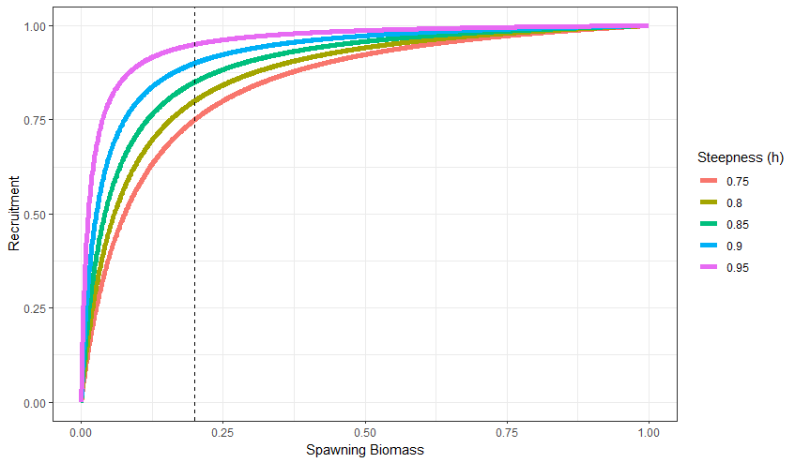
Determining Symmetrical Steepness Values
Beverton-Holt Stock Recruitment Curve

Slide 2
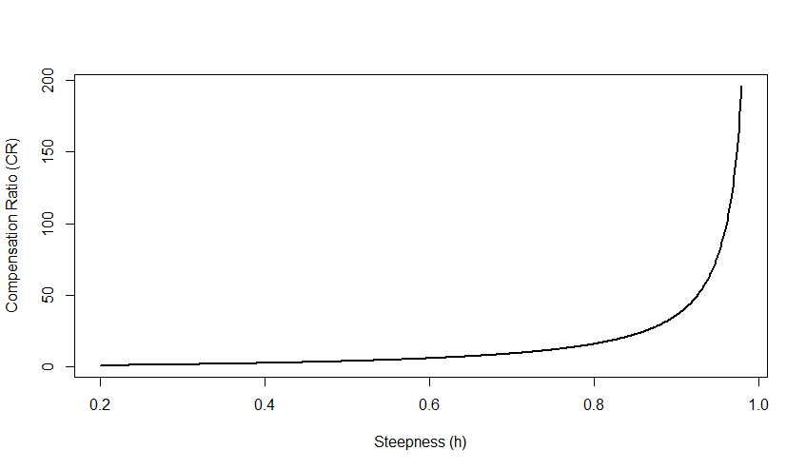


Determining Symmetrical Steepness Values
Compensation Ratio (CR; Goodyear (1980): relative increase in survival of recruits at low densities
For B-H SRR:
$$CR= \frac{4h}{1−h}$$
$$h= \frac{CR}{CR+4}$$

Slide 3
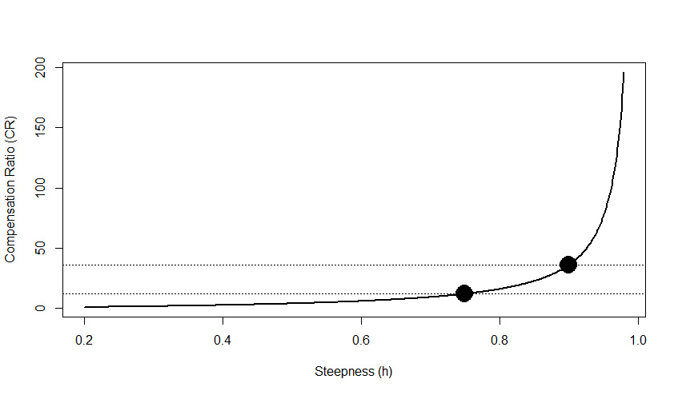
Determining Symmetrical Steepness Values
Compensation Ratio (CR; Goodyear (1980): relative increase in survival of recruits at low densities
For B-H SRR:
$$CR= \frac{4h}{1−h}$$
$$h= \frac{CR}{CR+4}$$
Steepness (h) | CR
0.75 | 12
0.9 | 36
? | ?

Slide 4
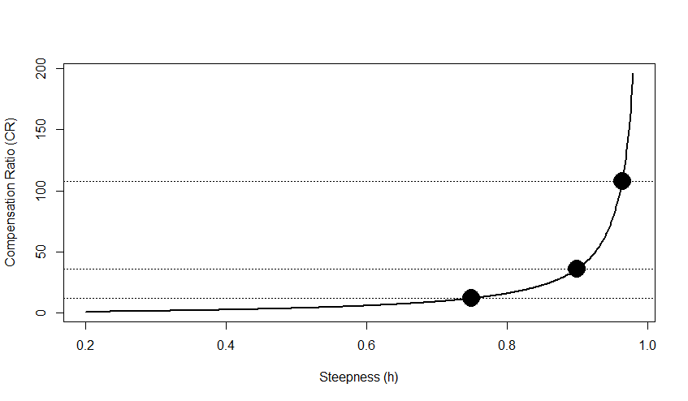
Determining Symmetrical Steepness Values
Compensation Ratio (CR; Goodyear (1980): relative increase in survival of recruits at low densities
For B-H SRR:
$$CR= \frac{4h}{1−h}$$
$$h= \frac{CR}{CR+4}$$
Steepness (h) | CR
0.75 | 12 (36 x 1/3)
0.9 | 36
0.96 | 108 (36 x 3)

