Slide 1
Network Analysis
Thanks to Prof. Shuangge Ma for sharing some slides.

Slide 2
Data collection is complicated!

Slide 11
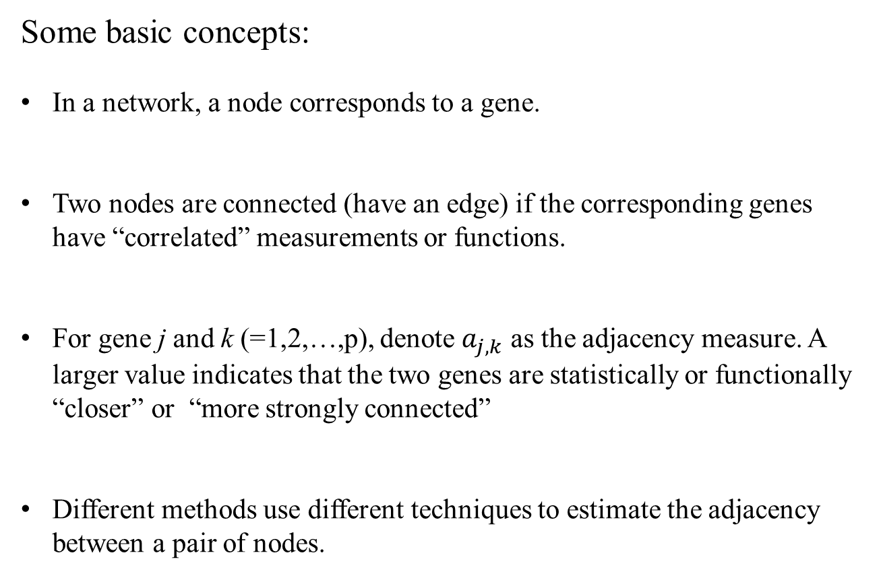
Some basic concepts:
In a network, a node corresponds to a gene.
Two nodes are connected (have an edge) if the corresponding genes have “correlated” measurements or functions.
For gene j and k (=1,2,…,p), denote $a_{j,k}$ as the adjacency measure. A larger value indicates that the two genes are statistically or functionally “closer” or “more strongly connected”
Different methods use different techniques to estimate the adjacency between a pair of nodes.

Slide 12
Network Construction (the biological way):
Knockout studies: “delete” or “modify” one gene (or a few), and see how it impacts the others.
Protein interaction based network: use downstream product (or upstream regulator) information.
Pros and Cons:
Directly describe the causal relationship
Generate a directed network (possibly aj,k != ak,j)
Only applicable to a small number of genes. To fully deduce the network, one may need to knockout multiple genes simultaneously.

Slide 14
Network Construction (the statistical way):
Weighted Gene Co-Expression Network Analysis (WGCNA)
Graphical LASSO
Bayesian network
Many more…

Slide 15
An example:
331 skin melanoma patients
Outcome: Breslow depth
Covariates: clinical features, gene expressions obtained from Affymetrix.
Clinical goal: identify genes to serve as molecular targets for treatment.
Main goal: “correlate” genes with prognosis.
Secondary goal: understand how genes
“correlate” with each other.

Slide 16
A very “simple” problem:
Say we have n samples. For each sample, there is a response variable and p covariates.
Goal: associate the covariates with response.
Strategy:
Use network to describe the interconnections between samples and between covariates
Incorporate the network information to improve model fitting.

Slide 17
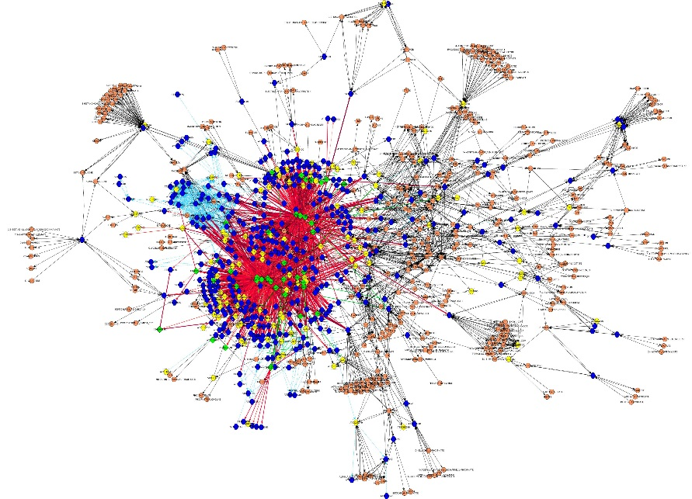
Accordingly, we can incorporate:
Network of covariates
Network of samples
Both
With the nature of my own research, I will mostly use biomedical data as an example. BUT, the same strategies are applicable to a large number of other data types.
http://www.bioquicknews.com/node/600

Slide 18
Outline:
The basic analysis schemes
Constructing gene networks
Incorporating network in the joint analysis of gene effects

Slide 20
Gene environment Interaction

