Slide 1

Interim analysis tool
Susanne Blotwijk & Wilfried Cools

Slide 2
Interim analysis
Data collection
All data at once
Not all data at once
18 data points (e.g 18 mice)
Example 1
6 data points
6 data points
6 data points
Example 2
2
4
3
3
1
5
Purpose:
Stop data collection early,
in case of sufficient evidence
Interim
analysis 1
Interim
analysis 2
Final
analysis

Slide 3
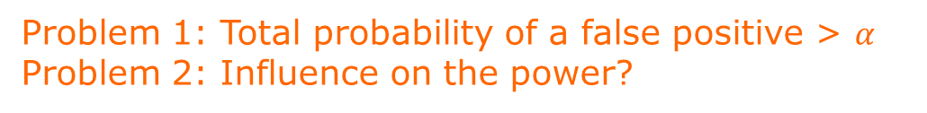
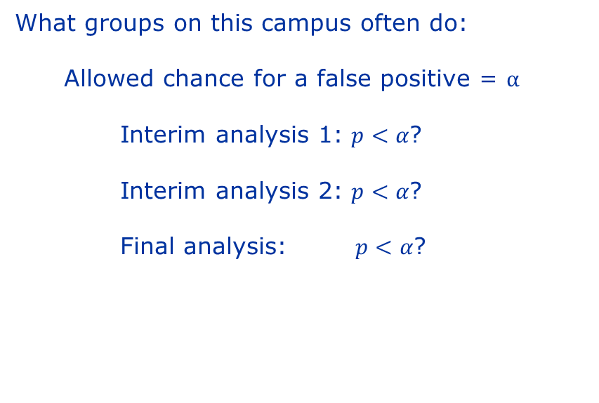
Interim analysis
Approach
What groups on this campus often do:
Allowed chance for a false positive = $α$
Interim analysis 1: $p<α$?
Interim analysis 2: $p<α$?
Final analysis: $p<α$?
Problem 1: Total probability of a false positive > $α$
Problem 2: Influence on the power?

Slide 4

Interim analysis
APPROACH
Step 1: perform the power analysis in Gpower as you would without interim analysis
determine a first approximation of the sample size
Step 2: use our tool
determine interim specific alpha’s and total sample size
F tests - ANOVA: Fixed effects, omnibus, one-way
Analysis: A priori: Compute required sample size
Input: Effect size f = 0.6531973
α err prob = 0.05
Power (1-β) = 0.8
Number of groups = 3
Output: Noncentrality = 11.5200012
Critical F = 3.4028261
Numerator df = 2
Denominator df = 24
Total sample size = 27
Actual power = 0.8210086
Ex.: control group, experimental condition 1 & 2
Group means: 1, 2, 3
SD: 1.25
We can process 6 mice at a time
Stages: 6; 12; 18; 24; 27
Mice per group: 2; 4; 6; 8; 9
2 mice per group in a one way ANOVA is not reasonable $→$ no interim analysis here

Slide 5
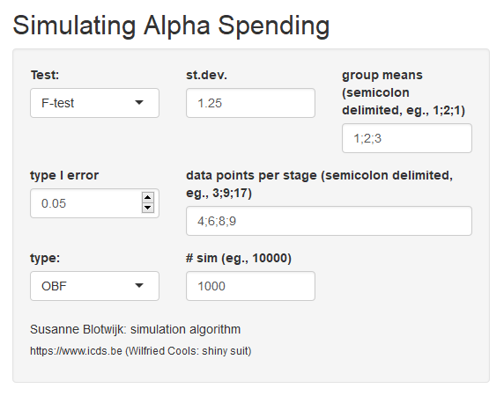
Interim analysis
Tool: input
T-test of one-way ANOVA
Same group parameters as the ones you used for the Gpower calculation
alpha
Number of mice per group at each interim analysis
Alpha spending function, leave it as is
Number of simulations
Higher number: takes more time
Lower number: lower accuracy and precision

Slide 6
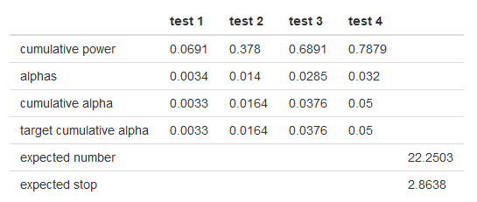
Interim analysis
Too little Power
Total power: decreases by adding interim analyses.
Type I errors for each test (all < .05)
In case of insufficient power (< 0.8), there are two options:
Add an extra mouse to the final stage
Remove one of the interim analyses

Slide 7
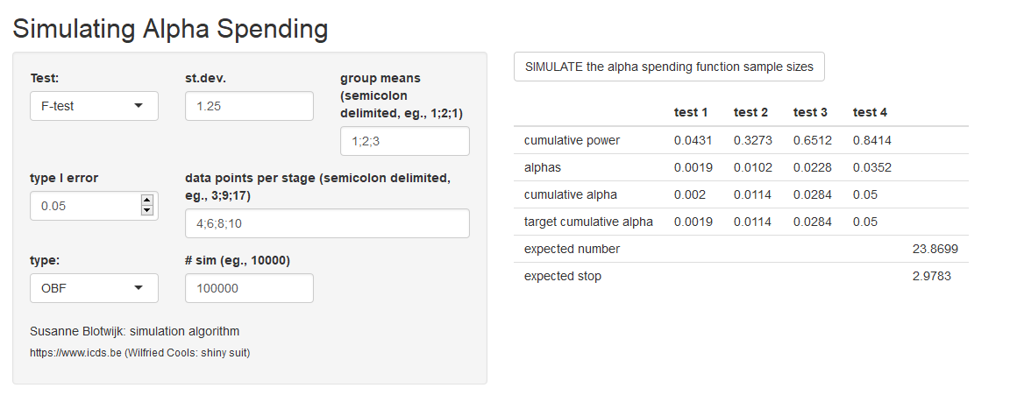
Interim analysis
Tool: output
Total Power
Alpha values you should apply at each analysis
Total chance of a type I error at each analysis
Expected number of used mice
We add one mouse to our original number, so 9+1 = 10. We have 3 groups, so in total 3*10 = 30.

Slide 8
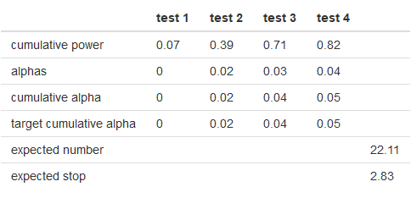

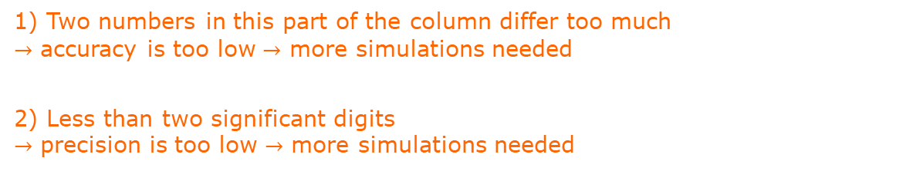
Interim analysis
Too few simulations
These two rows differ too much
$→$ accuracy is too low $→$ more simulations needed
At least one number here is 0
$→$ precision is too low$→$ more simulations needed
1) Two numbers in this part of the column differ too much
$→$ accuracy is too low $→$ more simulations needed
2) Less than two significant digits
$→$ precision is too low $→$ more simulations needed

