Slide 1

EMOTION-BASED MOVIE RECOMMENDATION SYSTEM
Project members:
Libang Xia, Xinyi Zhang
Zixi Wang, Zihe Wang

Slide 2
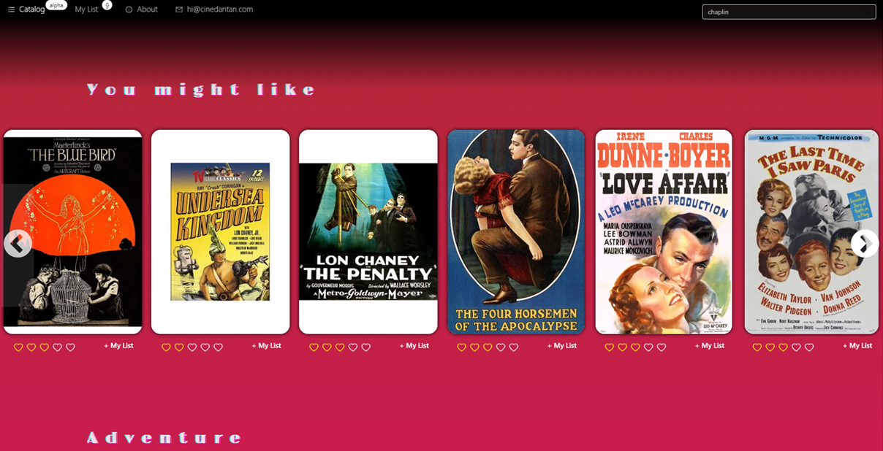
Emotion based recommendations:
Emotions can play a significant role in how people enjoy and connect with movies.
It has the potential to provide more personalized and satisfying movie recommendations for users.
People tend to watch movies for different reasons
* Empathy
* Cheer up
Important to match emotion content of movies with emotional response of users. How?

Slide 3
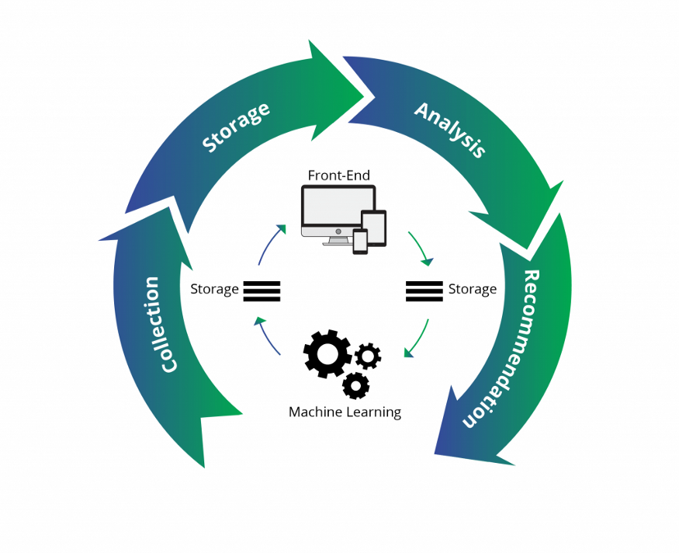
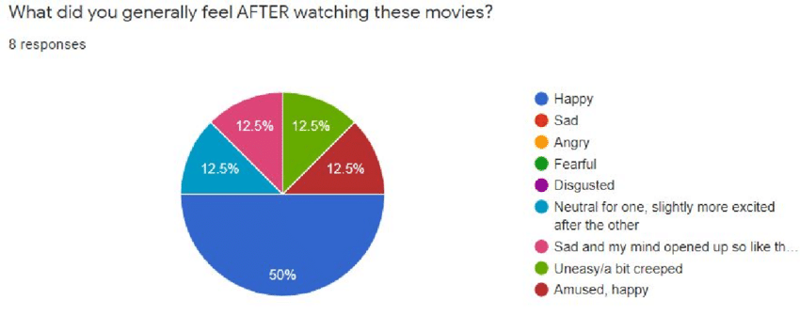
Emotion extraction of movies:
Requires a dataset of movies with their emotional contents. — text2emotion python library
* original dataset Kaggle movie recommendation
Calculate the emotion distribution of the movie based on the movie description, user reviews.
* happy, sad, angry, fearful, surprised
Emotions are conveyed by continuous scores representing the intensity of a particular emotion

Slide 4
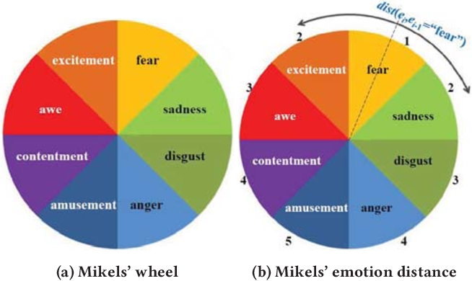
Emotion quantification of users:
Human emotions are complex and hard to specify.
Current approach: questionnaires:
*on a scale from 1 to 10, what level of happiness?
Collect for all 5 kinds of question, normalize and create a current emotion vector.
Secondary approach: keyword selection:
provide random emotion-related words/phrases for user to select. Then analyze the combined string with text2emotion.

Slide 5
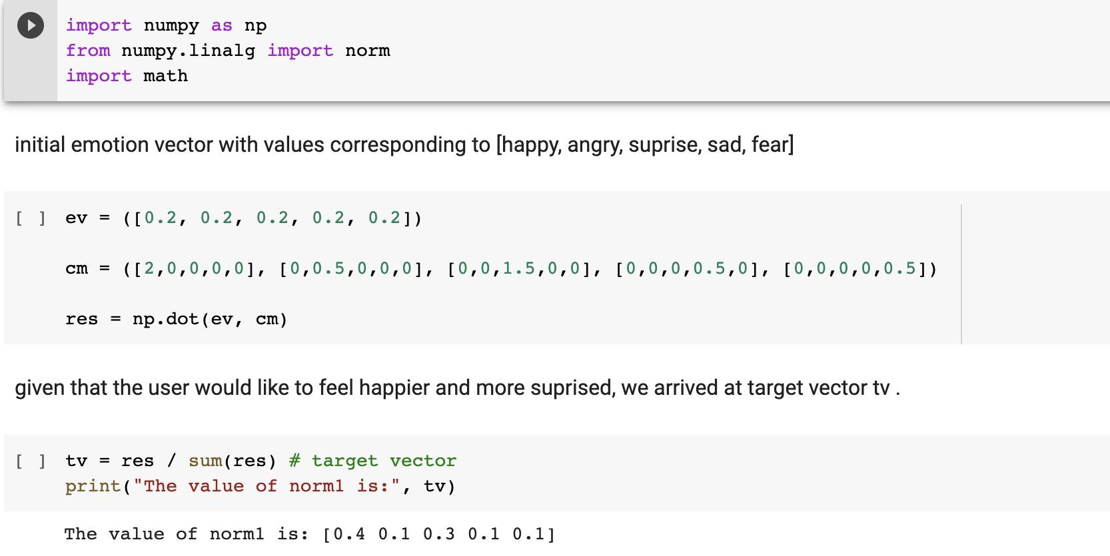
Meet user expectation:
User may prefer movies with different emotions:
*change their current emotion?
*empathize with their current emotion?
*need a target vector to match to the movies
Acquire user expectation with prompted questions
Create an N*N matrix for target vector through matrix multiplication.

Slide 6
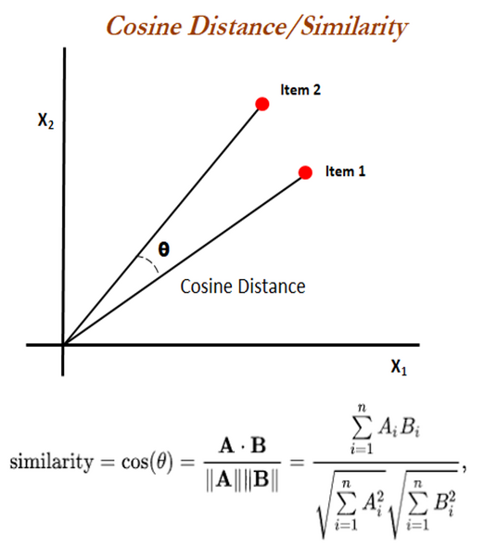
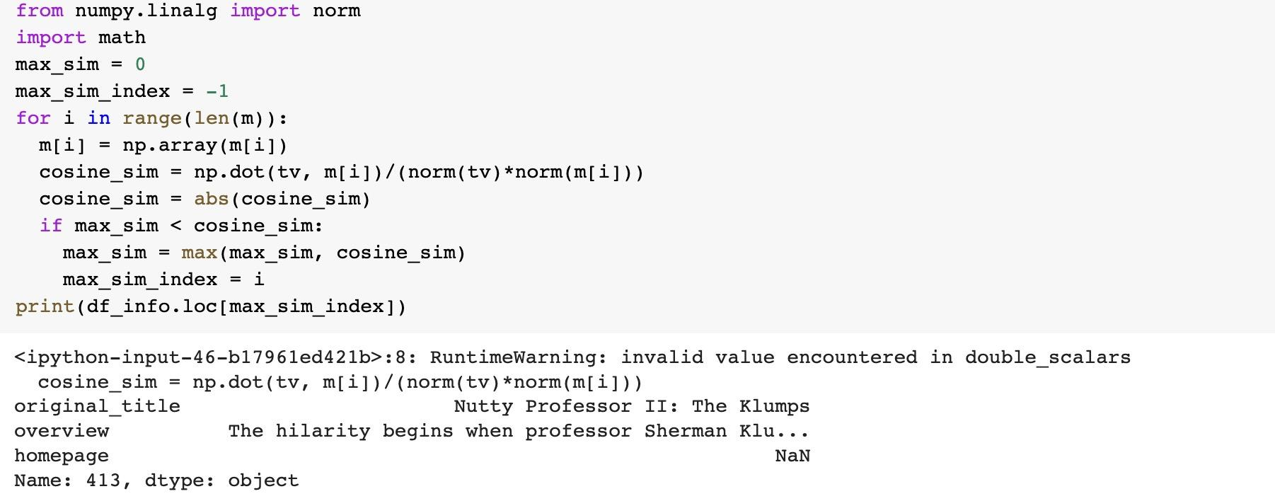
Get a sample movie for user:
With the target vector and emotion vector of movies, select the one with highest cosine similarity, a sample.
The sample movie allows user to provide feedback: too much? Or too little…
if necessary, transform the target vector until user agrees with the sample.

Slide 7
More recommendation after sample:
Use content-based recommendations based on the sample movie.
Movies share similar content cause similar emotional response.
* Can’t rely solely on emotion vectors.
Hybrid methods provide more nuanced and accurate recommendations.

Slide 8
Q&A

