Slide 1
Basic Git for Ice lab use
By Andrew Miller

Slide 2
Vocabulary
Repository – A tracked filesystem
Tracked – VCS Knows about it and will limit your ability to change it (a helpful feature)
VCS – Version control system (git)
Branch – A version of the repository that we want to make changes to
Remote – A repository located off-disk (on bitbucket!)

Slide 3
Commands
Clone
Pull
Checkout
Add
Commit
Push
Get all the files into a *new* local folder
Get the file(s) from remote based on current branch
Same as pull, switches branch if necessary/possible
Make the changes valid (more on this later)
Make the current state of files the new state
Make the remote copy look like this copy (last commit)

Slide 4
Talking in Git
Clone it
Push to the remote
Checkout that commit
Stage these changes
Commit these changes
File not tracked, need add
Pull this branch only
Commit to that branch only
Check-in your changes!

Slide 5
Basic Workflow
Get the source (clone or pull)
Make a branch to keep master safe
Make as few changes as possible, preferably any task should require a few “commits”
Stage changes and commit
Repeat until work is done (don’t leave until you commit!)
Push changes to remote

Slide 6
Get the source
First time:
git clone <link>
Subsequently
git fetch
git checkout <branch name>

Slide 7
Make a branch
git branch <choose a name>
git checkout <that branch>

Slide 8
Staging and Committing
git add --all
git commit –m “<inset short message here>”

Slide 9
Push
git push origin <branch name>

Slide 10
Making a difference
Team leaders need to control “merges” so that “master” branch stays functional
How? Team creates “Pull Request” and leader approves/rejects!
Let’s let bitbucket do this for us!

Slide 11
Getting started
Git tools for Windows:
http://www.git-scm.com/downloads
The command line is called “GIT bash” and the gui is called “GIT gui”. After installation, look in
Start/All Programs/GIT

Slide 12
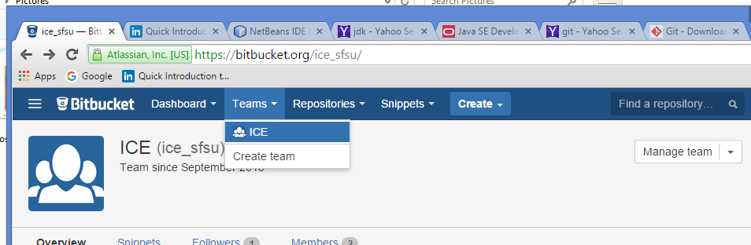
Getting started
Get a bitbucket account:
https://bitbucket.org/account/signup/
Login as admin and add yourself to ICE group
Username: generic_ice_user
Password: icelabsfsu
Add yourself here
Access ICE team here
Logged in as generic_ice_user:

Slide 13
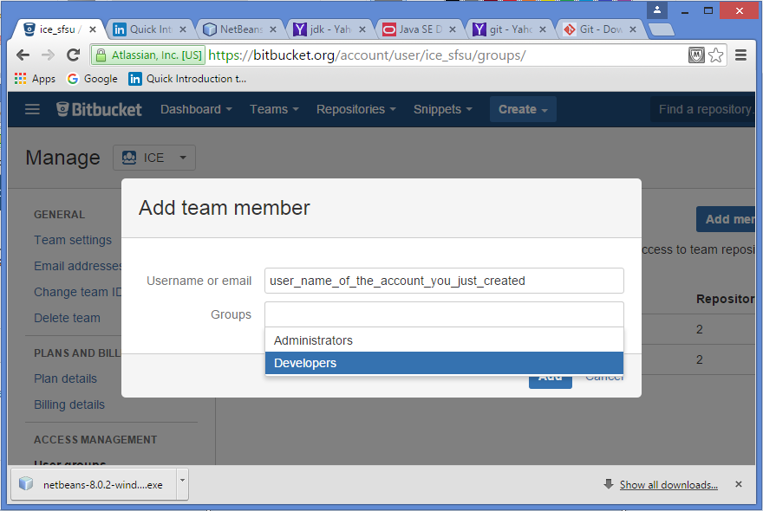
Getting Started
In the “Manage Team” screen, click “Add Member”
Type the username you created in the last slide
Please only add yourself as a Developer

Slide 14
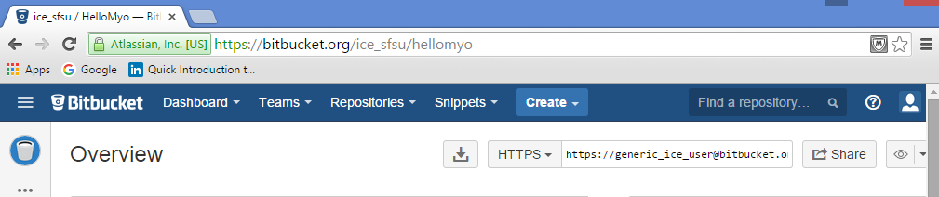
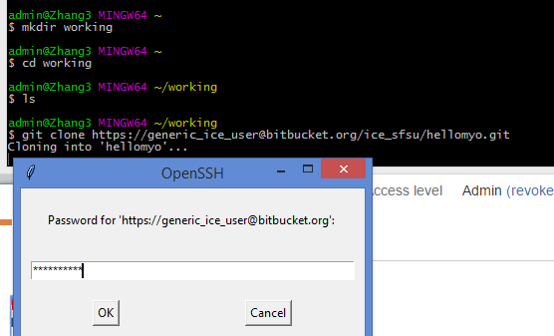
Getting Started: Get the Source
Login to bitbucket and navigate the repository you want to work on
Copy this link
“clone” the repository to your local system using GIT Bash
And login, password will be for what ever bitbucket account you got the link from

Slide 15
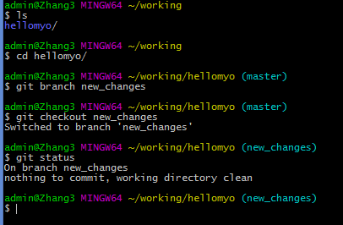
Getting Started: Isolate your changes
Notice that parent folder is created
also notice default branch is master
To avoid mucking up the “stable” code, create a local branch
Checkout the branch to make the changes effect that branch only
“git status” here should match example

Slide 16
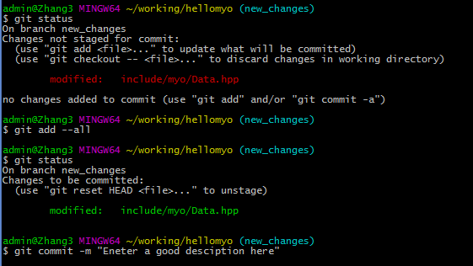
Getting Started: First Commit pt. 1
Once your happy with your changes switch back to GIT Bash
Notice that git status will now show “unstaged” changes
Make sure the “commit” will get these changes by “add”-ing the changed files
Notice here that I used“--all” which is acceptable if you only changed one file
Now, changes that will be applied to the commit will show in green

Slide 17
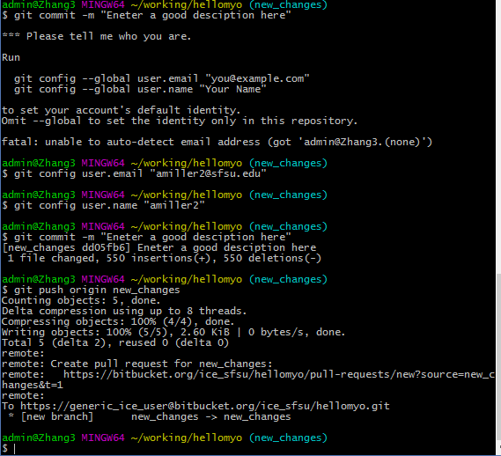
Getting Started: First Commit pt. 2
Trying to commit now will throw
This error
Please follow these instruction
PLEASE omit “—global” when using a lab computer
This setup is only required once in each local repository
After the commit, use “push” to push your branch to the remote

Slide 18
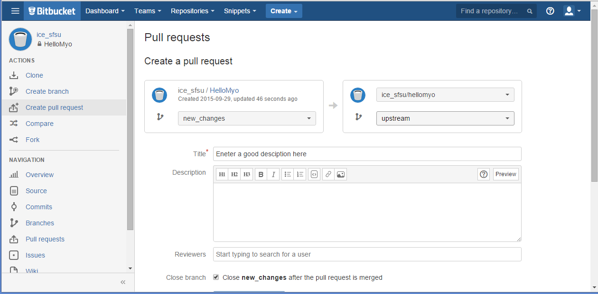
Getting Started: Sharing Changes
Create a pull request
Select which branch with changes you think should propagate
Please submit changes to “upstream”, master will be reserved for major milestones

