Slide 1
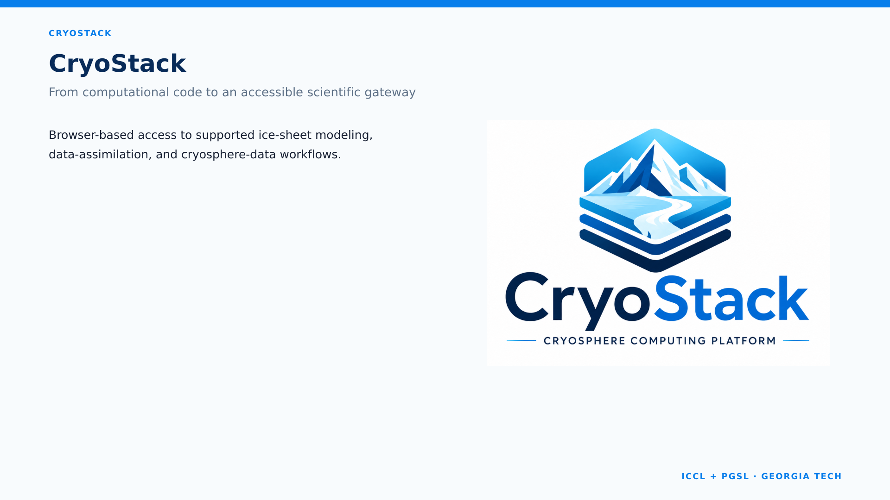
CryoStack
Ice-sheet modeling without the setup barrier

Slide 2
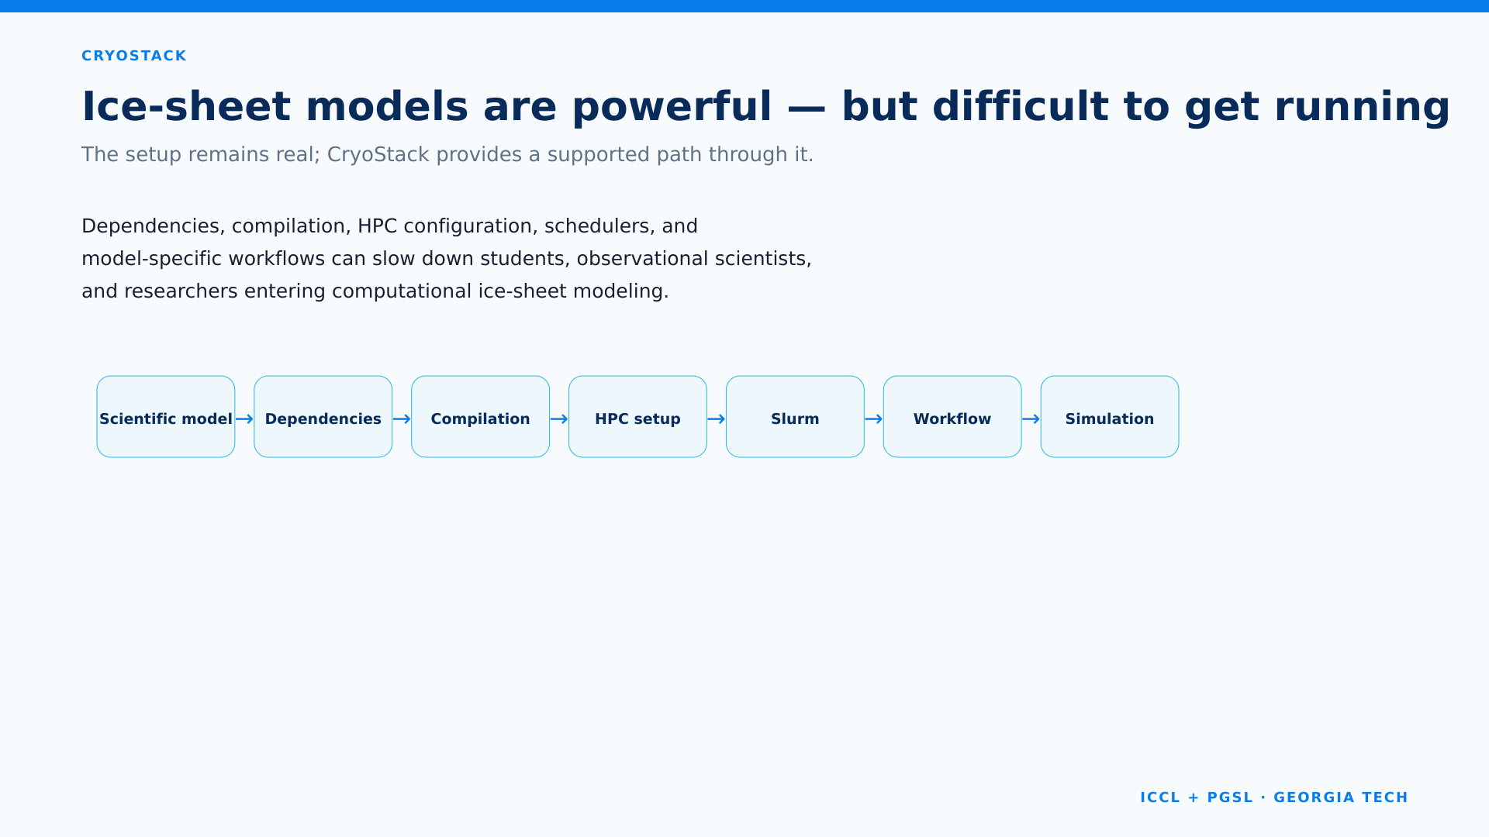
The Problem
Dependencies → Compilation → HPC configuration → Slurm → Model workflow → Simulation

Slide 3
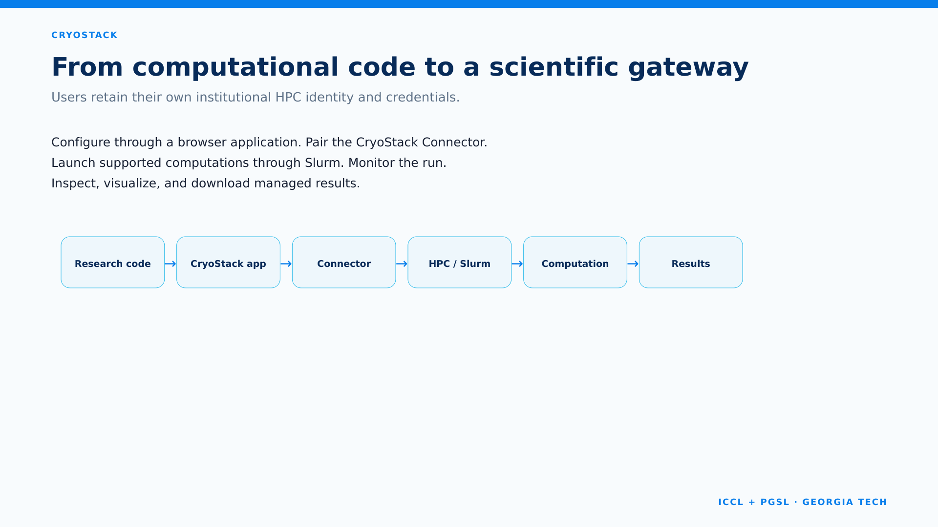
From browser to HPC
Browser → CryoStack → CryoStack Connector → HPC / Slurm → Ice-sheet model → Results

Slide 4
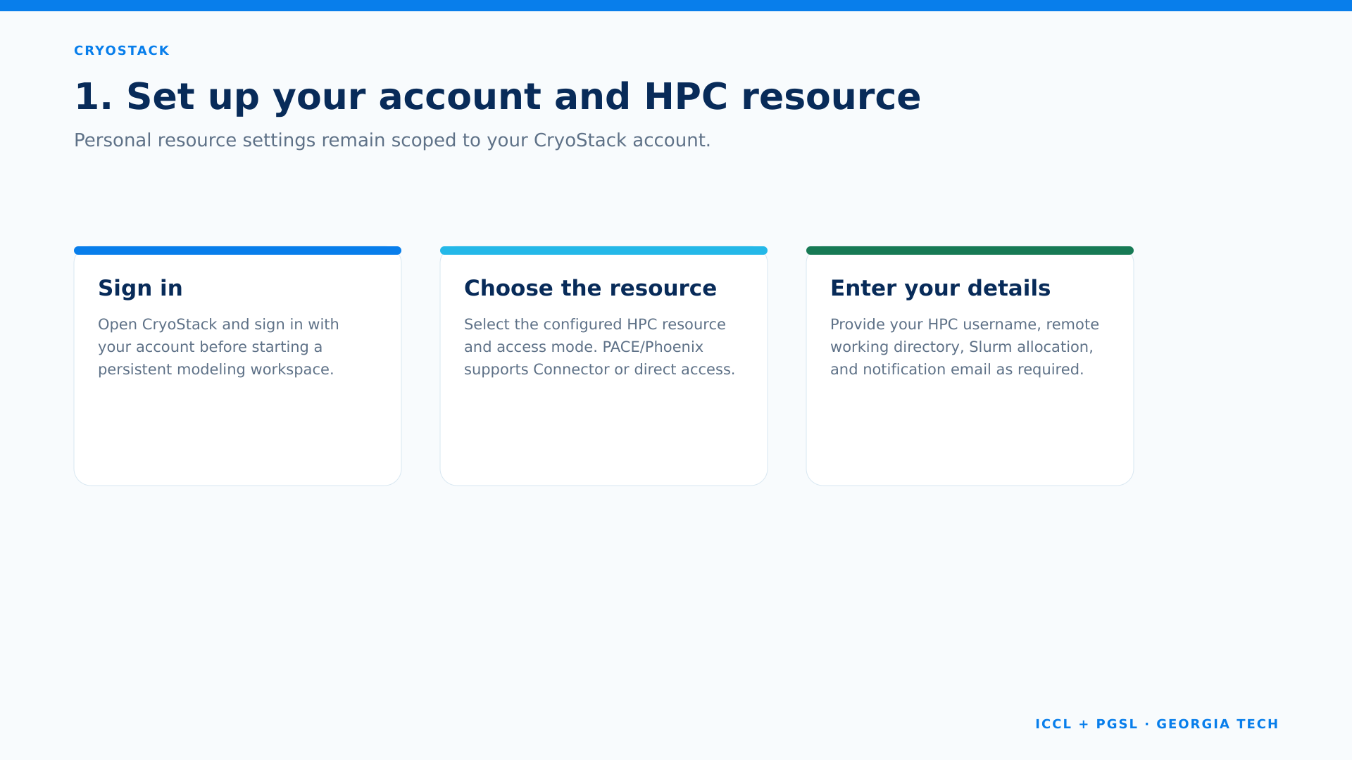
Set up your account
Sign in → Select resource → Enter personal HPC settings

Slide 5
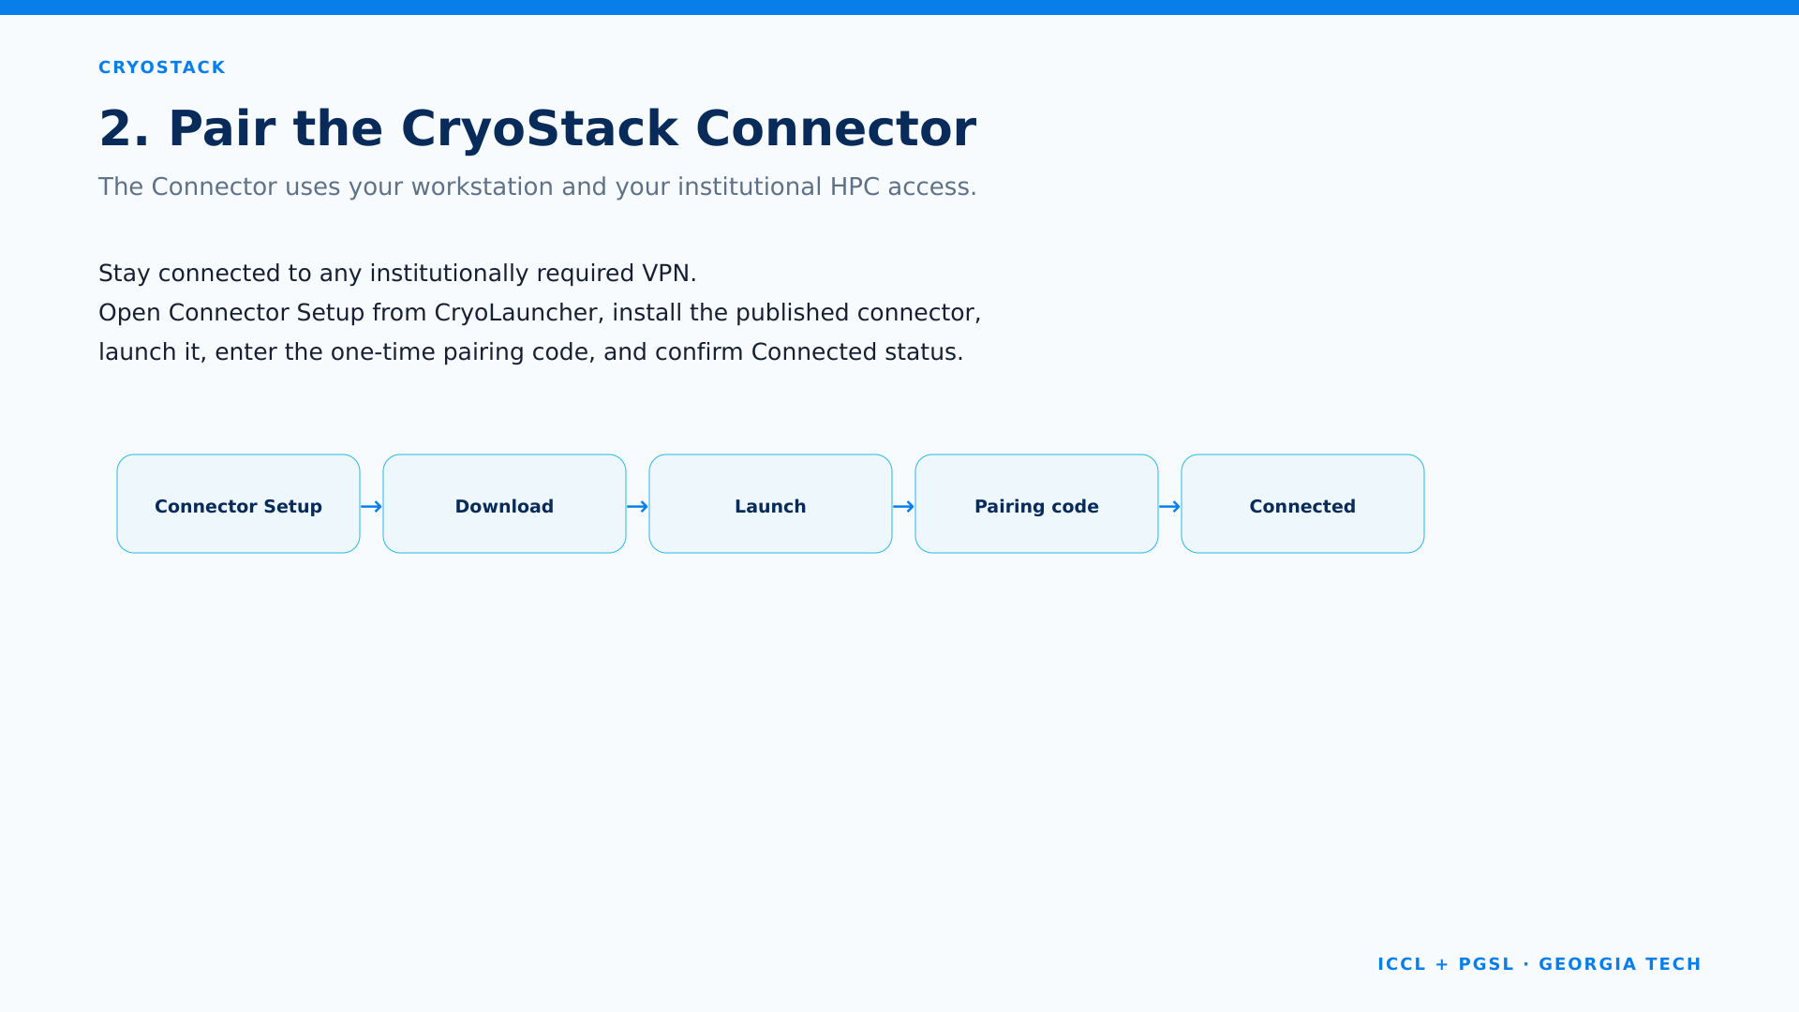
Pair the Connector
Connector Setup → Download → Launch → Pair → Connected

Slide 6
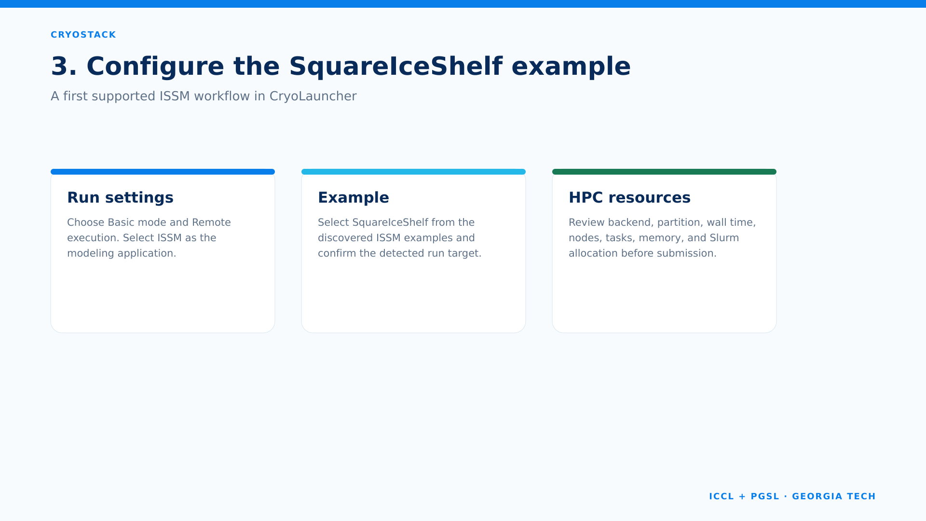
Configure SquareIceShelf
Basic → Remote → ISSM → SquareIceShelf → HPC resources

Slide 7
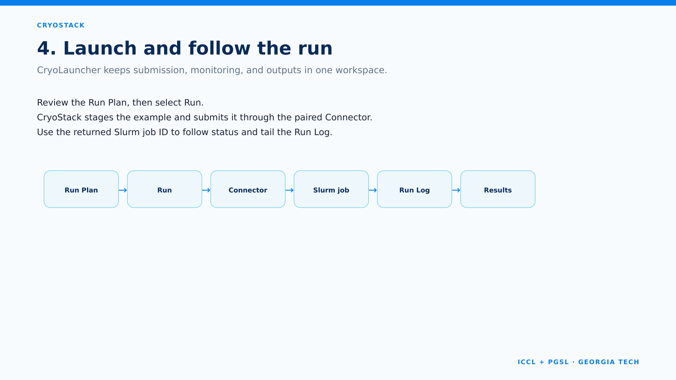
Launch and follow
Run Plan → Run → Connector → Slurm job → Run Log → Results

Slide 8
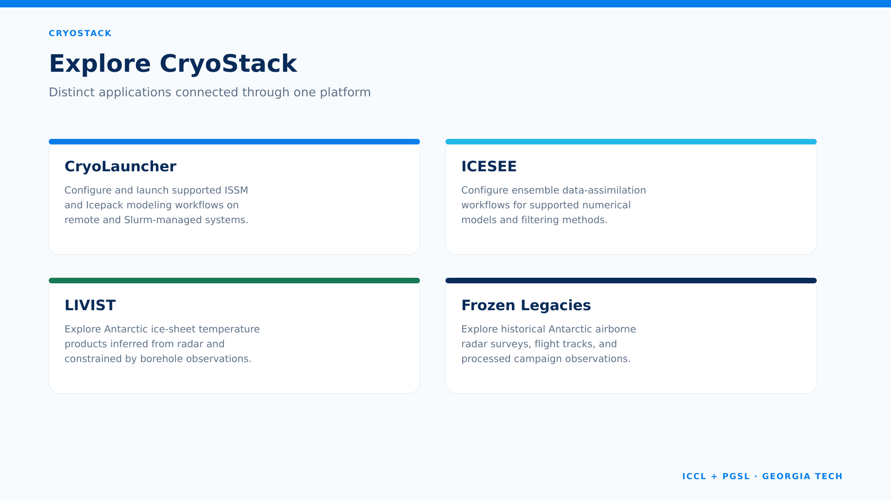
Explore CryoStack
CryoLauncher | ICESEE | LIVIST | Frozen Legacies

Slide 9
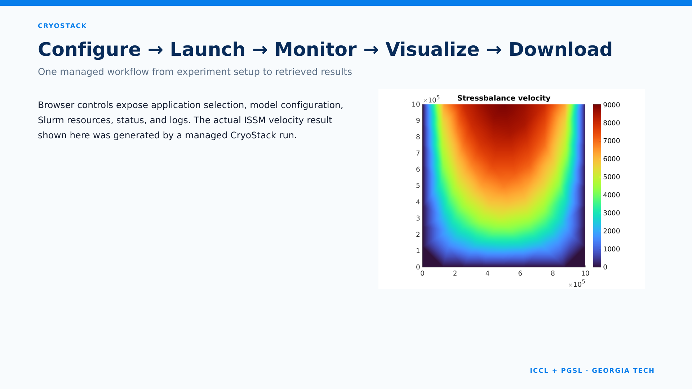
One managed workflow
Configure → Launch → Monitor → Visualize → Download

Slide 10
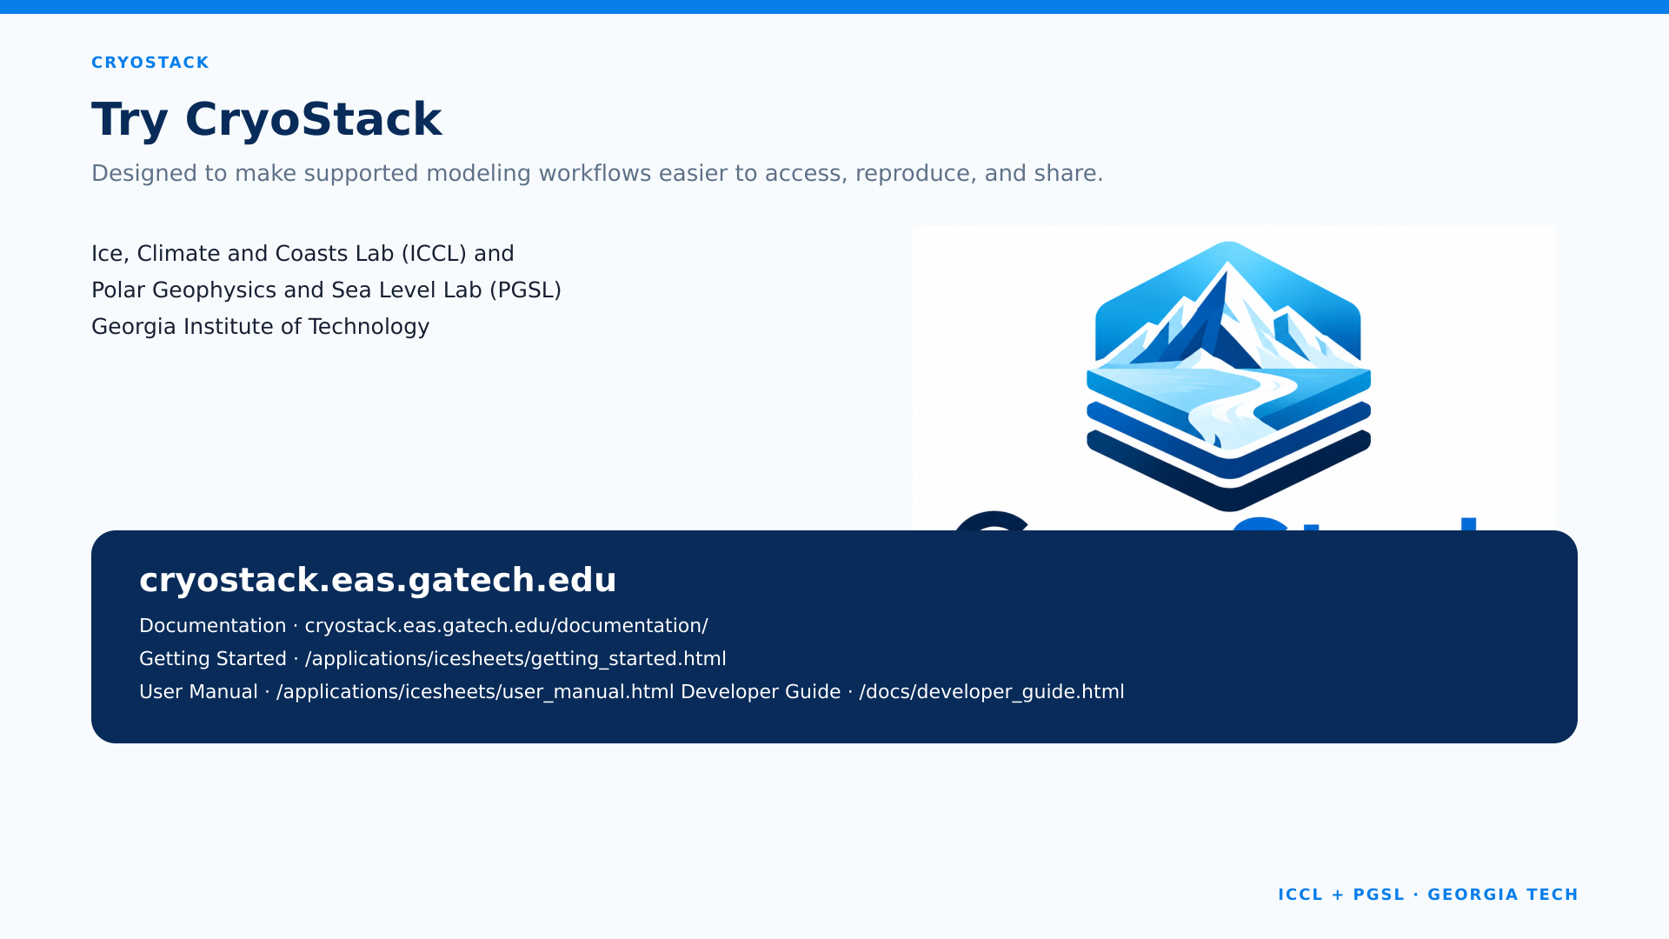
Try CryoStack
cryostack.eas.gatech.edu cryostack.eas.gatech.edu/documentation/

