Slide 1
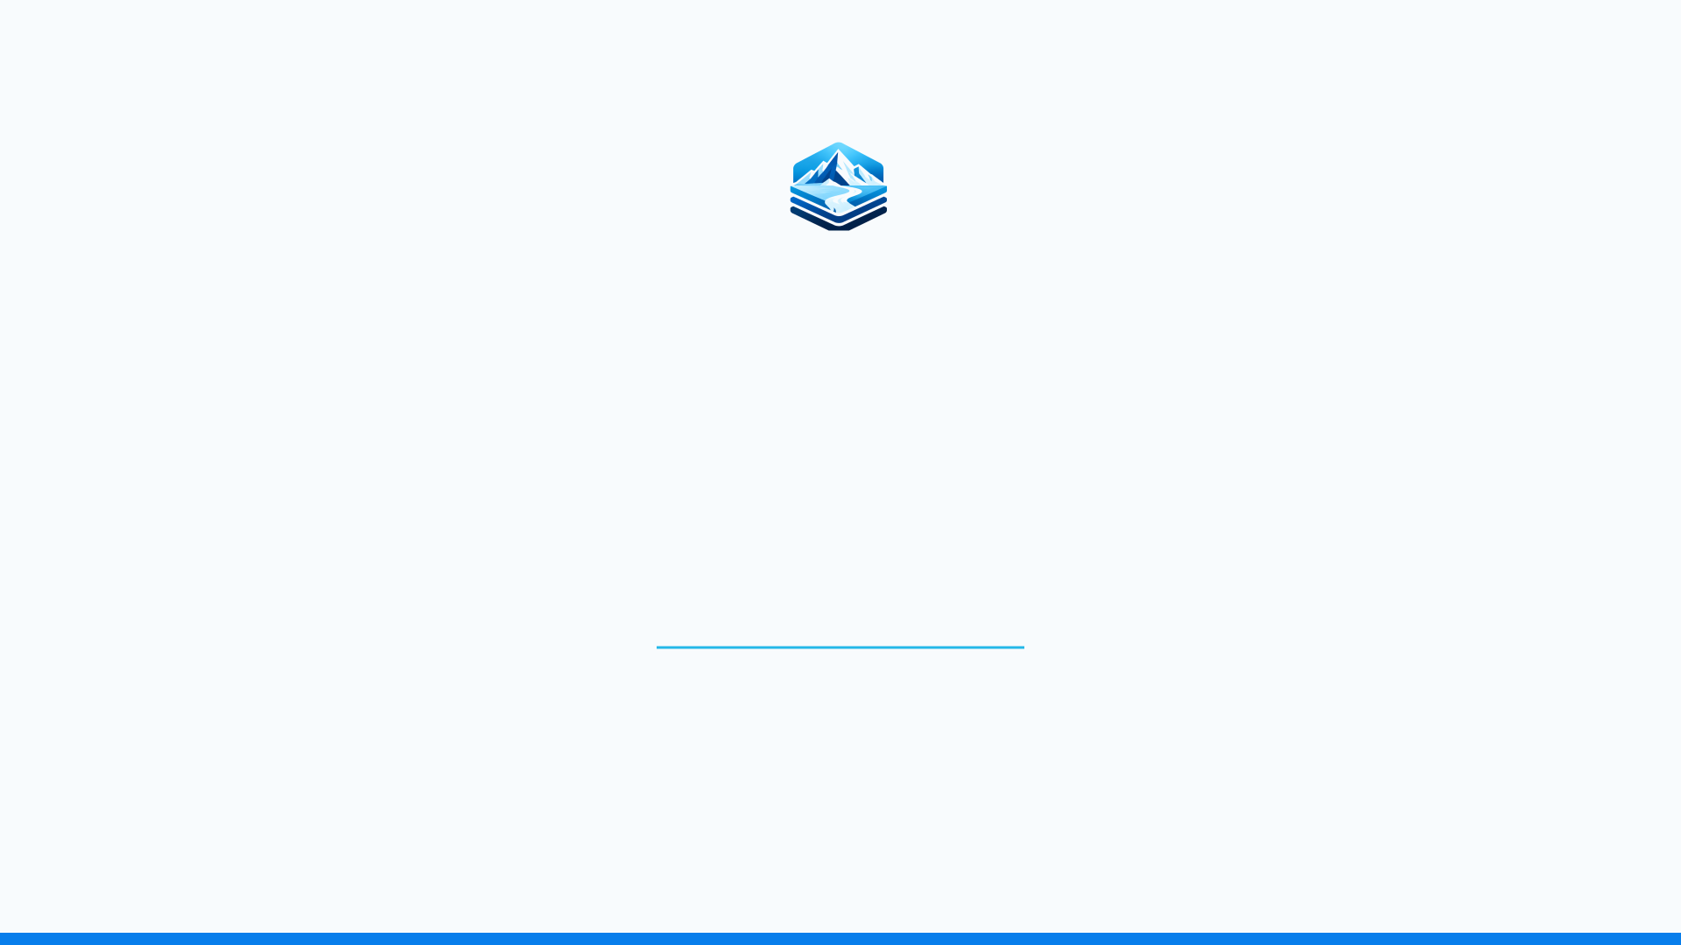
CryoStack
A Unified Cyberinfrastructure Platform for Reproducible Ice-Sheet Modeling, Data Assimilation, and Scientific Computing across HPC and Cloud Environments
Brian Kyanjo
Research Scientist II
Georgia Tech · Earth and Atmospheric Sciences
Notes:
Good morning. I'm Brian Kyanjo, a research scientist in Earth and Atmospheric Sciences at Georgia Tech. Today I want to introduce CryoStack, a cyberinfrastructure platform for running ice-sheet modeling, data assimilation, and other cryosphere computing reproducibly across HPC and cloud systems. In the next ten minutes: why it exists, what it connects, what's working today, and where you can start.

Slide 2
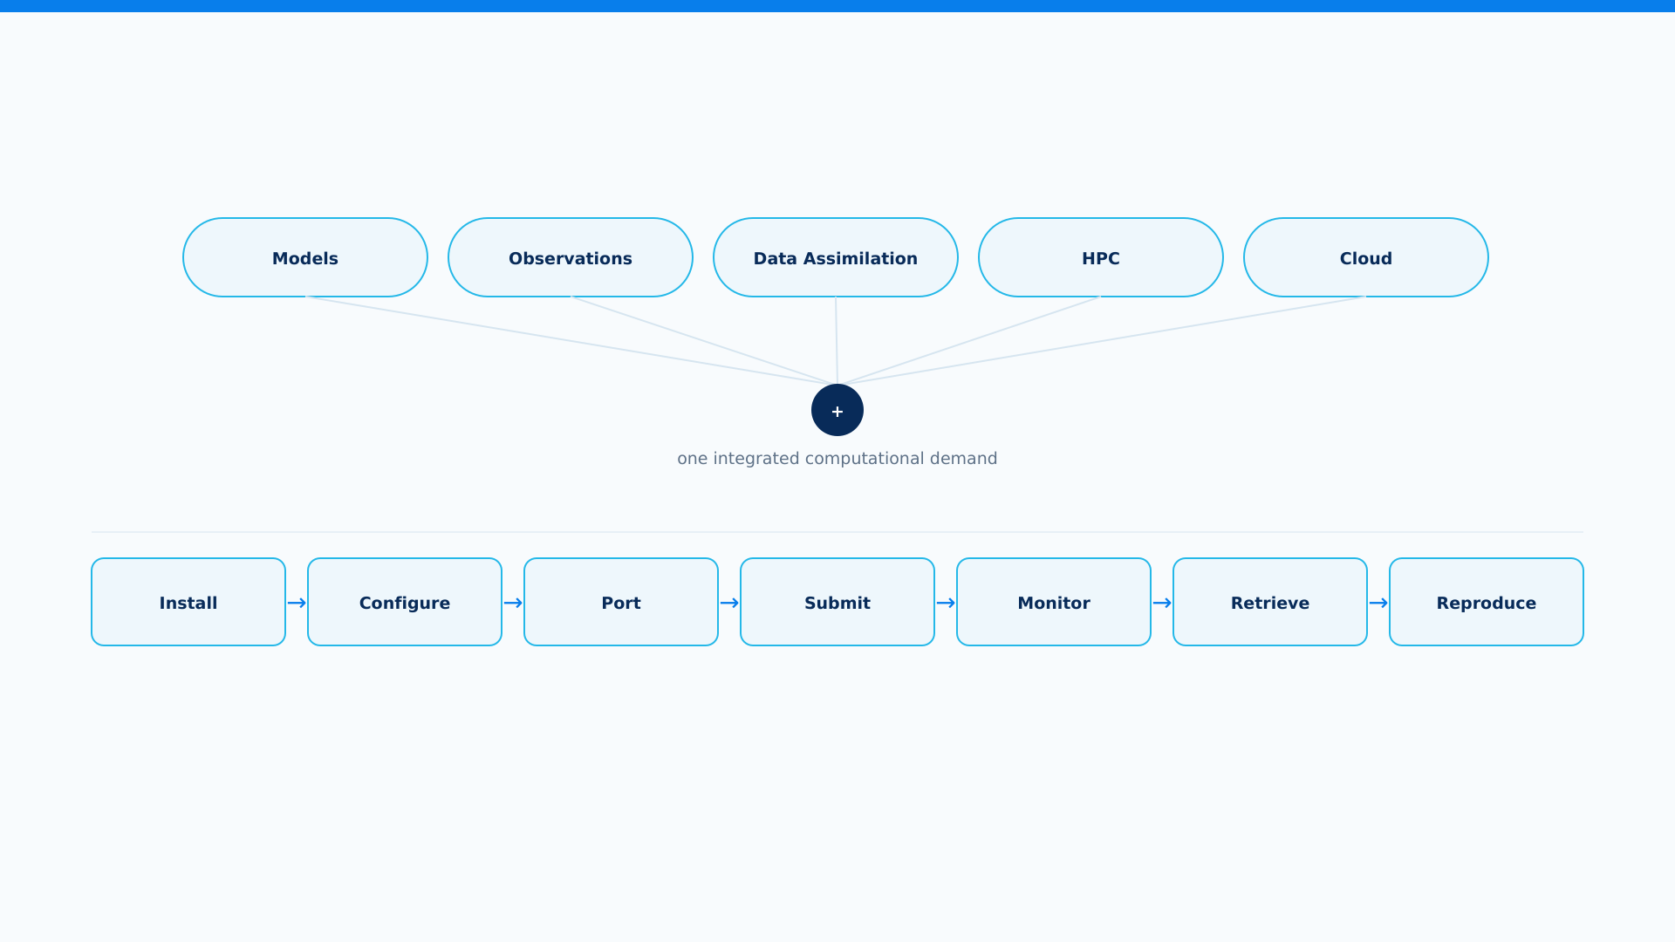
CRYOSTACK
The challenge is bigger than the model
Every one of those steps is a place where reproducibility can quietly break.
ICCL + PGSL · GEORGIA TECH
Notes:
Cryosphere science increasingly means combining models, observations, and data assimilation -- and running all of it across HPC and cloud systems. But every one of those pieces carries its own infrastructure burden: install the software, configure it for a specific machine, port workflows when you move systems, submit and monitor jobs, retrieve results, and -- if you're careful -- still be able to reproduce what you did. That burden falls on scientists, and it grows with how sophisticated our models and observations get.

Slide 3
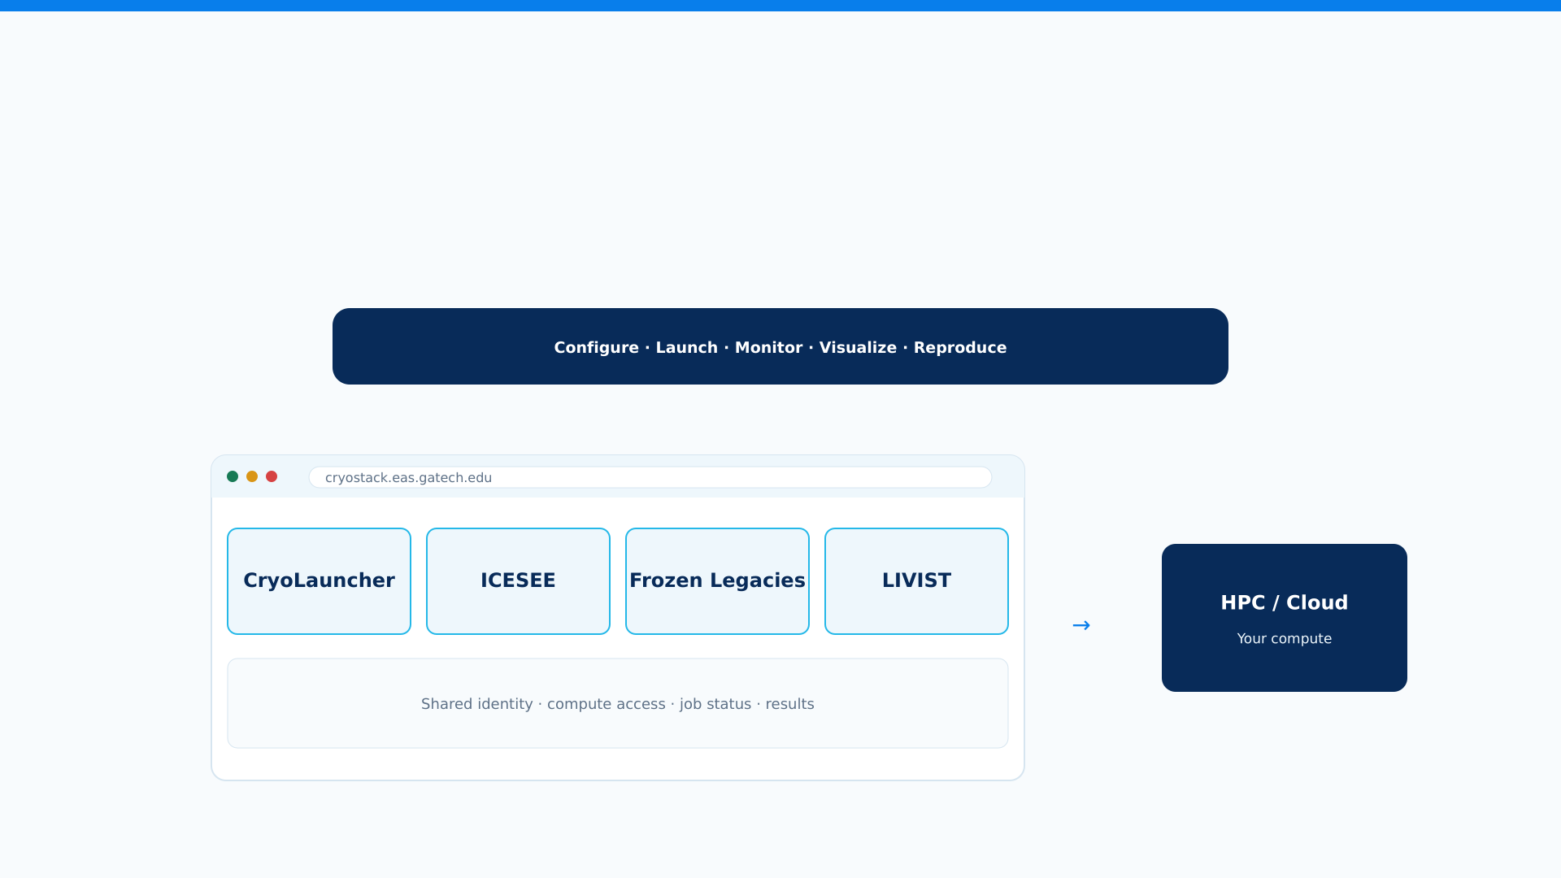
CRYOSTACK
Introducing CryoStack
Science first. Infrastructure underneath.
ICCL + PGSL · GEORGIA TECH
Notes:
This is CryoStack: a single, web-based environment where a researcher configures a scientific run, launches it, monitors it, visualizes results, and can reproduce the experiment later -- without becoming a systems administrator along the way. Different scientific applications connect to that infrastructure in their own way -- I'll show you that next -- but from the researcher's side it's one consistent environment.

Slide 4
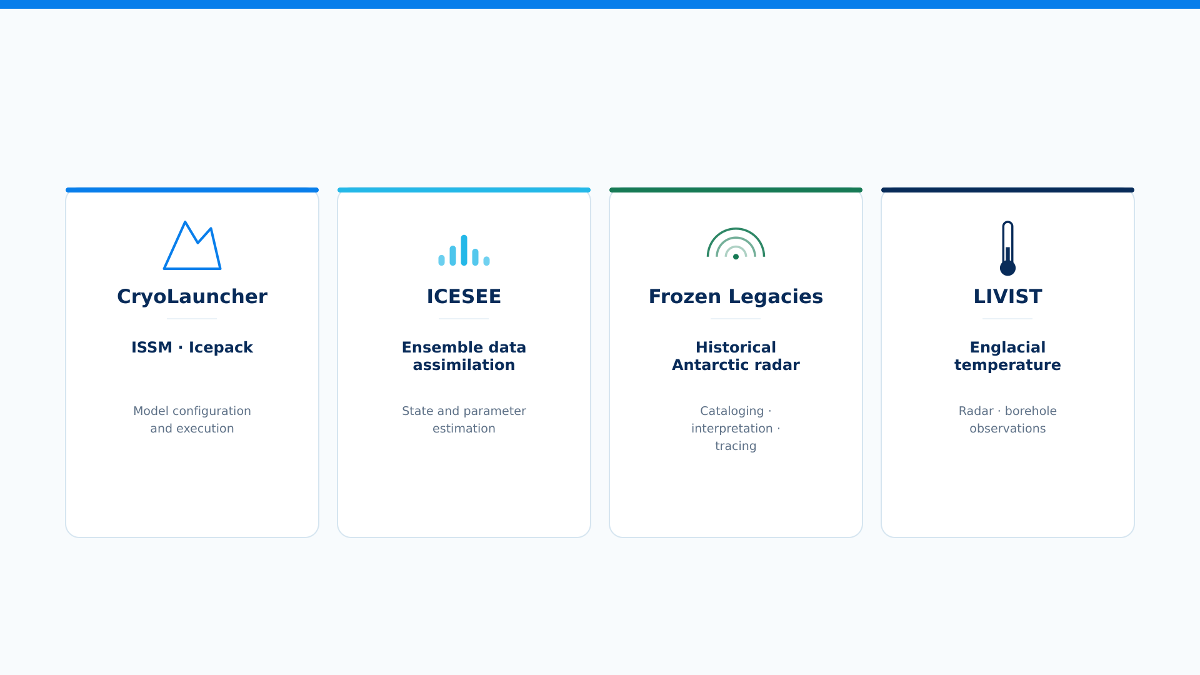
CRYOSTACK
One platform. Different scientific workflows.
Shared cyberinfrastructure. Application-specific science.
ICCL + PGSL · GEORGIA TECH
Notes:
CryoStack today hosts four first-class scientific applications. CryoLauncher runs ice-sheet models -- ISSM and Icepack. ICESEE performs ensemble data assimilation for state and parameter estimation. Frozen Legacies works with historical Antarctic radar -- cataloging, interpreting, and tracing. LIVIST focuses on englacial temperature from radar and borehole observations. These are genuinely different workflows -- CryoStack doesn't force one universal pipeline on them. What they share is the cyberinfrastructure underneath: identity, compute access, and a common web environment.

Slide 5
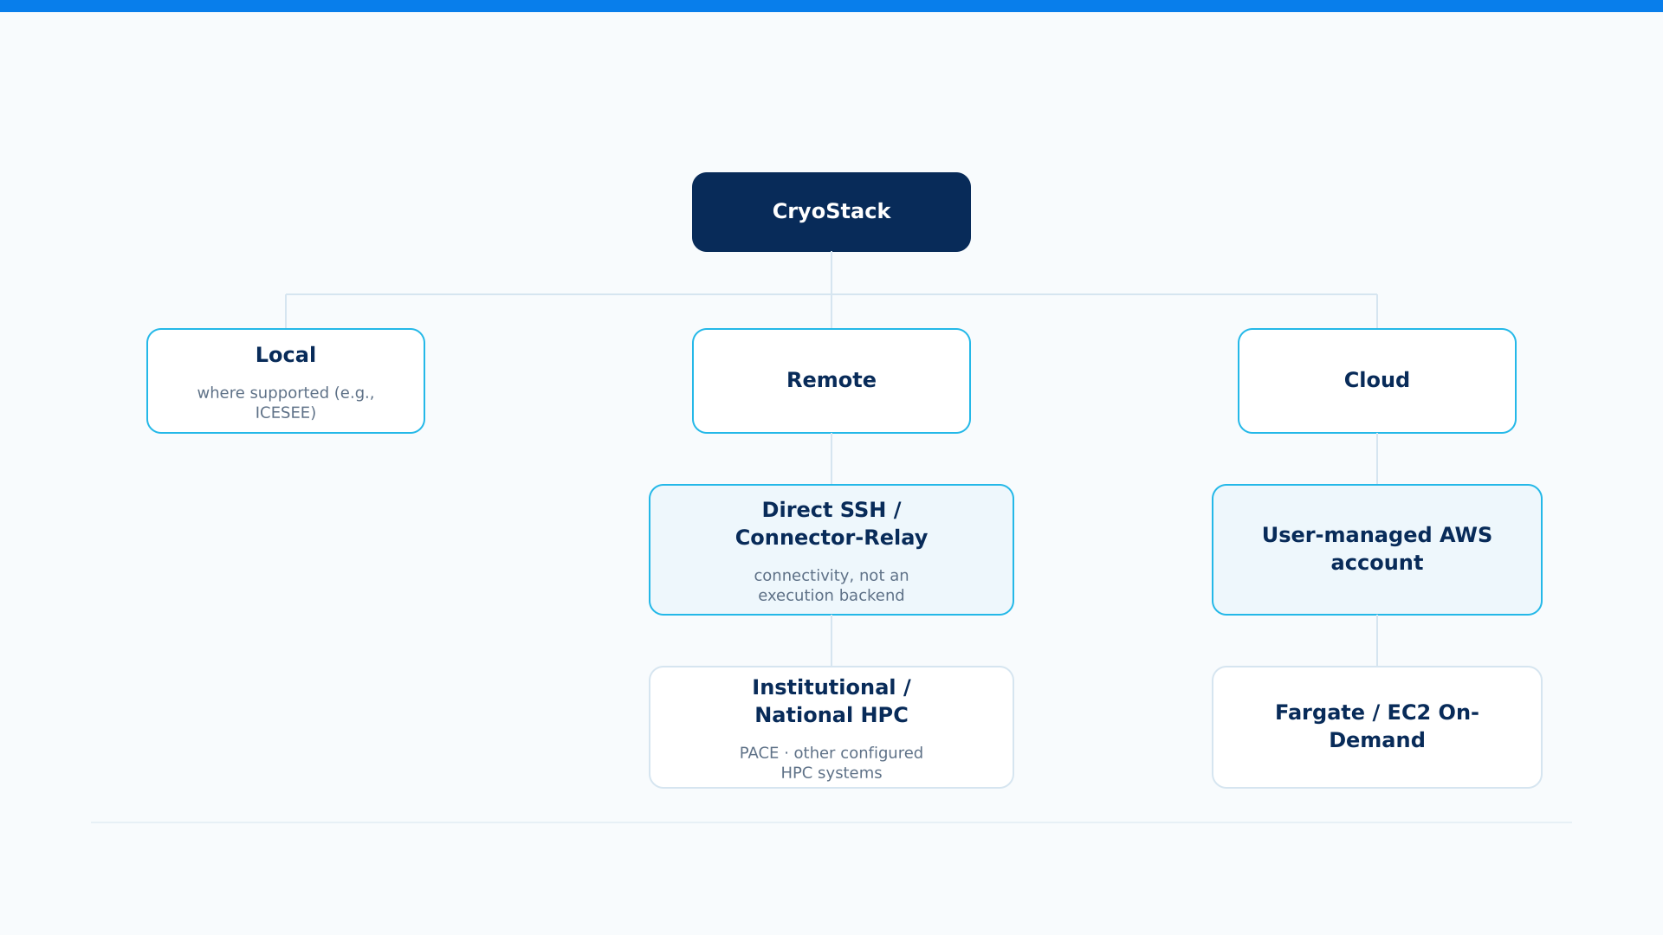
CRYOSTACK
From your browser to the compute you already use
CryoLauncher supports Remote and Cloud. Local applies where supported, particularly ICESEE.
ICCL + PGSL · GEORGIA TECH
Notes:
CryoStack connects to compute you already have access to. For applications where it makes sense -- particularly ICESEE -- you can run locally. For remote HPC, CryoStack connects either through direct SSH or through our Connector/Relay -- connectivity infrastructure, not a separate execution backend -- either way landing on institutional or national HPC like PACE. For cloud, CryoStack currently uses AWS, on Fargate or EC2 on-demand, under your own account. CryoLauncher specifically supports Remote and Cloud, not Local. The point: CryoStack doesn't replace your compute, it gives you one consistent way to reach it.

Slide 6
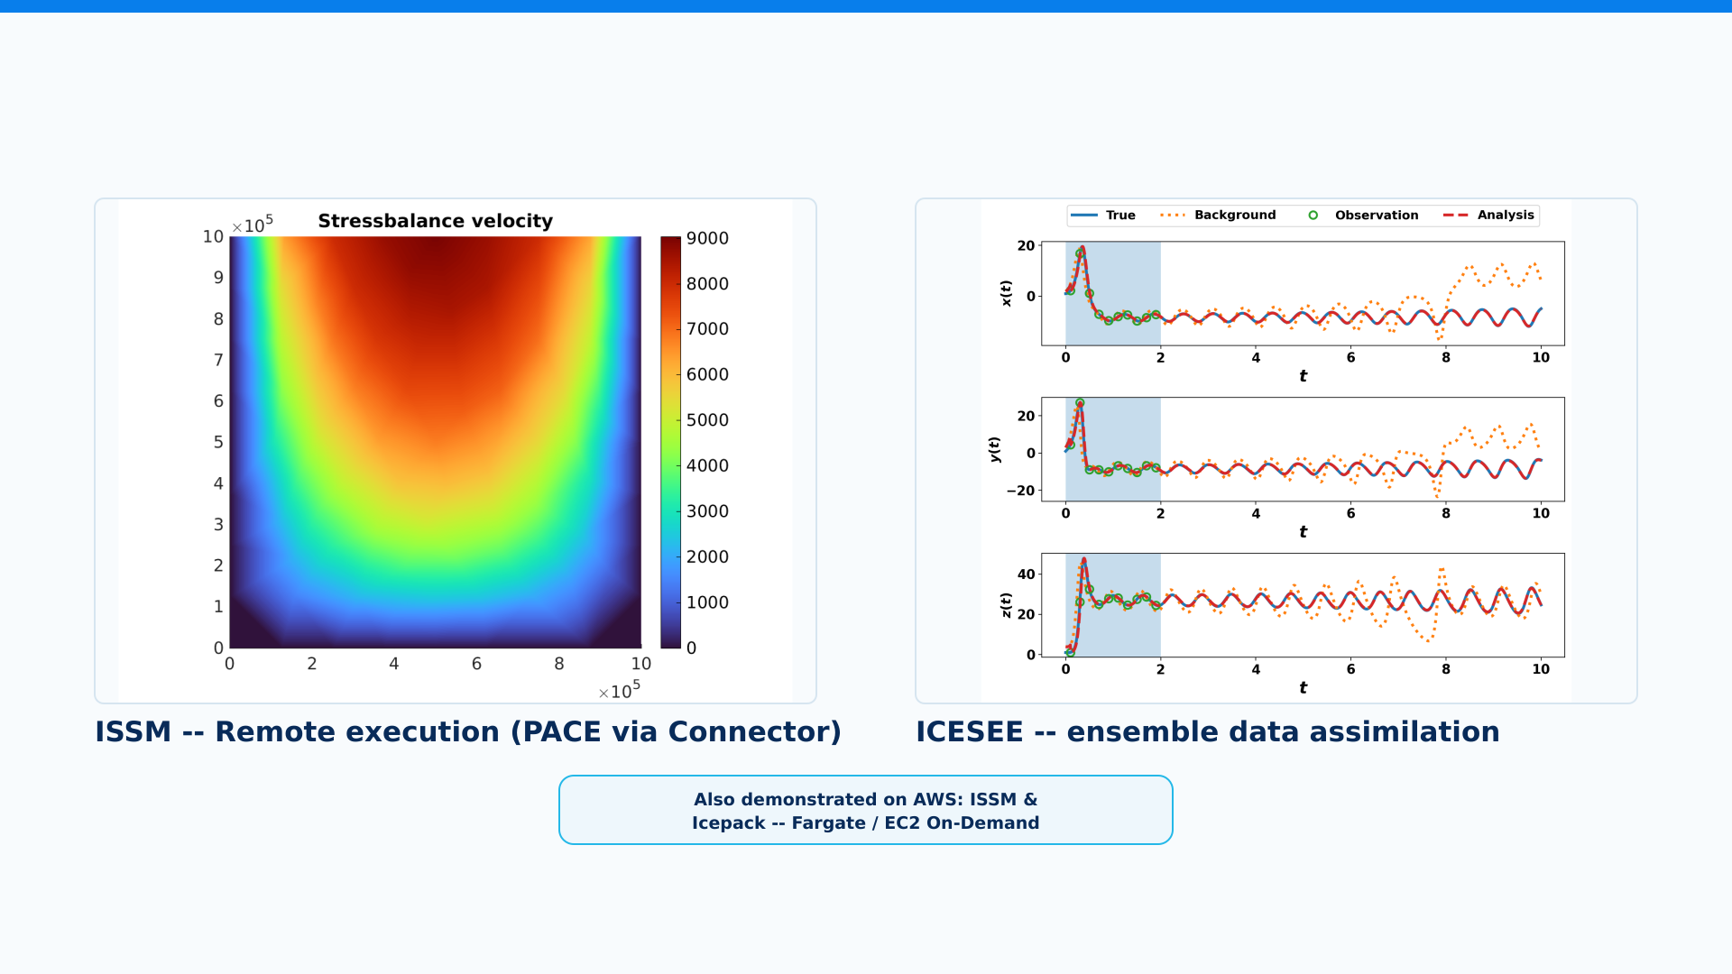
CRYOSTACK
It is already running real science
ICCL + PGSL · GEORGIA TECH
Notes:
This isn't a proposed architecture -- it's running today. CryoLauncher has executed ISSM on institutional HPC and on AWS Batch, both Fargate and EC2 on-demand, including full MPI solver runs, postprocessing, retrieval, and visualization. Icepack has been demonstrated on those same cloud paths. ICESEE has its own local, remote, and cloud execution paths, and we've demonstrated its Lorenz-96 configuration running in the cloud. When a run needs Georgia Tech's institutional MATLAB license, CryoLauncher can reach it from AWS through Connector/Relay. To be precise about where we are: Spot instances, GPUs, multi-node execution, and a fully cloud-coupled ICESEE-ISSM workflow are not yet validated -- that's ongoing work, not a claim I'm making today.

Slide 7
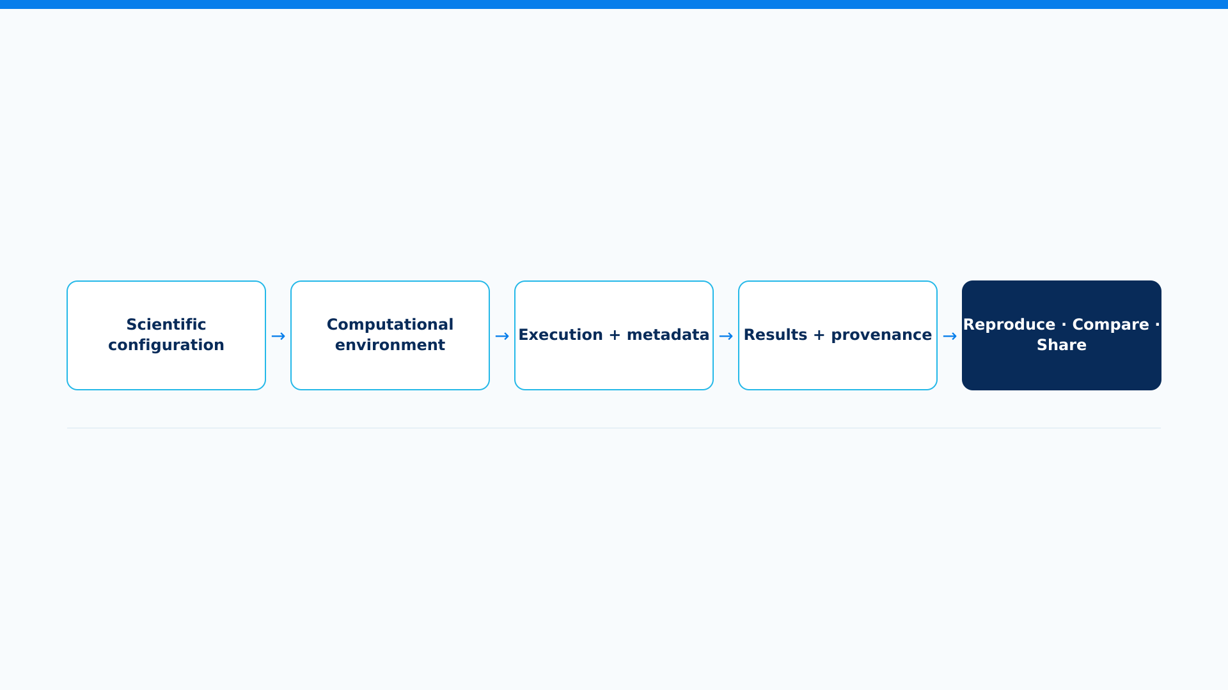
CRYOSTACK
The experiment is more than its final output
CryoStack is built to carry an experiment's context through its lifecycle -- not just the final result.
ICCL + PGSL · GEORGIA TECH
Notes:
A result is only as useful as your ability to trust and repeat it. That's the goal behind CryoStack's reproducibility architecture: carry an experiment's scientific configuration, computational environment, execution metadata, and results with provenance across its lifecycle, so it can be reproduced, compared, and shared. How far that goes today varies by application -- it's further along for some workflows than others -- but it's core to why CryoStack exists, not an afterthought.

Slide 8
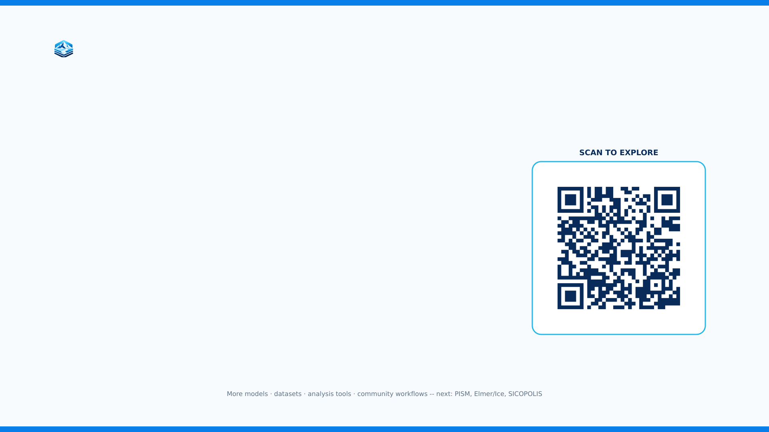
CryoStack is live.
Explore the platform. Run a workflow. Help us build what comes next.
cryostack.eas.gatech.edu
Documentation · cryostack.eas.gatech.edu/documentation.html
Notes:
We're actively growing this: more models like PISM, Elmer/Ice, and SICOPOLIS are on our onboarding roadmap, along with more datasets, analysis tools, and community workflows. But the main point today is simpler than that: CryoStack is live, right now, at this address -- and we invite you to explore it, run a workflow, and help us shape what comes next. Thank you.

Slide 9
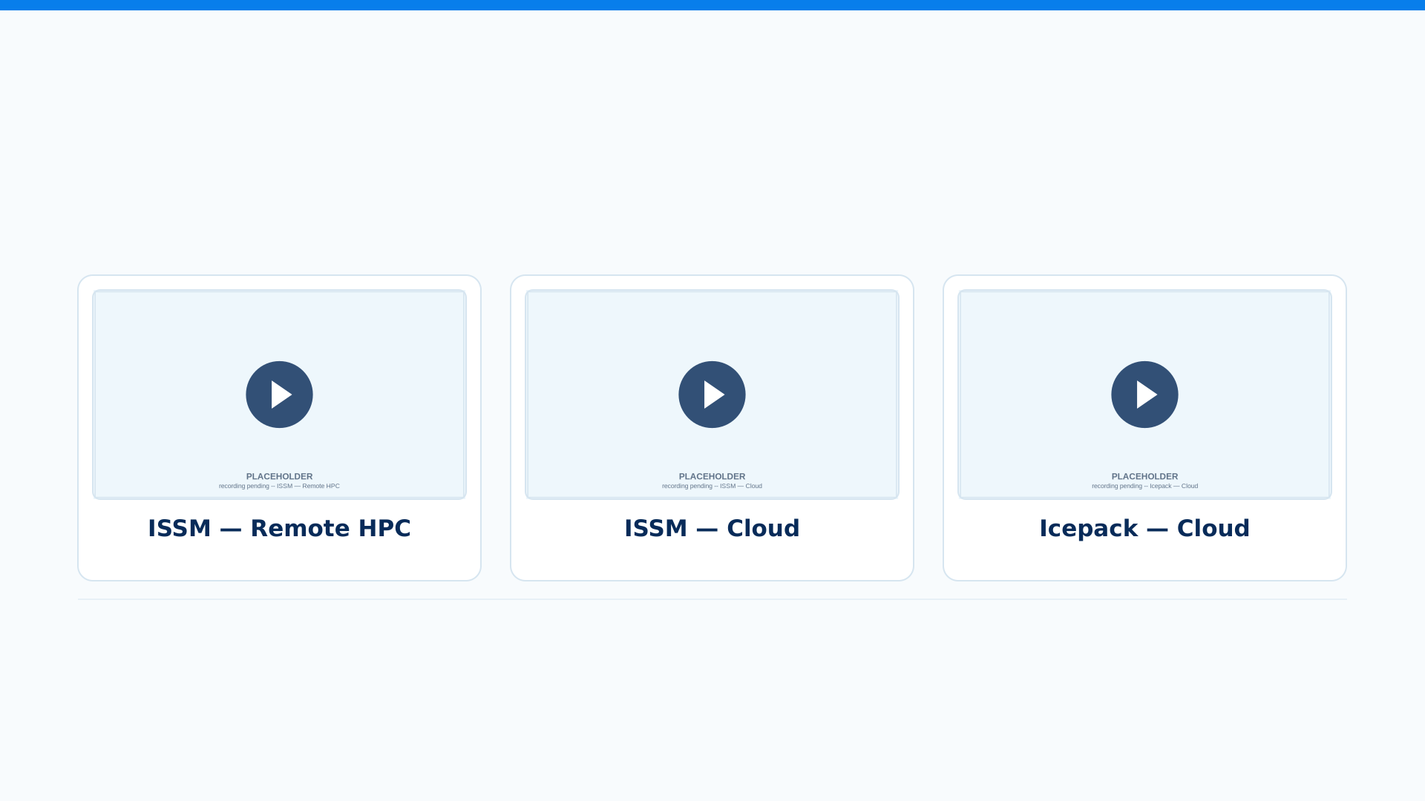
CRYOSTACK
See CryoStack in action
From configuration to scientific results
Short excerpts here -- full recordings will be published as CryoStack tutorials.
ICCL + PGSL · GEORGIA TECH
Notes:
Rather than only showing the architecture, I want to briefly show CryoStack actually running scientific workflows. Here are three examples: ISSM running remotely on HPC, ISSM running in the cloud, and Icepack running in the cloud. In each case, the researcher works through CryoLauncher while CryoStack handles the underlying execution. These are short excerpts -- the full demonstrations will also be published as CryoStack tutorials.

