Slide 2
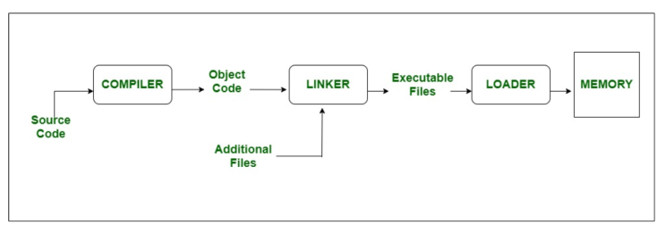
When executing a C/C++ program, its executable image is loaded into the computer’s RAM by an essential Operating System component known as the Program Loader(or Loader).

Slide 3
Code Segment
Contains the machine code instructions of the compiled program (e.g., .exe, .out).
Typically read-only and immutable to prevent accidental modification.
Sharable so that only a single copy needs to be in memory for frequently executed programs, such as text editors.
Limited to code execution, no data storage.

Slide 4
Initialized Data Segment:
Also known as the Data Segment.
Stores global and static variables with predefined initial values.
Efficient access to initialized data during program execution.
Supports both read and write operations.
Variables remain in memory throughout program execution.

Slide 5
Uninitialized Data Segment (BSS):
Often referred to as the “BSS” (block started by symbol) segment.
Contains uninitialized global and static variables.
Data in this segment is automatically initialized to arithmetic Zero or null before program execution.
Efficient use of memory for variables without explicit initialization.

Slide 6
Heap Segment:
The term “heap” here has no connection to the heap data structure. It’s simply a pool of memory available for allocation and deallocation.
In The heap, memory is allocated dynamically and it's usually not contiguous.
Allocation and deallocation are managed explicitly by the programmer (e.g., using malloc and free ,new ,delete functions).
The heap has no fixed-size restriction, but heap handling is slower than stack handling.
Developers have direct control over heap memory.
The developer is responsible for remembering to deallocate the object in memory.
Heap memory isn’t as safe as stack memory, If not handled properly, memory leaks can occur

Slide 7
Stack Segment:
Stack memory allocation occurs on contiguous blocks of memory. It’s called “stack” because it operates like a stack of plates, where items are added and removed from the top.
In the Stack, the allocation happens on contiguous blocks of memory.
Stores local variables, function parameters, pointers, and return addresses.
Follows a last-in, first-out (LIFO) order.
Efficient for managing function calls and local variables.
The size of memory to be allocated is known to the compiler.
The stack has a fixed size(OS-Dependant).
We don't have to worry about memory allocation/deallocation of stack variables.
Stack memory is considered safer and faster than heap memory. It’s accessible only by the owning thread.

Slide 8
Procedimiento
Crear un proyecto C++ y agregar el archivo Memory Layout.cpp, y luego usando los 4 visualizadores de Memoria del Debug→ ventanas→Memoria1, Memoria2, Memoria3 y Memoria4, realice una captura de pantalla que muestre cada uno de los segmentos del programa, incluyendo el code segment.

Slide 9
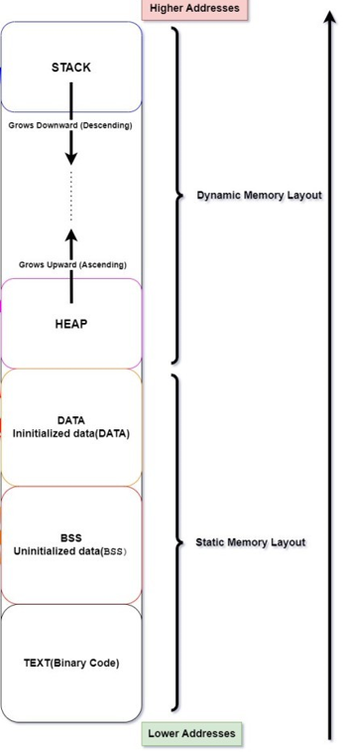
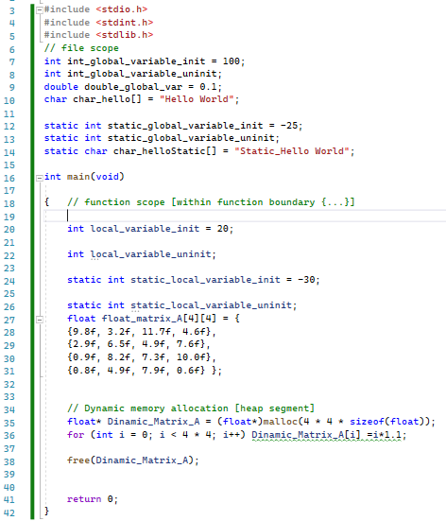
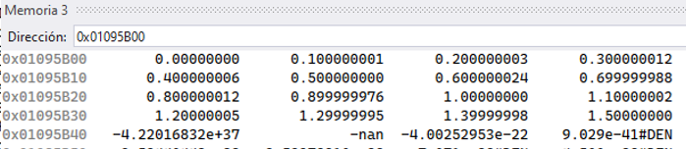
complete

Slide 10
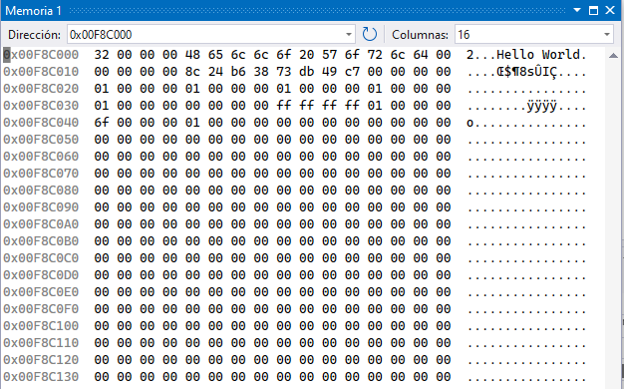
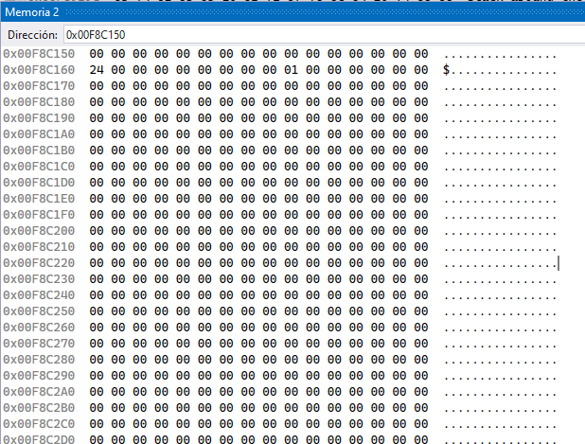
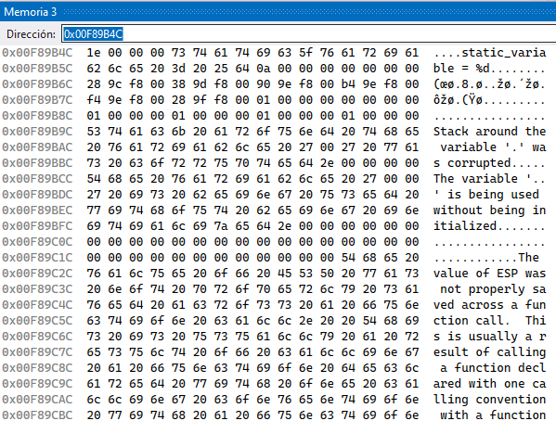
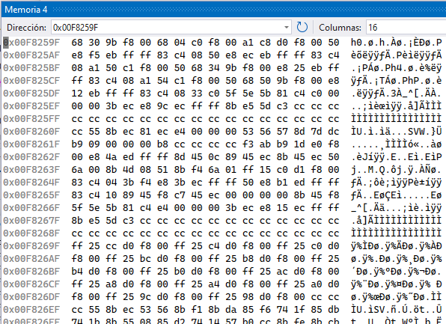
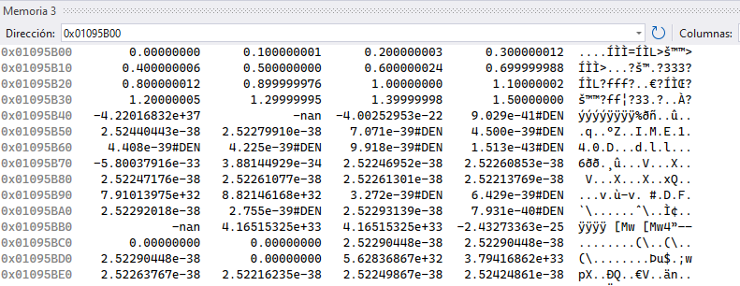

Slide 11
Stack (paso de parámetros)
void swap_v(int a, int b)
{
int temp;
temp = a;
a = b;
b = temp;
}

Slide 12
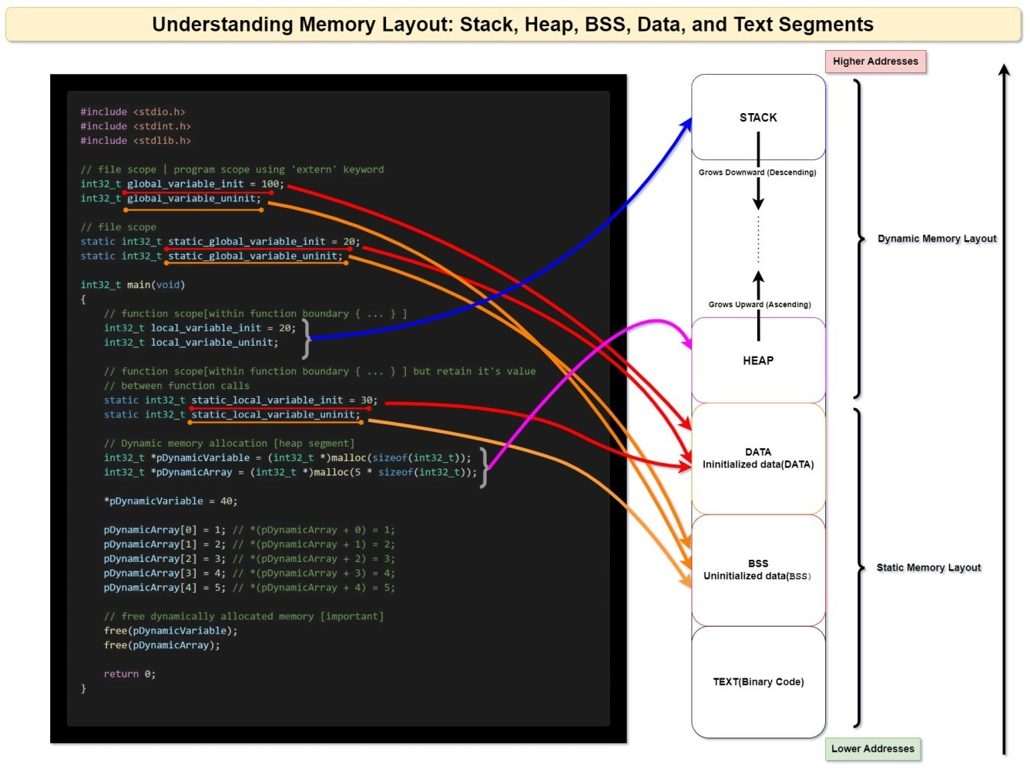
https://media.licdn.com/dms/image/D4E12AQHjU0ECh0s3WA/article-inline_image-shrink_1000_1488/0/1710628515143?e=1716422400&v=beta&t=V-ZPYOYS6PbXH9JrJdxIXGvRLWkAF-EWXGG5SZ9fsGg&trk=article-ssr-frontend-pulse_publishing-image-block

Slide 13
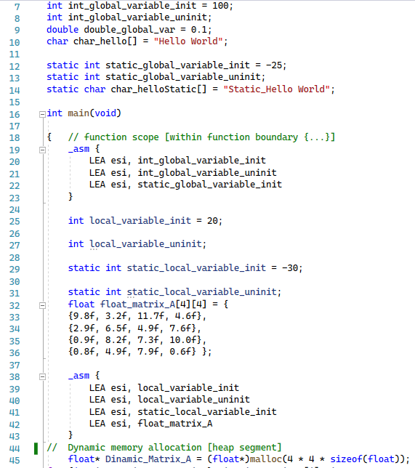
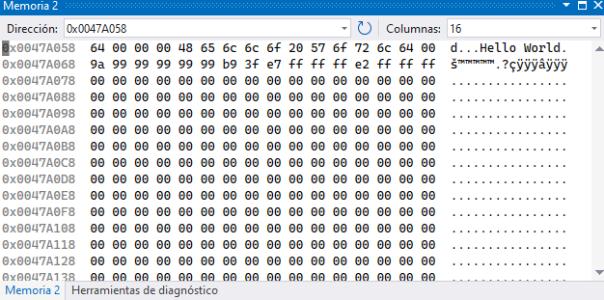
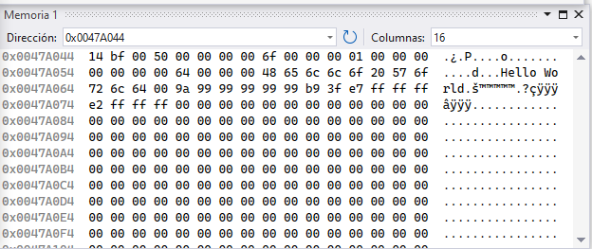
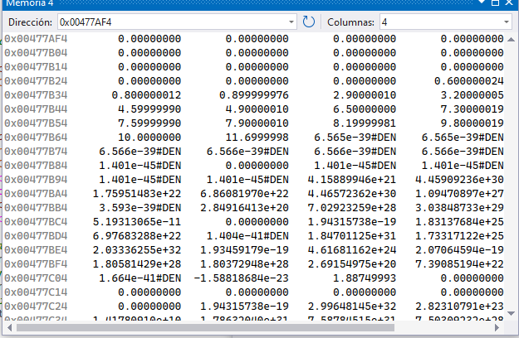
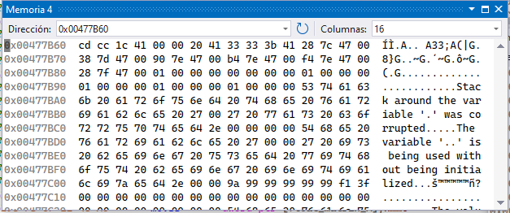
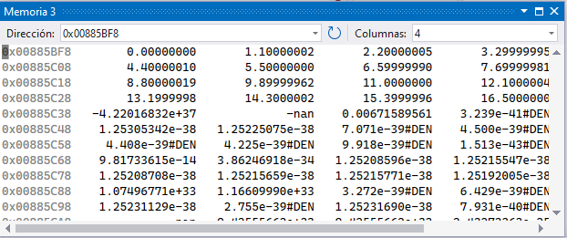
Data segment
Stack
Heap
Code Segment

Slide 14
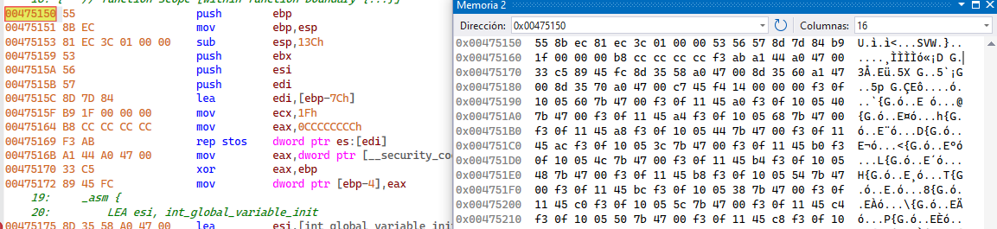
Code Segment

