Slide 1
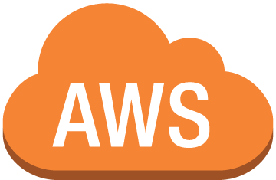
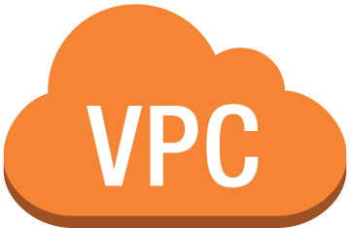


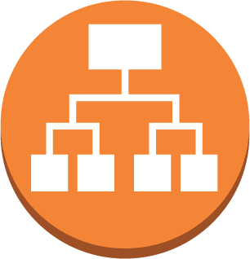
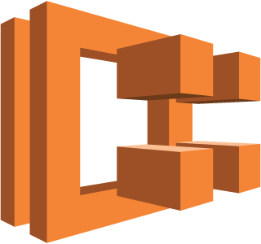



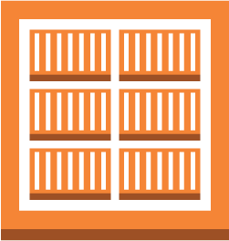

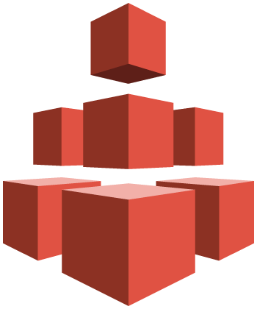
Public subnet 1
Internet gateway
Public subnet 2
NAT Gateway
NAT Gateway
Application Load Balancer
Private subnet 1
Private subnet 2
EC2 Container Service Cluster
API
Jenkins
Auto Scaling Group
ECS Instances
ECS Instances
ECS Instances
ECS Instances
Virtual Private Cloud
10.0.0.0/16
Availability Zone 1
Availability Zone 2
Container Registry
(private images)
CloudWatch Logs
(centralized container logs)
Elastic File System
(Shared NFS for volumes)
AWS Region: us-east-2

