Slide 1


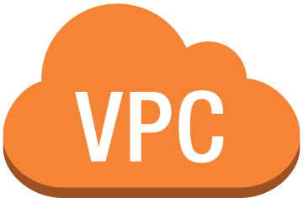


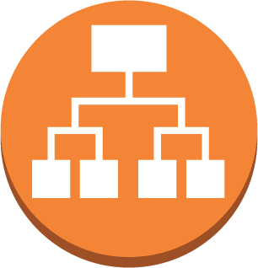



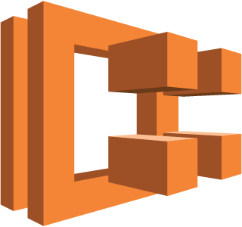



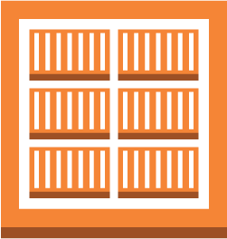
1.) Project code fork/clone
2.) GitHub hook authorized
Public subnet 1
Internet gateway
Public subnet 2
CodePipeline
Application Load Balancer
3.) Provision using CloudFormation
Developers
CloudFormation
EC2 Container Service Cluster
CodeBuild
API
Auto Scaling Group
EC2 Container Registry
ECS Instances
ECS Instances
Virtual Private Cloud
10.215.0.0/16
Availability Zone 1
Availability Zone 2
AWS Region

