Slide 1

PYTHON IN HIGH-PERFORMANCE COMPUTING
Presenters:
Chris Werner
Fionnuala Solomon
Adam Ralph
Notes:
Welcome
Introduction + round table

Slide 2


PRACE – Partnership for Advanced Computing in Europe
ICHEC is a member of PRACE, which has 20+ member countries
Provides a range of organisations from academia to industry with access to Europe’s supercomputers via host members
PRACE’s training helps scientists and engineers make optimal use of the machines in their quest for new discoveries
Notes:
Final year of PRACE

Slide 3
To start: 5 mins
Ensure you can log into Kay
ssh courseXX@kay.ichec.ie
If you can, sit back and relax!
If you have not set up an ssh key, YOU MUST DO IT NOW!
ssh-keygen –t ed25519
Copy the FULL KEY generated in id_ed25519.pub and send to either fionnuala.solomon@ichec.ie or adam.ralph@ichec.ie
If you do not know your course number and the log in password, check your emails & junk folder for a message titled “Python in HPC @ ICHEC” sent on Monday

Slide 4
Schedule – Day 1
Time | Topic
13:00 | Introduction, Welcome and Setup
13:45 | Fundamentals
14:45 | BREAK
15:00 | Numba
16:00 | Session End
Notes:
Here is our schedule, and we begin with the hardest part, getting everyone logged in. We have sent emails to you over the last couple of days about submitting your ssh key to us. If you have, thank you! If you have not, now is the time to panic. We will be using ICHEC’s cluster Kay to run jupyter notebooks on our jupyterhub. The materials are on Kay, the exercises are on Kay, you will be working on Kay. To have access to it, you need an ssh key submitted to us. Now is the time to start working on it, as I go through the schedule and a short lecture on Python in general. These sessions are being recorded, so you can check back later in this section if you are struggling with logging in
We will have a bit of time to log in and make sure you are set up, but we have a tight schedule which we must stick to over the next few days
Our fundamentals section will look into details on numpy arrays, vectorization, performance analysis tools as well as utlising caching
Followed by a coffee break and then Fionnuala will take over looking at Numba. We hope to finish today by 4pm IST, but depending on how things go, should be no later than 4:15.

Slide 5
Schedule – Day 2
Time | Topic
13:00 | Cython
14:00 | BREAK
14:10 | Interfacing with C libraries using cffi
15:00 | BREAK
15:10 | MPI – Part 1
16:15 | Session End
Notes:
Same time tomorrow we will be looking at exteneded languages, Cython, where you will learn a bit more about how C works with python under the hood, and that some C like knowledge is required to speed up certain aspects of python
Goung further, say you had a necessity to use a C library, well using cffi, you can utilize it through python.
We will then end the day with an introduction to the mothershp of HPC which is MPI. The most important part of the course, so a lot of time is spent by you doing stuff rather than just me talking. I or someone else could give the most amazing lecture on MPI worthy of an international award, but means nothing without thinking and coding.

Slide 6
Schedule – Day 3
Time | Topic
13:00 | MPI – Part 2
14:30 | BREAK
14:40 | Dask Array
15:30 | Dask MPI
15:55 | BREAK
16:00 | Dask GPU
16:45 | Session End
Notes:
Day 3 we will move onto more complex MPI topics before Adam takes over looking into Dask and how arrays and MPI can be used as well as GPUs.

Slide 7
Zen of Python
Beautiful is better than ugly.
Explicit is better than implicit.
Simple is better than complex.
Complex is better than complicated.
Flat is better than nested.
Sparse is better than dense.
Readability counts.
Special cases aren't special enough to break the rules.
Errors should never pass silently, unless explicitly silenced.
In the face of ambiguity, refuse the temptation to guess.
There should be one—and preferably only one—obvious way to do it.
Although that way may not be obvious at first unless you're Dutch.
Now is better than never. Although never is often better than right now.
If the implementation is hard to explain, it's a bad idea.
Namespaces are one honking great idea – lets do more of those

Slide 8
Python Overview
Python is an interpreted, high-level and general-purpose programming language
Emphasis on code readability with use of significant whitespace
Object oriented and language constructs approach promote clear and logical code writing
Objects are dynamic – can create objects that are non-static
Operations can be overloaded
Highly flexible – as close to ‘English’ as coding can get
Notes:
It can also be easily binded to trickier and more efficient languages like C and Fortran, and you can have access to complex aspects of CPU features and memory management. Of course it can also be solved by learning these languages themselves
Most of the time with python, in the background, C code is being run, and we don’t get to see it. Throughout this course in cython in particular, we will look at this C usability

Slide 9
Reference counting & garbage collection
a (ref = 2) a = np.random.random(x)
0010011101101101011001
Notes:
Let us move onto reference counting and garbage collection. This is a very high livel overview of the memory management in Python. It is very complicated in reality, but this will give an overview to have a good idea and will hopefully help you during the course. Let’s consider the example where a script that starts by creating a random numpy array and assigning it to a. And in the background, you are creating a location in memory, that is in continuous with some binary notation inside it. When you create something. Python will update the reference count. The refernce refers to the number of variables that point to the memory. Reference is not to the variable. Now if you create another operation

Slide 10
Reference counting & garbage collection
a (ref = 2) a = np.random.random(x)
b b = a.T ( increases ref count )
0010011101101101011001
Notes:
And the script continues, and you do a transpose of a and assign it to b, doesn’t create new memory, and instead does some changes and reuses the same block of memory, as it is used by two variables, the reference counter will increase by 1. Let us continue our script again…

Slide 11
Reference counting & garbage collection
a (ref = 2) a = np.random.random(x)
b b = a.T ( increases ref count )
0010011101101101011001
0010011101101101011001
c (ref = 1) c = np.random.random(x)
d = np.random.random(x)
0010011101101101011001
d (ref = 1)
Notes:
We have two other arrays and going to be allocated next to them, our reference counters will be 1 and 1. Now lets say we delete C

Slide 12
Reference counting & garbage collection
a (ref = 2) a = np.random.random(x)
b b = a.T ( increases ref count )
0010011101101101011001
(ref = 0) c = np.random.random(x)
d = np.random.random(x)
0010011101101101011001
d (ref = 1) del c ( sets ref count to 0 )
OR
c = 1
Notes:
Our reference counter decreases as there is no variables that point to that block of memory. The memory location has no variable pointing to it. Now there is another thing called the garbage collection that are cycles that occur in python. It is a mechanism that checks through the memory and when it finds that a memory location has a reference equal to 0, then the garbage collector will mark it as free. But the memory appears as free to python, but not to anything outside of python, you see it as a black box and so does the operating system. Python sees it as an empty black box it can use. If you create a new variable, it may put it into this space in memory. You can also reduce the reference count by setting c=1, so that it now points somewhere else. Now let us continue the script

Slide 13
Reference counting & garbage collection
a (ref = 2) a = np.random.random(x)
b b = a.T ( increases ref count )
0010011101101101011001
(ref = 0) c = np.random.random(x)
d = np.random.random(x)
0010011101101101011001
d (ref = 1) del c ( sets ref count to 0 )
00100111011011010110011000111011001101101001
e (ref = 1) e = np.random.random(y)
( y > x )
Notes:
If we allocate an array of sixe y, where y is larger than x, then the memory doesn’t fit here, and unlike a gas fitting into a small container, we can’t fit this in in the same way we can’t fit a litre of water in a teacup. The memory of numpy arrays is allocated as a continuous block only. So the block will be unused ad only will be used if you create something later that fits in the memory. If that happens python can allocate the memory, reuse it and set the reference counter to 1 again. Let us continue on

Slide 14
Reference counting & garbage collection
a (ref = 2) a = np.random.random(x)
b b = a.T ( increases ref count )
0010011101101101011001
0110110011011110101001
f (ref = 1) c = np.random.random(x)
d = np.random.random(x)
0010011101101101011001
d (ref = 1) del c ( sets ref count to 0 )
00100111011011010110011000111011001101101001
e (ref = 1) e = np.random.random(y)
( y > x )
f = np.random.random(x)
Notes:
When working with threads, an issue can occur. One needs to be careful with this if you are working with threads, which we will not go into much detail on here. Bcause conflicts can occur if you are trying to access the same memory at the same time. These are known as race conditions and can lead to incorrect results or corruption of data, or leaking of memory, which can cause crashing,, and you can often be a bit unaware of them. Just a warning note if you use threads. C and Fortran users will be well aware of such things.

Slide 15
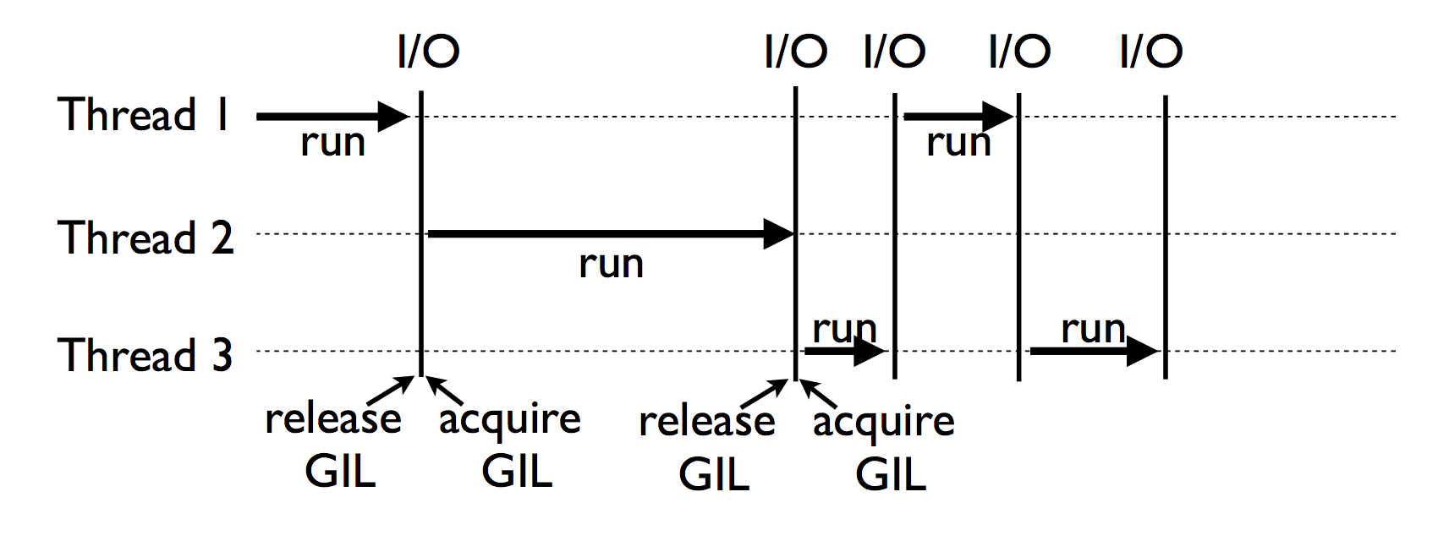
Global Interpreter Lock (GIL) in CPython
A lock is a mechanism of forcing limits on access to a resource in an environment where there are many threads of execution
Two methods
acquire()
release()
Notes:
The global interpreter lock is a very important concept in python, which many python users take for granted without really knowing what, why or how it works. To do HPC code with python, its good to have an understanding of what it is
So, locks are mechanisms to regulate the limit to common resources during situations where there are multiple threads. Locks have two methods, acquire and release. You can look a bit more into detail about this in your own free time
Because we are going to steer clear of threads, because there are in my opinion much better ways to parallelise and speed up your code.

Slide 16
Parallelisation Strategies for Python
Array based communications using NumPy
Using caching based techniques
JIT (just in time) compilation with Numba
Using extended Cython programming language
Embed compiled code in a Python program
C, Fortran
Utilise parallel programming
Multiprocessing, MPI
Use of libraries such as Dask for simpler methodologies
Notes:
For simple

Slide 17
Setting up
Log into Kay
Load modules
Create ssh tunnel
Open JupyterHub
Set up the environment
Notes:
Now we are going to spend the next while getting our jupyterhub set up.
First we will log into Kay, load the modules we need and then create an ssh tunnel. So work along with me, I will go slow at this point to make sure everyone is at the same point

