Slide 1

QuantEx : Project Kick-Off Efficient Quantum Circuit Simulation on Exascale Systems January 2020

Slide 2
Overview
Context PRACE 6IP WP8
Staffing
Timeline
Project management

Slide 3
PRACE 6IP-WP8
Objectives:
Deliver solutions in the form of high quality, transversal software that address challenges posed by the rapidly changing HPC pre-Exascale landscape to HPC users and scientific communities.
Advance strategic projects, selected in a transparent and competitive process, that require a long-term and significant dedicated effort.
Allow for disruptive approaches to modernize HPC software, leveraging of software technologies adopted, developed, and maintained by the big players in IT
10 Projects funded: Initial eight started mid 2019, final two January 2020
Key Performance Indicators (draft)
Percentage of projects that release software
Percentage of projects that run codes efficiently on pre exa-scale machines
Percentage of projects that are adopted by scientists

Slide 4
Staffing
Project is 22 months and 66 PM: 3 FTE (2 at ICHEC and 1 at LRZ)
Current estimates:
January to March: 0.93 – 1.33 FTE
ICHEC: Niall 60-80%, Lee 0-20% ~ 60-100%
LRZ: Luigi 33%
March onwards: 3 FTE
ICHEC: Niall 60%, Lee 40%, New hire 100%
LRZ: New hire 100%
Aim to make up 2-3 PM during busy times

Slide 5
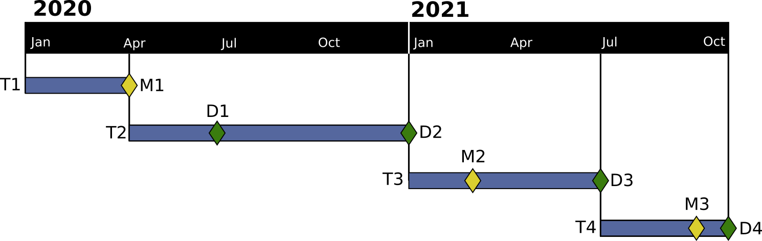
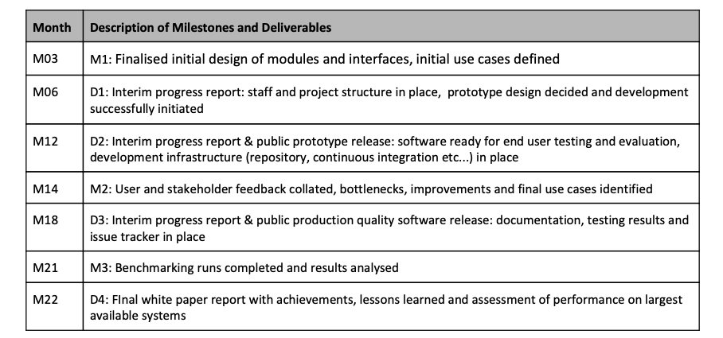
Timeline

Slide 6
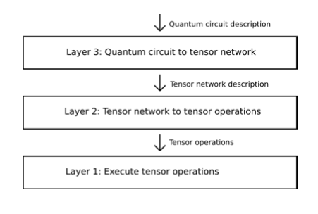
M01-M03 tasks
Identify simple use cases
Scripts which generate circuit descriptions QASM
End to end prototype (write one to throw away)
Evaluate available software:
ExaTensor
TAL-SH
CUTENSOR
Qflex
Itensor
…

Slide 7
Project Management
Gitlab for code and project management, central repository at ICHEC, mirror repository at LRZ and elsewhere as needed
Class C project created at ICHEC to get access to resources, test account at LRZ and will watch for access to pre exa-scale machines
Meeting every two weeks at initial project stages
Face to face meeting to be arranged for April/May
To arrange initial stakeholder/user meeting, suggestions for additional stakeholders welcome
Slack group (if possible to add external members)

