Slide 1

Quantum Natural Language Processing
Kick-off Meeting
14th January 2019
ICHEC, Dublin, Ireland

Slide 2
Agenda
Project overview
People at ICHEC and Intel
Execution plan
Work plan and timeline
Risk mitigation
Dissemination strategy
Logistics
Action points

Slide 3
Project overview
DisCo model
Distributional compositional semantics
NLP algorithm to compute meanings of two sentences and decide if their meanings match
Incorporates grammatical structure of sentences in a language into the analysis algorithms
“Closest vector problem” algorithm
Determine the word/phrase out of a set of words/phrases that has the closest relation to a given word/phrase
“CSC sentence similarity” algorithm
Compute the meaning of sentences/phrases and perform sentence similarity calculations
Objectives
Deploy Intel Quantum Simulator (qHiPSTER) on Kay
Implement DisCo model algorithms on qHiPSTER
Evaluate performance of DisCo model algorithms
NOTE: Proposal does not include comparison with a classic HPC implementation
Period: 14-Jan-2019 to 13-Mar-2020

Slide 4
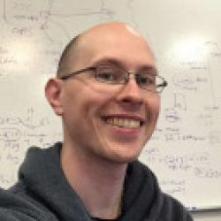
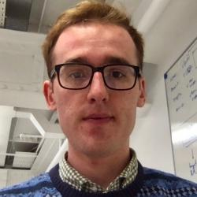

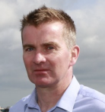
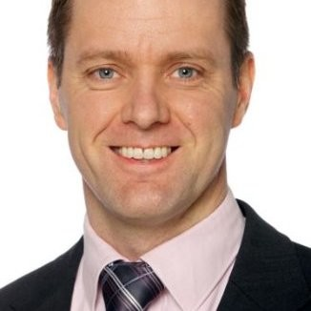
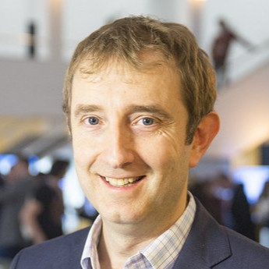
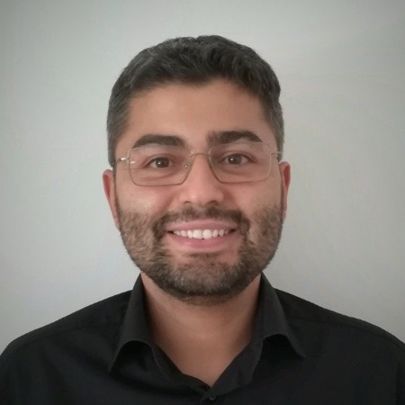
People at ICHEC and Intel
ICHEC
Researchers
Lee James O’Riordan
Myles Doyle
Venkatesh Kannan (PI)
Project manager
Peter Woods
Intel
Jim Kenneally (Lead)
Brian Quinn
Fabio Baruffa

Slide 5
Agenda
Project overview
People at ICHEC and Intel
Execution plan
Work plan and timeline
Risk mitigation
Dissemination strategy
Logistics
Action points

Slide 6
Work plan and timeline … (1)
Project executed through 4 tasks
Task 1 – Resource setup and problem mapping
Task 2 – Solution development
Task 3 – Solution evaluation and packaging
Task 4 – Technical report and handover
Meetings
Month | Location
M01 (Jan 2019) | Project kick-off meeting (ICHEC, Dublin, Ireland)
M01 – M14 | One meeting every 3 weeks (video conference and at Intel Ireland Campus, Leixlip, Ireland as needed)
M11 (Nov 2019) | Face-to-face meeting between ICHEC and Intel Quantum Computing team at SC 2019
M14 (Mar 2020) | Project closing meeting (Intel Ireland Campus, Leixlip, Ireland)

Slide 7
Work plan and timeline … (2)
Task 1 – Resource setup and problem mapping (M01 – M03)
Objective
Install and test the Intel Quantum Simulator (qHiPSTER) on the ICHEC supercomputer (Kay)
Define the strategy to map the quantum version of the DisCo model algorithm on the Intel Quantum Simulator.
Deliverables
D1.1 (M03): A report describing the abstraction of the quantum DisCo model algorithms for implementation on any quantum platform, and their mapping on qHiPSTER, along with testing and evaluation methodologies, and the representative corpora.
Milestones
M1.1 (M01): qHiPSTER is installed and tested on ICHEC’s Kay.
M1.2 (M03): Abstraction and mapping of DisCo algorithms on qHiPSTER is complete.
M1.3 (M03): Testing and evaluation methodologies are defined.
M1.4 (M03): Representative corpora for testing are ready.

Slide 8
Work plan and timeline … (3)
Task 2 – Solution development (M04 – M11)
Objective
Implement the DisCo module algorithms on qHiPSTER and perform preliminary evaluations.
Deliverables
D2.1 (M07): A report summarising the implementation, testing and evaluation of the “closest vector problem” algorithm using the representative corpora.
D2.2 (M11): A technical presentation at an Intel event at SC 2019.
D2.3 (M11): A report summarising the implementation, testing and evaluation of the “CSC sentence similarity” algorithm using the representative corpora.
Milestones
M2.1 (M07): Implementation of the abstract and qHiPSTER-specific code, and evaluation for the “closest vector problem” is complete.
M2.2 (M11): Implementation of the abstract and qHiPSTER-specific code, and evaluation for the “CSC sentence similarity” algorithm is complete.

Slide 9
Work plan and timeline … (4)
Task 3 – Solution evaluation and packaging (M12 – M14)
Objective
Perform extended evaluations and package the software solution along with results and documentation.
Deliverables
D3.1 (M14): A report describing the larger corpora, and summarising the final evaluations using the larger corpora.
D3.2 (M14): Final version of the abstract interface code for the DisCo algorithms, with documentation.
D3.3 (M14): Final version of the qHiPSTER-specific code for the DisCo algorithms, with documentation.
D3.4 (M14): A technical poster and presentation for ISC 2020.
Milestones
M3.1 (M14): Larger corpora for final testing and evaluation is ready.
M3.2 (M14): Final version of the DisCo algorithms implementations and evaluation is complete.

Slide 10
Work plan and timeline … (5)
Task 4 – Technical report and handover (M14)
Objective
Delivery of the software solutions and results to Intel.
Deliverables
D4.1 (M14): A consolidation of reports from deliverables D1.1, D2.1, D2.2, D2.3, D3.1, D3.3 and final software from deliverables D3.2 and D3.3.
Milestones
M4.1 (M14): Consolidated reports and final software are prepared.
M4.2 (M14): Deliverable D4.1 is published on a GitHub page under the Apache License version 2.0.

Slide 11
Risk mitigation
Risks | Steps for management
Installation and performance issues of the Intel Quantum Simulator (qHiPSTER) on the ICHEC Kay supercomputer. | The first task in the project work plan is to install and test qHiPSTER on the ICHEC supercomputer. Reservations can be made for this project on the Kay supercomputer to achieve the desired performance. The simulator developers from Intel will also be available to assist with solving installation and configuration issues.
Issues in mapping and/or implementing the DisCo model algorithms on the programming model of qHiPSTER. | The developers of qHiPSTER will be available to provide user support during implementation of the algorithms. Also, the authors of the DisCo model at the University of Oxford may be consulted for a deeper understanding of their algorithms.
Performance of the algorithm implementations is lower than expected and thus evaluation is delayed. | The size of the corpuses targeted for the evaluations may be reduced accordingly to achieve reasonable performance to get evaluation results.
Intel support is primarily sought for troubleshooting for installing and using the qHiPSTER platform.
What is the channel for ICHEC to raise a question or issue with Intel?

Slide 12
Dissemination strategy
Proposed
SC 2019
ISC 2020
Any others
Press release
2nd All Ireland Conference on Quantum Technologies at Maynooth University, 21-Jan-2019
EQTC 2020 (TBC)
Intel Technical Computing Roundtable 2020
Talk at a quantum computing workshop at UCD (TBC), Mar-2019
…

Slide 13
Logistics
ICHEC-Intel periodic meetings (proposed)
Once every 3 weeks
Mondays 11:00 (Irish time) starting 04-Feb-2019
Google meetings at https://meet.google.com/zvp-kmhp-pak
Hosting and delivery of code and reports
https://git.ichec.ie/intel-qnlp/intel-qnlp/
Currently public. Access restrictions?
Any other business?

Slide 14
Action points
Start technical tasks for M01 (ICHEC – VK, LOR, MD)
T1.1. Install and test the Intel Quantum Simulator (qHiPSTER) on Kay
T1.2. Investigate the DisCo model algorithms and define their mapping strategy on qHiPSTER
Set up periodic meetings on calendar (ICHEC – VK)
ICHEC-Intel meetings
ICHEC-internal meetings
Upcoming milestones
M1.1 (M01): qHiPSTER is installed and tested on ICHEC’s Kay.

