Slide 1
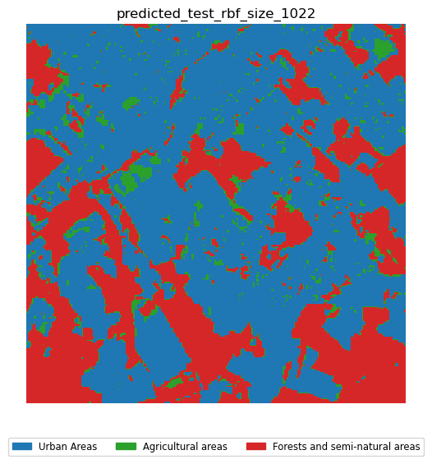
57, 342, …
Encode
Measure
Predict
SVM
Train
Probability
# of Excitations

