Slide 1
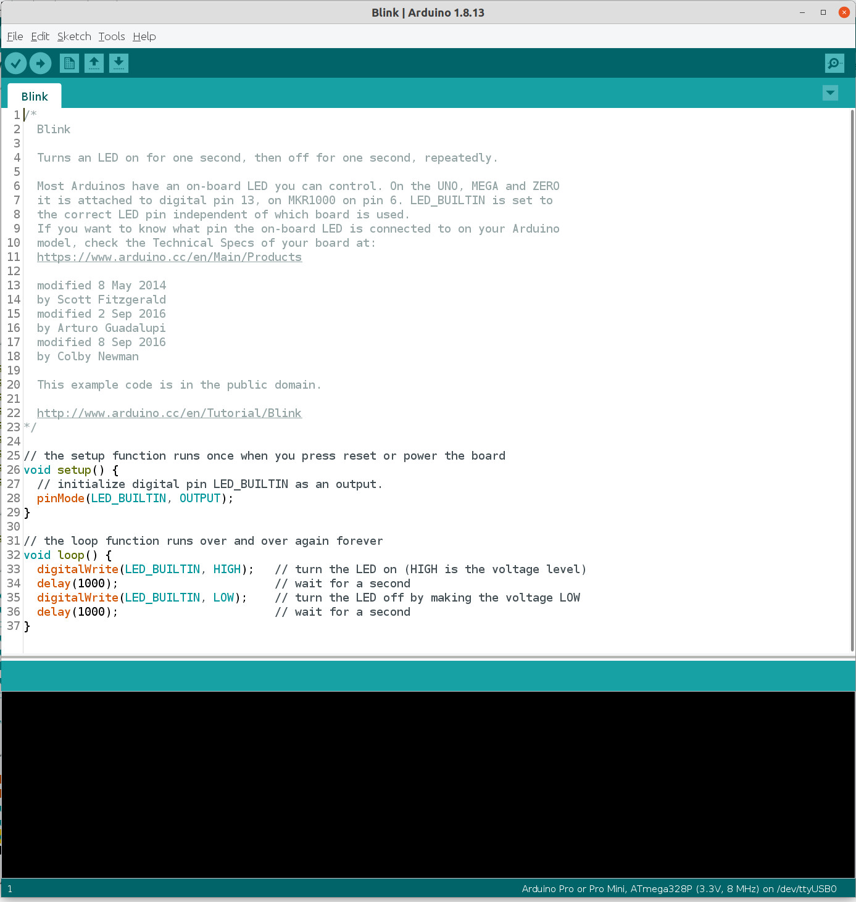
Compile and upload button
Compile button
Editor window
Info window

Slide 2
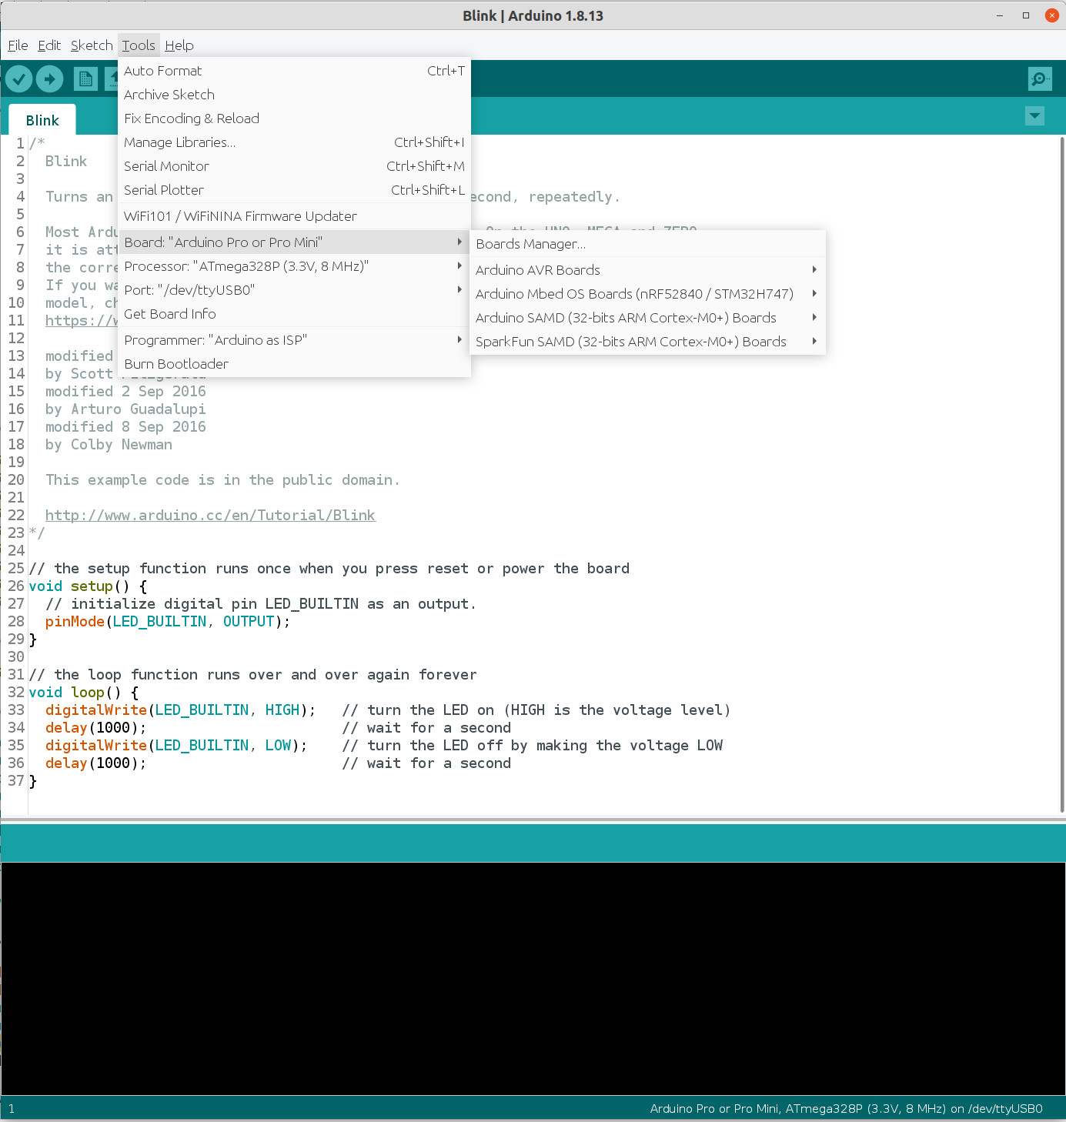
Select the correct board
Select the correct processor
Select the correct board

