Slide 1
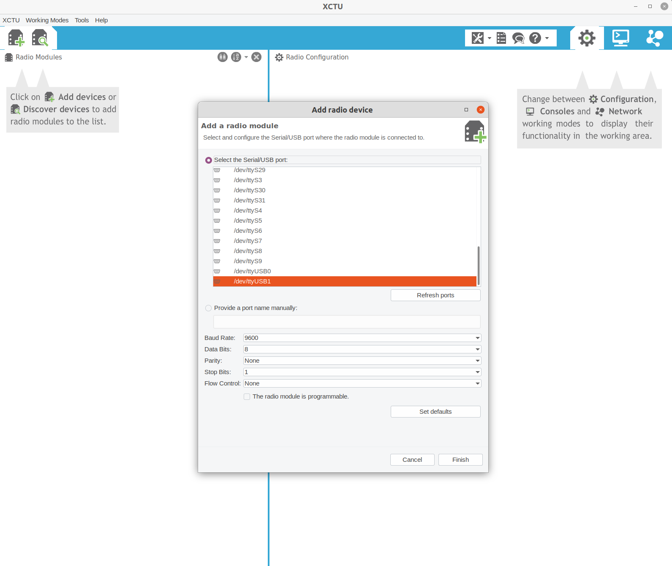
1. Click to connect
to the Xbee
2. Select the correct USB port
3. Keep the default
Parameters as shown here

Slide 2
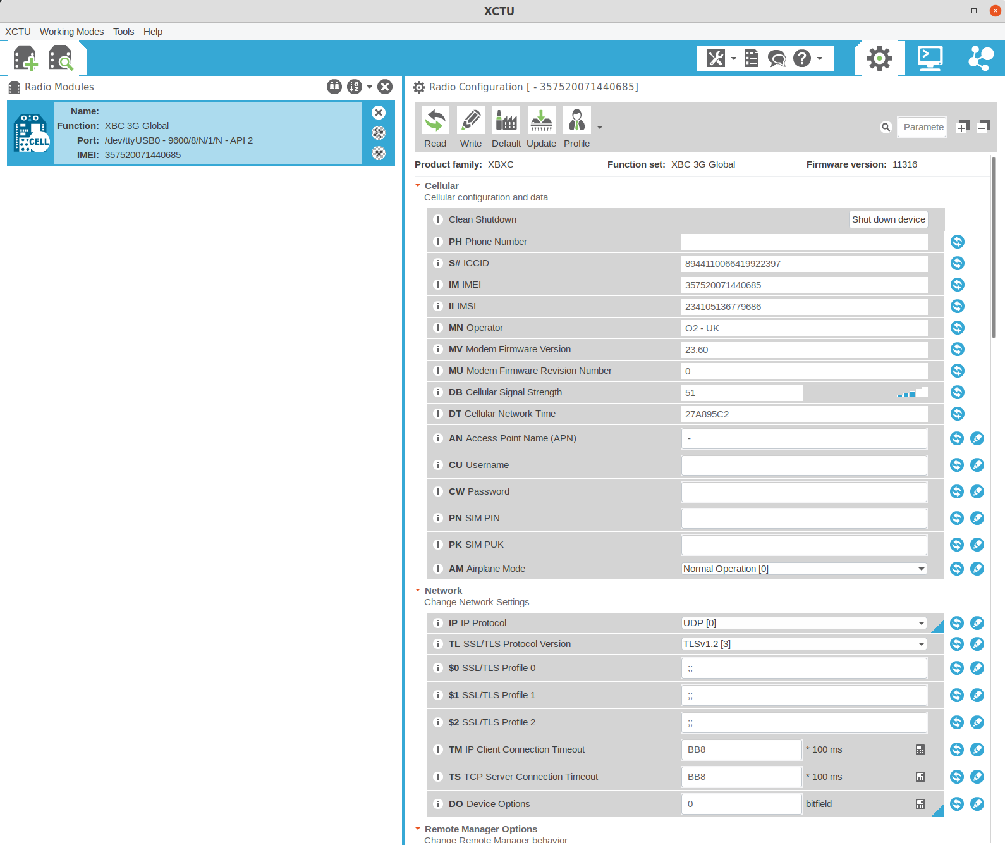
5. To update the parameter values shown,
Click “read”. To write any that you changed,
Click “write”.
6. If the radio contains a SIM card, and it is able to connect to the cellular network, then network characteristics such as the network operator and signal strength should appear here. This may take a minute, and you may need to click “Read” a few times to refresh the values.
4. If all goes well, the radio
should show up here.
Clicking it will show the right
hand pane.

