Slide 1
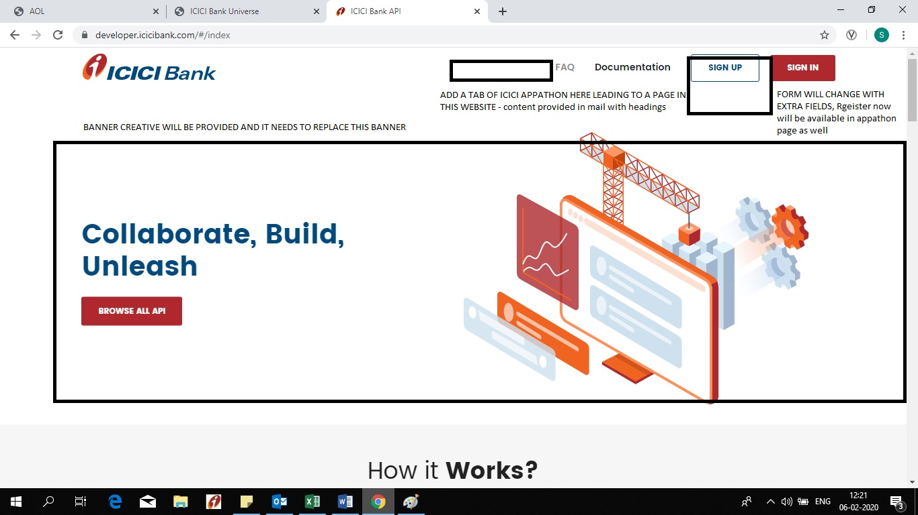
UI of homepage

Slide 2

Web banner

Slide 3
Registration field
On registration form, we require to capture following details of the startups
Team representative name
team name
Gender
Year of birth
Mobile
email
alternate gmail id
resident of india?
Startup name
participants - 1 to 4

Slide 4
User dashboard
On registration form, we require to capture following details of the startups
Team representative name
team name
Gender
Year of birth
Mobile
email
alternate gmail id
resident of india?
Startup name
participants - 1 to 4
PDF Insert field

Slide 5
Introduction
Introduction
ICICI Bank invites you to explore the world of payments innovation with the ‘ICICI Appathon’. We are looking for revolutionary ideas around the core theme of UPI 2.0.
Participants need to envision a new solution and use the diverse set of UPI, Financial Services and Partner APIs to create innovative minimum viable solutions. The solutions that surpass the currently available solutions in the market, give a superior and intuitive experience to the end user, will compete for the top prizes in the Grand Finale.
The selected top three winners will be awarded with a prize money of Rs. 10 lakh along with a potential engagement opportunity with ICICI Bank. They will also have a potential opportunity to be mentored by the programme partners.
So get started and register now!

Slide 6
Programme Detail
Programme Details
ICICI Bank Appathon will be conducted in 3 phases:
Phase 1: Participants need to register by providing a brief summary of the idea and identify categories of APIs which will be used for creating the solution.
Phase 2: Shortlisted participants will be provided with access to all APIs on the partner patform/ ICICI Bank developer platform and they will have to submit a video demonstrating a minimum viable solution, ICICI Bank’s API usage and business benefits.
Phase 3: Finalists will be invited to ICICI Bank Towers, BKC, Mumbai to present their minimum viable solution to an eminent Jury.

Slide 7
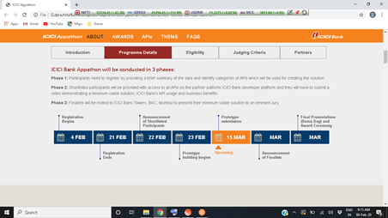

Slide 8
Eligibility
Eligibility
All participants must adhere to the following criteria to participate in the programme:
This programme is open to companies and individuals.
This programme is also open to companies who have previously sold, licensed or otherwise provided services and/or similar solutions to ICICI Bank.
This is a team participation programme. You can have at most 5 members in a team.
In order to participate, the team needs to use at least one of the listed UPI APIs on the site. The theme of this Appathon is UPI 2.0, so participants are recommended to focus on the features of UPI 2.0 (i.e., Mandate, Linking overdraft account on UPI, Signed Intent and QR, Invoice in the Box (View and Pay). Participants are also encouraged to use the Partner APIs in the Appathon. Usage of at least one UPI API would be mandatory for solution to qualify.
You may use any other open source libraries available elsewhere.
By participating in the Appathon, you agree to the Terms and Conditions.

Slide 9
Judging criteria
Judging Criteria
Since ICICI Bank is seeking innovative ideas and solutions, there is no single criterion on which we will judge your submission. However, keeping in mind the core theme of UPI 2.0 and broad objectives of the Appathon, following metrics can be used as an indicator of how the evaluation will happen to determine finalists and overall award recipients:
The judges reserve the right to provide a participant who applies for one category with an award from another category, at their sole discretion.
The decisions of the judges are final and binding. If we do not receive a sufficient number of entries meeting the entry requirements, we may, at our discretion, select fewer winners than described.
In the event of a tie between any eligible entries, an additional judge will break the tie based on the judging criteria described above.
Evaluation Criteria |  | Weightage
Implementability of Idea |  | 20%
Innovation around UPI (2.0 and 1.0) |  | 50 %
Overall Final Solution | Completeness of the solution | 10%
 | Business Potential, relevance & Scalability | 10%
 | User Experience | 10%

Slide 10
FAQ
Frequently Asked Questions
How is the ICICI Appathon structured?
Is the registration for the Appathon free?
What is the eligibility criteria?
Can I register as an individual?
Will everyone who registers be eligible to participate?
I am not resident in India, can I still participate?
How many people can be in my team?
What is the scope of the ICICI Appathon?
In Phase 1, do participants need to share complete details of the solution?
In Phase 2, do participants need to share a “minimum viable solution”?
In Phase 2, how do I submit what I have made?
In Phase 2, is there any specific technology / language to be used for building up the project? Will you provide any IDE and DB for us to work on ideas?
In Phase 2, do we need to build a Mobile Application?
In Phase 2, do we need to have the entire idea fully working?
Are the participants required to be online for the entire duration of the programme?
If I am a finalist, where will I present on the Grand Finale?
In case of team, do all team members also have to be present during the Grand Finale?
Can I demonstrate my solution remotely during the Grand Finale?
Will ICICI Bank pay for my company / my team / my trip?
What should I bring to the Grand Finale?
What criteria will the judges use to evaluate the prototypes?

Slide 11
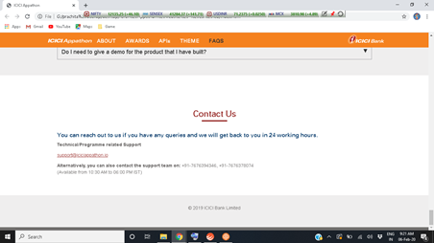
Contact us

