Slide 1

A Visual-Pilot Deep Fusion
for Target Speech Separation
in Multitalker Noisy Environment
Yun Li, Zhang Liu, Yueyue Na, Ziteng Wang, Biao Tian, Qiang Fu
汇报人：孙世宇
汇报时间：2024-09-05
[1]Y. Li, Z. Liu, Y. Na, Z. Wang, B. Tian and Q. Fu, "A Visual-Pilot Deep Fusion for Target Speech Separation in Multitalker Noisy Environment," ICASSP 2020 - 2020 IEEE International Conference on Acoustics, Speech and Signal Processing (ICASSP), Barcelona, Spain, 2020, pp. 4442-4446, doi: 10.1109/ICASSP40776.2020.9054263.

Slide 2
01
PART ONE
文章贡献

Slide 3
文章贡献
本文的主要贡献:
1)面部检测的部署和目标谈话者的选择;
2)预提取目标说话者的低维手工视觉特征(先导视觉特征);
3)采用低成本的视听深度融合架构估计分离掩模;
4)在公共数据集上不同测试条件下与说话人无关的分离性能比较;
5)在模拟真实数据集上的目标语音识别性能及其处理多个可见源的灵活性。

Slide 4
02
PART TWO
相关工作

Slide 5
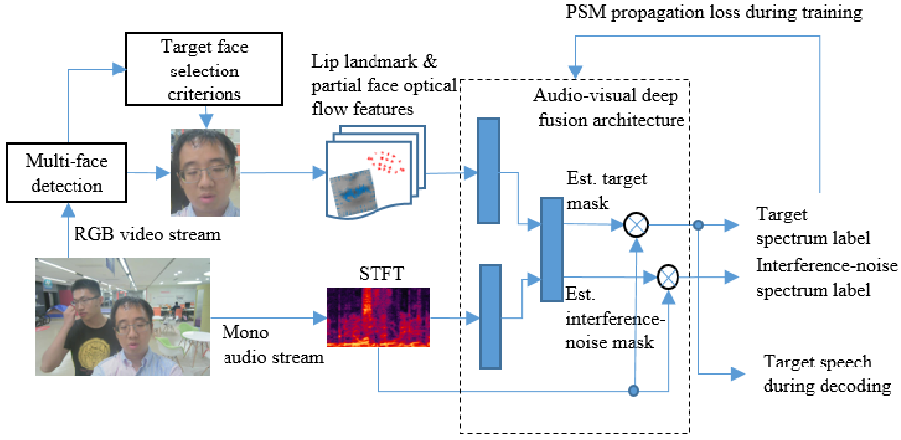
网络模型
首先对视频流进行人脸检测算法处理，检测出多个可见的人脸。然后根据他/她的职位、着装、性别和年龄等一些标准来选择目标谈话者，这在很大程度上取决于商业利益。利用目标人脸提取唇形地标和部分人脸光流特征。使用短时傅里叶变换(STFT)来创建单声道音频的时频特征。然后利用视听特征训练融合体系来估计目标和干扰噪声源的掩模。
[1]
[1]Y. Li, Z. Liu, Y. Na, Z. Wang, B. Tian and Q. Fu, "A Visual-Pilot Deep Fusion for Target Speech Separation in Multitalker Noisy Environment," ICASSP 2020 - 2020 IEEE International Conference on Acoustics, Speech and Signal Processing (ICASSP), Barcelona, Spain, 2020, pp. 4442-4446.

Slide 6
实验设置
&
结果分析
03
PART THREE

Slide 7
实验设置
数据集：GRID，NTCD-TIMIT
评估指标：SDR,PESQ,WER

Slide 8
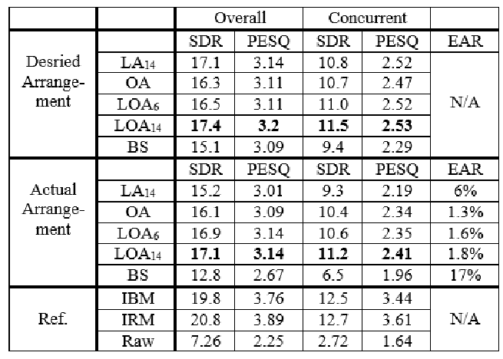
结果分析与对比
[1]
[1]Y. Li, Z. Liu, Y. Na, Z. Wang, B. Tian and Q. Fu, "A Visual-Pilot Deep Fusion for Target Speech Separation in Multitalker Noisy Environment," ICASSP 2020 - 2020 IEEE International Conference on Acoustics, Speech and Signal Processing (ICASSP), Barcelona, Spain, 2020, pp. 4442-4446.

Slide 9
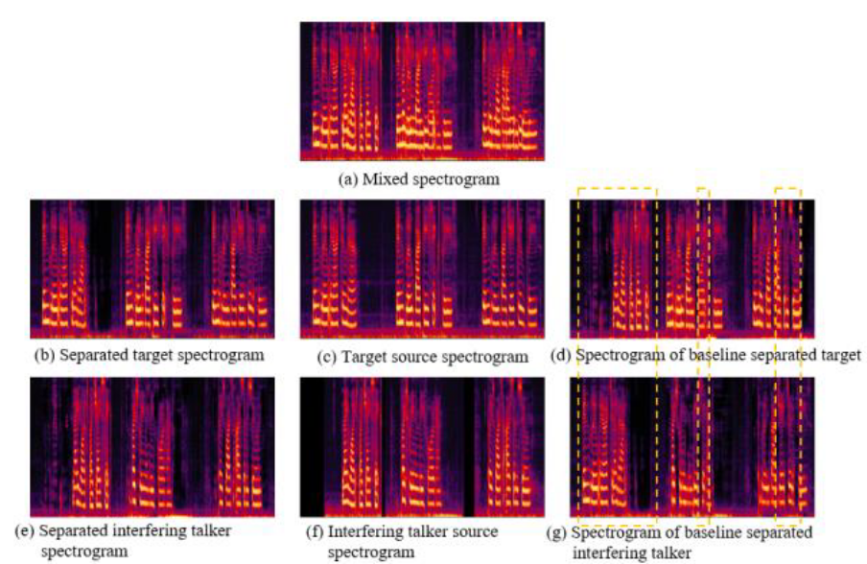
结果分析与对比
[1]
[1]Y. Li, Z. Liu, Y. Na, Z. Wang, B. Tian and Q. Fu, "A Visual-Pilot Deep Fusion for Target Speech Separation in Multitalker Noisy Environment," ICASSP 2020 - 2020 IEEE International Conference on Acoustics, Speech and Signal Processing (ICASSP), Barcelona, Spain, 2020, pp. 4442-4446.

Slide 10
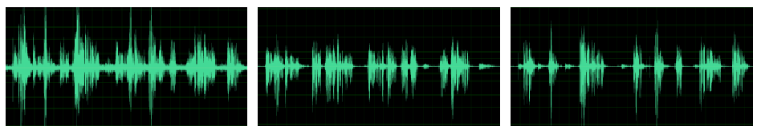
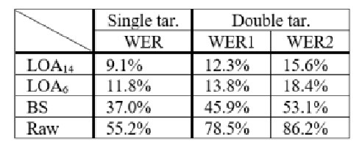
结果分析与对比
[1]
[1]
[1]Y. Li, Z. Liu, Y. Na, Z. Wang, B. Tian and Q. Fu, "A Visual-Pilot Deep Fusion for Target Speech Separation in Multitalker Noisy Environment," ICASSP 2020 - 2020 IEEE International Conference on Acoustics, Speech and Signal Processing (ICASSP), Barcelona, Spain, 2020, pp. 4442-4446.

Slide 11
04
PART FOUR
总结

Slide 12
总结
在这项工作中，提出了一种视觉导航深度融合方法，以有效地将看不见的“可见”目标语音从多说话者噪声环境中分离出来。与最先进的PIT方法相比，总体分离性能显着提高，同时有效地解决了通话者排列问题,只需学习单个模型即可处理多个可见源，节省了特征和建模的复杂性。未来的工作将侧重于将这种方法扩展到多渠道案例，以进一步改进和实时实施。

Slide 13
汇报完毕，感谢聆听
汇报人：孙世宇
汇报时间：2024-09-05

