Slide 1
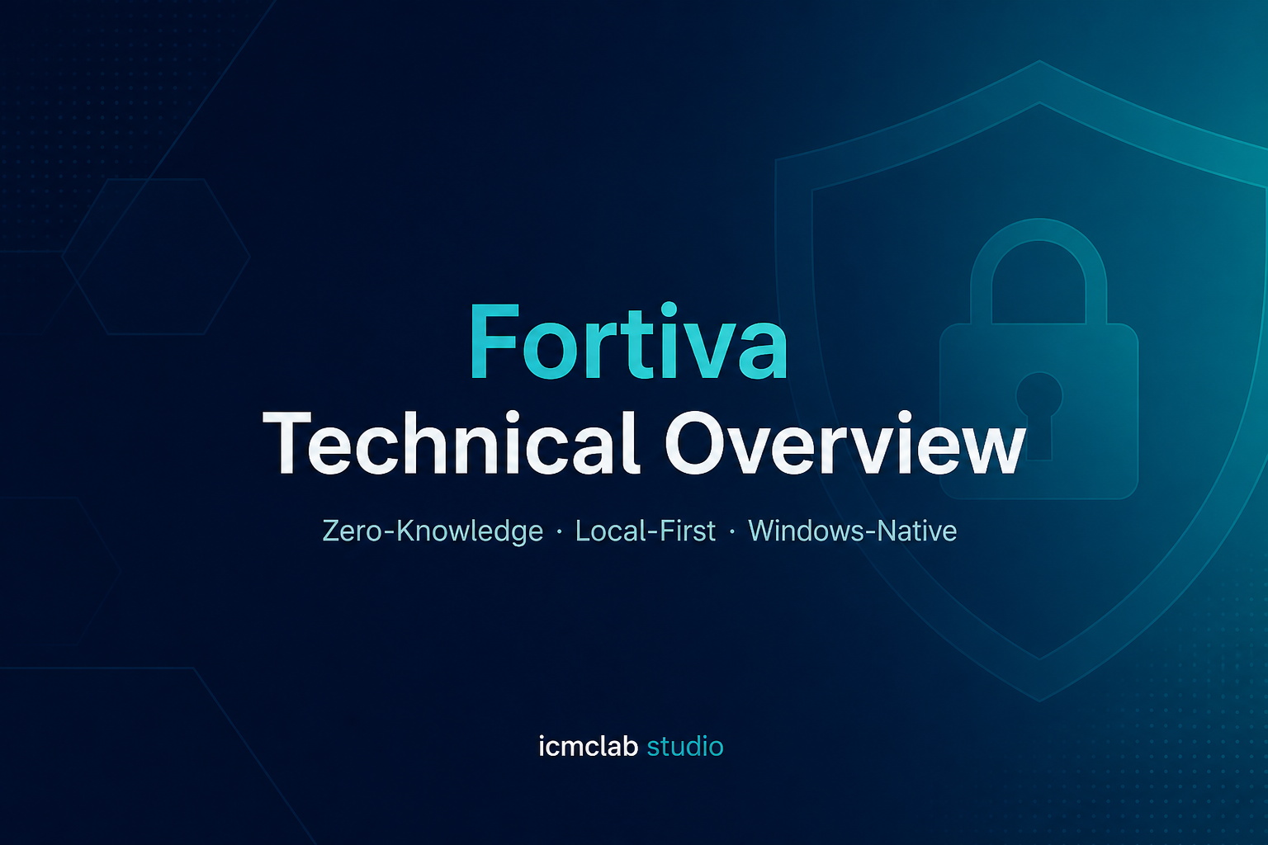
Fortiva Technical Overview
Zero-Knowledge · Local-First · Windows-Native | icmclab studio

Slide 2
What Fortiva Is
Fortiva is a Windows-native password manager built on WinUI 3 and .NET 8.
Zero-knowledge: your master password is never stored. Only derived keys and encrypted blobs exist on disk.
Local-first: no cloud sync, no telemetry, no background service when the app is closed.
Living off the land: AES-256-GCM via Windows CNG, DPAPI for local metadata, Argon2id for KDF.
Three shipping applications plus CLI tools and a browser extension bridge.
Notes:
Audience may include IT, security reviewers, and developers. Emphasize offline operation.

Slide 3
Solution Components
Fortiva.Core — shared library: vault format, crypto, policy, audit, browser bridge server.
Fortiva.Personal — free WinUI app for individuals (%APPDATA% vault).
Fortiva.Enterprise — licensed WinUI app with IT policy, seats, shared vaults.
Fortiva.Admin — IT console (requires Administrator) for license, policy, shared vault config.
Fortiva.LicenseTool — CLI to generate RSA keys and sign enterprise licenses.
Fortiva.BrowserBridge.Host — native messaging host for Chromium/Edge extension.
extension/ — browser extension (local-only credential fill via named pipes).

Slide 4
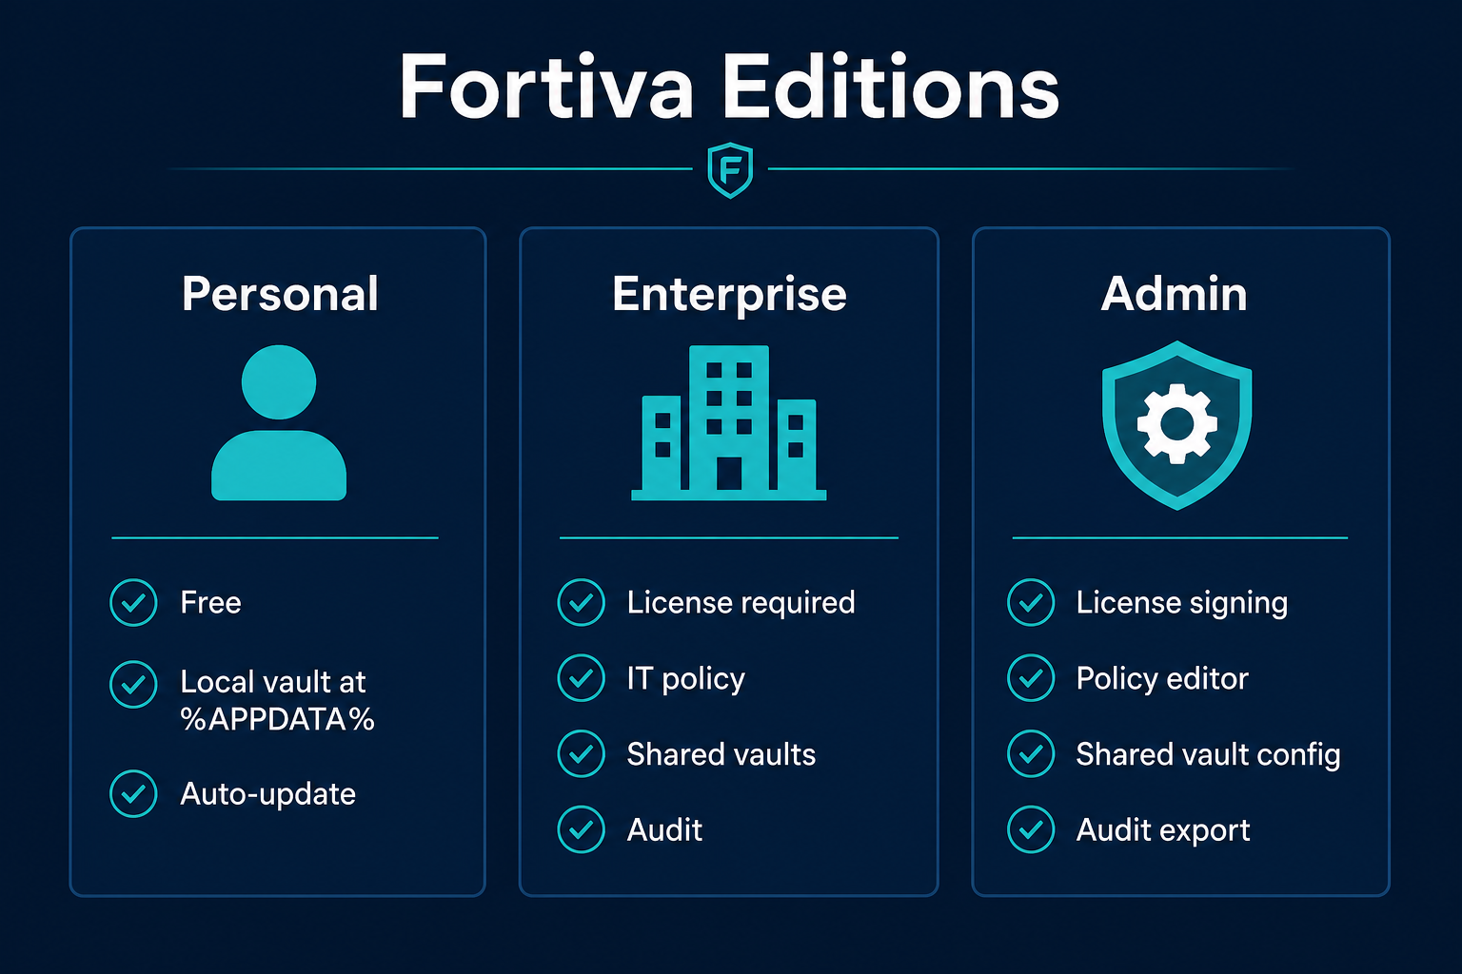
Three Editions (Who Uses What)
Personal: individual users, vault at %APPDATA%\Fortiva\vault.fva, optional auto-update check.
Enterprise: business users, vault default %PROGRAMDATA%\Fortiva, license + policy required.
Admin: IT staff only, does not store end-user passwords; manages license.dat and policies.json.
Enterprise users pick shared vault paths configured by Admin in Settings.
All editions share the same .fva vault cryptography and Fortiva.Core engine.

Slide 5
Part 1 — Vault Cryptography

Slide 6
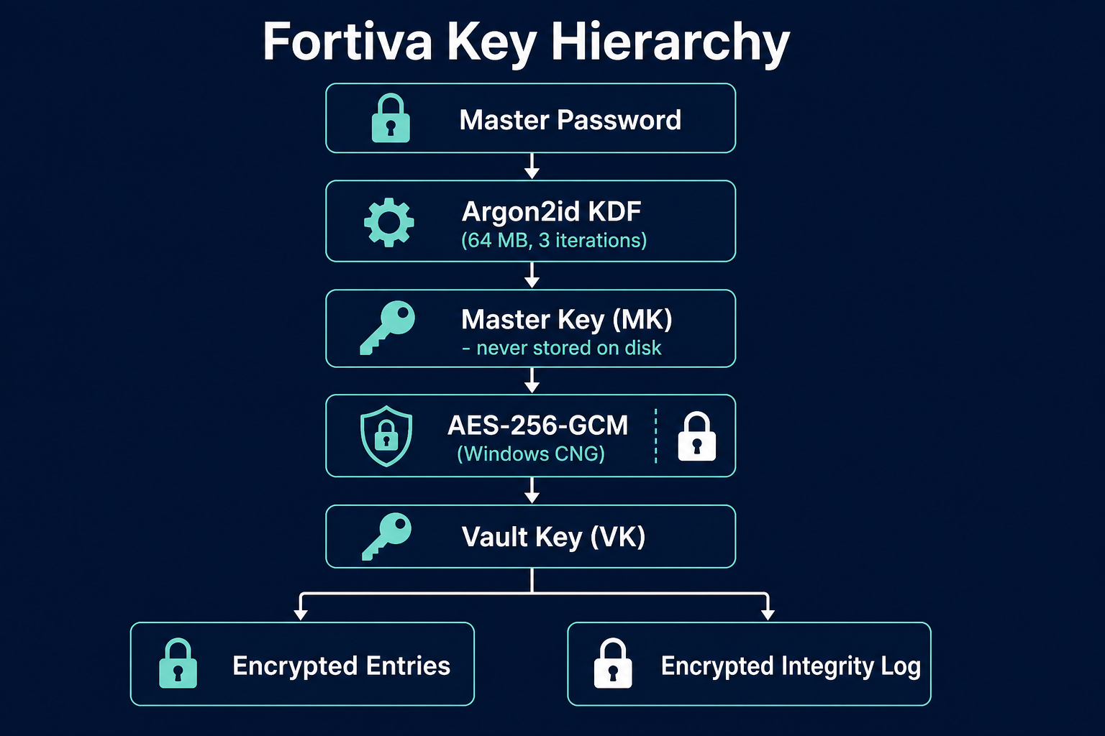
Zero-Knowledge Model (Explicit)
YOU know: master password (never written to disk by Fortiva).
DISK contains: encrypted vault file, wrapped vault key, salts, KDF parameters, DPAPI metadata.
MEMORY (while unlocked): Master Key (MK) and Vault Key (VK) — wiped on lock/panic.
Fortiva cannot reset your master password. Loss = no recovery unless you have a backup export.
IT admins can set policy and license but cannot decrypt vault entries without the master password.
Notes:
Walk through that MK is derived on every unlock and zeroed after lock.

Slide 7
Argon2id Parameters (From Source Code)
Profile | Memory (KB) | Iterations | Parallelism | Typical use
PersonalDefault | 65,536 (64 MB) | 3 | 4 | Fortiva Personal new vaults
EnterpriseMinimum (policy floor) | 131,072 (128 MB) | 4 | 4 | Strict enterprise policy default
Paranoia | 262,144 (256 MB) | 5 | 4 | Paranoia security level / mandatory policy
Notes:
Implementation: Isopoh.Cryptography.Argon2, Argon2Type.HybridAddressing, Argon2Version.Nineteen.

Slide 8
Key Hierarchy (Step by Step)
1. User enters master password at unlock.
2. Argon2id derives 32-byte Master Key (MK) using per-vault salt + stored KDF parameters.
3. MK unwraps Vault Key (VK) from header field wrapped_vault_key (AES-256-GCM).
4. VK decrypts entries blob and integrity log blob inside vault.fva.
5. On lock: MK/VK zeroed via CryptographicOperations.ZeroMemory; bridge token cleared.
Security levels: Standard, Enhanced, Paranoia — Paranoia uses stronger Argon2 profile.

Slide 9
Symmetric Encryption — Windows CNG
Algorithm: AES-256-GCM (authenticated encryption) through Windows CNG.
Header MAC: canonical header bytes authenticated under VK.
Payload: entries JSON + integrity log encrypted as separate GCM blobs.
Export backup: separate Argon2id + AES-GCM wrapper with user-chosen export password.
No custom crypto primitives — platform CNG and vetted Argon2 library (Konscious/Isopoh).

Slide 10
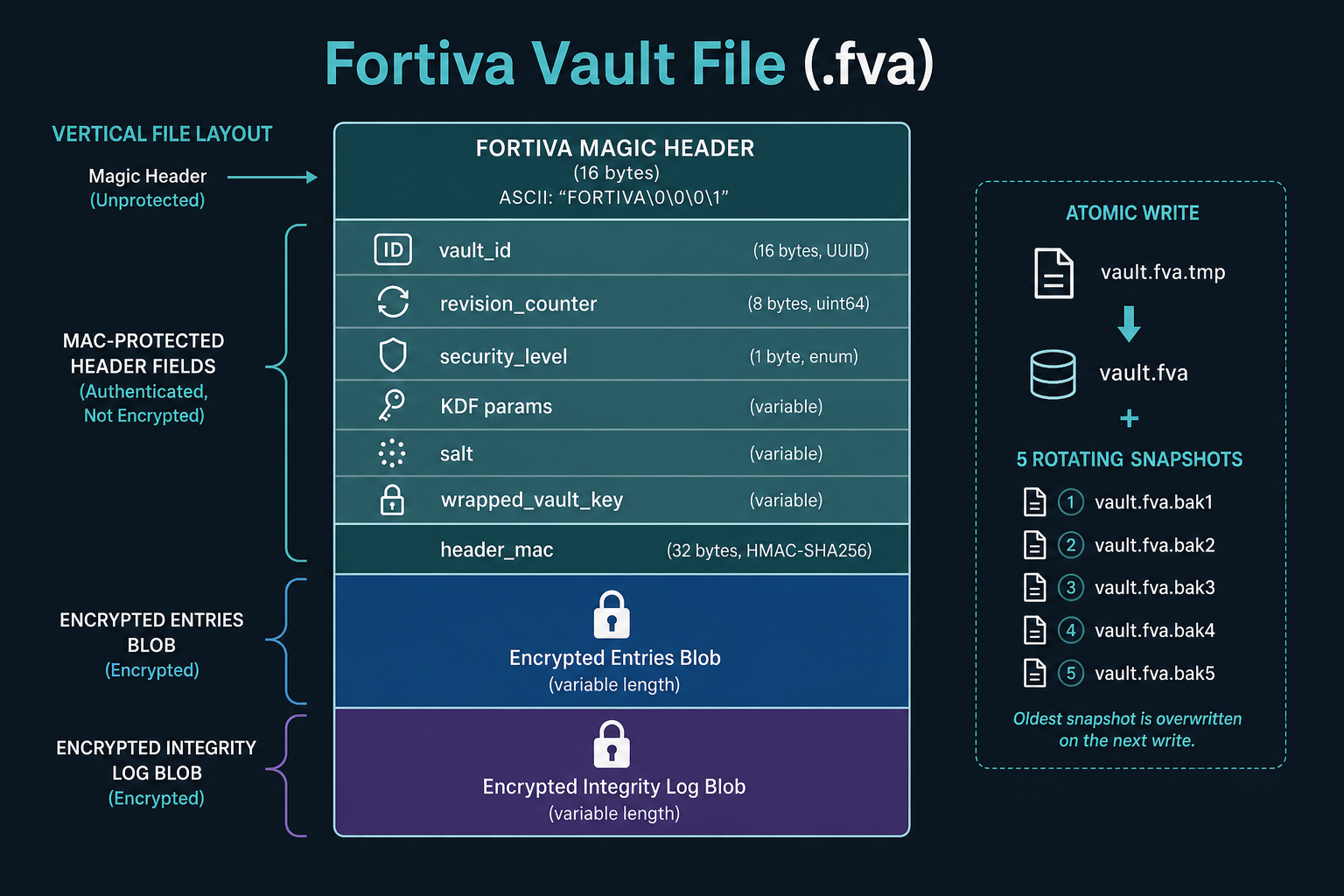
Vault File Layout (.fva)
Magic string FORTIVA then versioned header fields.
Header stores: vault_id (GUID), created/modified UTC, revision_counter, security_level_counter.
KDF blob, salt, wrapped_vault_key, header_mac.
Encrypted entries: titles, usernames, passwords, URLs, notes, TOTP secrets (Enterprise).
Encrypted integrity log: add/update/delete/import events for consistency checks.
Max vault file size enforced (VaultConstants.MaxVaultFileBytes).

Slide 11
Atomic Save + Snapshot Rotation
Write protocol: write vault.fva.tmp → flush to disk → File.Replace into vault.fva.
After each save, rotate snapshots: snapshot5 deleted, 4→5, 3→4, 2→3, 1→2, current→snapshot1.
Default SnapshotCount = 5 (vault.fva.snapshot1 … snapshot5).
Restore: unlock snapshot with password, verify, optionally replace live vault.
Protects against partial writes and some corruption scenarios.

Slide 12
Rollback & Paranoia Protection
Separate file local.state — DPAPI-protected metadata (Personal: CurrentUser, Enterprise: LocalMachine scope for vault dir).
Tracks: max security_level seen, last vault_id, last modified time, revision_counter.
If vault revision_counter decreases or security_level downgrades suspiciously → rollback detected.
Default behavior: vault opens READ-ONLY until user explicitly confirms rollback.
Paranoia Mode (user or policy): stricter posture; enterprise can mandate via MandatoryParanoiaMode.

Slide 13
Part 2 — Runtime & Data Locations

Slide 14
On-Disk Locations (Personal vs Enterprise)
Asset | Personal | Enterprise
Vault file | %APPDATA%\Fortiva\vault.fva | %PROGRAMDATA%\Fortiva\vault.fva (default)
local.state (rollback) | Same folder as vault | Same folder as vault
Windows Hello blobs | %APPDATA%\Fortiva\hello.* | %LOCALAPPDATA%\FortivaEnterprise\Hello\
Audit logs | %LOCALAPPDATA%\FortivaPersonal\audit\ | %PROGRAMDATA%\Fortiva\audit\
License / policy | N/A | %PROGRAMDATA%\Fortiva\license.dat, policies.json
Seat registry | N/A | %PROGRAMDATA%\Fortiva\seats.dat
Shared vault config | N/A | %PROGRAMDATA%\Fortiva\shared-vaults.json
Portable USB vault | User-selected path\Fortiva\vault.fva | Blocked by typical enterprise policy

Slide 15
Unlock Flow (End User)
App starts → checks vault.fva exists → Unlock page or Onboarding.
Password path: Argon2id → unwrap VK → decrypt payload → StartInfrastructure().
Hello path: UserConsentVerifier biometric/PIN gate → load DPAPI hello.keyprotect → MK.
Enterprise: valid license + seat available checked before unlock succeeds.
While unlocked: auto-lock timer, browser bridge pipes, clipboard policy enforced.
Lock/Panic: dispose session keys, stop bridge, clear in-memory bridge token.

Slide 16
Windows Hello (How It Works — No Assumptions)
Hello does NOT replace the master password cryptographically for vault creation.
Setup flow: user verifies master password → app copies MK from session → stores hello bundle.
Bundle format v3 (FTWH): random unlock key + MK wrapped with AES-GCM, then DPAPI-protected.
DPAPI scope: always CurrentUser (never LocalMachine) to prevent cross-user decrypt on shared PCs.
Unlock: UserConsentVerifier must succeed, then TryLoadMasterKey(helloVerified: true).
Limitation (documented): same-user malware could extract MK from DPAPI blob — Hello is a consent gate.

Slide 17
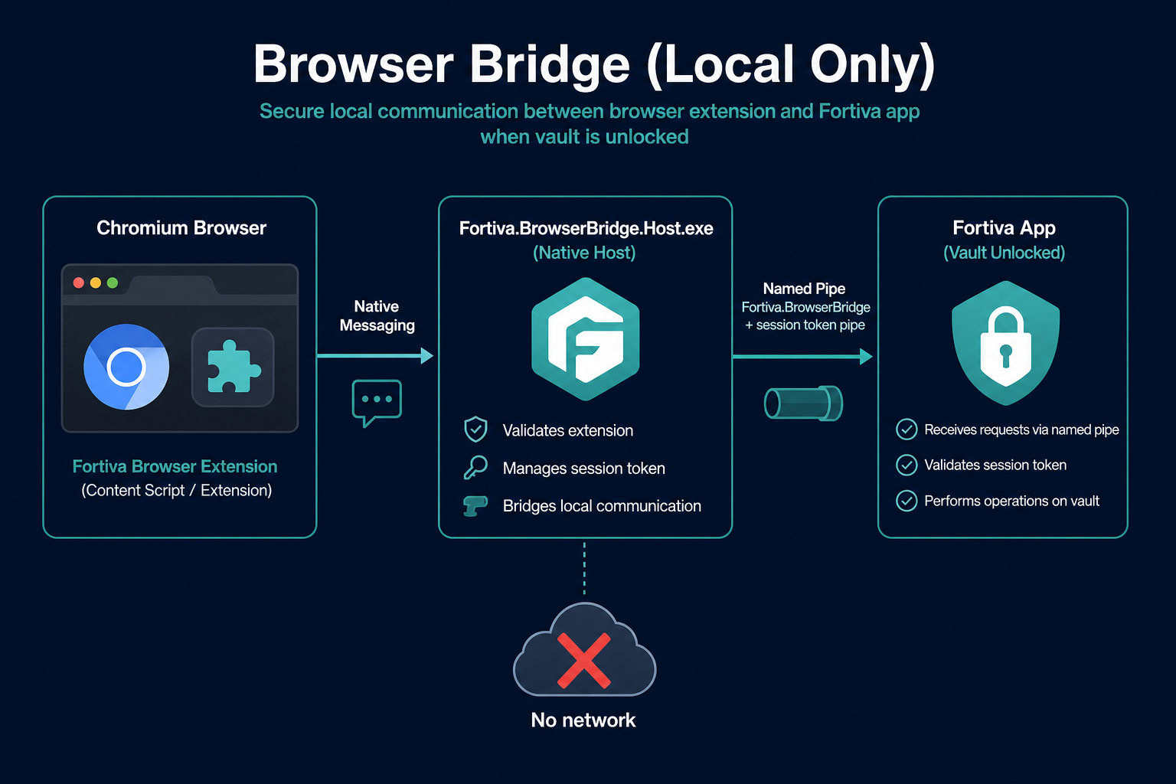
Browser Bridge Architecture
Extension never reads vault file directly.
Native host Fortiva.BrowserBridge.Host.exe receives JSON via Chrome native messaging.
Host requests session token from secured pipe Fortiva.Bridge.Token (in-memory, same user ACL).
Host connects to named pipe Fortiva.BrowserBridge with token + domain payload.
Fortiva app returns username/password for matching entry only while vault unlocked.
Client validation: bridge executable path checked against install roots (fail closed in release).

Slide 18
Part 3 — Enterprise Licensing & Policy

Slide 19
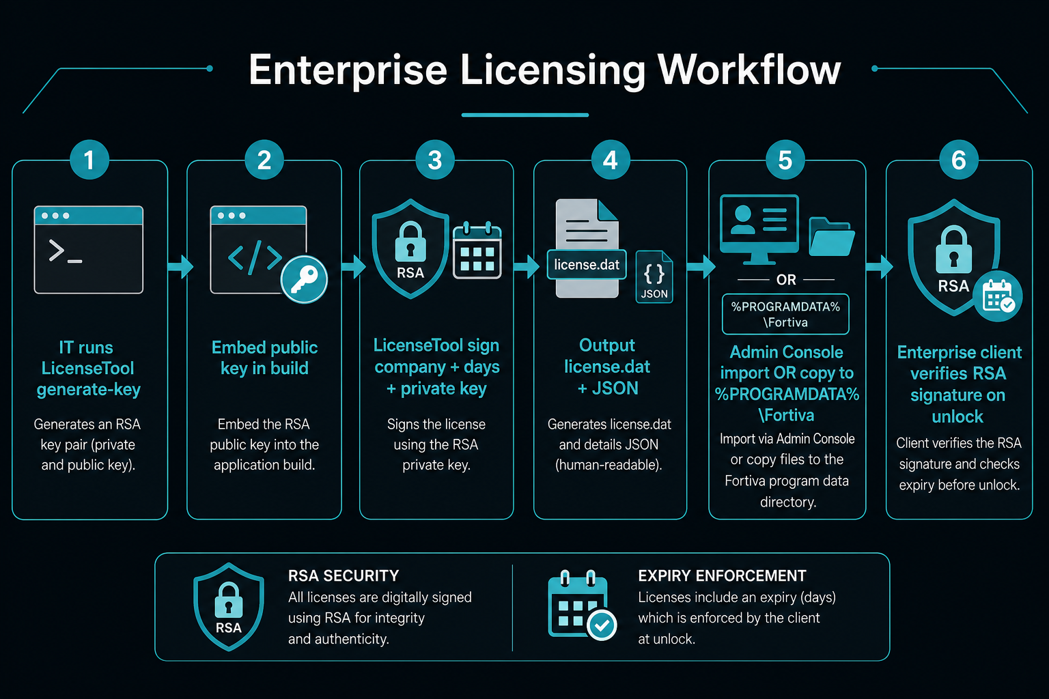
License Document Fields
Edition (default Enterprise), CompanyName, ExpiresAt (UTC).
FeatureFlags: vault, policy, audit, shared_vaults.
MaxSeats: enforced via LicenseSeatRegistry on enterprise unlock.
Signature: RSA-PKCS1-SHA256 over canonical JSON payload.
Storage: license.dat = DPAPI-protected (LocalMachine) under %PROGRAMDATA%\Fortiva\.
Portable distribution: signed .json file importable via Admin or TryImportFromFile.

Slide 20
LicenseTool — Step 1: Build the CLI
cd C:\Repo\Github\Fortiva
dotnet build src\Fortiva.LicenseTool\Fortiva.LicenseTool.csproj -c Release
# Run from repo (development):
dotnet run --project src\Fortiva.LicenseTool -- generate-key
Notes:
Release deployments ship LicenseTool beside Admin or as separate CLI.

Slide 21
LicenseTool — Step 2: Generate RSA Key Pair (First Time Only)
dotnet run --project src\Fortiva.LicenseTool -- generate-key
# Output:
# PUBLIC KEY → embed in LicenseVerifier.EmbeddedPublicKeyXml before production build
# PRIVATE KEY → save to secure file, e.g. C:\Secure\fortiva-private.xml
# NEVER commit private key to git.
# Release Enterprise/Admin builds fail if dev public key still embedded (unless DEBUG).
Notes:
Production: replace EmbeddedPublicKeyXml in LicenseDocument.cs / LicenseVerifier with your org public key.

Slide 22
LicenseTool — Step 3: Sign a License
# Syntax (from Program.cs):
# sign <company-name> <days-valid> <private-key.xml>
dotnet run --project src\Fortiva.LicenseTool -- sign "Acme Corp" 365 C:\Secure\fortiva-private.xml
# Writes:
# %PROGRAMDATA%\Fortiva\license.dat (DPAPI-protected, machine scope)
# .\fortiva-license-acme-corp.json (portable JSON for Admin import)
# Default MaxSeats in signer: 100 (edit LicenseTool Program.cs to customize).

Slide 23
LicenseTool — Step 4: Verify a License
# Verify portable JSON:
dotnet run --project src\Fortiva.LicenseTool -- verify .\fortiva-license-acme-corp.json
# Verify installed license.dat (no args — loads from %PROGRAMDATA%):
dotnet run --project src\Fortiva.LicenseTool -- verify
# Output shows: Company, Edition, Expires, Signature VALID/INVALID, Active status.

Slide 24
Deploying License to Clients
Option A — Admin Console: run Fortiva Admin as Administrator → License tab → Import License → pick .json or .dat.
Option B — MDM/script: copy signed license.dat to %PROGRAMDATA%\Fortiva\ (requires admin).
Option C — Intune: wrap installer + config (see packaging/intune/README.md).
Enterprise client loads license on startup; invalid/expired license blocks vault create/unlock.
Admin shows seat usage: CountActiveSeats() / MaxSeats from seats.dat.

Slide 25
Enterprise Policy Engine
policies.json — DPAPI LocalMachine protected at %PROGRAMDATA%\Fortiva\.
Fields: Min Argon2 memory/iters/parallelism, MaxAutoLockSeconds, clipboard mode/clear, ExportMode.
PortableModeAllowed, MandatoryParanoiaMode, MandatoryWindowsHello, TotpEnabled.
HKLM registry overrides: SOFTWARE\Fortiva\Enterprise\Policy (documented for Intune).
PolicyEnforcer applies floors in UI and Core (KDF, export, clipboard, security level on save).
Users cannot weaken below IT baseline; violations logged to audit trail.

Slide 26
Shared Vaults & Seat Enforcement
Admin → Shared Vaults tab: name + storage path (UNC/SMB/local folder).
Saved to shared-vaults.json (DPAPI LocalMachine).
Enterprise Settings → Shared vault combo: pick org vault or default %PROGRAMDATA% path.
Selection persisted in %LOCALAPPDATA%\FortivaEnterprise\user.prefs.json.
MaxSeats: seats.dat tracks machineId + userSid; stale seats pruned after 90 days.
New enterprise unlock blocked when active seats >= MaxSeats (existing seat refreshes LastSeen).

Slide 27
Audit Logging
Events: unlock attempt/success/failure, lock, policy violation, snapshot restore, bridge access.
Format: JSONL lines with HMAC-SHA256 signature (AuditIntegrity) — tamper detection.
HMAC key: .audit.hmac.key under audit directory, DPAPI LocalMachine protected.
Personal audit: per-user under FortivaPersonal\audit.
Enterprise audit: %PROGRAMDATA%\Fortiva\audit\ — exportable JSONL from Admin or client.
Exports contain metadata only — never passwords or master keys.

Slide 28
Part 4 — Operations & QA

Slide 29
Build & Test (Developer / IT Validation)
# Core + tests (no Visual Studio required):
dotnet build src\Fortiva.Core\Fortiva.Core.csproj -c Release
dotnet test tests\Fortiva.Core.Tests\Fortiva.Core.Tests.csproj
dotnet test tests\Fortiva.AppHost.Tests\Fortiva.AppHost.Tests.csproj
# Full release + installers:
.\build-release.ps1 -Version 1.0.x
.\build-installers.ps1 -Version 1.0.x

Slide 30
Import, Export & Backup
Encrypted export (.fva backup): re-encrypts vault payload with export password (Argon2id + AES-GCM).
Plaintext CSV: allowed on Personal with warning; enterprise policy can block (NoPlaintext).
Import: CSV/KeePass CSV while unlocked; bulk import with row/size limits.
Portable mode (Personal): vault on USB at …\Fortiva\vault.fva; startup prompt if drive missing.
Recommendation: periodic encrypted export stored offline separate from master password.

Slide 31
Threat Model Summary (What Fortiva Does NOT Claim)
Does NOT protect against kernel-level malware or memory scraping while vault is unlocked.
Does NOT provide cloud sync, account recovery, or master password reset.
Does NOT send vault data over the network (Personal may HTTPS check for updates only).
DOES protect offline vault at rest with Argon2id + AES-GCM + DPAPI layering.
DOES enforce enterprise policy, licensing, seats, audit, and rollback detection.
Full detail: docs/THREAT-MODEL.md, docs/SECURITY-PENTEST-REPORT.md, docs/FULL-AUDIT-2026.md.

Slide 32
Questions?
Repository: Fortiva | Docs: docs/UserManual.md | Support: icmclab studio

