Slide 1
Data Exchange Technologies: XML, EAI, Middleware

Slide 2




Police
Prosecution
Local
Agencies
Jail
Courts
Portals
Middle-
ware
Servers
Data
Warehouse
U.S.
Attorney
(Southern
District)
AOIC
(Polaris)
ISP
(ECHO)
DOC
SOS
CPD
(CLEAR)

Slide 3
XML for Justice Data Exchange
    Not specific to any database or information system
    Rapidly becoming widely accepted as means of information exchange between organizations
    Becoming widely supported by software vendors

Slide 4
What is XML?
A structured language for describing a electronic document sent by one agency to another (e.g. Arrest/ Incident Report)
Sets a standard for exchanging information electronically
Establishes an organizing template for the electronic document
Facilitates standards-based data exchange

Slide 5
XML Specifications
XML specifications do not dictate how the data is stored in sending or receiving systems
Specifications are broad enough to accommodate jurisdictional differences
Specifications are shared among states and federal justice agencies

Slide 6
XML Example
Section of the Criminal History Record (Rap Sheet)
<Ident>
<Name>
<Lname>Simpson</Lname><Fname>Homer</Fname>
<Mname>M</Mname><Suffix>Jr</Suffix>
</Name>
<FBI>62660NY12</FBI>
<SID>NY12345678></SID>
<SocSecNr>220565860</SocSecNr>
</Ident>

Slide 7
Smallville, Illinois Agency Data Elements (Purely Hypothetical)
XML Tag
Prosecutor data
Clerk’s Data
Probation Data
Police Data
<Lname>
CO-DEFNAME
SUB_NAME
PR_NAM
BAD_GUY
<FBI>
CO-DEFFBI
SUB_FBI
PR_FBI
BAD_GUYFBI
<SID>
CO-DEFSID
SUB_SID
PR_SID
BAD_GUYSID
<Race>
CO-DEFRAC
SUB_RACE
PR_RACE
BAD_GUYRACE
<Sex>
CO-DEFSEX
SUB_SEX
PR_SEX
BAD_GUYSEX
<SocSecNr>
CO-DEFSSN
SUB_SOC
PR_SSN
BAD_GUYSOC

Slide 8
Major XML Initiatives
Criminal Histories (Rap Sheets)
  Based on NIST standard
  FBI, States, NLETS, SEARCH
Law Enforcement Intelligence
  Regional Information Sharing Systems
Electronic Court Filing
  LegalXML and NCSC

Slide 9






Upper
Midwest
Justice
Consortium

Slide 10
Regional XML Standards
Allows regional sharing on common standards
Strengthens XML standards nationally
Mutual integration benefits between border states
Federal funding opportunities

Slide 11
Enterprise Application
Integration (EAI)
EAI – “A response to decades of creating distributed, monolithic, single-purpose applications leveraging a hodgepodge of platforms and development approaches. EAI articulates a solution to a problem that has existed since applications first moved from central processors.”
The ultimate solution is the “virtual” system, which allows all exchanges between systems to occur with no data reentry and in a manner that is invisible to users of the individual systems.
EAI allows any authorized user to access information no matter where the information is stored within the enterprise.
EAI should allow for multiple disparate systems to operate as one unified but secure system, while allowing for agency independence.

Slide 12
Middleware
Middleware provides the means of moving data between agencies and applications and can even format data on the fly, so that it will be received by foreign applications as if it were that application’s own data.
Middleware is the enabling technology of EAI. It performs timely delivery and transformation of data based on rules predefined by the owners of the various agency systems.
Middleware is simply a name for sophisticated and complex software that seamlessly pipes information between applications. Middleware provides bridges between many different systems in a way that creates a virtual system.
Notes:
These days, most enterprises have hundreds, maybe even thousands of databases and data-level EAI facilitates the seamless connection of these databases. Before these middleware tools were available, such integration was next to impossible.

Slide 13
Defender
“DockTrac”
Police
“PIMS”
Prosecutor
“Damien”
Middleware
Server
Jail
“CIMIS”
Probation
”Promis”

Slide 14
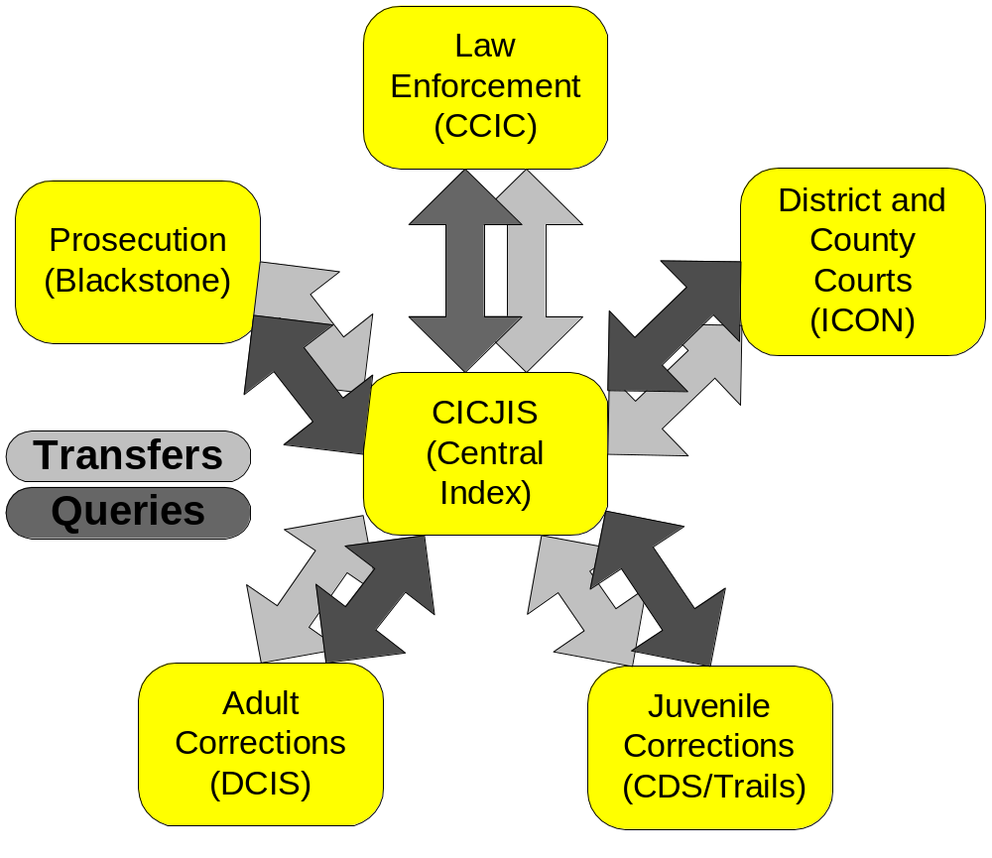
Colorado Middleware Solution

Slide 15
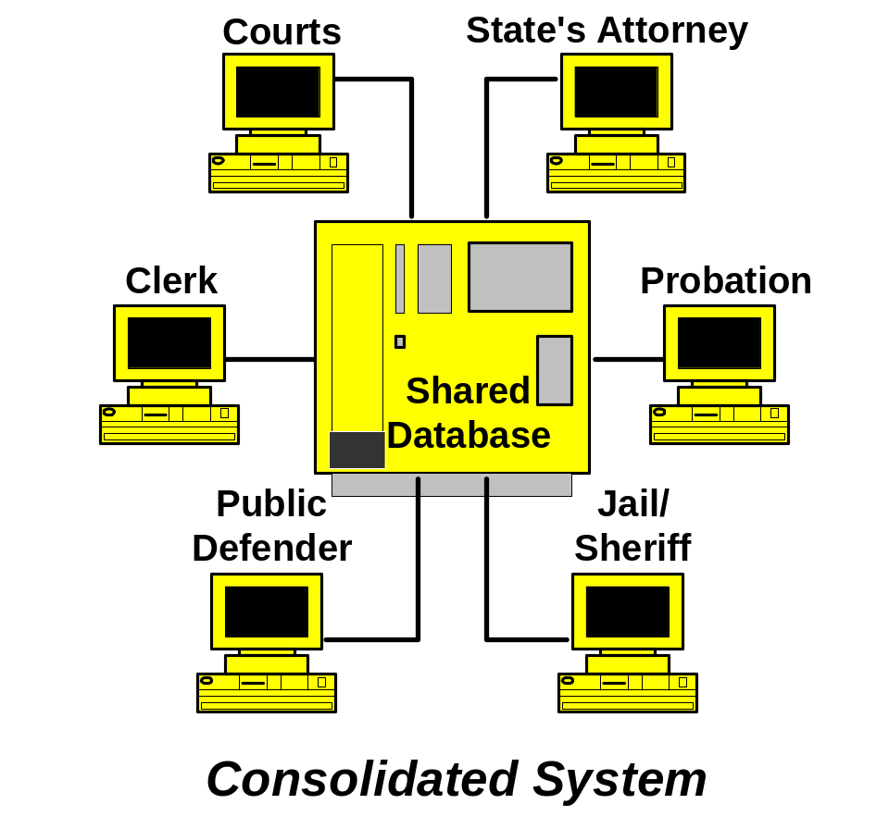
Consolidated Integration Solution

Slide 16
Police
Prosecution
Local
Agencies
Jail
Courts
Portals
Middle-
ware
Servers
Data
Warehouse
U.S.
Attorney
(Southern
District)
AOIC
(Polaris)
ISP
(ECHO)
DOC
SOS
CPD
(CLEAR)

