Slide 1

Illinois Justice Network

Slide 2
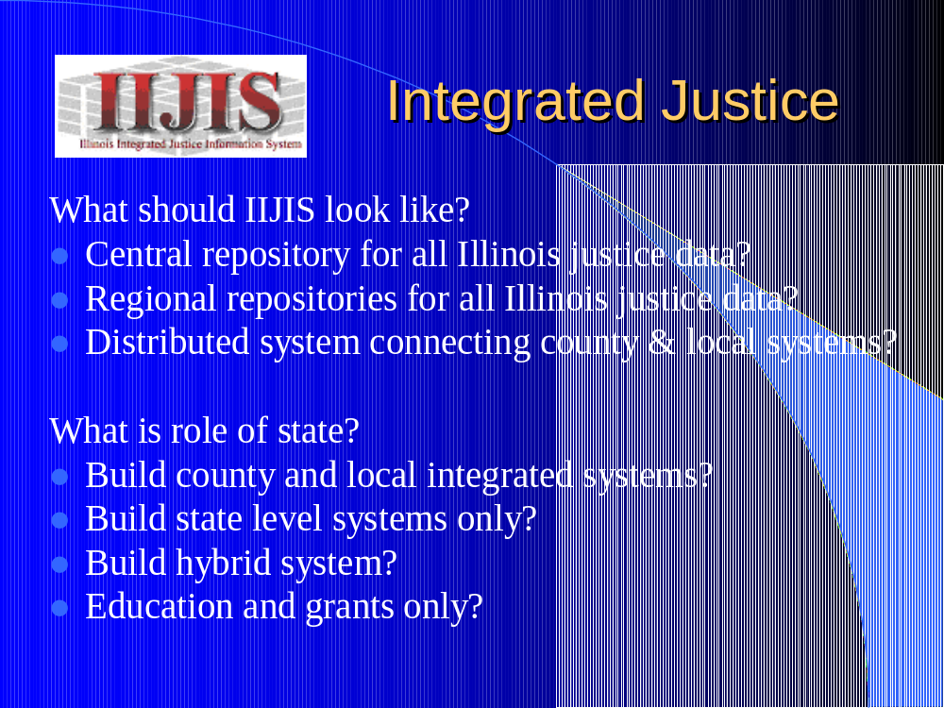

Slide 3
Integrated Justice
Strategic Plan
Scenario for Information Sharing
Inventory of Justice Information Systems & Networks
Survey of justice agencies & exchange points
Gap Analysis
The scenario, survey, and gap analysis suggest that two
areas of improvement are needed:
Improved access to state level systems
Development of county-level integrated justice

Slide 4
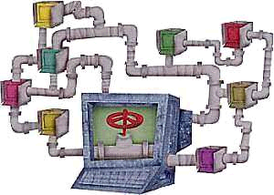
Illinois
Gap Analysis
Police
Current Technology
CHRI
LEADS
IDOC Offender Management System
AVN
SOS Data Systems
POLARIS (planned)
Police Needs
Improved Officer Safety Information
Probation Information
Parole Conditions
Digital Photos
Bond Information
Improved access to CHRI

Slide 5
Illinois
Gap Analysis
Courts
Current Technology
Police, prosecutor, and court case management systems:
  JIMS
  JANO
  Other Local Systems
Circuit Court Needs
The ability to accept electronic charging documents from police and prosecutors
The ability to transmit hearing dates & court generated documents electronically to other justice agencies in order to facilitate workflow

Slide 6
Illinois Justice Network
Hybrid Solution
Illinois Justice Network
Justice portal to access state systems
  LEADS (hot files, SOS, CCH)
  IDOC
  AVN
County Hub application to access local agencies & facilitate integration
  Core Data Transfer (booking data)
  Incident Data
Data warehouse for queries
  CHRI
  Incident data

Slide 7
Illinois Justice Network
Portal
Functionality
Criminal Justice Inquiry
Inmate Locator
  IDOC
  Cook County Jail
  AVN
Mug Shot
  CHRI or SOS
Secretary of State
Juvenile Inquiry
Master Name File
  SID/IR Look-Up

Slide 8
Illinois Justice Network
Portal
Criminal Justice Inquiry
“Google for COPS”
Single search that associates information from various sources
Applications to be Searched
LEADS (warrants, etc.)
CHRI
Sex offender
AVN
POLARIS
IDOC
Publicly available Internet sources (FBI most wanted)

Slide 9
Illinois Justice Network
County Hub
Applications
Link local jurisdictions to state applications
  LEADS & CHRI
  SOS
  AOIC
  AVN
Core data transfer to local jurisdictions
  Live Scan bookings
  Feed integrated justice at local level
Future development platform
  Standard RMS, court case, and jail management systems
  Share incident level data

Slide 10
Illinois Justice Network
Data Warehouse
Functionality
Store core data from systems that cannot bear workload of portal (AVN?)
Facilitate ad hoc queries
  CHRI
  Accessed through portal

Slide 11
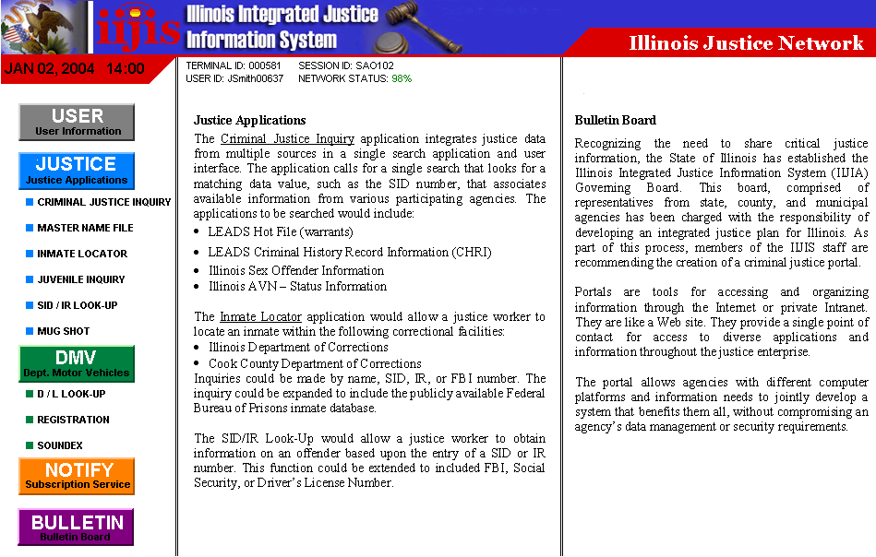

Slide 12
Illinois Justice Network
Next Steps
Determine capacity of systems to participate
  CHRI, AVN, IDOC, SOS, POLARIS, LEADS
Determine what data is needed from each agency
Determine the type of architecture that is needed
Determine the hardware that is needed
Develop incident level data system
Meet with JIMS and JANO
Develop tactical plan
????

