Slide 1

Illinois Justice Network Portal
Implementation Board Meeting
February 11, 2004

Slide 2
Illinois’ Integration Needs
The Strategic Plan identifies two areas of need for integrated justice in Illinois:
Improved access to and enhanced statewide justice information systems and county-level data stores, and
The development of county-level integrated justice systems

Slide 3
Research into Integrated Justice Models
Research focused on Illinois’ first integration need: Improved access to existing justice systems.
Nationwide, two principle architectures have been used to meet this type of integration need:
Centralized Repositories
Distributed Systems

Slide 4
Principle Integration Architectures
Centralized Repository
Unified database
Collects and stores information from multiple agencies
Each component of the justice system enters and retrieves data from the same computer system
Distributed System
No central repository
Each agency maintains its own information system
Users view published data thru a Portal by virtue of a middleware server
Presents a more pragmatic solution for Illinois’ integration needs

Slide 5
Justice Portals
Most jurisdictions engaged in justice information sharing efforts, whether county-level or statewide, have facilitated the sharing of justice information through the use of portals.
The Technical Committee identified several justice information portals currently in use throughout the nation.

Slide 6


Existing Justice Portals
Core arrest data transfer
Predefined queries
Secured e-mail & notification services
Juvenile justice data
Department of motor vehicles data
Mug shots
Public access component
Criminal history records
Juvenile justice data
Driver’s license photos
Inmate locations
Pre defined queries
Notification services

Slide 7


Existing Justice Portals
Minnesota court information
Arrest booking information
Statewide supervision data
Minnesota repository of arrest photos
Victim Information and Notification Everyday (VINE) data
Minnesota driver’s license records
Criminal history records
Warrant information
Driver’s license history
Court records
Restraining orders
Public access component

Slide 8
Existing Justice Portals
Business Requirements
These portal systems have all met some or all of the following business requirements of an integrated justice information system.

Slide 9
Existing Justice Portals
Business Requirements
The portals all provide:
Role-based views of subject data by authorized justice decision makers
Biometric and non-biometric based searches
Single point of access to multiple data stores
System-wide security policies
Ease of use, including meta-data
Regular timely updates of portal data

Slide 10
Existing Justice Portals
Business Requirements
The portals all provide:
Flexibility for future expansion
Policies and mechanisms to support privacy, authentication, and data integrity
Messaging infrastructure
Little or no impact on source agency production environment
Ongoing portal policy input/governance by stakeholders

Slide 11
Illinois Justice Network
Goals
The Illinois Justice Network portal will:
Function as a “virtual single system”
Record & update justice-related subject history and status information
Provide status information from a single point of access by a single inquiry

Slide 12
Illinois Justice Network
the Hybrid Solution
The Illinois Justice Network will consist of two primary components:
Justice portal to access state and county-level information systems.
  Data warehouse for queries
County Hub application to facilitate integration.
  Core data transfer

Slide 13
Illinois Justice Network
Existing State & County Justice Information Systems
Automated Victim Notification (AVN) system Illinois Attorney General’s Office
Victim Information and Notification Everyday (VINE) system Cook County
Criminal history repository (CHRI)
Law Enforcement Agencies Data System (LEADS)
Illinois Sex Offender Registry
Circuit court clerk data systems
(Cook and others)
I-CLEARS
IDOC offender management systems
Illinois Secretary of State data systems
Probation On-Line Automated Reporting Information System (POLARIS) AOIC

Slide 14
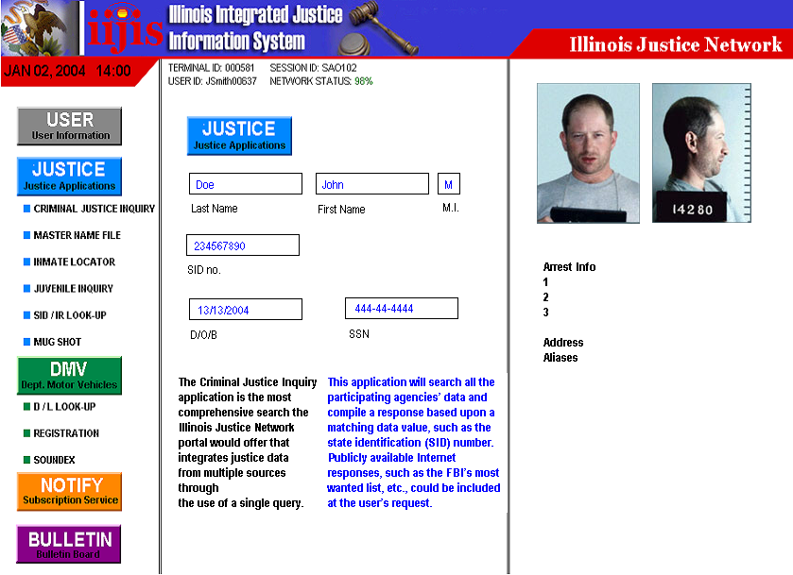
Illinois Justice Network
Expected Benefits
Criminal Justice Inquiry
Inmate Locator
Mug Shot
Secretary of State
Juvenile Inquiry
SID/IR Look-Up
Master Name File
Notification Service
Bulletin Board

Slide 15
Illinois Justice Network
Implementation
All the existing justice portals successfully addressed the following sophisticated technical and policy matters.
Most utilized the assistance of technology experts during portal planning and development.

Slide 16
Illinois Justice Network
Technological Matters
Assessment of the technological capacity of the justice information systems to participate in the portal
Development of standard IJN portal client
Utilization of Justice XML Data Model
Linking of subject records across systems
Centralized vs. distributed management of data quality
Establishment of record update procedures

Slide 17
Illinois Justice Network
Technological Matters
Leveraging existing telecommunication infrastructure
Conducting prototyping and pilot testing of the portal
Assessing the impact of recent and current justice IT initiatives on the portal
Identifying any additional technical skills necessary for portal development

Slide 18
Illinois Justice Network
Policy Matters
Determine the willingness of source agencies to participate
Establish the types of data from each system that will be accessible via the portal
Agree on the eligibility of users to access the portal
Identify any legal restrictions on access & use of portal data

Slide 19
Illinois Justice Network
Policy Matters
Determine the authority of IIJIS Board in post-implementation portal operations
Establish procedures for the acquisition, use, and management of funding
Decide whether individual users will bear any transaction costs beyond their telecommunications

Slide 20
Illinois Justice Network
Tactical Plan
IIJIS is at the optimal stage for requesting assistance from technology experts.
With that assistance, a tactical plan will be developed to successfully address the technological and policy matters confronting the portal.

Slide 21
Illinois Justice Network
Tactical Plan
The Tactical Plan will:
Outline the development of the portal
Address the technical and policy matters facing portal development
Contain project timelines for individual development phases
Provide performance and progress measures
Identify additional management and staffing needs
Include project cost estimates

