Slide 1

Report to the IIJIS
Implementation Board
October 20, 2004
Dale Good – SEARCH
Dave Usery – IJIS Institute

Slide 2

Recommendations
Governance
Detail Planning
Define Roles
Formalize a Project Management Office (PMO) Function

Slide 3
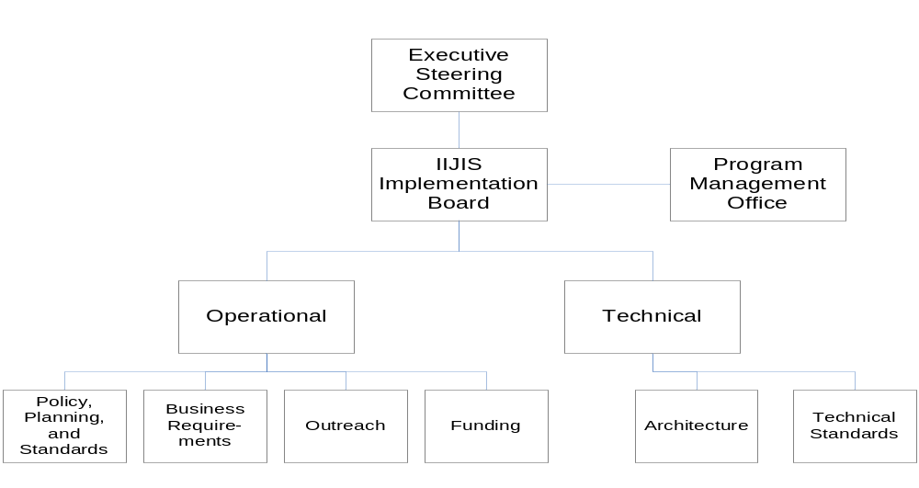
Governance
Judicial Branch Membership
Executive Steering Committee
Operational Committee -

Slide 4
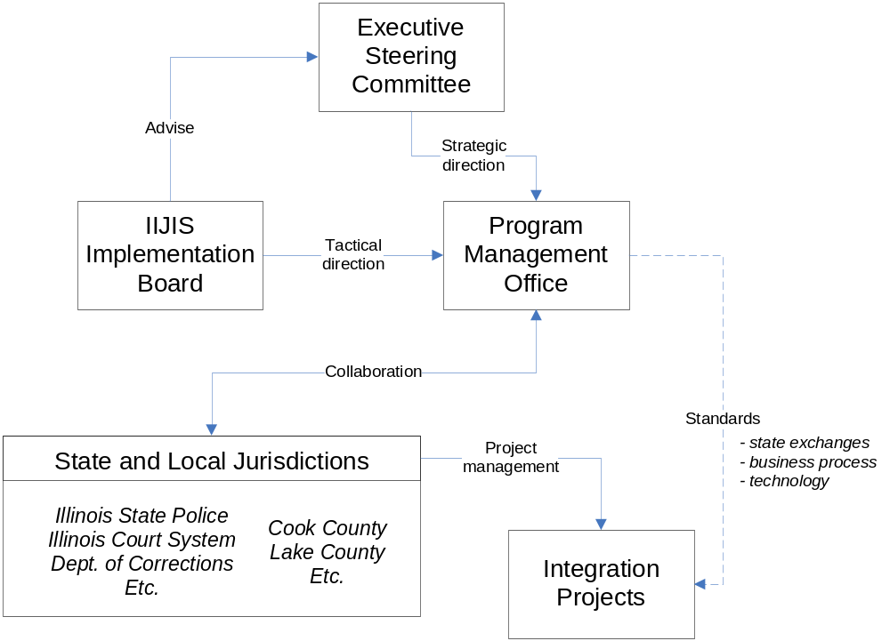

Slide 5

Detail Planning
Business Planning
  State vs. Local Exchanges
    Biometric identification (DNA, fingerprints, booking photos, DL photos, etc.)
    Warrant and warrant recall
    Release status
    No contact and restraining orders
    Disposition and conviction
    Weapons prohibition
    Probation conditions
    Predatory offender status
    Gang membership

Slide 6
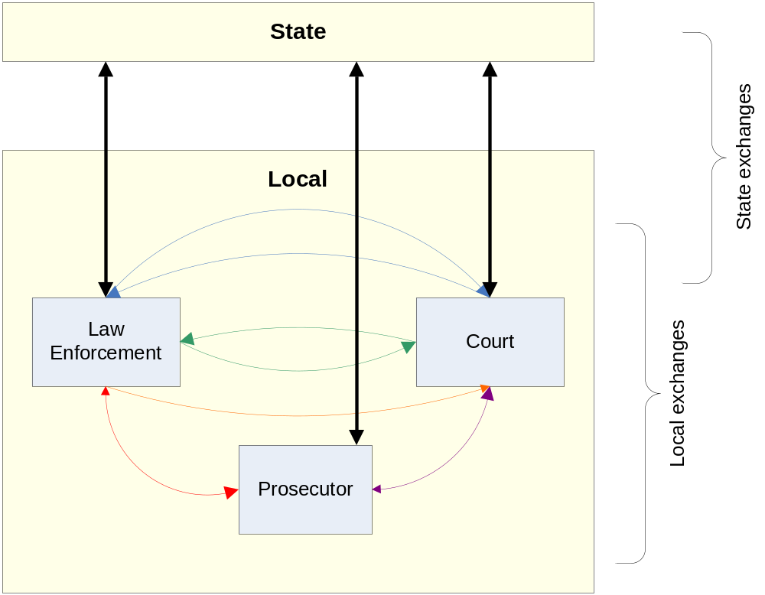

Slide 7
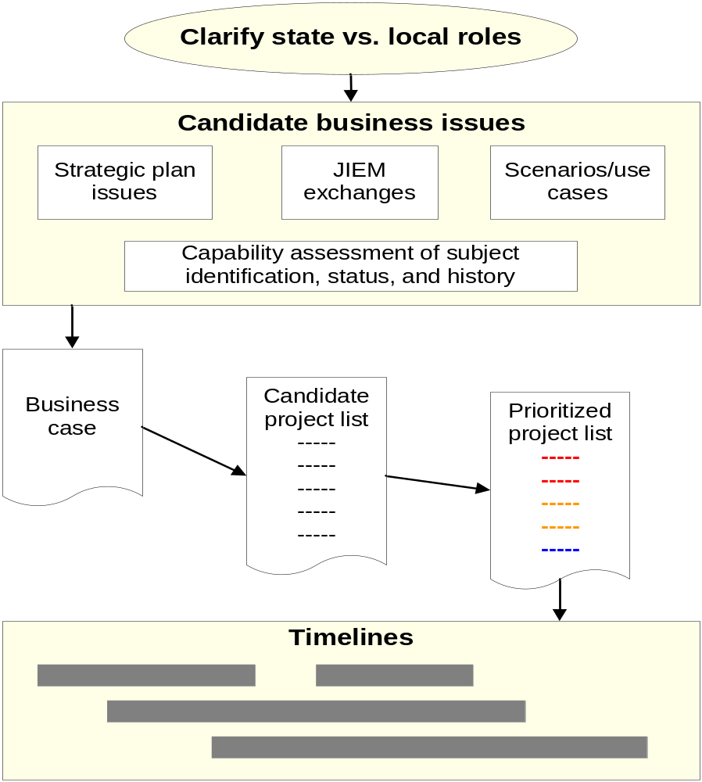

Slide 8
Detail Planning
Candidate Business Issues
Develop Business Case (Appendix A)
Analyze Gap Between Business Need and Current System Support
Candidate Project List
Technical Planning
Prioritize and Select Projects - Value vs. Risk
High Level Timeline
Develop Budget and Staffing Detail Planning

Slide 9
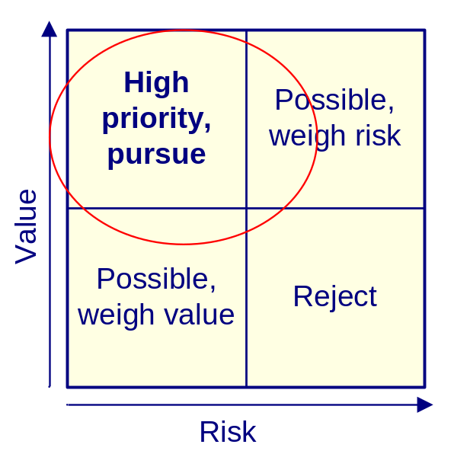
Value vs. Risk
Consider the following criteria for
determining project value:
  Does the project improve capability for subject identification, status, and history?
  Does the project provide statewide benefit, or does it only apply to certain regional or organizational areas?
  Does the project contribute to the goals and key issues in the strategic plan?
  Does the project address key gaps in the overall criminal justice business process?
  Are other projects dependent on this one for their success?

Slide 10
Consider the following criteria for determining project risk:
  Can the project meet its business and operational requirements and make use of existing systems, with little or no changes? Then, for example, the risk is low.
  What is the gap between current system functionality and the new business requirements? The larger the gap, the larger the project and with larger projects comes potentially higher risk.
  Is the project highly complex, either from a business or technical point of view?
  Is the cost high, or are funding sources difficult?
  Are the performance requirements difficult to achieve (i.e., fast response time, high transaction throughput, large data volumes, etc.)?
  Will the project conform to standards, either general industry direction or federal or state standards?
  Are personnel with necessary skills readily available for this project? Detail Planning

Slide 11
Detail Planning
Develop Policies and Standards – Business
  Business Practices and Business Rules
  “Documents”
  Data Policy
  Performance Measures
  Project Management Standards
    Charter
    Scope Statement
    Project Plan
    Status Reporting
    Budget
    Risk Assessment and Mitigation

Slide 12
Detail Planning
Develop Policies and Standards – Technical
  Industry – e.g. XML
  Justice Domain – Global Justice XML Data Model
  Enterprise

Slide 13
Practical Suggestions
“Think Big, Act Small”
  Develop the End State Vision (the “big plan”)
  But pick small projects that have good value and there is consensus on
  Create a quick success
  Success builds excitement and motivation
What About Bob?? (“Baby Steps”)

Slide 14
Project Management
Keys to Success
Full time Project Manager
Clearly defined roles
A formal plan that is kept current
Controls
Transparency
Constant status reporting and communication
Business and technical – enterprise architecture and standards

Slide 15
Role (across) Responsibility (down) | Funding Body | Policy Board | Executives Sponsors | Project Manager | Business Stakeholders | IT/CIO
Business Case | Review | Review/ approve | Develop | Facilitate | Participate | Observe
Strategic Plan | Review | Review/ approve | Develop | Facilitate | Participate | Participate
Performance Measures | Review | Review/ Approve | Develop | Facilitate | Participate | Participate
Tactical Plan |  |  | Review/ approve | Develop | Participate | Participate
Lifecycle funding & resources | Approve | Approve & request | Develop/ Assign to project | Facilitate Assign to project teams | Participate | Participate
Risk Management And Controls |  | Review | Approve | Develop | Participate | Participate
Business process change |  | Approve and “sell” | Approve | Facilitate | Participate | Observe
,

Slide 16

Controls
Performance measures
Constant risk assessment and mitigation
  Probability of Occurrence
  Impact
Change control
Checkpoints and go/no-go milestones
Vendor and contract management
Issue management
Cost
Time
Scope

Slide 17
Develop and Use
Performance Measures
How do you know…
  If the effort is on schedule?
  On budget?
  Meets the project goals and/or goals of the funding stream
  IF IT IS A SUCCESS?
Can performance in accomplishing goals and objectives be demonstrated quantitatively?
Notes:
Early days of IT and automation = TRUST ME, TO AUTOMATE IS TO IMPROVE
Real experience: failures, delays, cost overruns, frustrated users, systems that didn’t meet needs or solve problems
Loss of confidence by funders, decisionmakers, users
TELL ME THE RETURN ON INVESTMENT
Performance measures establish REALISTIC EXPECTATIONS AND MEASURES TO QUANTIFY PROGRESS toward meeting those expectations
PMs:
Help build consensus and commitment
Obtain and allocate resources
Plan and manage project execution
Demonstrate success
Improve accountability

Slide 18

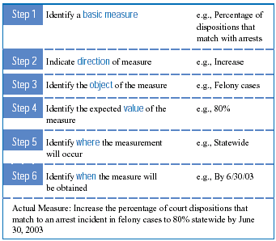
Building a Measurable Business Objective
Example:
“Increase the percentage of court dispositions that match to a felony arrest incident to 80% statewide by 6/30/03.”
From: Measuring the Success of Integrated Justice: A Practical Approach. A SEARCH Special Report.
Notes:
Other Resources: CTG and NGA studies on performance measures

Slide 19
Transparency and Communication
Transparency builds trust
Involve business and technical stakeholders in project teams
Regular status reporting
  “Down” to the project teams
  “Up” to the Executive Sponsors
  “Out” to Stakeholders
Communicate, communicate, communicate!

Slide 20
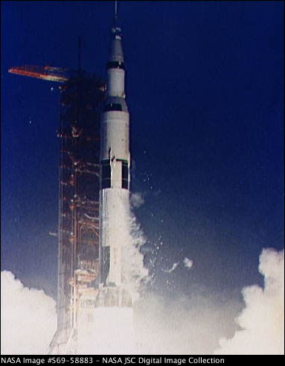
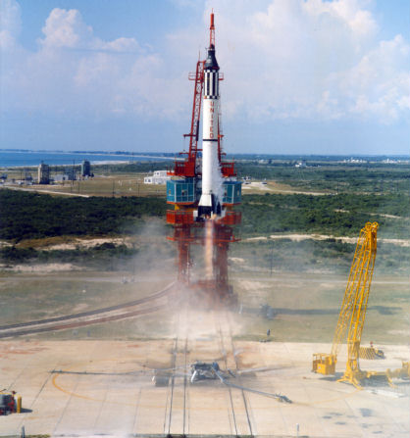



Failure Is Not an Option

