Slide 1
IIJIS Strategic Plan – Issue 5, Establish Standards
Strategic Goal 1: Recommend and implement mechanisms and processes to inventory, develop, adopt, publish, disseminate, and maintain standards/regulations that apply to justice information sharing
Strategic Goal 2: Inventory, adopt, and/or develop a uniform set of standards/regulations that enable secure, robust information exchanges and are compatible with national standards.

Slide 2
Types of Standards
Communications
Security
Privacy
Functional
Data Exchange

Slide 3
Why Standards?
Key to justice agencies with dissimilar systems sharing data.
Data exchanges without standards are needlessly time-consuming and expensive.
Much of the work has been done.
Standards are voluntary.

Slide 4
Standards v. Regulations
Standard – A document approved by a recognized body, that provides for common and repeated use, rules, guidelines, or characteristics for products, processes or services for which compliance is not mandatory.
Regulation – A document that describes product, process or service characteristics, including the applicable administrative provisions, with which compliance is mandatory.
International Standards Organization

Slide 5
Sources Used for JXDM
Sponsor Source Documents
Global ISWG Reconciliation Data Dictionary
RISS RISS Intelligence schema
OASIS Court Filing DTD
AAMVA Driver History schema
NIJ InfoTech Data Dictionary & schema
LA County Incident Report Schema
SEARCH Justice Information Exchange Model
OASIS Arrest warrant, charging document, & sentencing order schema
Minnesota CRIMNET Data Dictionary & schema
NLETS NCIC 2000 Code Tables
NIBRS Incident Report schema

Slide 6



Slide 7
Global Justice Information Sharing Initiative (Global) Advisory Committee (GAC)
Reports to the U.S. Assistant Attorney General, Office of Justice Programs (OJP), and the
U.S. Attorney General in an advisory capacity
Promotes broad-scale sharing of pertinent justice information to support public safety
Consists of key officials from local, state, tribal, federal, and other justice-related entities

Slide 8
Global’s Mission
To improve the administration of justice and protect the nation’s public by promoting practices and technologies for the secure sharing of justice-related information

Slide 9
GAC Composition
Constituencies represented by Global participants
  Law enforcement agencies
  Prosecutors
  Public defenders
  Courts
  Corrections agencies
  Probation and parole departments
  Additional agencies in the justice and public safety communities

Slide 10
How Global Achieves Its Objectives…
GAC
GAC Executive Steering Committee
Working Groups
  Global Infrastructure/Standards Working Group
  Global Intelligence Working Group
  Global Privacy and Information Quality Working Group
  Global Security Working Group

Slide 11
GAC Executive Steering Committee (GESC)
Consists of the GAC Chair and Vice Chair, the working groups’ chairpersons, and two at-large members
Guides the work of the GAC and its working groups
Collaborates and partners with the U.S. Department of Homeland Security (DHS)

Slide 12
Global Infrastructure/Standards Working Group (GISWG)
GISWG Goal
  Define a framework
    To assist government entities to establish an operational environment for sharing justice
    and public safety information

Slide 13
GISWG (continued)
Tasks
  Coordinate with the Global Intelligence, Privacy and Information Quality, and Security Working Groups to assure a comprehensive Global approach, and to address interdependent information sharing issues
  Examine emerging technologies that advance justice information sharing
  Identify programmatic and technical components
  to develop infrastructure

Slide 14
GISWG (continued)
Products
  Justice Standards Clearinghouse (JSC)
    The JSC for Information Sharing is a repository for standards and specifications within the justice and public safety communities
    The JSC is located at http://www.it.ojp.gov/jsc

Slide 15
GISWG (continued)
Products (continued)
  Metadata Repository – Justice XML Data Dictionary (JXDD) v3.0
    Foundation: reconciliation initiative
    The Interstate Criminal History transmission specification
    The Regional Information Sharing Systems (RISS) data exchange specification
    The electronic court filing standard

Slide 16
GISWG (continued)
Products (continued)
  Metadata Repository –JXDD v3.0 (continued)
    Schema Task Team
    Collaborative effort between OJP, National Telecommunications and Information Administration,
    and the Georgia Tech Research Institute

Slide 17
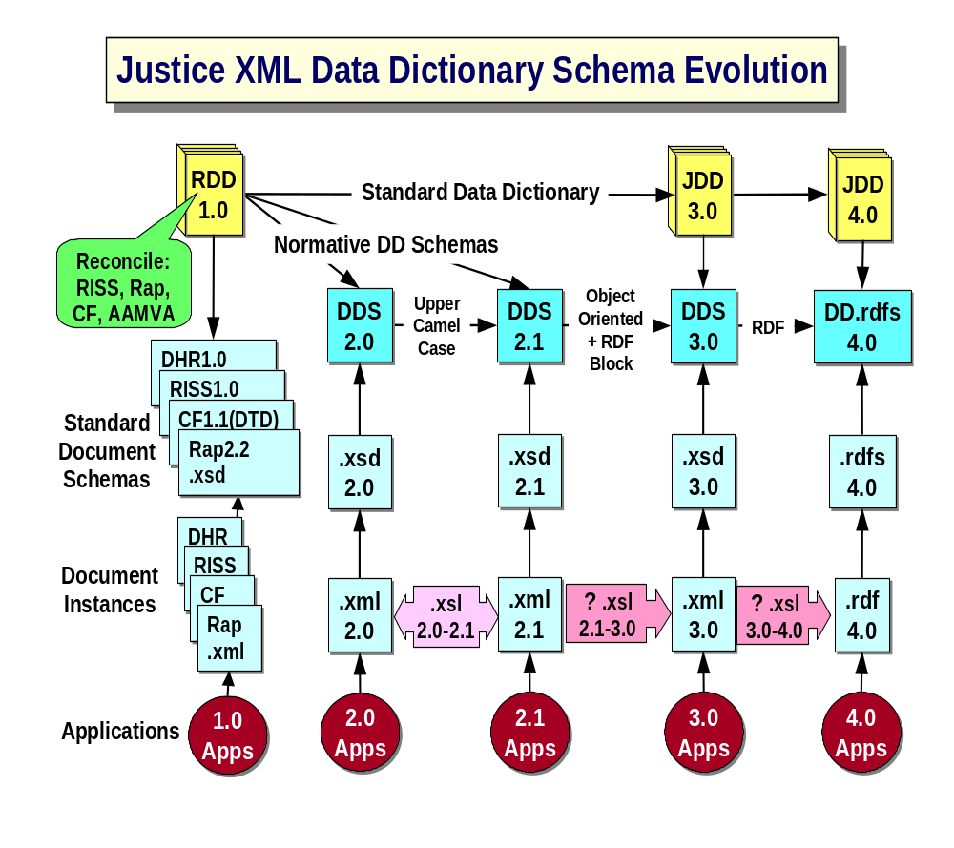

Slide 18
Global Intelligence Working Group (GIWG)
GIWG Goals
  Promote and recommend policies, plans, and promising practices to ensure effective intelligence sharing critical
  to public safety
  Address and recommend solutions that allow information sharing while safeguarding the privacy and constitutional rights of individuals

Slide 19
GIWG (continued)
Tasks
  Overcome intelligence information exchange barriers
  Develop National Criminal Intelligence Sharing Plan
  Establish a Coordinating Council

Slide 20
GIWG (continued)
Product
  Interim Report: Development of the National Criminal Intelligence Sharing Plan

Slide 21
Global Privacy and Information Quality Working Group (GPIQWG)
GPIQWG Goals
  To provide national leadership to justice entities on policies and practices to prevent inappropriate collection, use, and dissemination of personal information
  To examine means of improving the reliability of criminal records
  in an integrated justice information system
  To examine emerging technologies for accurately and reliably identifying individuals through biometrics technology

Slide 22
GPIQWG (continued)
Tasks
  Produce a policy-level white paper on protecting privacy and security in integrated justice systems in the post-9/11 era of public safety and homeland security
  Develop, in consultation with DHS, policies that maintain the balance between information sharing and individual rights/privacy
  Explore emerging biometrics technologies

Slide 23
GPIQWG (continued)
Product
  White Paper (Draft)
    Recognizes the new context in which justice information sharing systems operate
    Applies settled privacy principles to existing models
    of justice information sharing systems and makes recommendations for promising practices

Slide 24
GPIQWG (continued)
Product (continued)
  White Paper (Draft) (continued)
    Addresses the legal mandates and prohibitions arising from applying privacy principles to current systems and makes recommendations for amending current law
    Ensures that in the pursuit of effective justice information sharing systems, adequate consideration is given to policies that protect privacy and constitutional values

Slide 25
Global Security Working Group (GSWG)
GSWG Goal
  Apply relevant security practices to justice and related information sharing initiatives

Slide 26
GSWG (continued)
Tasks
  Compile a comprehensive set of security promising practices in the areas of technologies, guidelines, policies, and procedures
  Provide specific real-world examples and case studies of security implementations
  Research Web services security specifications, standards, and other security issues necessary in justice and related information sharing applications

Slide 27
GSWG (continued)
Product
  Applying Security Practices to Justice Information Sharing

Slide 28
Information Technology (IT) Web Site http://www.it.ojp.gov
An easy-to-use Web site designed to give practitioners a centralized location to find information sharing and technology integration resources
Specifically designed to serve the justice and public safety communities
Offers a variety of ways to access information and aims to assist practitioners by providing extensive resources within the justice and public safety communities

Slide 29
Summary
Global Mission
Ground breaking, justice information sharing initiatives
Focused on practitioner needs
Public safety orientation

Slide 30
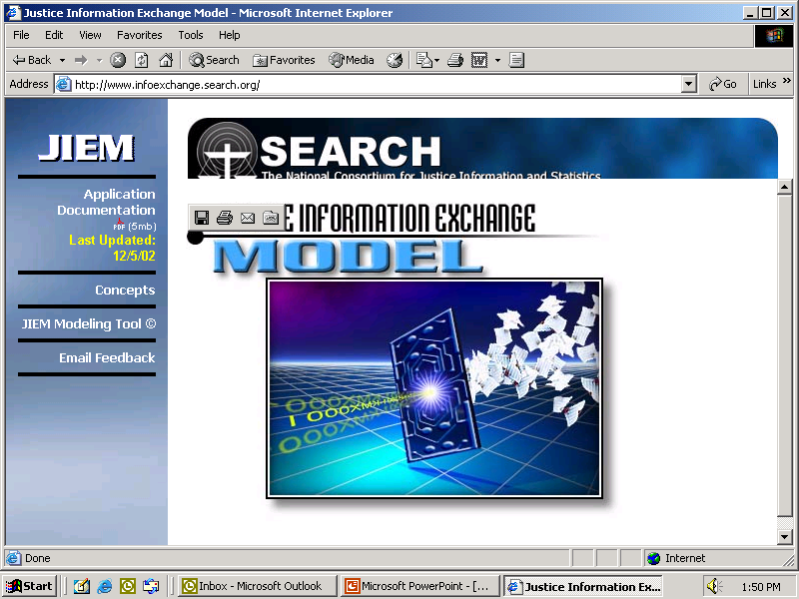

Slide 31
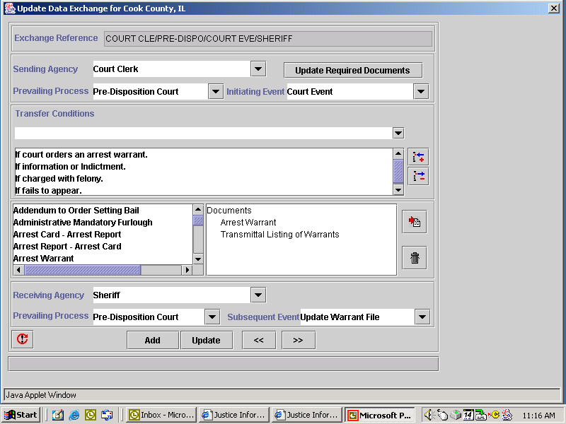

Slide 32
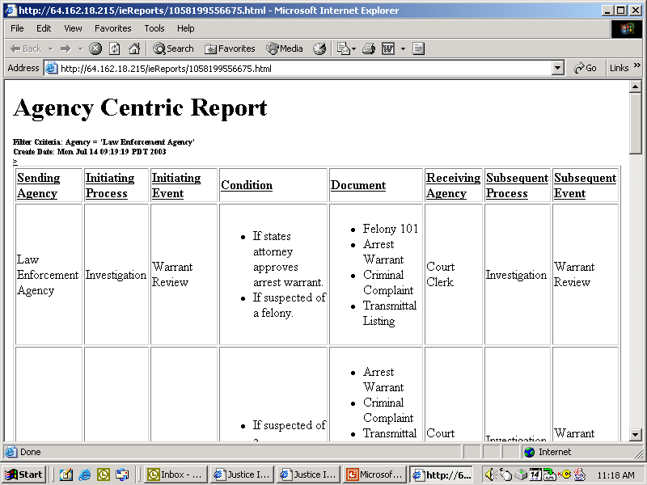

Slide 33
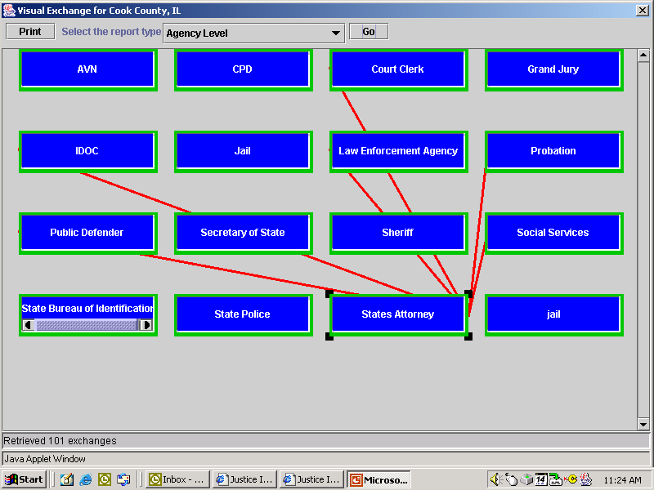

Slide 34
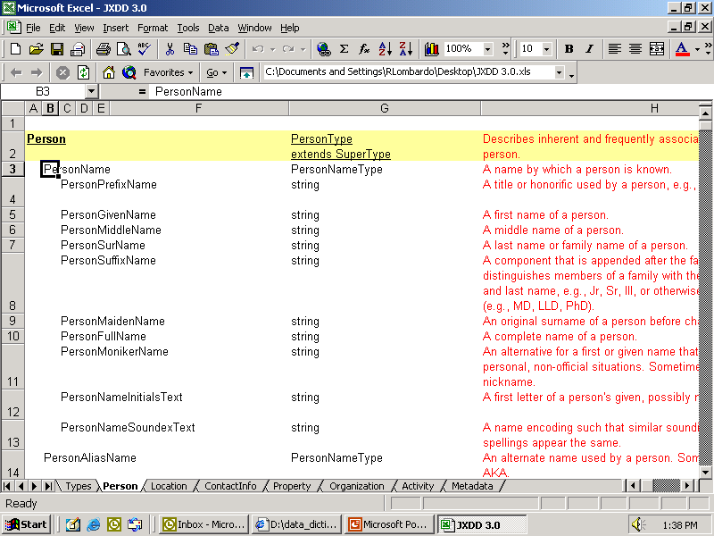

Slide 35
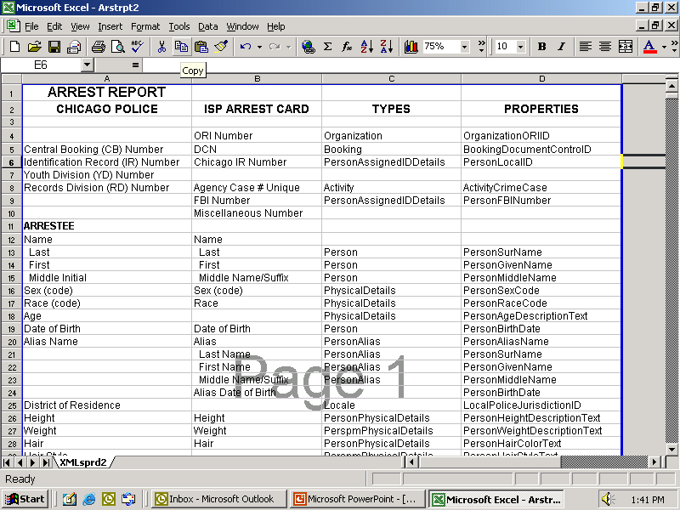

Slide 36
What is XML?
Extensible Markup Language (XML) is a technology
designed to transmit both data and its meaning within a particular transfer occurrence.
XML accomplishes this by using Markup Language to identify structures within a document.
Structured information contains both content
(words) and an indication of what role the content plays.
For example, the object “vehicle” contains many elements such as description, color, and model.

Slide 37
What is XML?
The Justice XML data dictionary organizes data into six Super
Types – Person, Property, Organization, Location, Contact
Information, and Activity.
These Super Types contain approximately 2000 unique data
elements that have been incorporated into nearly 300 reusable components.
XML Example
<Person>
  <PersonName>
  <PersonLastNameText> Smith </PersonLastNameText>
  </PersonName>
  <PersonEyeColorCode> BRN </PersonEyeColorCode>
  </Person>

Slide 38
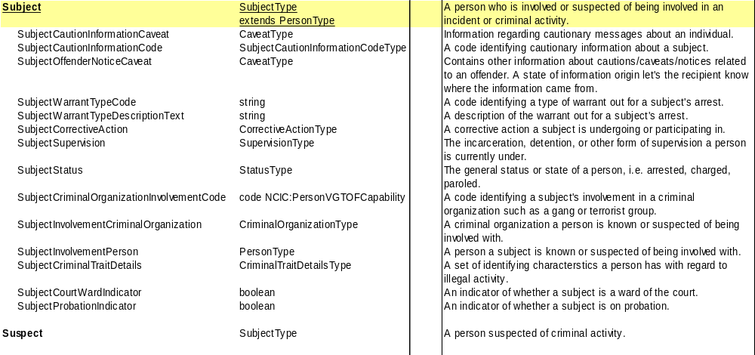

Slide 39
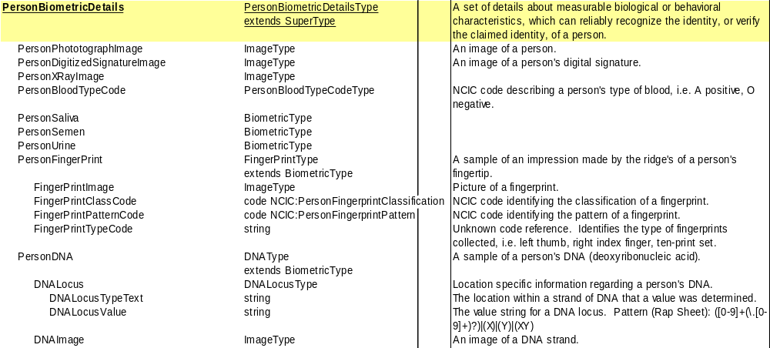

Slide 40
  <?xml version="1.0" encoding="UTF-8" ?>
  - <rs:RapSheet xmlns:rs="http://bogus.justicexml.gtri.gatech.edu/RapSheet/2002-12-10-1018" xmlns:jdd="http://justicexml.gtri.gatech.edu/JusticeDataDictionary/2002-11-19-1545" xmlns:xsi="http://www.w3.org/2001/XMLSchema-instance" xsi:schemaLocation="http://bogus.justicexml.gtri.gatech.edu/RapSheet/2002-12-10-1018 JDD-RapSheet.xsd">
  - <Introduction>
  - <RapSheetRequest>
  <jdd:PersonFBIIdentifier>618079JA8</jdd:PersonFBIIdentifier>
  <jdd:PersonStateIdentifier>WI183246</jdd:PersonStateIdentifier>
  <PurposeCode>C</PurposeCode>
  <Attention>OFC LYNCH</Attention>
  </RapSheetRequest>
  - <jdd:Caveat>
  <jdd:CaveatText>The response is based on a search using the fingerprints and/or identification data supplied. Searches based solely on name and non-unique identifiers are not fully reliable. The CIB cannot guarantee that the information furnished pertains to the individual you are interested in.</jdd:CaveatText>
  <jdd:CaveatReferenceDateTime>2002-01-30T12:00:00-05:00</jdd:CaveatReferenceDateTime>
  <jdd:CaveatIssuingAuthorityText>"WI"</jdd:CaveatIssuingAuthorityText>
  </jdd:Caveat>
  </Introduction>
  - <jdd:Subject jdd:id="Subject1">
  <jdd:CommentText>Felony offender.</jdd:CommentText>
  - <jdd:PersonAssignedIdentity>
  <jdd:DriverLicenseIdentifier>S455-2826-4895-L</jdd:DriverLicenseIdentifier>
  <jdd:PersonFBIIdentifier>618079JA8</jdd:PersonFBIIdentifier>

Slide 41
  <jdd:PersonStateIdentifier>WI183246</jdd:PersonStateIdentifier>

