Slide 1




LEADS
Law Enforcement Agencies Data System
The Foundation for Integrated Justice in Illinois

Slide 2
What Is LEADS 2000?
LEADS 2000 is an enterprise information technology initiative by the Illinois State Police to upgrade the existing Law Enforcement Agencies Data System, which is over 30 years old.

Slide 3
Approximately 800 Criminal Justice agencies have direct access to LEADS statewide.

Slide 4
Over 20,000 personal computer desktop workstations and wireless mobile data computers access a variety of criminal justice data via LEADS.

Slide 5
LEADS Participants
Police
  County, Municipal, State and Federal law enforcement agencies
Courts
  Circuit Clerk
  State’s Attorney
  Probation
  Judge
Corrections
  IDOC
  County Corrections

Slide 6
LEADS 2000 provides infrastructure upgrades to the Illinois Criminal Justice Community’s information-sharing and communication network.

Slide 7
The heart of LEADS is CHF
Born in 1968, the Illinois computerized hot files provide law enforcement with a database for maintaining on-line records of wanted persons, missing persons, stolen vehicles and property.

Slide 8
LEADS also provides an administrative messaging component which serves as the primary method for data communications among law enforcement agencies nationwide.

Slide 9
LEADS also provides access to the FBI’s National Crime Information Center (NCIC) and the National Law Enforcement Telecommunications System (NLETS) which provides access to other state’s criminal justice information.

Slide 10
LAW ENFORCEMENT AGENCIES DATA SYSTEM
LEADS
NCIC
Wanted Persons
Missing Persons
Stolen Vehicles
Felony Vehicles
Stolen Vehicle Parts
License Plate
Articles
Guns
Recovered Guns
Boats
Securities
Protection Order
Violent Gang and Terrorist Organization
Convicted Sexual
Offender Registry
Convicted Person on Supervised Release
U.S. Secret Service
Protective
Foreign Fugitive File
Deported Felon File
Unidentified Persons
Triple I
LEADS CHF
Wanted Persons
Missing Persons
Accident Victims
Incarcerated Persons
Stolen Vehicles
Felony Vehicles
Stolen Vehicle Parts
Towed/Impounded
Tagged
License
Articles
Stolen Guns
Recovered Guns
Seized Guns
Boats
Securities
Orders of Protection
Caution File
(Parolee)
(Sex Offenders)
(Field Notification)
(Gang Members)
LEADS INFORMATIONAL
CCH/CHRI
Highway Conditions
FOID
HELP
SALOON
DNR
Boat/Snowmobile
Registration
SOS
Driver’s License
Vehicle Registration
Soundex
Vehicle Titles
NLETS
Driver’s License
Vehicle Registration
NICB
Directed Messages
Criminal Histories
Canadian Inquiries
Aircraft Tracking and
Registration
Immigration and
Naturalization

Slide 11
What Does LEADS 2000 Do?
Provides for the essential infrastructure necessary of the implementation of a Statewide Integrated Criminal Justice System which links criminal justice agencies to create a virtual criminal justice information system.

Slide 12
There are two major phases to LEADS 2000:
  Phase 1
    Statewide TCP/IP Frame Relay Network
    Front-End (Web Client and User Registry)
    Computer-Based Training
  Phase 2
    Rewrite of the legacy LEADS computerized hot files database (support of NCIC 2000 functionality)
    Rewrite of the legacy Administrative Message functionality.

Slide 13
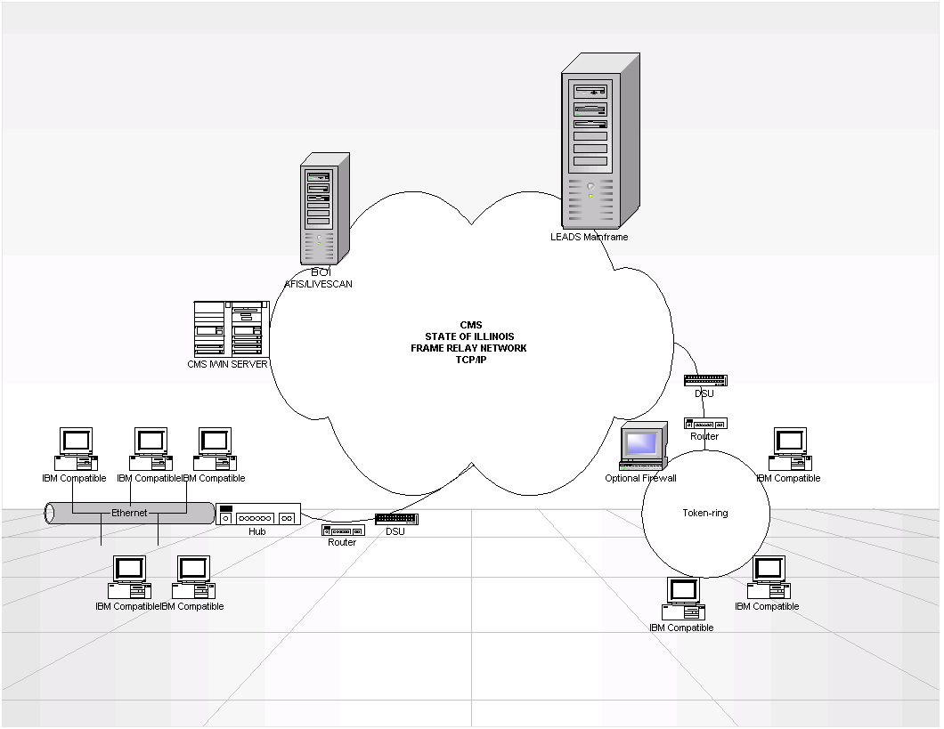

Slide 14
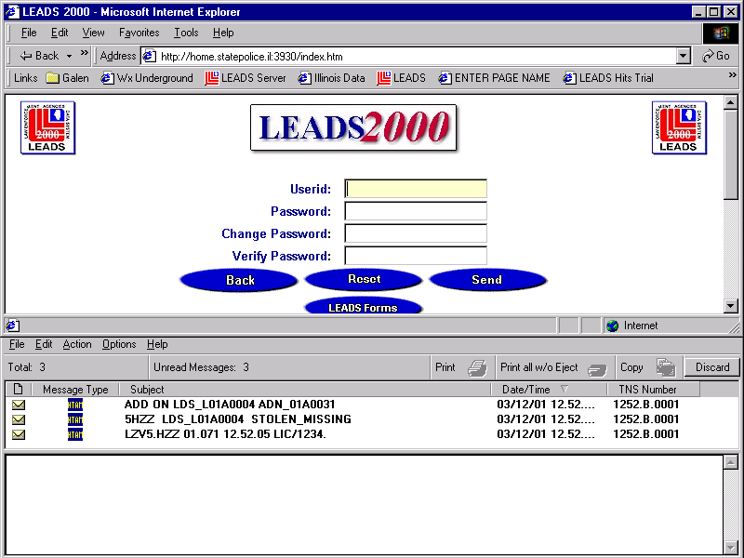

Slide 15
Costs?
ISP provides the new LEADS 2000 web client software at NO COST to Illinois criminal justice agencies.
However, user agencies are responsible for the procurement of personal computers and the network connectivity to the state of Illinois frame relay network.

Slide 16
Transitioning to LEADS 2000
Visit the LEADS 2000 Internet Web Site at:
http://www.isp.state.il.us/leads/leadspub/

Slide 17
The Date for all LEADS agencies to transition to phase 1 of LEADS 2000 was March 31, 2002.

Slide 18
Obstacles to State Justice Information Systems
All criminal justice agencies are not connected to the network
  Example: Currently 8 Sheriff’s Departments in Illinois do not have direct access to LEADS.
Lack of standards
  Data Dictionary
Training
Fingerprint-based employee background checks

Slide 19
Obstacles to State Justice Information Systems
Name-based systems (no biometrics)
  Soundex algorithms
  Positive identification
Incomplete information
  Lack of uniformity in data capturing among all 102 counties (e.g., no standard warrant form)
  Failure by counties to contribute records to the system (e.g., all warrants, etc.)
  Prisoner transportation
Timely entry
  Delays between the courts and the law enforcement agency entering the court order
Accuracy of Data
  Inadequate quality assurance

Slide 20
LEADS 2000
Thank You!

