Slide 1
Privacy policy development efforts
Presentation to the
National Governors Association
Center for Best Practices
October 23, 2006

Slide 2
Table of Contents
Background: Illinois integrated justice efforts
Process: Steps taken by the IIJIS Privacy Policy Subcommittee toward the development of privacy policies
Substance: Substantive privacy issues identified by the subcommittee
NGA activities: Policy recommendations regarding the analysis and sharing of police incident report data

Slide 3

Executive Order No. 12 (2001)
Created the IIJIS Governing Board.
Governing Board was charged with:
  Identifying all justice information systems in Illinois and
  Developing a Strategic Plan for justice integration.

Slide 4
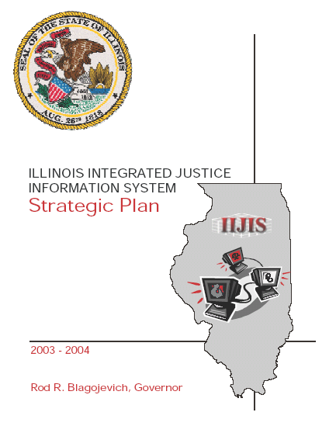
IIJIS Strategic Plan
Introduced justice systems integration to Illinois stakeholders and practitioners
Outlined strategic goals to address challenges confronting integration
Included the Scenario for Information Sharing and the Gap Analysis

Slide 5
Strategic Issue No. 3
“Serve justice, public safety, and homeland security needs while protecting privacy, preventing unauthorized disclosures of information, and allowing appropriate public access.”

Slide 6
Executive Order No. 16 (2003)
Established the IIJIS Implementation Board
The Implementation Board was charged with, among other things:
  Addressing the challenges identified in the IIJIS Strategic Plan and
  Creating policies that protect individuals’ privacy rights related to the sharing of justice information.

Slide 7
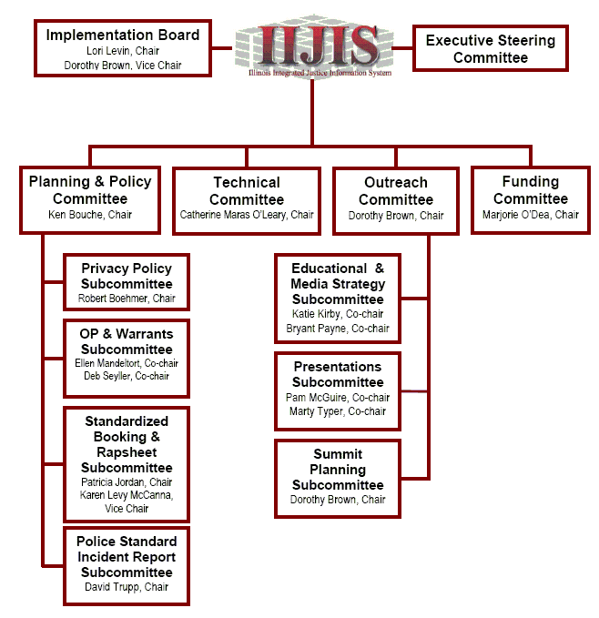
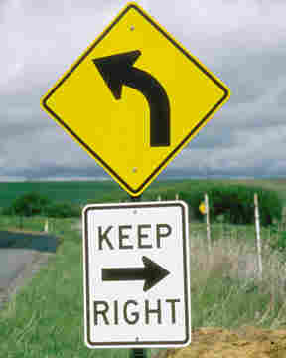
Organizational chart
You are here

Slide 8
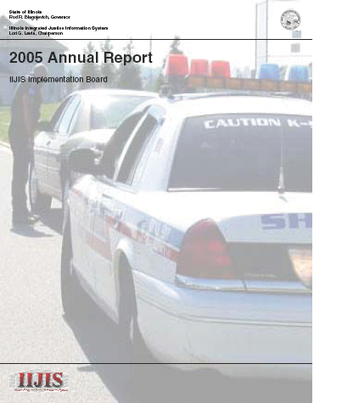
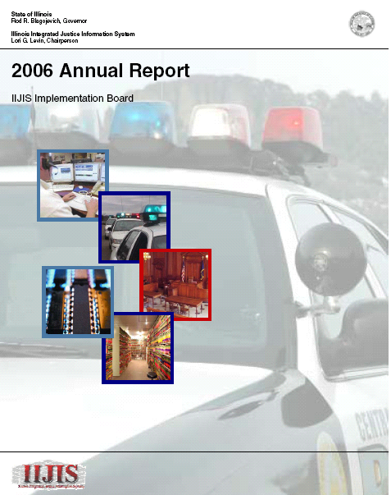
Annual reports

Slide 9
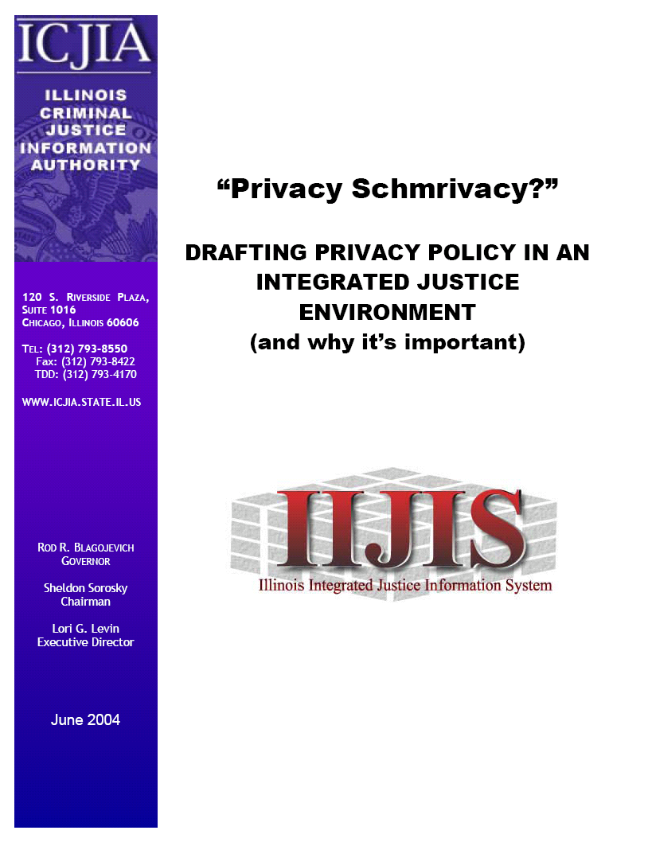
Privacy Schmrivacy…
Introduced the need for a privacy policy
Explained the types of people who should participate in policy development efforts
Described a process to develop a privacy policy.
Notes:
Officially published in June 2004, the work involved with drafting the document began during the IIJIS strategic planning process in 2002.
Originally developed to better understand the evolution, intent, and operation of FIPs.
Functionally, it allowed us focus our thoughts on the direction and day-to-day operation of the Privacy Committee. It was also used as a primer on the privacy issues both for our committee members and us. We wanted to make sure that our committee members had an understanding of the fundamentals of the privacy issue, including background on the fair information practices as well as our recommendation for the work of the committee and how that work would take place.

Slide 10
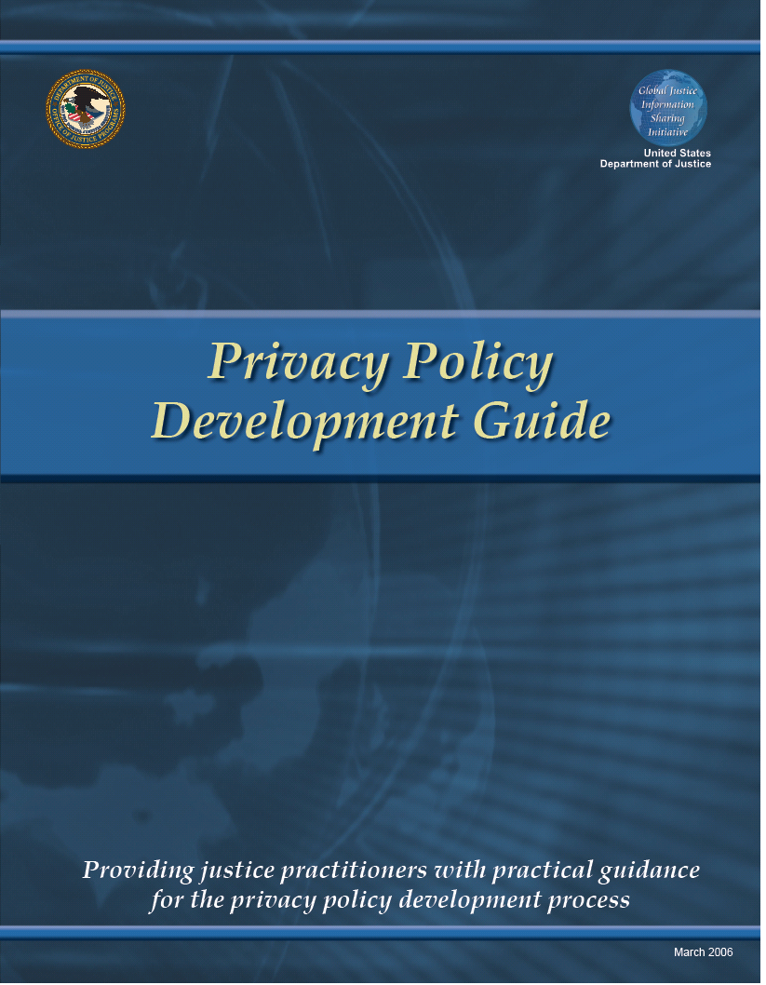
Global Privacy Policy Development
Governance
Planning
Process
  Understand information exchanges
Product
Implementation

Slide 11
Privacy Policy Subcommittee
Illinois Press Association | Illinois State Police | Chicago Police Department
Illinois Association of Chiefs of Police | Illinois Sheriff's Association | Illinois Department of Corrections
Illinois Public Defenders’ Association | Office of the State Appellate Defender | Metro Chicago Health Care Council
Law school professors | Illinois Attorney General’s Office | Administrative Office of Illinois Courts
Office of the Chief Judge, Circuit Court of Cook County | Illinois Probation and Court Services Association | Illinois Association of Court Clerks
Illinois State’s Attorneys’ Association | Illinois Coalition Against Domestic Violence | Illinois Coalition Against Sexual Assault

Slide 12
Subcommittee members
Individual meetings were crucial
  Members are subject-matter experts and an excellent source of information.
  Identify privacy issues these representatives and their agencies are already facing.
Streamlines subcommittee meetings
Notes:
Be prepared with questions for each member to keep everyone involved and to jumpstart the discussion if it slows down.

Slide 13
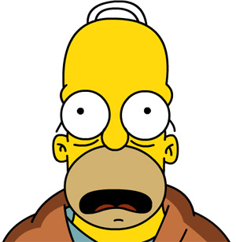
Meeting philosophy
“Break the mold of the typical government meeting.”
  “So you hired an axe murderer”
  Access & review quiz
  “Why Johnny can’t read” the Illinois expungement statute
  Newspaper headlines
  Brainstorming sessions
Notes:
We sought creative ways to either present information or obtain information from the participants.
Visual presentation and ease of understanding are essential goals of any presentation.
Presentations were designed to get members to let their guard down a little, to eliminate tension, and to make things interesting.

Slide 14
Meeting philosophy (continued)
Sound meeting management
Respect members’ time
  Identify need for meeting and expected results/products
  Materials to members 2 weeks before meeting
  2-hour meetings
Carefully craft, prepare, and conduct meetings
Notes:
Meeting dates were established as needed by committee staff, with sufficient lead-time [4 to 6 weeks]
Develop a meeting checklist to make sure that meeting goals are accomplished
Communicate meeting goals to members and let them know that we will end on time.
Keep track of action items
Debrief after the meeting

Slide 15
Shifts in approach
Two substantial changes in the subcommittee’s approaches to addressing privacy issues :
Changing focus from FIPs to specific issue resolution
Changing the product from a privacy policy to policy guidance
Notes:
No. 2 is evident from the Issue Resolution Worksheet to the draft PPG Vol. 1 – it includes section numbers and policy language versus the finding-style of the final draft.

Slide 16

Privacy Policy Guidance Vol. 1
Briefly describes privacy interests implicated by integrated justice systems
Identifies mandatory, prohibited, and permissible information practices
Sets forth sound privacy principles in place of FIPs
Notes:
Limitations.
1. Report discusses access to info, not the means of access (e.g., paper form or electronic)
2. Report focuses on executive branch agencies; no recommendations concerning how courts and court clerks manage their information.
3. Consult agency counsel for specific interpretations of federal and Illinois law.

Slide 17
Privacy Policy Guidance series
Volume 1: Traditional justice information
Volume 2: Police incident report data sharing
Volume 3: Assorted types of information shared by the justice system
Volume 4: Accountability and oversight
Volume 5: Juvenile justice information
Volume 6: Intelligence information gathered by the justice system
Notes:
3. Privacy issues surrounding several of these types of information, including, but not limited to, officer safety information; Social Security numbers; fingerprints; DNA profiles; medical information; expunged and sealed records; warrants; offender registration information; and statistical data.
4. Specifically, it will contain recommendations concerning privacy policy compliance audits and how to ensure the accuracy of data contained in justice information systems.

Slide 18
NGA-funded efforts
Focus on the sharing of police incident report data
Identify the privacy issues raised by the sharing of police incident report data across jurisdictions
Develop privacy policy recommendations to address these issues.
Notes:
I-CLEAR & N-DEx (i.e., not typical case flow sharing)

Slide 19
Issue identification
Document the issues agencies developing or participating in integrated justice systems should address.
Traditional justice information sharing
Sharing of police incident report data

Slide 20
Privacy Policy Guidance Vol. 2
Treatment of victim information
Treatment of witness information
Treatment of information concerning juveniles
Treatment of suspect information
Treatment of social security numbers
Treatment of medical information
Availability of statistical summary information
Treatment of non-criminal incident report data
Retention of police incident report data
Rights to access and challenge police incident data
Notes:
May 11, 2006 meeting: Issues regarding I-CLEAR sharing of police incident reports
August 29, 2006 meeting: approve PPG Vol. 1 with changes
Drafted i

