Slide 1
“What we’ve been up to these past few months…”
IIJIS Privacy Policy Subcommittee
February 24, 2005

Slide 2
June 2004
Reviewed how the CHRI repository implements the fair information practices.
Brainstormed issues that should be addressed by the privacy policy.
Compiled those issues and sought members’ comments.
July 2004 through February 2005…

Slide 3


Notes:
Bob skydiving

Slide 4
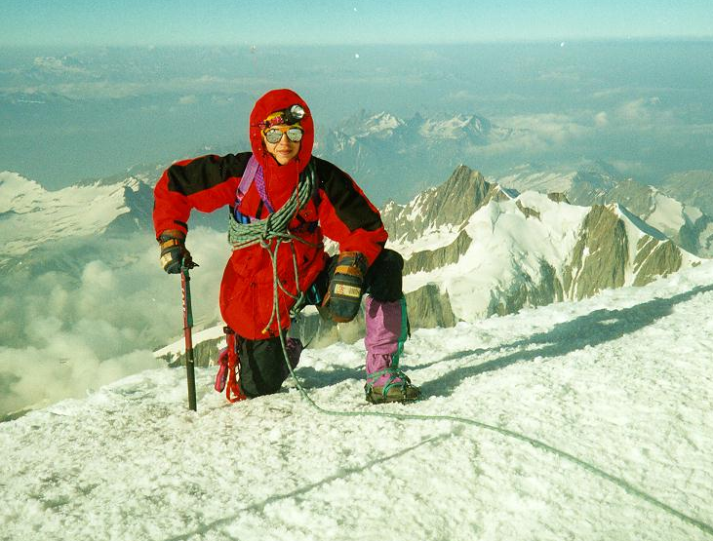

Notes:
Wil mountain climbing

Slide 5
July 2004 – February 2005
Participation on GLOBAL
Worked with GLOBAL on the development of their privacy policy development workbook.
Development of an Illinois Case Study
Utilization of Illinois’ policy as a sample for other jurisdictions.

Slide 6
July 2004 – February 2005
Comparison of unofficial and official sources of CHRI in Illinois
6 subjects’ criminal histories were collected
  2 sex offenders;
  2 convicted persons (common name);
  2 persons with expunged records
Very preliminary findings

Slide 7
July 2004 – February 2005
Collected everyone’s comments on the Issues paper and revised the document.
Is the organization okay?
Are there any missing issues?
  Are there any clarifications of the issues?
Help!

Slide 8
Some thoughts on policy development
Drafted an outline of the privacy policy.
Current information sharing practices
Illinois’ FIP implementation
Development of the IIJIS Privacy Policy
Issues document

Slide 9
Some thoughts on policy development: Phase 1
This is where the development phases start.
  Start with the traditional exchanges of adult justice information.
  Next focus on the accessibility of victim & witness information.
    Note that this information impacts directly the development of Illinois’ I-CASE system as well as Illinois’s participation in the FBI’s N-DEX system.

Slide 10
Wide angle lens…
Preamble
  What the document is trying to accomplish
General principles
  Philosophical underpinnings, FIPs
Guidance
  Justice information sharing provisions of the policy.

Slide 11
Wide angle lens…
Guidance
  Definitions
  Information about individuals
  Information about incidents
  Special circumstances
  Accountability
  Quality of justice information

Slide 12
Guidance overview
Information about individuals
  Information concerning suspects, arrestees and offenders
  Victims of crime
  Witnesses
  Actors in the justice system
  Other individuals whose information is collected by the justice system?

Slide 13
Guidance overview
Information about incidents
  Incident report
  Arrest report
  Other types of information about incidents?

Slide 14
Guidance overview
Special circumstances
  Officer safety information
  Publicly available information
  Contact cards
  Intelligence
  Social Security Numbers

Slide 15
Guidance overview
Accountability
  Policy compliance audits
  Remedies available under Illinois law
Quality of justice information
  Data quality audit provisions
  Individual’s right to access and review justice information

