Slide 1

Integrated Justice
Models

Slide 2
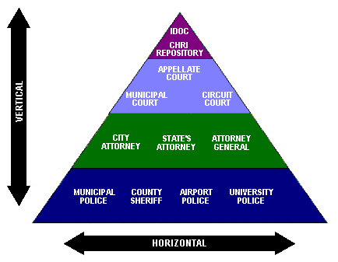
Integrated Justice
Two types of integration:
Vertical – The upward sharing of information between agencies to facilitate workflow
Horizontal – Data sharing between like agencies usually limited to real time inquiries

Slide 3
Integrated Justice
Principle Architectures
Central Repository
Unified data base
Collects and stores information from multiple agencies
Each component of the justice system enters and retrieves data from the same computer system
Distributed Systems
No central repository
Each agency maintains its own system
Users view published data directly or thru middleware server
WAN
Portal to access state level systems
Can also support county integration

Slide 4


Integrated Justice
Central Repository
Law Enforcement
Jail Management
Courts
State’s Attorney
Probation
Law Enforcement
Criminal
Civil
Juvenile
Jury

Slide 5

Integrated Justice
Washington DC
Participants
DC Police
US Attorney
Public Defender
Courts
Probation
Corrections
Functionality – Access to
Arrest Data Transfer
DMV
Mug Shots
Sex Offenders
Wanted Persons
Juvenile History
Public Access

Slide 6
Integrated Justice
Washington DC
Systems Architecture
Hub and Spoke
  Justice Server as hub
WAN connectivity
5 formats to exchange data including XML
Predefined queries
  Allow access to data in other agency systems
Core Arrest Data
DC police gather core data and forward to Core Data Transfer
Data available to all JUSTIS agencies who can download data into their legacy system server

Slide 7
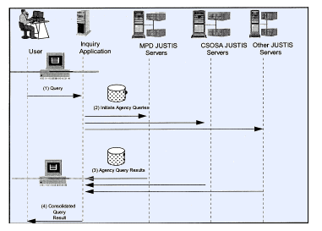

Slide 8

Integrated Justice
San Diego
Participants
All justice agencies
Functionality
“Google for Cops”
Information available
Booking Photos
Arrest Warrants
Wanted Persons
DMV
Sex Offender, Gang, Parole
911 CAD Data
Systems Architecture
Sun Ultra 10 Web Servers
INFOTECH Software
WAN
COTS Web Browser
MDT accessible
2500 workstations
Public Access

Slide 9
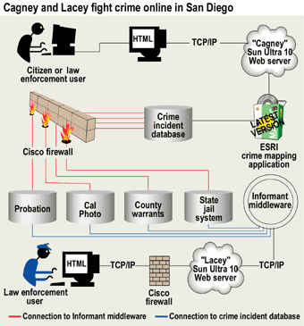

Slide 10

Integrated Justice
Colorado
Functionality
CICJIS Queries
  Criminal History
  Driver’s License
  Warrants
Data Transfer
  Arrest Information
  Case Filings
  Amended Charges
  Court Scheduling
  Dispositions & Sentencing
Participants
Law Enforcement
District & County Courts
Youth Corrections
District Attorneys
Department of Corrections
Colorado Bureau of Investigation

Slide 11
Integrated Justice
Colorado
Systems Architecture
Middleware Solution
Virtual Database
Sybase Omni Connect
software
Each agency maintains its own legacy system
Connected by central index
Central Index
Indexed by SID
Information is routed according to business rules
Real time data exchange

Slide 12
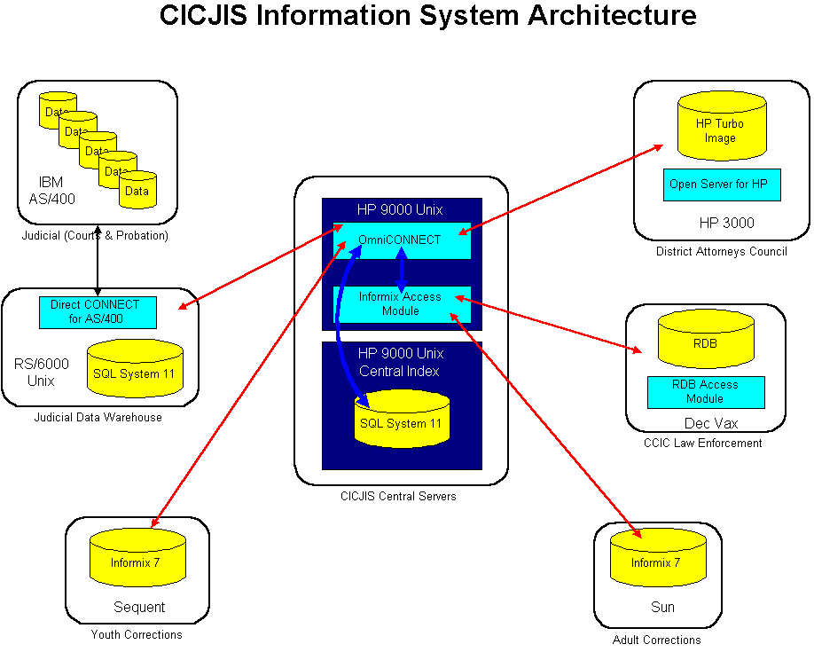

Slide 13

Integrated Justice
Minnesota
Participants
Police & Sheriffs
City & County Prosecutors
Public Defenders
District & Supreme Courts
Corrections
Sentencing Commission
Functionality -
Access to:
Court Information
Arrest Photos
Booking Information
Victim Notification
DMV
Pawnshop
Agency data sharing

Slide 14
Integrated Justice
Minnesota
Systems Architecture
Local agencies connect thru Integration hub
Each hub contains business rules to share justice data within that jurisdiction
Hub also provides means to share information with local systems, the integration backbone, and pointers to additional data
Key Components
State managed Integration Backbone
Regional, county, & locally managed Integration Middleware
and Web Services hubs.
State Criminal Justice Data Network

Slide 15
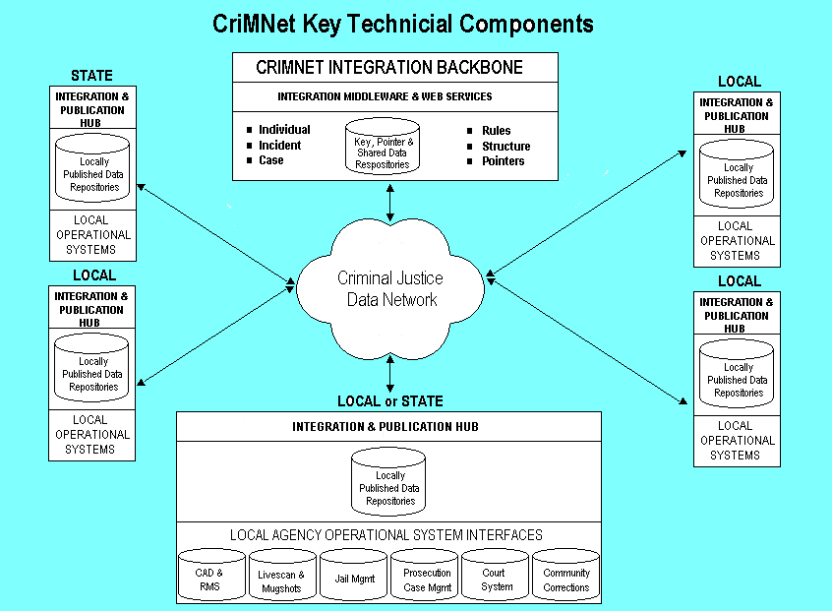

Slide 16

Integrated Justice
Nebraska
Participants
Law Enforcement
Prosecutors
Public Defenders
Courts
Probation
Jails and Corrections
Parole
Social Services
Functionality – Access to:
Criminal History
Local Jail Bookings
Mug shots
DMV
Sex Offenders
Orders of Protection
Standardized Case Management Systems
  Police
  Prosecutors
  Jail

Slide 17
Integrated Justice
Nebraska
Systems Architecture
Internet Technology
WAN
Data copied to NCJIS server or directly accessed thru central index
Data files remain under control of participating agency

Slide 18
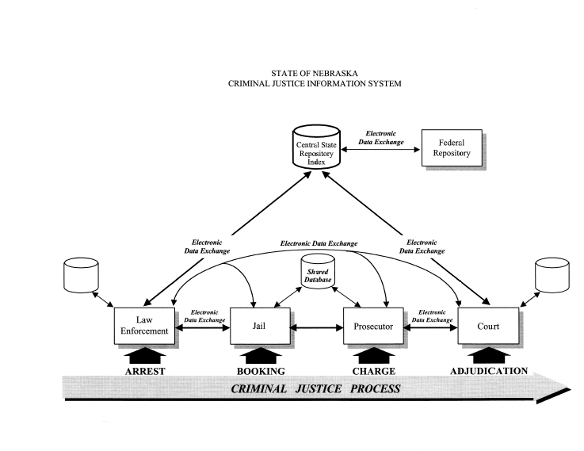

Slide 19

Integrated Justice Pennsylvania
Participants
32 State Agencies
  State Police
  DMV
  Corrections
  Probation & Parole
27 counties
300 Police Departments
Functionality –Access to:
Criminal History
Juvenile Arrests
DL Photos
Inmate Locator
Query justice data in local systems
Court Case Status
Share documents between agencies

Slide 20
Integrated Justice Pennsylvania
Systems Architecture
JNET pulls together legacy systems over middleware
Business to Business Platform
  Data mapping, conversion, and integration
Application Adapters
  Interfaces & format XML
GUI
WAN
County Justice Hub
Provides single data integration platform to support local information sharing
Messaging Infrastructure
  Enables integration of separate computer systems by sending messages to each other
Case File Transfer
  Transfer of pertinent data from one agency to another as offender progresses through justice system

Slide 21
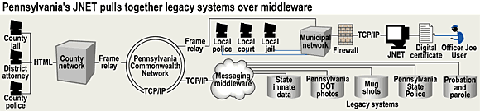

Slide 22

Integrated Justice
Kansas
Participants
State Police
Sheriffs and Local Police
Courts
District Attorneys
Department of Corrections
DMV
Juvenile Justice
Kansas Bureau of Investigation
Functionality -
Access to:
Criminal History
Missing Persons
Wanted Persons
Registered Offenders
DMV
Incident Reporting
Email

Slide 23
Integrated Justice
Kansas
Systems Architecture
Integration of existing applications thru Omni Connect and SQL databases
Internet and Intranet
Middleware server
Web Services

