Slide 2
What is Integration?
  The ability to access and share critical
  information electronically at key
  decision points throughout the justice
  enterprise.

Slide 3
History
NGA Award -- $973,600
Executive Order Number 12 (2001)
  Complete a Needs Assessment
  Identify Exchange Points
  Develop a Strategic Plan
SEARCH Technical Assistance
  Illinois Integrated Justice Information Sharing Project
  Lake County Exchange Points Project

Slide 4
Governing Board, Planning, Technical and Outreach Committees
Governing Board:
  Agency directors with authority and responsibility to commit resources and establish priorities.
Planning Committee:
  Representatives of state and local agencies and users who understand the operational needs.
Technical Committee:
  To define the technical architecture and ensure compatibility with local/state/national systems.
Outreach Committee:
  To communicate IIJIS initiatives to the justice enterprise.

Slide 5
Scenario for Information Sharing in Illinois
Ensures the needs of users are addressed
Defines “information sharing” from a business, not IT perspective
Identifies needed business process changes
Identifies future functions, range of exchanges, and interactions needed among primary justice entities
Includes response time and information currency requirements
Provides baseline for validation of the current technology
to identify gaps that exists today

Slide 6
Scenario
vision
Measure
gaps
between
vision and
current
state
close the gaps

Slide 7
IIJIS Technical Committee
Scenario validation focus groups
Analysis of state-level justice data systems
Analysis of state data communications infrastructure
Justice Information Exchange Points Model (JIEM)

Slide 8
Focus Groups to Validate Scenario
Eight meetings were held to gather participant reaction to the criminal justice scenario
Included police, state’s attorneys, public defenders, court clerks, judiciary, selected counties and justice-related associations
Objective was to validate scenario and gather input from participants on how scenario could be improved

Slide 9
Sample Focus Group Findings
Subject history and status shouldn’t require separate inquiries
Inquiry from field should return only officer safety info
Criminal history info is not current
Police need access to incident report databases
Digital photos needed
Parole and probation conditions needed for street stops
Live-scan is cost-prohibitive for small jurisdictions
Checking immigrant status requires phone query
Many warrants and most civil OP’s not entered into LEADS
Many prosecutors and probation departments lack access to criminal history files
Judiciary reluctant to use digital signatures and e-filing
Video bond court expansion needed

Slide 10
Research on State Justice Systems and Communications Networks
State Criminal History System (CCH)
LEADS
Illinois Century Network (CMS)
Secretary of State
POLARIS (in process)
State Frame Relay Network (CMS)
Automated Victim Notification System (AVN)
Illinois Department of Corrections

Slide 11
Justice Information Exchange Model
Complete process model describing document flow and electronic exchanges between justice agencies
All data elements being exchanged between justice agencies were documented
Predicate events for each exchange were identified
Conditions for each exchange were identified

Slide 12
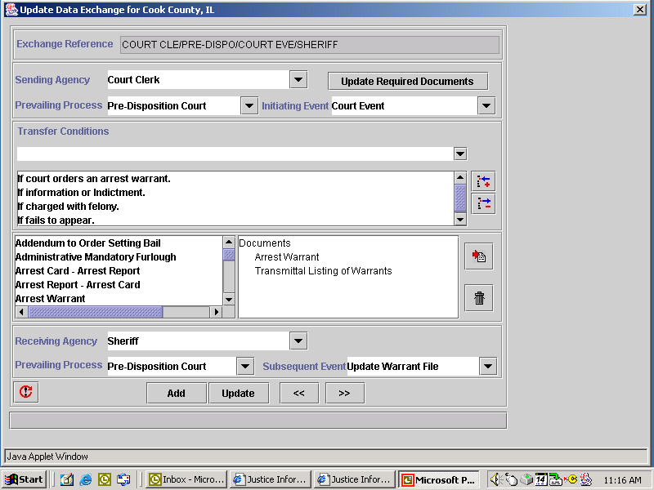

Slide 13
Post Strategic Plan Activities
Sent justice systems survey to 450 justice agencies in Illinois
Analyzed and published survey results
Reconciled JIEM data elements with JXDM elements
Brought together Illinois counties engaged in integration efforts
Received technical assistance from SEARCH, University of New Orleans Center for Law and Justice, and Center for Technology in Government
  Assistance with reconciling justice data elements
  Assistance with justice exchange points modeling
  Assistance with integration performance measures
  Assistance with integration capacity assessment tool
Held Standards Workgroup Meeting

Slide 14
Infrastructure and Data Sharing Survey of Justice Agencies
Sent to a sampling of 450 police departments, sheriffs, state’s attorneys, court clerks, probation departments
Selected rural, collar and urban agencies (stratified regional sample)
55 percent response rate
Results indicate that while systems exist, electronic sharing is uncommon
Current information systems infrastructure in rural areas is behind that of urban counties

Slide 15
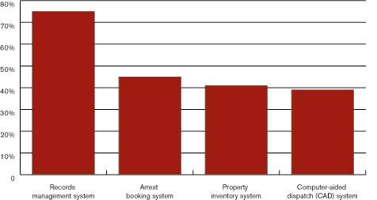

Slide 16
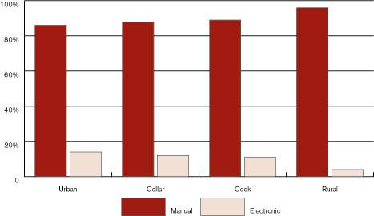

Slide 17
Outreach to Counties Engaged in Integration Efforts
On June 30, 2003, individuals working on county-level integration met to discuss common needs.
McLean, Lake, McHenry, Tazewell, Champaign, Sangamon, Kane, DuPage, Will and Cook are engaged in justice systems integration activities
Each county is going about integration in a slightly different way
There is a need for coordination so that individuals working on integration at the county level will know what their counterparts in other counties are doing

