Slide 1


Notes:
Criminal History Record Information title page

Slide 2
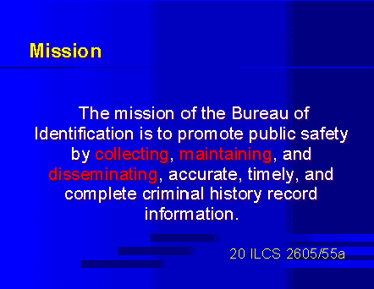
Notes:
Mission

Slide 3
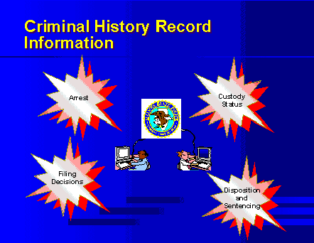
Notes:
4 types of CHRI data

Slide 4
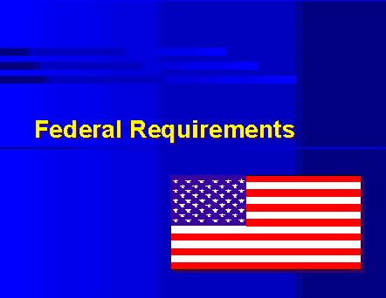
Notes:
Federal Requirements Coversheet

Slide 5
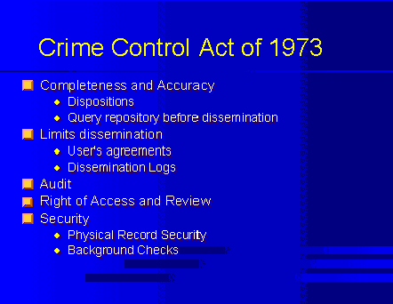
Notes:
Crime Control Act of 1973

Slide 6
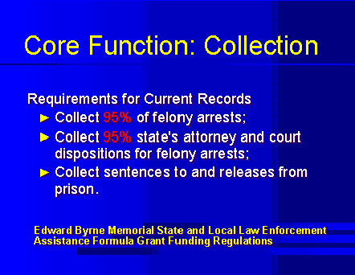
Notes:
Collection

Slide 7
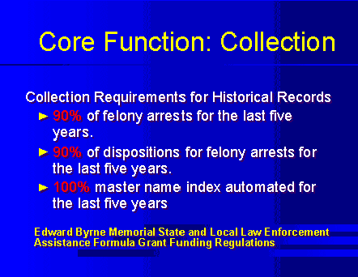
Notes:
Collection

Slide 8
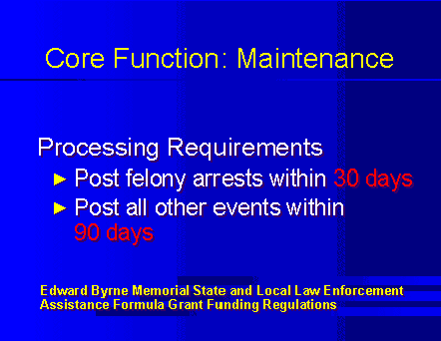
Notes:
Maintenance

Slide 9
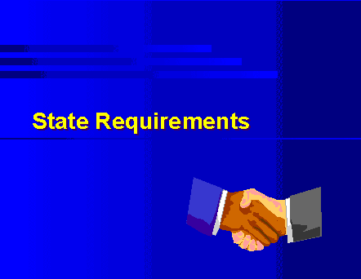
Notes:
State Requirements Coversheet

Slide 10
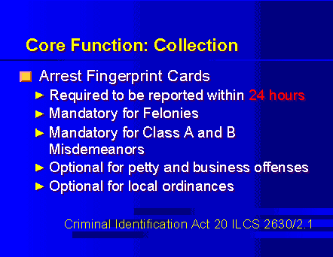
Notes:
Collection

Slide 11
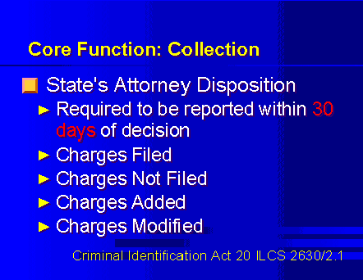
Notes:
Collection

Slide 12
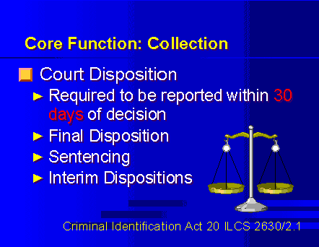
Notes:
Collection

Slide 13
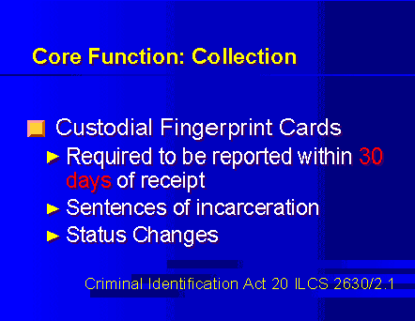
Notes:
Collection

Slide 14
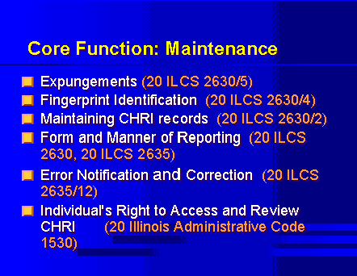
Notes:
Maintenance

Slide 15
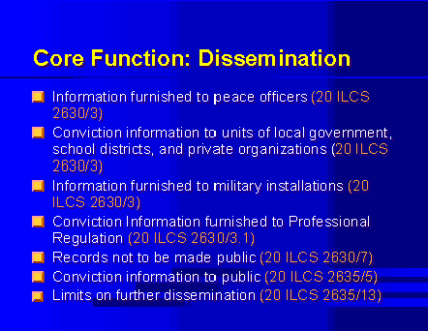
Notes:
Dissemination

Slide 16

Notes:
Standards Coversheet

Slide 17
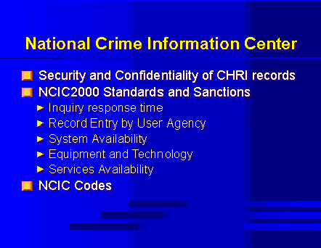
Notes:
NCIC

Slide 18
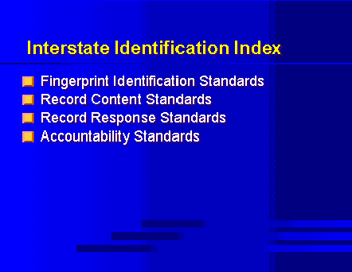
Notes:
I.I.I.

Slide 19
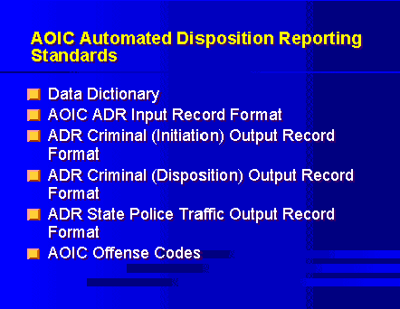
Notes:
AOIC ADR Standards

Slide 20
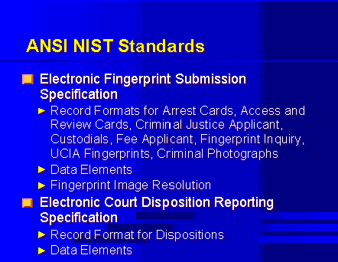
Notes:
ANSI NIST Standards

Slide 21
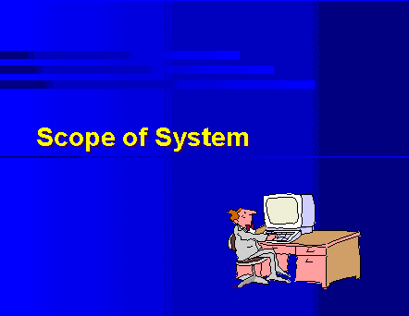
Notes:
Scope of CCH System

Slide 22
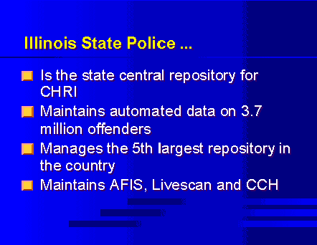
Notes:
ISP

Slide 23
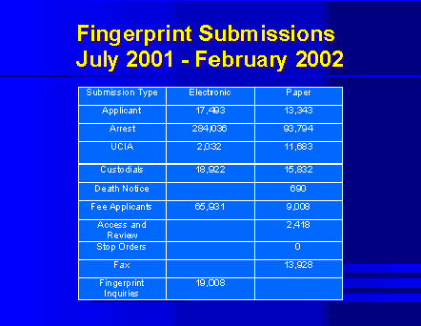
Notes:
Fingerprint Submissions July 2001 – February 2002

Slide 24
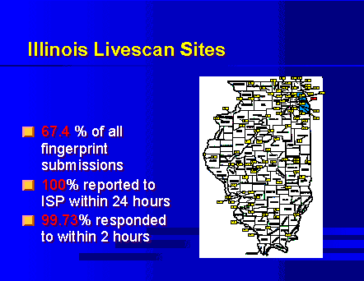
Notes:
Illinois Livescan sites

Slide 25
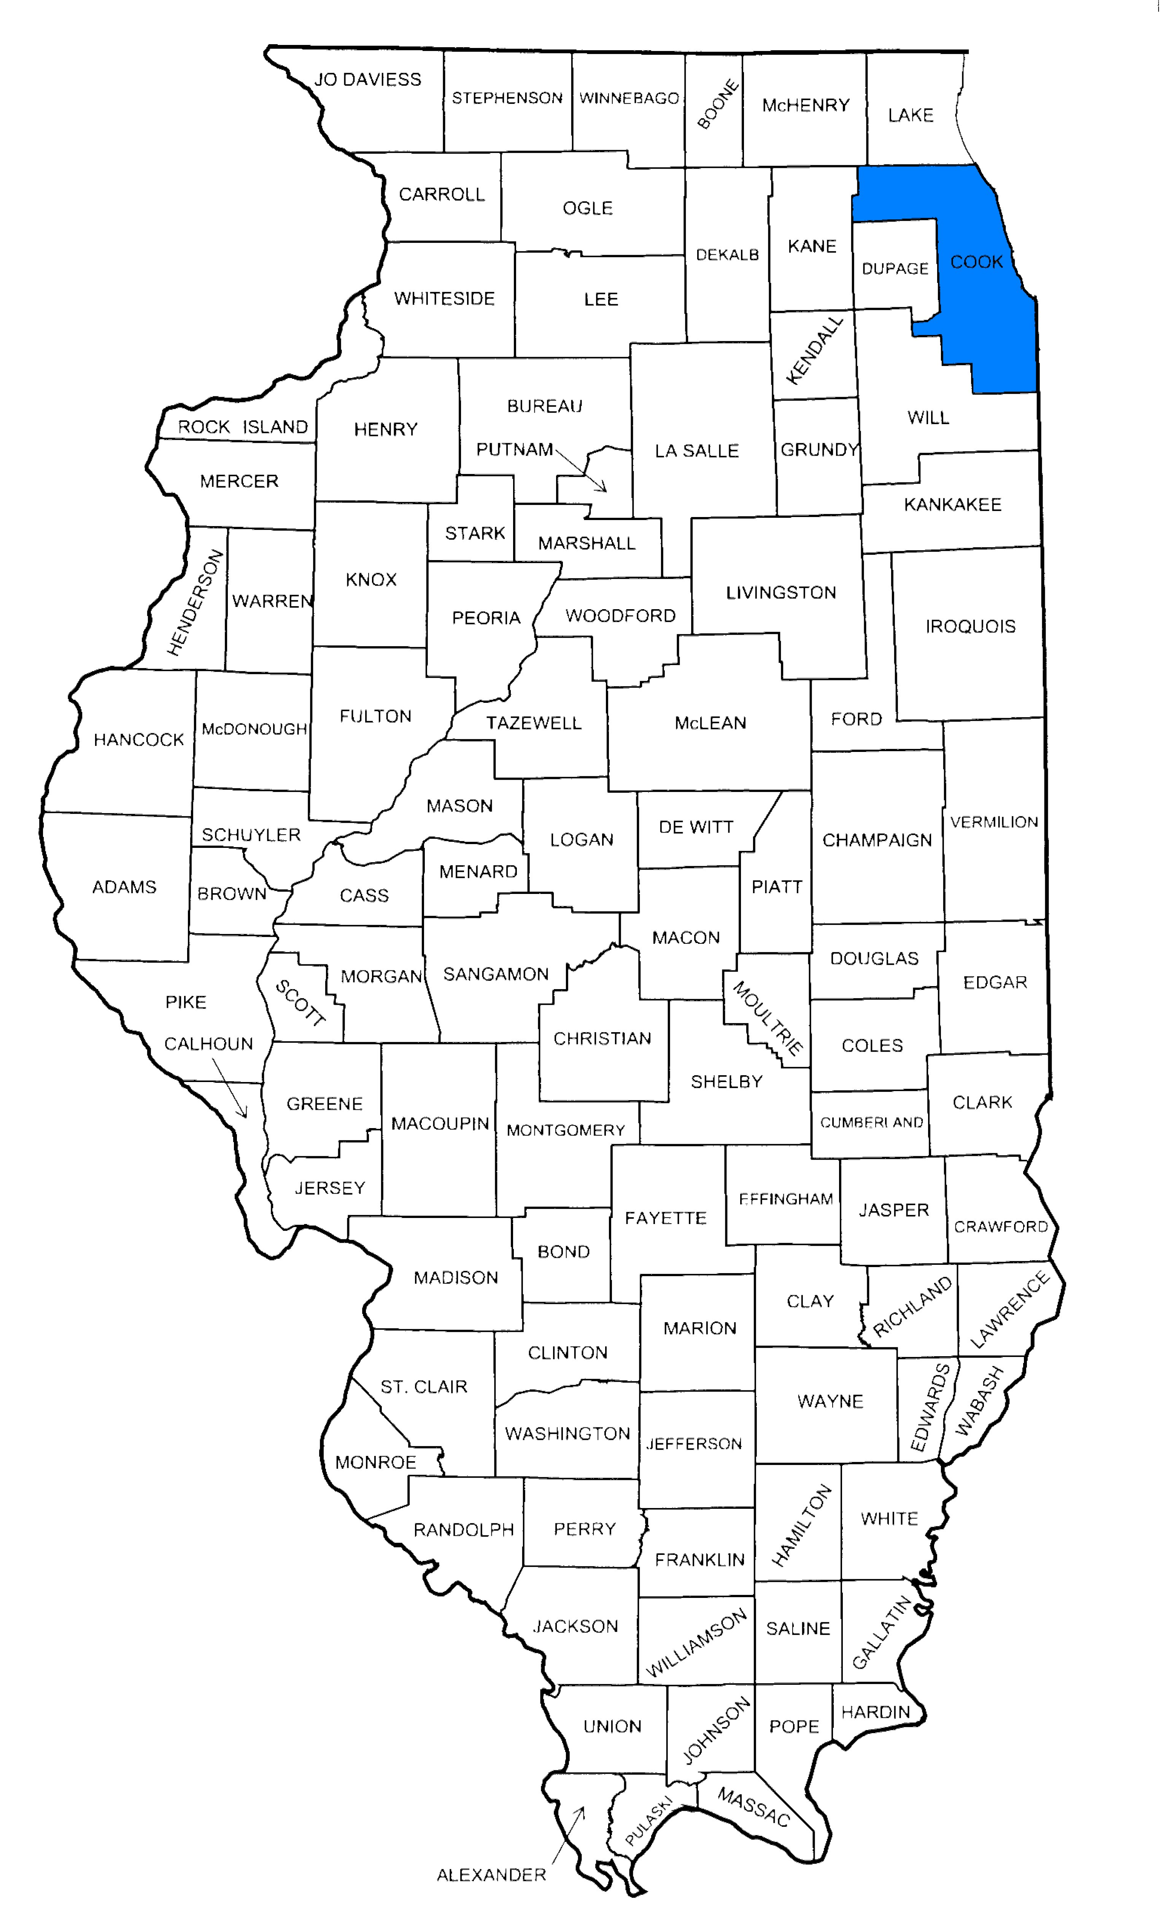
Notes:
Illinois Counties

Slide 26
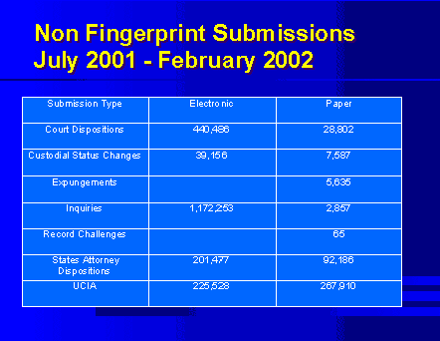
Notes:
Non-Fingerprint Submissions
July 2001 – February 2002

Slide 27
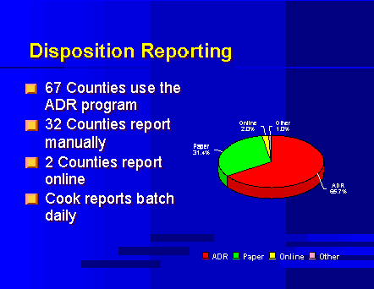
Notes:
Disposition Reporting

Slide 28
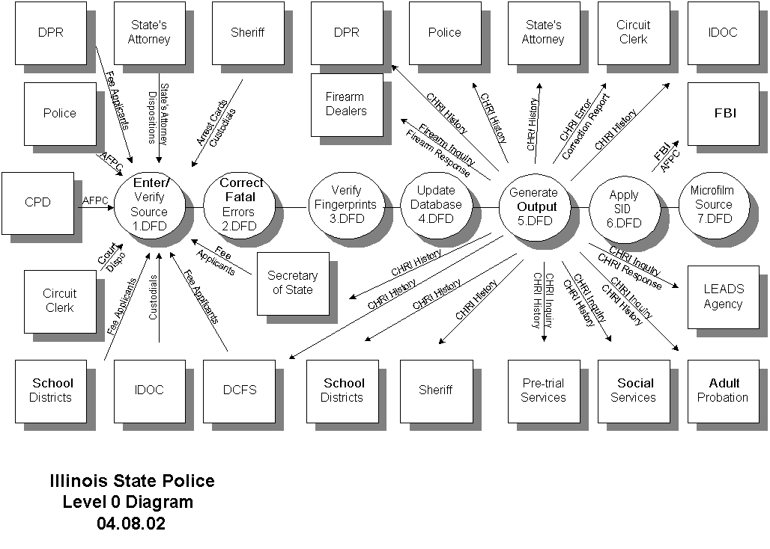
Notes:
Information Flow Diagram

Slide 29
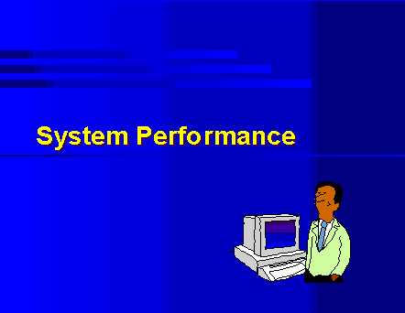
Notes:
System Performance Coversheet

Slide 30
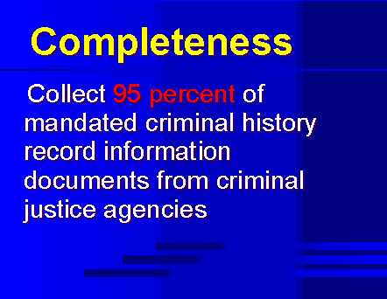
Notes:
Completeness

Slide 31
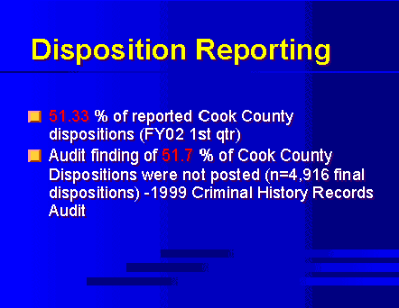
Notes:
Disposition Reporting

Slide 32
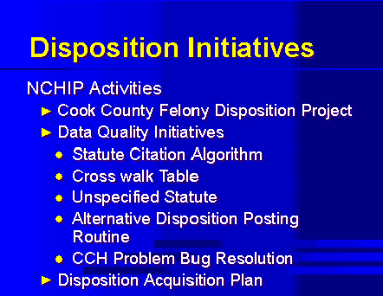
Notes:
Disposition Initiatives

Slide 33
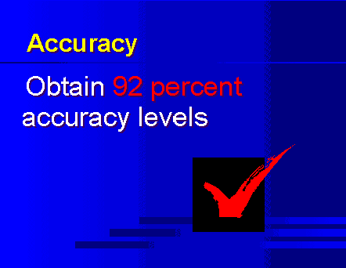
Notes:
Accuracy

Slide 34
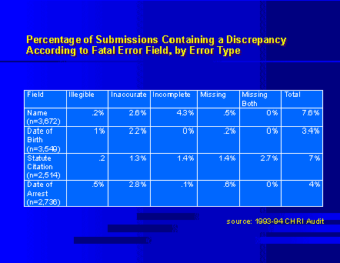
Notes:
Percentage of Submissions Containing a Discrepancy

Slide 35
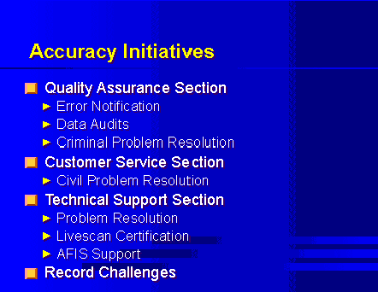
Notes:
Accuracy Initiatives

Slide 36
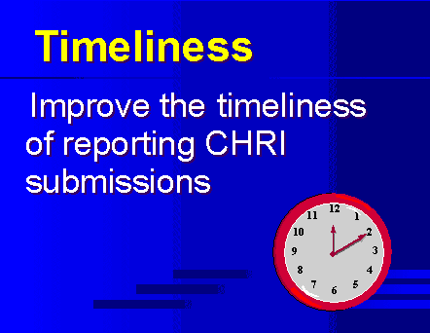
Notes:
Timeliness

Slide 37
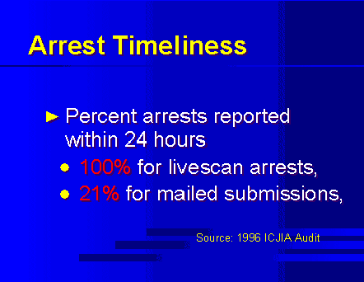
Notes:
Arrest Timeliness

Slide 38
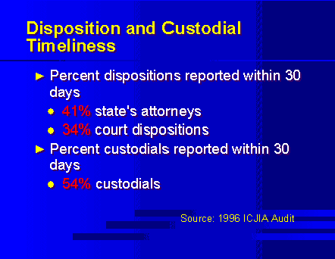
Notes:
Dispositional & Custodial Timeliness

Slide 39
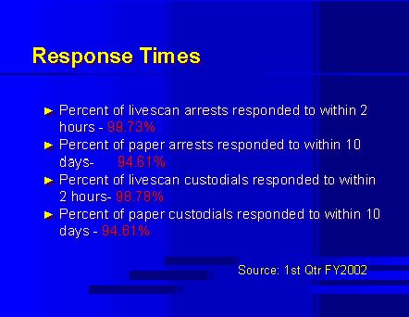
Notes:
Response Times

Slide 40
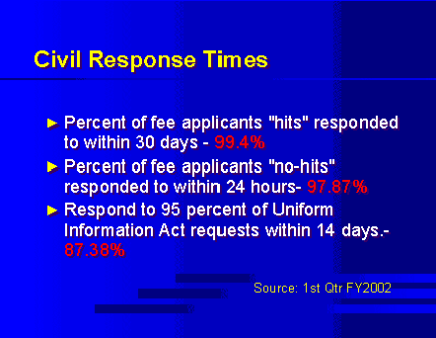
Notes:
Civil Response Times

Slide 41

Notes:
Strategic Initiatives

Slide 42
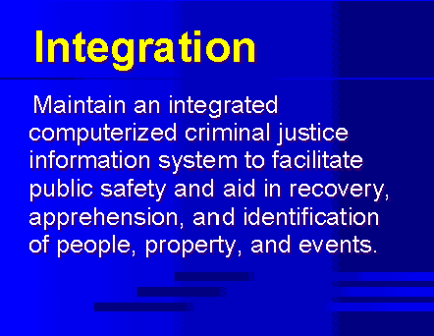
Notes:
Integration

Slide 43
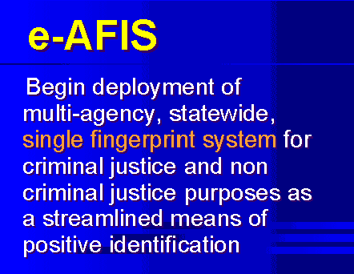
Notes:
e-AFIS

Slide 44
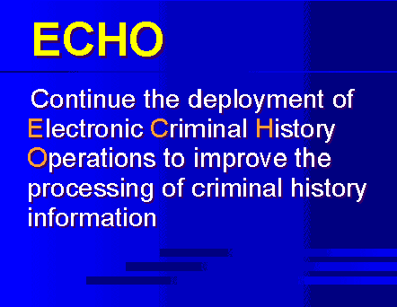
Notes:
ECHO

Slide 45
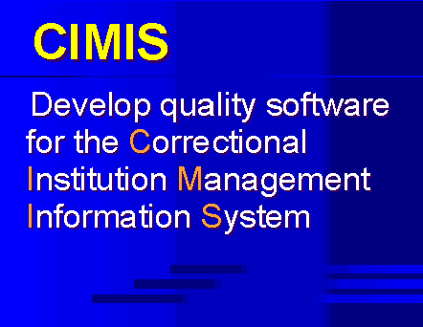
Notes:
CIMIS

Slide 46
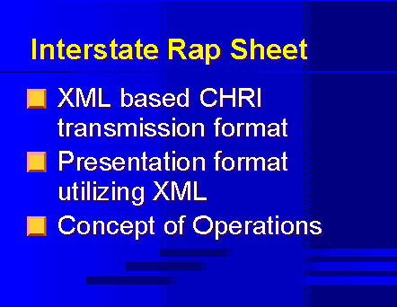
Notes:
Interstate Rap Sheet

Slide 47
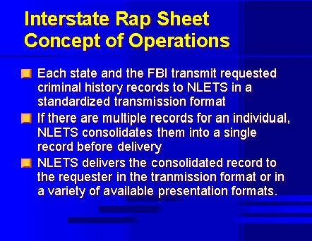
Notes:
Interstate Rap Sheet Concept of Operations

Slide 48
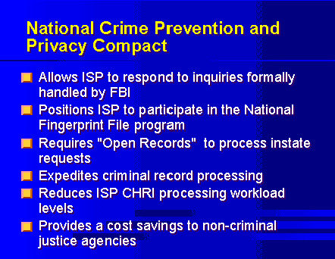
Notes:
National Crime Prevention & Privacy Compact

