Slide 1
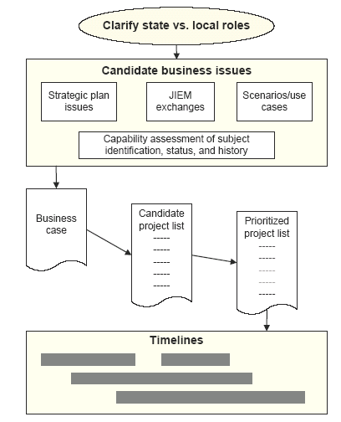
Tactical Planning

Slide 2
State versus local roles
Local exchanges tend to focus on efficiently enabling the everyday workflow between local entities, response and prevention of crimes, and case processing.
State exchanges are primarily focused on maintaining statewide information on subject identification, status, and history that are consumed by all agencies making decisions during critical justice events.

Slide 3
Candidate business issues
Strategic Plan Issues, as well as Scenario and Gap Analysis
JIEM Exchange Documentation
Issues associated with timeliness, completeness, accuracy, and accessibility of statewide subject identification, status, and history.

Slide 4
Components of a business case
Current Situation:
  What is the current business process?
Issues:
  How does the current process not meet the business need?
  What problems or issues are there with the current business process?
  What are the gaps that must be fixed to improve the situation?

Slide 5
Components of a business case
Impact if not implemented:
  What will the impact/consequences be if this issue is not resolved?
Alternatives:
  Describe any alternatives that have been considered
Solution:
  What is the proposed conceptual solution?

Slide 6
Components of a business case
Benefits
  How would the proposed solution improve the business process, quantitatively and qualitatively?
  How does it improve the overriding objectives of statewide subject history, status, and identity?
  Is the benefit impact statewide , cross-jurisdictional, and across organizations?

Slide 7
Components of a business case
Dependencies:
  Does the solution depend on other areas being fixed first?
  Do other areas depend on this solution?

Slide 8
CMS business case requirements for procurement
Basic info on proposed procurement
SPO contact information
Procurement information
Contract information
Contract terms & estimated value
Procurement justification
Summary of responsible bidders

Slide 9
CMS business case requirements for procurement
Procurement justification:
Programmatic objective (already covered?)
Economic justification ✓ (work groups need to address this!)
History/background of recent contracts & duration of vendor relationships (not needed at this stage?)

Slide 10
Tactical Planning

Slide 11
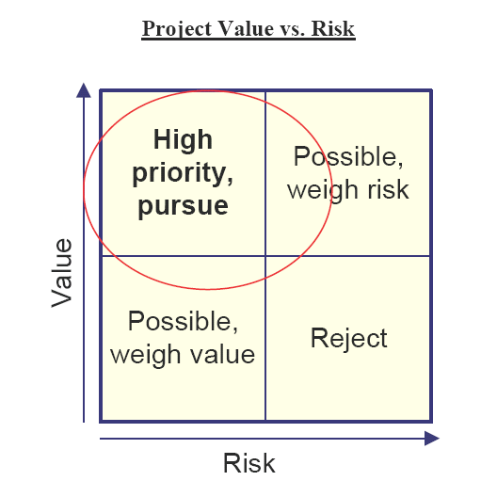
Prioritizing projects

Slide 12
Determining project value
Project improves capability for subject ID, status, and history?
Project provides statewide benefit or only to certain regional or organizational areas?
Project contributes to goals and key issues in Strategic Plan?

Slide 13
Determining project value
Project addresses key gaps in overall criminal justice business process?
Are other projects dependent on this one for their success?

Slide 14
Determining project risk
Can project meet business/operational requirements & make use of existing systems, with little or no changes?
Manageable gap between current system functionality & new business requirements?
Project highly complex, either from business or technical point of view?

Slide 15
Determining project risk
High cost/ difficulty getting funding?
Performance requirements difficult to achieve?
Will project conform to standards?
Personnel with necessary skills readily available for project?

Slide 16
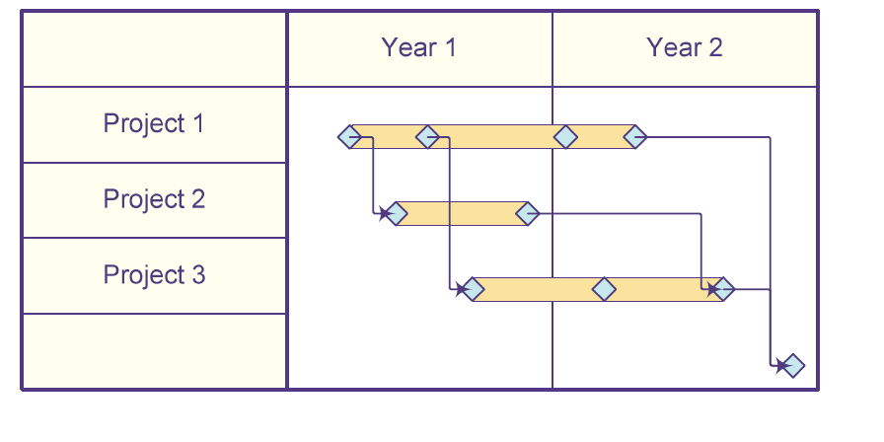
Developing timelines

