Slide 1





Mark
Notes:
Old process

Slide 2


</>
Notes:
Current process

Slide 3
SELECT S.ICJIANumber, C.FIPSnumber, C.CountyName AS Area, S.IndicatorNum_FK, I.Indic_Desc, S.DataYear, I.RateDivsor_FK, Tbl_Indicator.Indic_Desc AS PopType, P.Population_Count AS population, S.DataPoint AS DataCount, IIf([DataPoint] Is Null Or [P].[Population_Count] Is Null,Null,CDbl((Format(([DataCount]/[population])*IIf([I].[RateDivsor_FK]=2,100,100000),"#.0")))) AS rtPer100k, C.FIPSnumber AS FIPS
FROM Tbl_Indicator INNER JOIN ((((Tbl_Indicator AS I INNER JOIN tbl_SimpleCountData AS S ON I.Indic_Number = S.IndicatorNum_FK) INNER JOIN tbl_County AS C ON S.ICJIANumber = C.ICJIAnumber) INNER JOIN tbl_Population AS P ON (I.PopIndic_FK = P.IndicNum_FK) AND (S.DataYear = P.Pop_Year) AND (S.ICJIANumber = P.ICJIAnumber_FK)) LEFT JOIN Qry_M_SimpleCountRates_prep1 ON (S.IndicatorNum_FK = Qry_M_SimpleCountRates_prep1.IndicatorNum_FK) AND (S.DataYear = Qry_M_SimpleCountRates_prep1.DataYear) ANDa (S.ICJIANumber = Qry_M_SimpleCountRates_prep1.Container_ICJIAnum)) ON Tbl_Indicator.Indic_Number = P.IndicNum_FK
WHERE (((Qry_M_SimpleCountRates_prep1.pop) Is Null) AND ((P.IndicNum_FK)=[I].[PopIndic_FK]));
SELECT Tbl_Indicator.Indic_Desc, tbl_County.CountyName, tbl_Jail.Year, tbl_NoteDesc.NoteText
FROM tbl_NoteDesc INNER JOIN (Tbl_Indicator INNER JOIN (tbl_County INNER JOIN (tblJ_DataNoteDesc INNER JOIN tbl_Jail ON (tblJ_DataNoteDesc.DataYear = tbl_Jail.Year) AND (tblJ_DataNoteDesc.ICJIANumber = tbl_Jail.ICJIAnumber_FK) AND (tblJ_DataNoteDesc.Indic_Number = tbl_Jail.IndicNum_FK)) ON tbl_County.ICJIAnumber = tbl_Jail.ICJIAnumber_FK) ON (Tbl_Indicator.Indic_Number = tblJ_DataNoteDesc.Indic_Number) AND (Tbl_Indicator.Indic_Number = tbl_Jail.IndicNum_FK)) ON tbl_NoteDesc.NoteDesc_ID = tblJ_DataNoteDesc.NoteDescID_FK
WHERE (((tblJ_DataNoteDesc.PublicNote)=True) AND ((Tbl_Indicator.Indic_Number) Between 1500 And 1510))
ORDER BY Tbl_Indicator.Indic_Desc, tbl_County.CountyName, tbl_Jail.Year;
SELECT Tbl_Indicator.Indic_Number, Tbl_Indicator.Indic_Desc, Tbl_Indicator.Indic_Source, tbl_SimpleCountData.ICJIANumber, tbl_SimpleCountData.DataYear, tbl_SimpleCountData.DataPoint
FROM tbl_SimpleCountData INNER JOIN Tbl_Indicator ON tbl_SimpleCountData.IndicatorNum_FK = Tbl_Indicator.Indic_Number
WHERE (((Tbl_Indicator.Indic_Source)="Administrative Office of the Illinois Courts"));
SELECT Tbl_Indicator.Indic_Number, Tbl_Indicator.Indic_Desc, tblJ_DataNoteDesc.ICJIANumber, tbl_County.CountyName, tblJ_DataNoteDesc.DataYear, tbl_NoteDesc.NoteText, tblJ_DataNoteDesc.PublicNote
FROM tbl_NoteDesc INNER JOIN (Tbl_Indicator INNER JOIN (tblJ_DataNoteDesc INNER JOIN tbl_County ON tblJ_DataNoteDesc.ICJIANumber = tbl_County.ICJIAnumber) ON Tbl_Indicator.Indic_Number = tblJ_DataNoteDesc.Indic_Number) ON tbl_NoteDesc.NoteDesc_ID = tblJ_DataNoteDesc.NoteDescID_FK
WHERE (((tblJ_DataNoteDesc.PublicNote)=True));
Notes:
Modularity 1

Slide 4
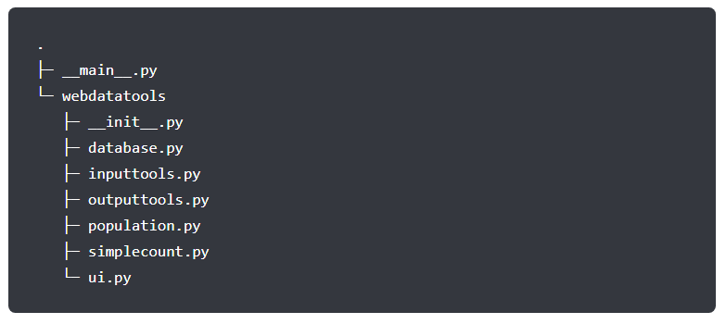
Notes:
Modularity 2

Slide 5




Notes:
Efficiency

Slide 6
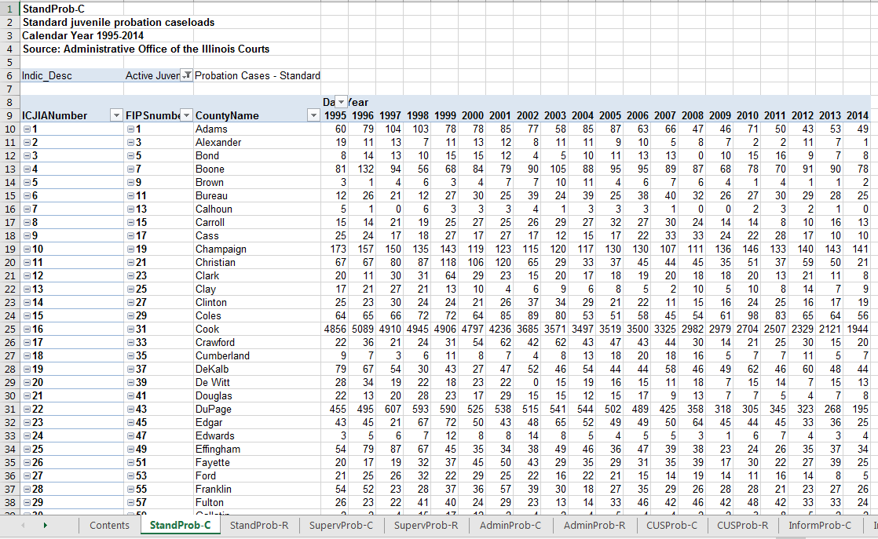
Notes:
Format 1

Slide 7
Notes:
Format 1

Slide 8
Notes:
Format 1

Slide 9
Notes:
Format 1

Slide 10
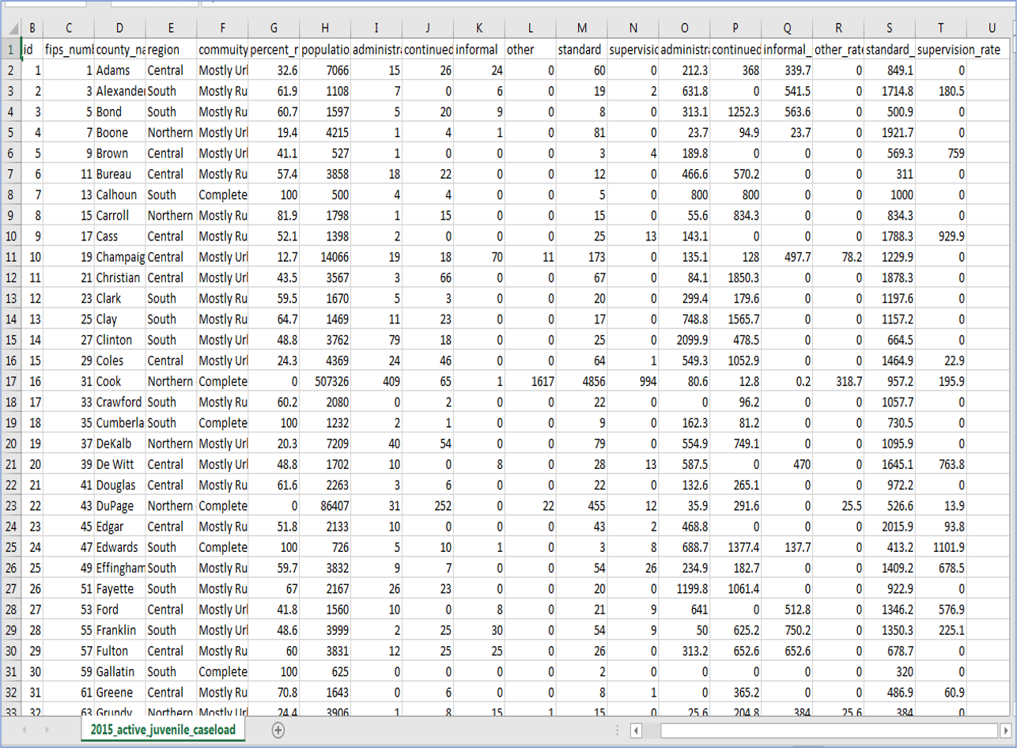
Notes:
Format 2

Slide 11
Notes:
Format 2

Slide 12
Notes:
Format 2

Slide 13
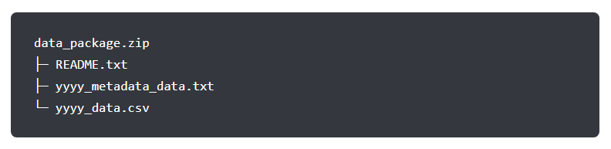
Notes:
Format 2

Slide 14
Mark
Notes:
Division of labor 1

Slide 15
</>
Notes:
Division of labor 2

