Slide 1
ICLAD 2025 GenAI Hackathon

Slide 2
Hackathon Overview

Slide 3
Problem Categories and Track
🛤️ Hackathon Tracks
The hackathon features two exciting tracks:
💻 SLM Challenge
Solve design tasks using small language models (SLMs) on low-cost laptops provided at the event.
☁️ Open Challenge
Use any GenAI models, including large language models (LLMs) running in the cloud. For this hackathon, we have support for Gemini APIs via Google Cloud Platform (GCP).
Participants choose any one track

Slide 4
Problem Categories and Track
🛠️ GenAI for Spec2Tapeout (ASU) Build an agent that generates RTL and GDS from design specs—automated start-to-finish flow.
🔍 GenAI for Design Verification (Google) Given buggy RTL and specs, create testbenches to catch sneaky logic bugs 🐞⚡.
🌀 Miscellaneous CVDP Problems (NVIDIA) Different tasks that include RTL debugging, testbench integration, design edits, and EDA workflow setup.
🔧 GenAI for Logic Synthesis (Qualcomm, NXP) Generate buggy RTL from the buggy netlist and correct RTL files.
Each category has multiple problems with varying levels of difficulty. Solve as many problems as you can across multiple categories. Winners will be named in each category and track.
Participants choose any number of problem categories that can be solved with either track

Slide 5
Venue and Location
Co-located with DAC 2025
Moscone West, 3012, 3rd Floor
Date: June 22, Sunday 9:00 AM
DAC registration is required

Slide 6
DAC/ICLAD GenAI Hackathon
GCP Infrastructure

Slide 7
Initial Setup
and login

Slide 8
Setup and login to GCP VM
Username/Password: Provided/will be provided via email.
VNC Viewer: External IP address and VNC password provided for existing VM (recommended)
Optional: Documentation to create more VMs is also provided

Slide 9
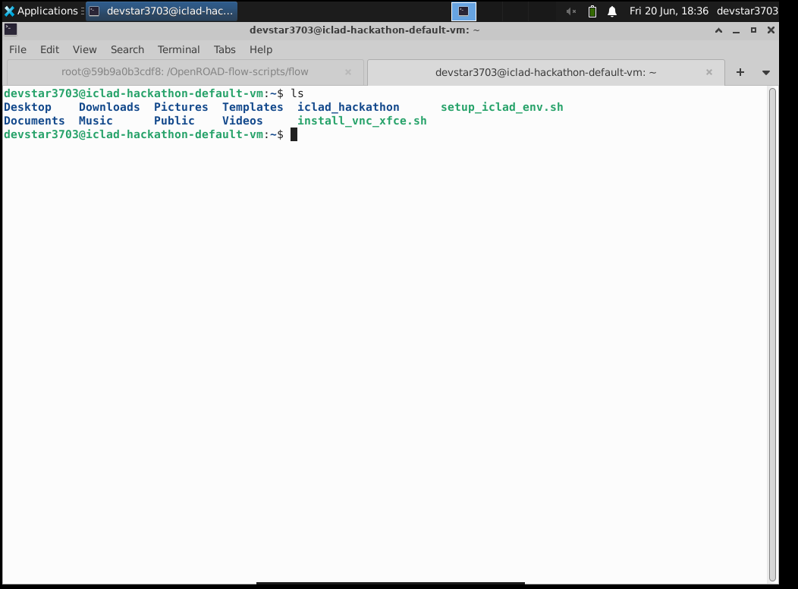
Virtual Machine Environment
The ICLAD Hackathon Repository is already pre-cloned and available
~/iclad_hackathon/ICLAD-Hackathon-2025
The problem categories repository has submodule to all the problems.
Each problem category:
Detailed description
Submission process
Evaluation

Slide 10
Docker Image Setup For Prerequisites
For the following problem categories:
GenAI for Spec2Tapeout (ASU)
GenAI for Design Verification (Google)
GenAI for Logic Synthesis (Qualcomm
In the VNC viewer
Start the docker image with the installed prerequisites and mount your repository
docker run -it --rm -v ~/iclad_hackathon:/workspace/iclad_hackathon iclad_hackathon:latest bash
The docker has the workspace mounted and it will have preinstalled prerequites
Prerequisites: OpenROAD-flow-scripts, iVerilog gtkwave

Slide 11
Docker Image Setup For Prerequisites
For the following problem categories:
Miscellaneous NVIDIA CVDP problems
~/iclad_hackathon/ICLAD-Hackathon-2025/problem-categories
From the virtual machine:
Follow instructions available https://github.com/ICLAD-Hackathon/NVIDIA-ICLAD25-Hackathon/README.md
Docker image will be pre-built for you on the VM to save some time

Slide 12
Interacting with Gemini on GCP
Hello World with Gemini on GCP
from vertexai.preview.generative_models import GenerativeModel import vertexai vertexai.init(location="us-central1") model = GenerativeModel("gemini-2.0-flash-001") response = model.generate_content("Say hi from inside the ICLAD Hackathon container!") print(response.candidates[0].text)

Slide 13
Action Items Before Sunday (if possible)
Email your team members name and if you are interested in the LLM track to receive your username and passwords for VNC
iclad2025-hackathon@googlegroups.com
Access your GCP VMs via VNC
Browse through the directory structure and familiarize yourself with the working environment. You can install anything else that you like inside docker or inside the VM to make you productive
Look at the details on each problem category on https://github.com/ICLAD-Hackathon/NVIDIA-ICLAD25-Hackathon
Expectations
Evaluation
Submission process

