Slide 1
COPSS Instructions
Georg-August-Universität Göttingen
GreenICN project
July 5th, 2014
{jiachen.chen, bruno.ricci}@informatik.uni-goettingen.de

Slide 2
COPSS Preparation
Operating system:
Tested on Ubuntu 12.04 LTS, Ubuntu 13.10 and Ubuntu 14.04
Exact distribution/version should not matter
Commands in this guide: Ubuntu 13.10
Java:
openjdk-7-jdk
CCNx:
CCNx 0.8.0 (provided with the package)
Wireshark 1.8.6 (provided with the package), with CCNx plugin
COPSS binary:
Provided with the package

Slide 3
Java
Java 7 installation:
sudo apt-get install openjdk-7-jdk openjdk-7-jre
Please make sure that you are using openjdk 7 (not 6). Test:
java -version
Sometimes, you will need to switch to java 7 from 6. Two options for Java 6/7 switch:
Removal, but might break/not work with other apps
sudo apt-get remove openjdk-6-jdk openjdk-6-jre
Updating java/javac alternatives, running both the commands
sudo update-alternatives --config javac
sudo update-alternatives --config java
From now on, “switch to Java *” refers to one
of the two solutions above

Slide 4
CCNx
Prerequisites (taken from https://www.ccnx.org/wiki/CCNx/InstallingCCNx)
sudo apt-get install build-essential ant autoconf automake libssl-dev libexpat1-dev libpcap-dev libecryptfs0 libxml2-utils gawk gcc g++ git-core pkg-config libpcre3-dev
Compilation and installation steps:
Unpack ccnx-0.8.0.tar.gz and move into its directory
Compile and install in the classical way:
./configure
make
sudo make install
Checkpoint: check the following commands
ccndstart
ccndstop
ccndc add
ccnr
ccnputfile
ccngetfile

Slide 5
Wireshark
Prerequisites
sudo apt-get build-dep wireshark
Compilation and installation steps:
Unpack wireshark-1.8.6.tar.bz2 and move into its directory
Go to wireshark folder
Copy all the CCNx plugin files in the plugins/ccn directory
cp -R ../ccnx-0.8.0/apps/wireshark/ccn plugins/ccn
Apply patch from CCNx.
patch –p1 < ../ccnx-0.8.0/apps/wireshark/wireshark-1.8.6.patch
Run autogen.sh and then compile and install in the classical way:
./autogen.sh
./configure
make
sudo make install
Checkpoint: launch a Wireshark capture and do some CCNx related operations (e.g. ccngetfile/ccnputfile)

Slide 6
Start COPSS
Run COPSS binary:
Move to COPSSBinary directory
java -jar COPSSD.jar
You can see a “FileNotFoundException” (see Create an initial COPSS setting) .
Commands available:
link %address% %port% %isRouter%
link to a node on address:port and tells if the node is a router.
FIB %name% %address% %port%
add an FIB entry name->address:port
RP %RPName%
starts an RP module using RPName
status
show the status of the COPSSD
help
show help message.
stop
stop COPSSD.

Slide 7
Test 1: Query/response using COPSS wrapper
Architecture
COPSSD
COPSSD
9696
9696
Client
CCND
CCND
CCN
repo
M1
M2

Slide 8
Test 1: Query/response using COPSS wrapper
Steps:
Start ccnd and COPSSD on M1 and M2
In COPSSD on M1:
link M2.IP 9696 true
COPSSD will listen on a random port (M1.P1) and create a face in CCNx on that port
In COPSSD on M2:
link M1.IP 9696 true
COPSSD will listen on a random port (M2.P1) and create a face in CCNx on that port
If you see “Cannot find face…”, ignore the messages
In COPSSD on M1
FIB /test M2.IP 9696
COPSSD on M1 will add an FIB entry in CCNX: “/test” → M1.P1
FIB /ccnx.org M2.IP 9696
This command is for key exchange when sending file.
On M2 start ccnr and put a file into the repo using ccnputfile and providing ContentName “/test/file1”
On M1:
ccngetfile /test/file1 test
Notes:
This message appear in the later version of ccnx. When a face is added to ccnx, it will send ping message (an Interest with name ccnx:/%C1.M.FACE). After you type command (link M2) in M1, M1’s ccnx will try to send ping to M2’s ccnx via COPSS layer. But at that time, M2’s COPSS layer has not accepted M1 yet. It will reject the packets from M1 and print out that message.

Slide 9
Test 1: Pub/Sub using COPSS
Architecture
COPSSD
COPSSD
9696
9696
C1
C2
CCND
CCND
C3
M1
M2

Slide 10
Test 2: Pub/Sub using COPSS
Steps:
Start ccnd and COPSSD on M1 and M2
In COPSSD on M1:
link M2.IP 9696 true
COPSSD will listen on a random port (M1.P1) and create a face in CCNx on that port
In COPSSD on M2:
link M1.IP 9696 true
COPSSD will listen on a random port (M2.P1) and create a face in CCNx on that port
In COPSSD on M1
FIB /RP M2.IP 9696
In COPSSD on M2
RP /RP
Start SimpleCOPSSClients (with the package in SimpleCOPSSClientBinary)
java -jar SimpleCOPSSClient.jar %listenPort%
Cn listens on Cn.P

Slide 11
Test 2: Pub/Sub using COPSS
Steps:
In COPSSD on M1:
link 127.0.0.1 C1.P false
link 127.0.0.1 C2.P false
This links COPSSD with the clients
In COPSSD on M2:
link 127.0.0.1 C3.P false
If you see “Invalid packet type” on clients, ignore.
Commands available in SimpleCOPSSClient:
sub: subscribe to a set of CDs
unsub: unsubscribe from a set of CDs
pub: publish a message
help: print this message
stop: cleanup the states and exit the program
Examples (see next slide)
Use different combinations of subscription and publication to send/receive data
Notes:
This invalid packet type is also caused by ping messages we mentioned in Page 8. just ignore it. Should be fine.

Slide 12
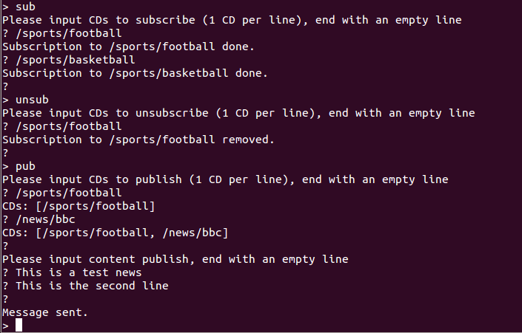
Test 2: Pub/Sub using COPSS
SimpleCOPSSClient commands example:
Subscribe to
/sports/football
/sports/basketball
Unsubscribe from
/sports/football
Publish a message

Slide 13
Programming interface of COPSS client
For query/response, please use the original CCNx commands
For FIB add/removal please use the commands in COPSSD
Library for COPSS client (with the package, in EndHostLib)
package common;
abstract class NetworkListener:
Listens to a UDP port and handles UDP packets
public NetworkListener(int port)
Initiator of the class
port: the UDP port to listen to
protected abstract void handlePacket(DatagramPacket packet)
Callback function, called when there is a packet on the port
packet: the packet received
protected void send(InetSocketAddress target, byte[] buf)
packet: the target to send the UDP packet to
buf: the content of the UDP packet

Slide 14
Programming interface of COPSS client
Library for COPSS client (with the package, in EndHostLib)
package copss.protocol;
public final class Control extends GenericXMLEncodable:
Packet for subscribe/unsubscribe
This packet can also be extended to FIB change and others. The control messages in COPSS. Control.ControlType.FIBChange not implemented.
public Control(Control.ControlType type, LinkedList<ContentName> contentNameAdd, LinkedList<ContentName> contentNameRemove, int version, int ttl)
Initiator of the class
type: type of the packet (Control.ControlType.STChange for now)
contentNameAdd: CDs to subscribe to
contentNameRemove: CDs to unsubscribe from
version: version of the packet (reserved)
ttl: TTL of the packet, -1 for infinite
Check org.ccnx.ccn.protocol.Interest in CCNx to see how to convert between Control (Interest) and byte[]

Slide 15
Programming interface of COPSS client
Library for COPSS client (with the package, in EndHostLib)
package copss.protocol;
public final class Multicast extends GenericXMLEncodable:
Packet for Publish (multicast)
public Multicast(LinkedList<ContentName> contentNames, byte[] content)
Initiator of the class
contentNames: CDs of the message
content: content of the message
Check org.ccnx.ccn.protocol.Interest in CCNx to see how to convert between Multicast (Interest) and byte[]
Example COPSS client code in folder SimpleCOPSSClient
Only 1 Java file (simplecopssclient.SimpleCOPSSClient.java)

Slide 16
Programming interface of COPSSD
To start/stop COPSSD from Java program rather than command line, you can create COPSSD object in your code directly if you use COPSSD.jar (and other jars in the COPSS binary lib) as your library.
package copss.protocol;
public class COPSSD extends NetworkListener
COPSS Daemon
public COPSSD(int listenPort, int ccnPort)
Create a COPSS daemon and start listening on listenPort
listenPort: the port COPSSD listens to
ccnPort: the local UDP port CCND listens to
public int link(InetSocketAddress address, boolean isRouter)
Same as link command
public boolean addFIB(ContentName prefix, InetSocketAddress outgoingAddress)
Same as FIB command
public int setRP(ContentName rpName)
Same as RP command

Slide 17
Programming interface of COPSSD
To start/stop COPSSD from Java program rather than command line, you can create COPSSD object in your code directly if you use COPSSD.jar (and other jars in the COPSS binary lib) as your library.
package copss.protocol;
public class COPSSD extends NetworkListener
COPSS Daemon
public String toString()
Same as status command
public void stop()
Same as stop command
Please check COPSSDsrc/Main.java to see how to control COPSSD object

Slide 18
Create an initial COPSSD setting
By default, COPSSD will read “Command.txt” for startup settings
That’s why you see the FileNotFoundException at the beginning
You can put COPSSD commands in the Command.txt file to avoid typing the commands repeatedly.
E.g., on M1, you can write in Command.txt
link M2.IP 9696 true
link 127.0.0.1 C1.P false
link 127.0.0.1 C2.P false
FIB /RP M2.IP 9696
FIB /test M2.IP 9696
FIB /ccnx.org M2.IP 9696
…

