Slide 1
Systems and Molecular Biology Data Archive (SyMBA):
Implementing the FuGE Milestone 3
Object Model
  Allyson Lister
  Centre for Integrated Systems Biology of
  Ageing and Nutrition (CISBAN)
  Newcastle University
  http://symba.sourceforge.net
  http://www.cisban.ac.uk
  August 2007

Slide 2
  SyMBA:
  Overview
Based on the Functional Genomics Experiment Object Model / Markup Language (FuGE-OM, FuGE-ML)
  http://fuge.sourceforge.net
Implements FuGE to create a systems biology data portal, archive, and data integration tool
  Archive of raw, High-Throughput (HT) data and associated metadata
  Useful as input in research into integrative bioinformatics within the CISBAN in silico group.

Slide 3
SyMBA:
“FuGE+” (Milestone 3)
Additions to the FuGE-OM
  FuGE Identifiers are LSIDs
  LSID Resolution Service and Assigner are integrated into the UI and Programmer's Software ToolKit (STK)
  A more complex versioning system has been layered on top of the existing OM
    ONLY additions to the UML: no deletions or modifications of existing entities/relationships/attributes
  Added querying capability
  Simple front-end web interface for experimentalists
  Pre-loading of users and workflows/protocols.

Slide 4
Purple: hand-generated
Blue: automatically-generated
Yellow: programmatic access
Green: End-User / GUI access
FuGE-OM
Back-end Database (MySQL, PostgreSQL...)
LSID
Assigner
(SOAP)
Java Object Persistence Layer
CISBAN STK (FuGE+): Developers just deal with POJOs!
XML
Marshaler/
Unmarshaler
Web Interface
JSPs
JavaBeans
LSID
Authority
(HTTP and
SOAP)
Programmatic
Access
Biologists/
End-Users
Programmatic Access (Taverna?)
and End-Users (Firefox Plugin?)
Programmatic
Access

Slide 5
SyMBA:
LSID Authority
Retrieving objects programmatically from the database in FuGE-ML is straightforward: just contact the LSID Resolution Service.
  Programmers may construct LSIDs based on timestamps, to retrieve the data as it was at a specific time
  Programmers may use existing LSIDs to retrieve specific versions

Slide 6
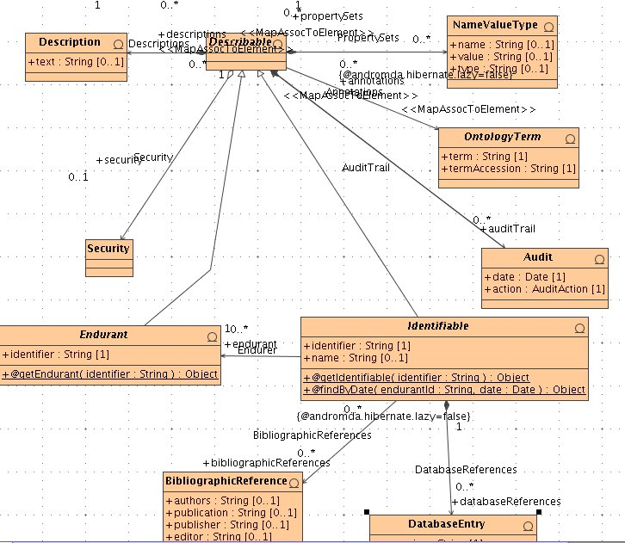
The addition of the Endurant Entity
(and its associated children entities)
is the only significant addition to the
FuGE STK.

Slide 7
SyMBA:
Versioning
“Endurant” objects endure over space and time
  Identified with an LSID
  Do not change their intrinsic value over time
  May point to many versions of non-enduring objects, one version for each modification
  These LSIDs are, by CISBAN definition, unresolvable.
“Identifiable” objects are just the current state of the Endurant
  All other objects identified with an LSID
  Will always point to the same, single, version of the object
  Are resolvable.
Error-correction or adding more information (such as fixing a typo in the name of a robot) creates new versions of the same Endurant
A fundamental change in an object (such as the addition of a new camera on a robot) means that the robot is a new enduring object, and the Identifiable object will be assigned to a new Endurant LSID

Slide 8
SyMBA:
Versioning
Endurants
Simple “Identifiables”
1234
“Rbot 1”
2007-01-01 12:00.00
“Robot 1”
2007-01-14 12:00.00
...Camera XYZ added
2345
“Robot 1 with Camera XYZ”
2007-01-14 12:10.00

Slide 9
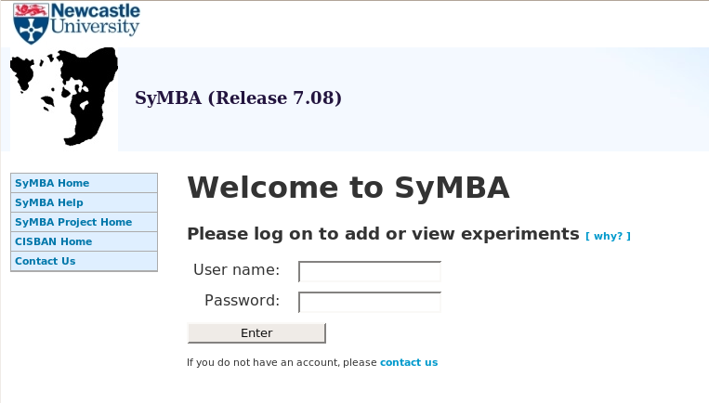

Slide 10
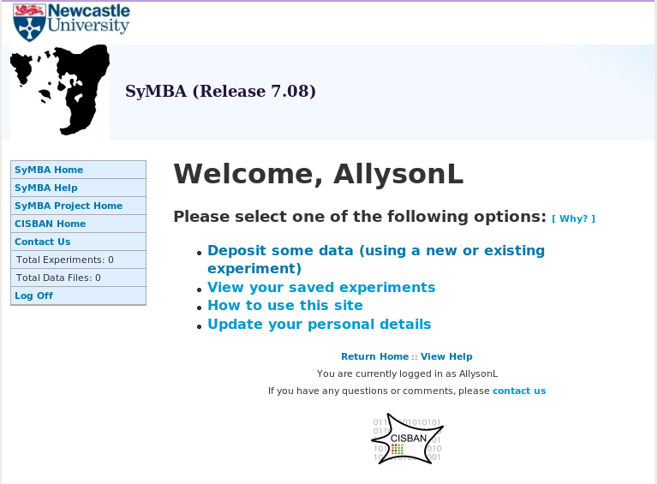

Slide 11
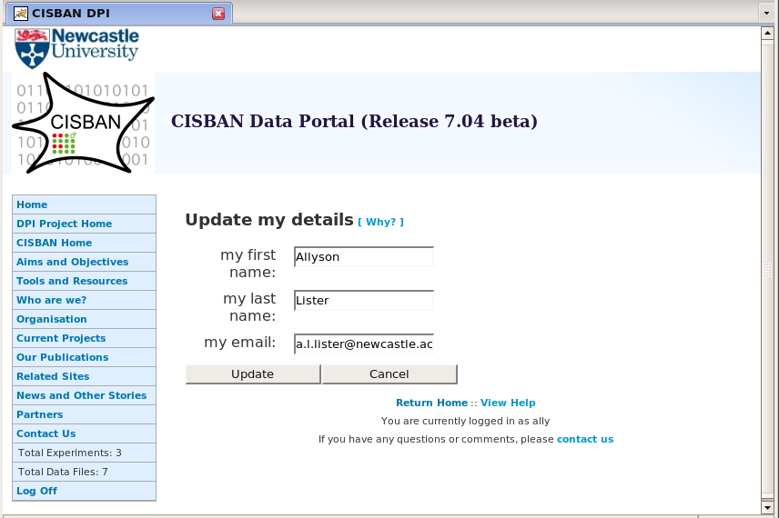

Slide 12
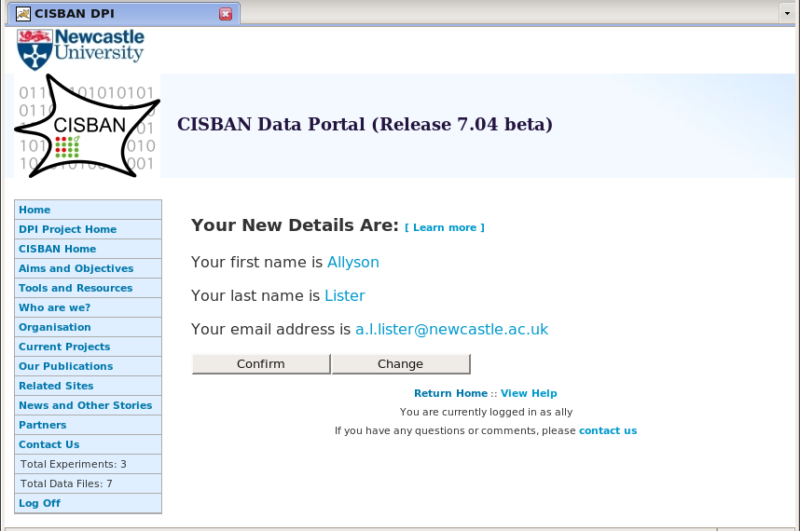

Slide 13
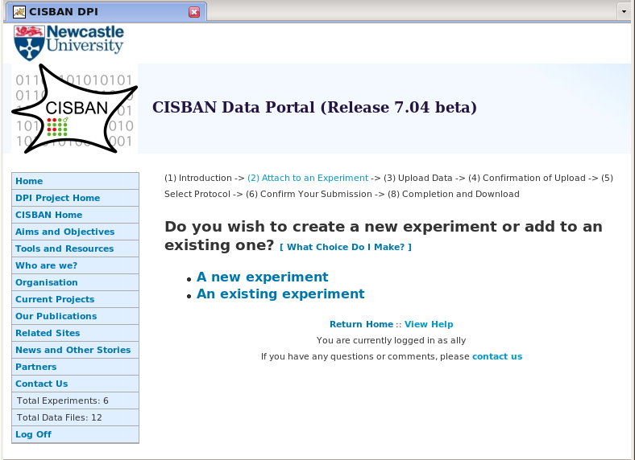

Slide 14
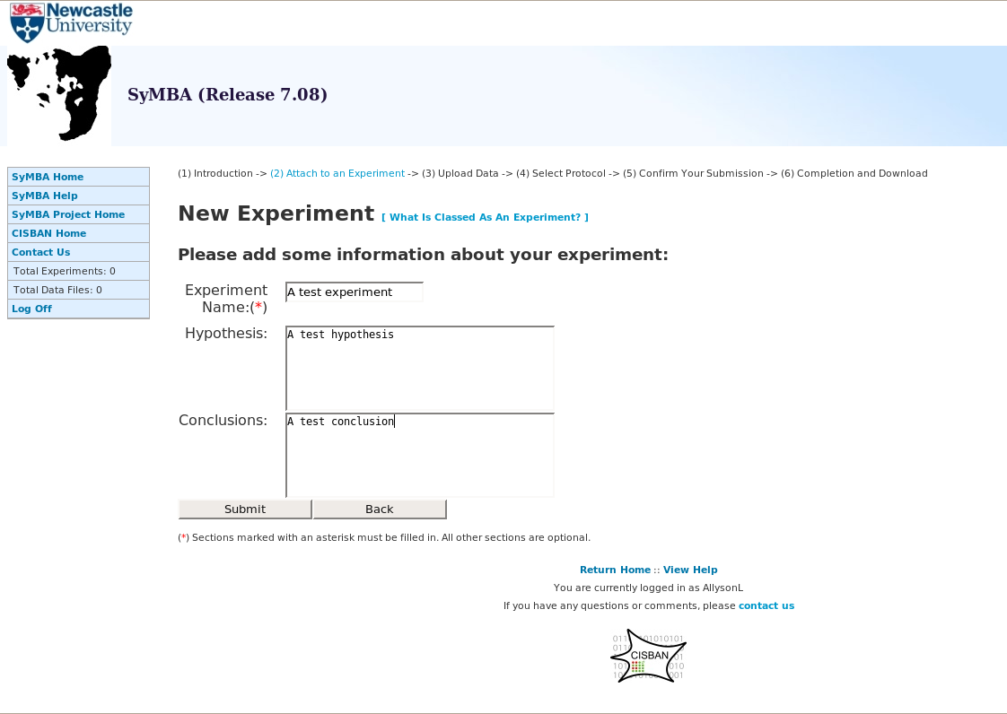

Slide 15
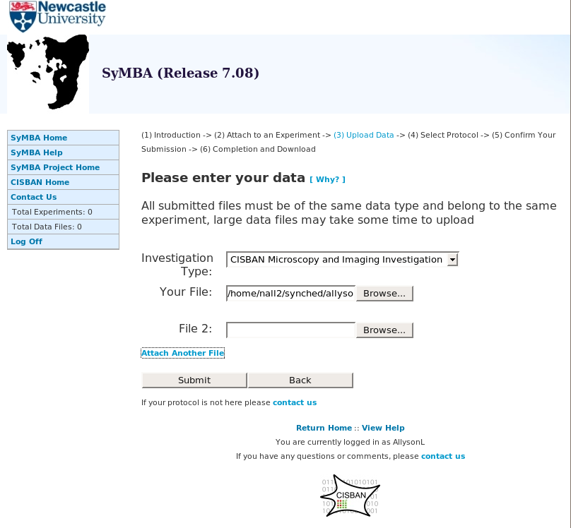

Slide 16
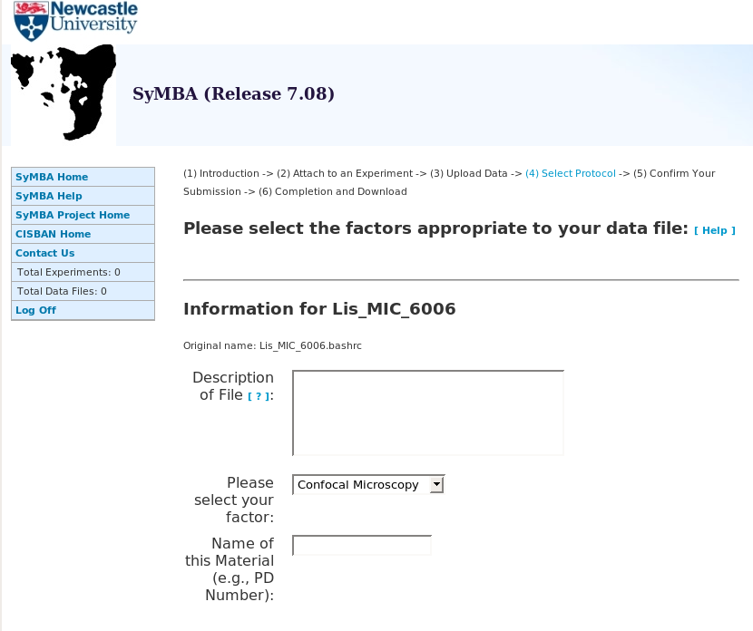

Slide 17
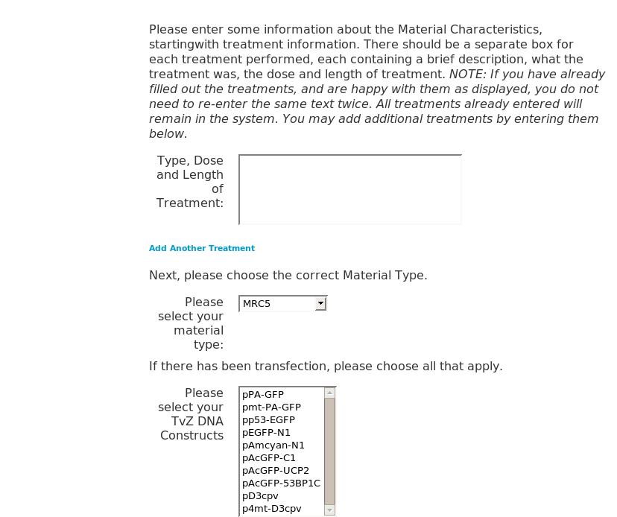

Slide 18
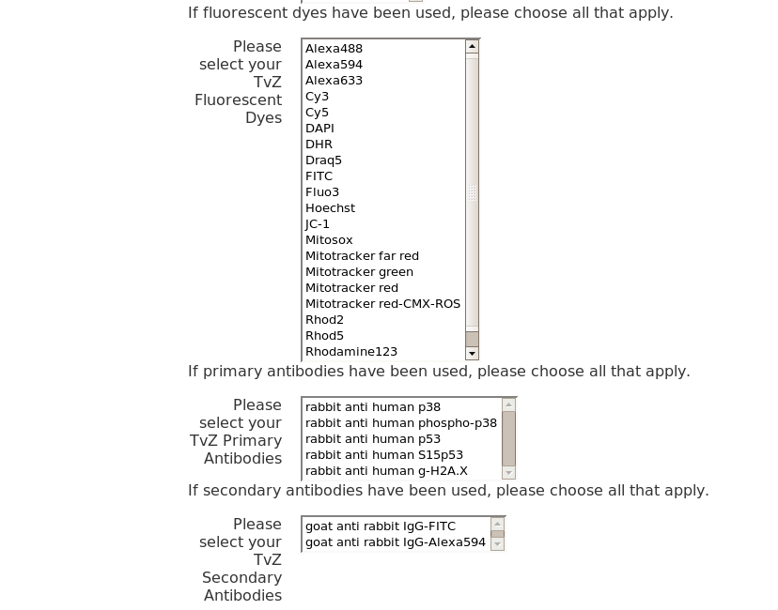

Slide 19
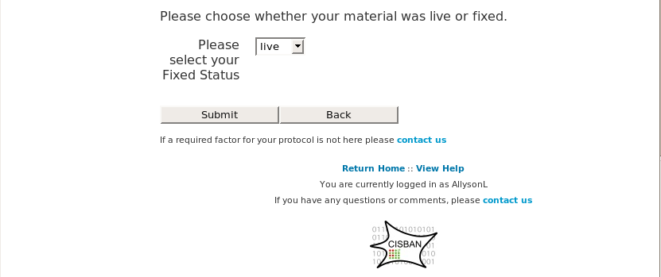

Slide 20
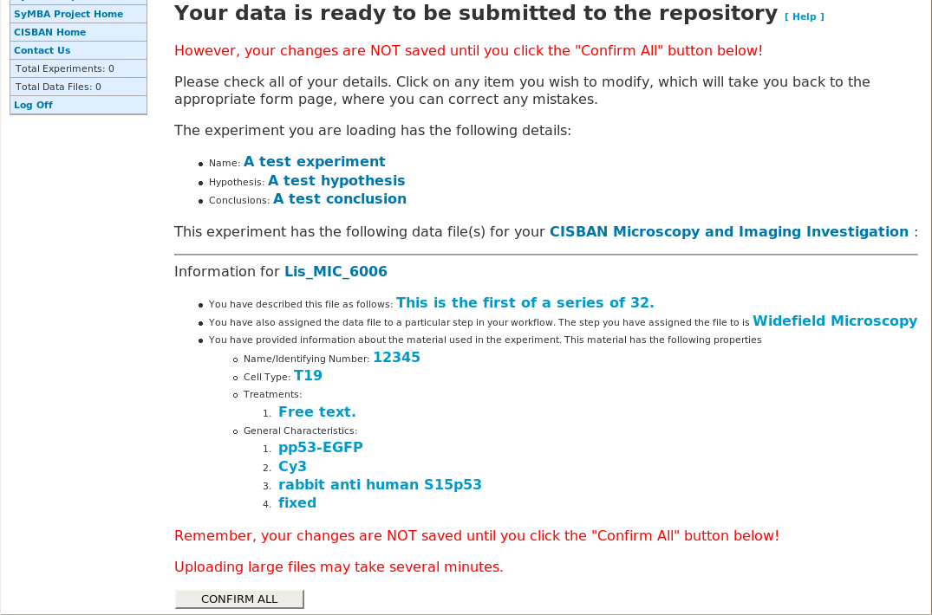

Slide 21
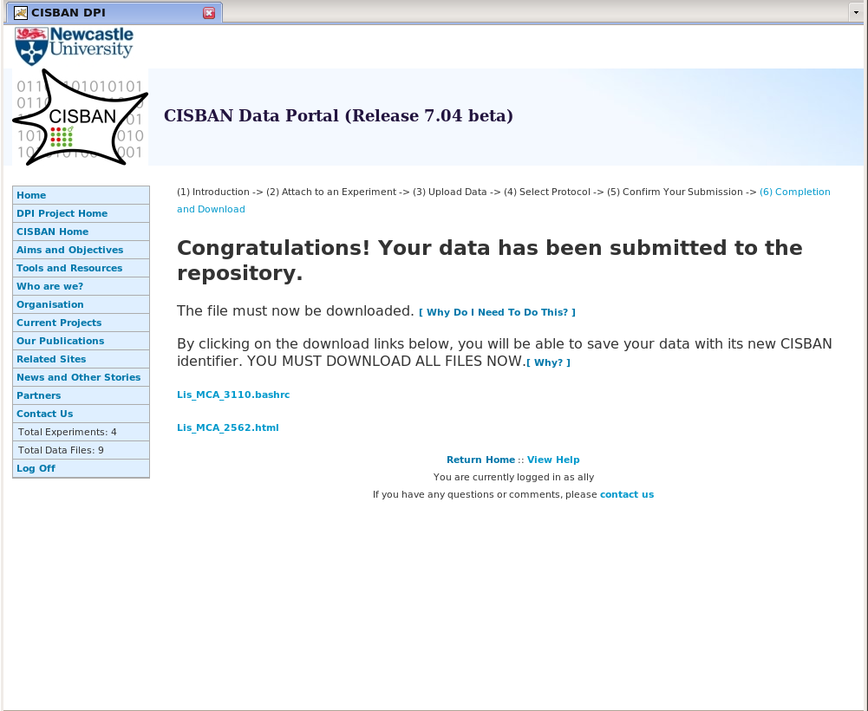

Slide 22
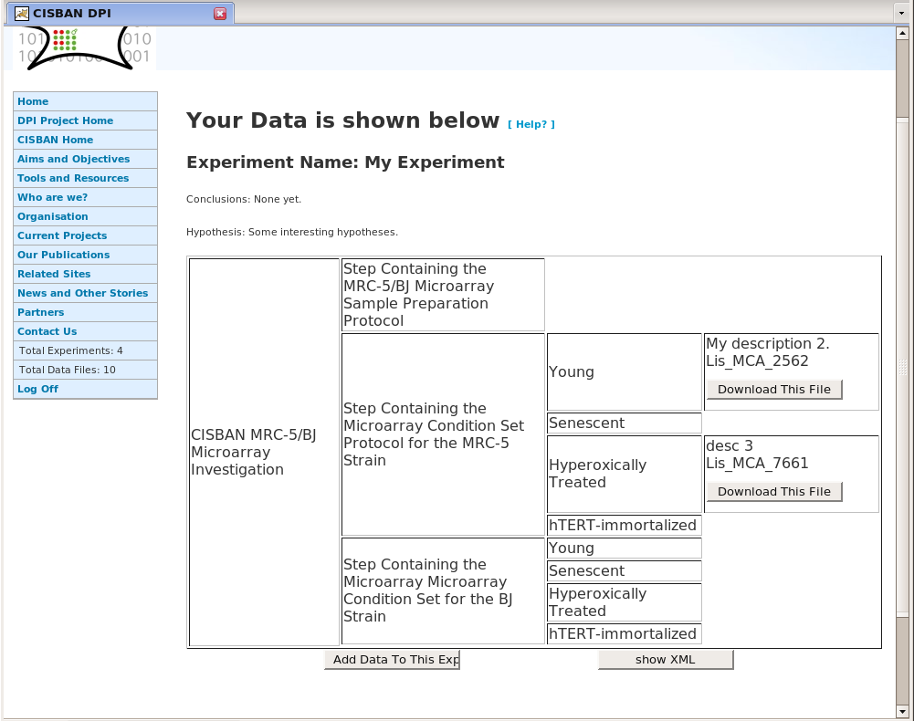

Slide 23
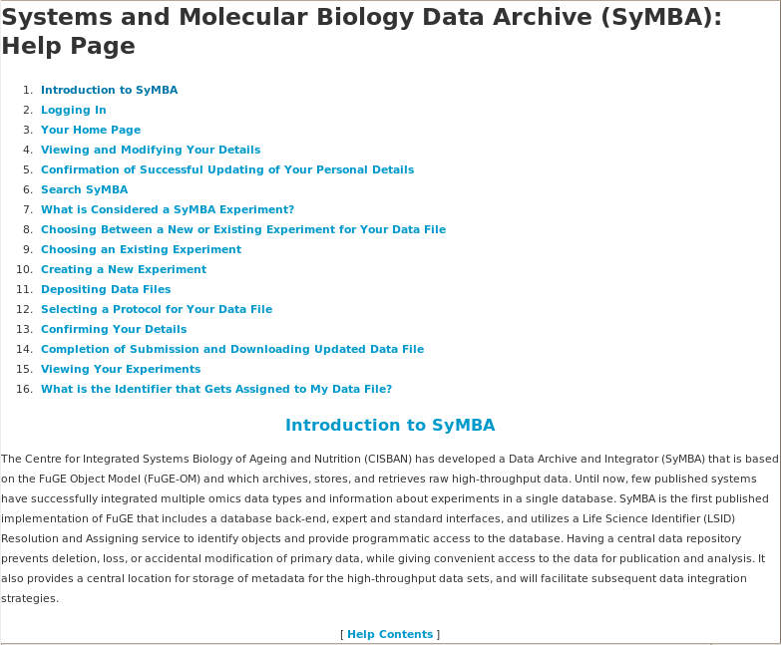

Slide 24
Thank you!
CISBAN Head: Tom Kirkwood, CISBAN PI: Anil Wipat
Developers: Allyson Lister, Olly Shaw
Beta Testers: Amanda Greenall, Stephen Addinall, Gabi Saretzki, Glyn Nelson
People who provided help and advice: Andy Jones, Matt Pocock
http://fuge.sourceforge.net, Jones, A.R., Miller, M., Aebersold, R., Apweiler, R., Ball, C.A., Brazma, A., DeGreef, J., Hardy, N., Hermjakob, H., Hubbard, S.J., Hussey, P., Igra, M., Jenkins, H., Julian, Jr. R.K., Laursen, K., Oliver, S.G., Paton, N.W., Sarkans, U., Sansone, S., Stoeckert, Jr. C.J., Taylor, C.F., Whetzel, P.L., White, J.A., Spellman, P. and Pizarro, A.: The Functional Genomics Experiment model (FuGE): an extensible framework for standards in functional genomics. Nature Biotechnology in community consultation (2007)
These may not be the most up-to-date version of these slides. Visit http://symba.sf.net to check for later versions, and for more information both on the status and installation of SyMBA. An beta version of the SyMBA is now available for those who wish to play with it.
Questions and comments are welcome, and should be sent to symba-devel@lists.sourceforge.net
CISBAN is supported jointly by the Biotechnology and Biological Sciences Research Council (BBSRC) and the Engineering and Physical Sciences Research Council (EPSRC).

