Slide 1
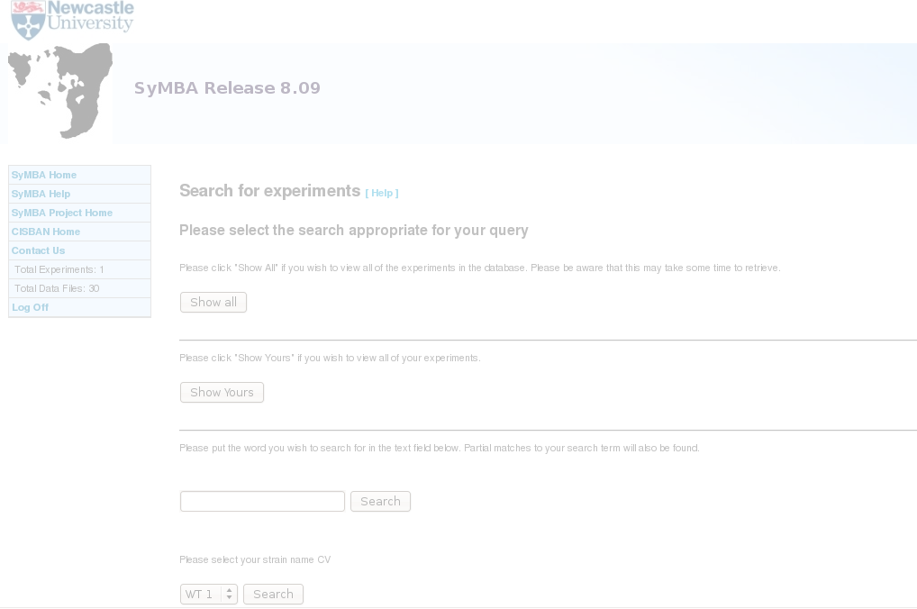
SyMBA Workshop
Allyson Lister
CISBAN, Newcastle University
September 2008

Slide 2
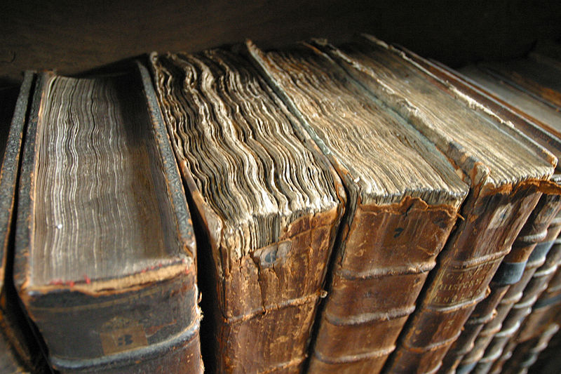
Systems and Molecular Biology Data and Metadata Archive
Background: Handling Big Data
Why use SyMBA?
What is SyMBA?
How is SyMBA used?
  CC-SA-2.0, Tom Murphy VII, commons.wikimedia.org

Slide 3
Background: Handling Big Data
  CC-SA-2.0, Tom Murphy VII, commons.wikimedia.org

Slide 4
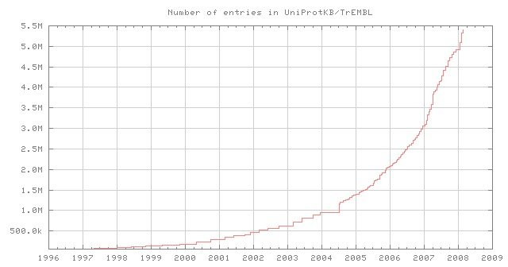
Responsible Data Management
“Sooner or later, the research community will need to be involved in the annotation effort to scale up to the rate of data generation.” Nature 455, 47-50
“This transition will require...standardized methods” Nature 455, 47-50
Release of September 2 2008: http://uniprot.org

Slide 5
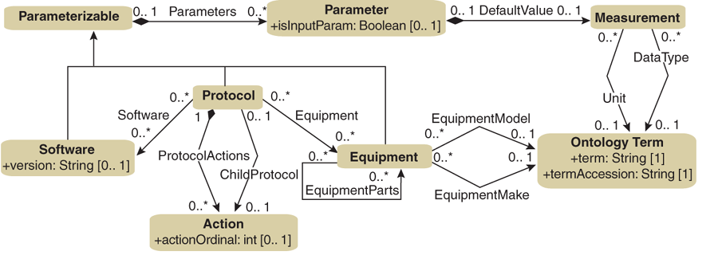
Commitment to Curation
“...standards require support from researchers, who should adopt them and deploy them consistently.” Nature 455, 1
“This takes a degree of intellectual and practical commitment to what can seem like tedious bookkeeping.” Nature 455, 1
Nature Biotechnology 25, 1127 - 1133

Slide 6

Documentation as Part of the Experiment
“Researchers need to adapt their institutions and practices in response to torrents of new data...” (Nature 455, 1)
“Researchers need to be obliged to document and manage their data with as much professionalism as they devote to their experiments.” (Nature 455, 1)
CC-NC-2.0

Slide 7

It's Not Just Researchers...
“Funding agencies have been slow to support data infrastructure and this is one cultural shift that needs to accelerate” Nature 455, 1
[researchers]... “should receive greater support in this endeavour than they are afforded at present.” Nature 455, 1

Slide 8
Researchers as Stewards
From Nature 455, 28-29: Scientists should act as stewards by
  Honouring disciplinary standards
  Defining and recording appropriate metadata to allow for later interpretation of the data
  Definition of metadata best done at the time of data capture
  This includes provenance, parameters, and more
This is where SyMBA comes in
  Allows the above, and removes tedious repetition

Slide 9
What is SyMBA?
  CC-SA-2.0, Tom Murphy VII, commons.wikimedia.org

Slide 10
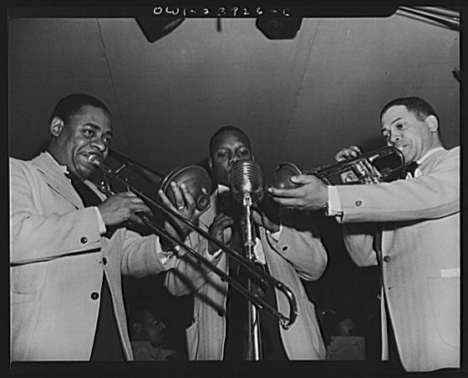
The Three Foundations
Content: the information about the experiment
Syntax: the structure for that information
Semantics: providing agreed-upon definitions for the information
PD: http://commons.wikimedia.org/wiki/Image:Duke_Ellington_-_Hurricane_Ballroom_-_trio.jpg

Slide 11
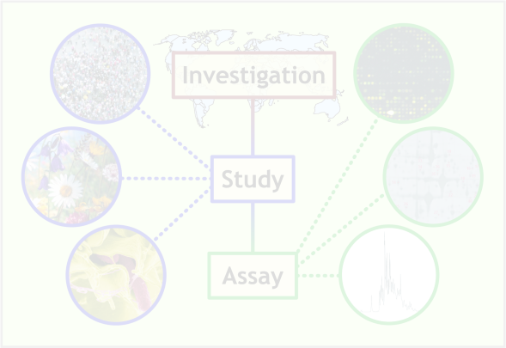
Content: MIBBI
MIAME: what is considered “minimal” for microarrays:
  the raw data for each hybridisation (e.g., CEL or GPR)
  the final processed (normalised) data for the set of hybridisations in the experiment
  the essential sample annotation
  the experimental design
  sufficient annotation of the array
  the essential laboratory and data processing protocols
adapted from http://www.mged.org/Workgroups/MIAME/miame.html

Slide 12
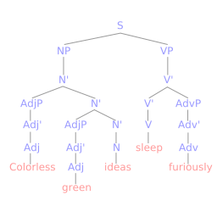
Syntax: FuGE
The Functional Genomics Experiment Object Model & Markup Language (FuGE-OM, FuGE-ML)
standardizes and structures experimental metadata for a range of omics experiments
models experimental objects such as samples, protocols, instruments, and software
provides extension points for the creation of individual community standards
PD: http://commons.wikimedia.org/wiki/Image:Syntax_tree.svg

Slide 13
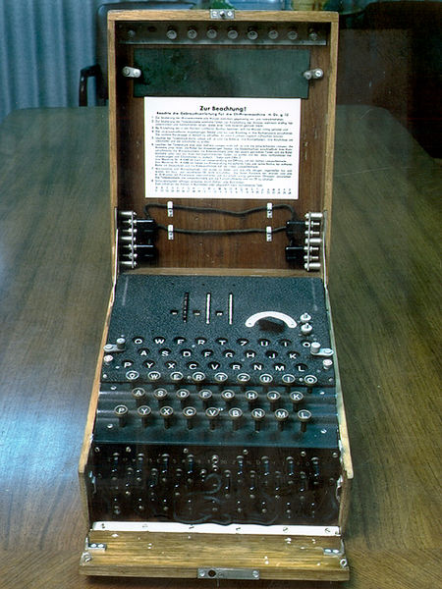
Semantics: OBI and others
encourages unambiguous names for things
'universal' terms, that are applicable across various biological and technological domains
enables computational exploitation of information
PD: http://commons.wikimedia.org/wiki/Image:Enigma.jpg

Slide 14
Why Use SyMBA?
  CC-SA-2.0, Tom Murphy VII, commons.wikimedia.org

Slide 15

Curation Starts at Home
Nature's recent Big Data special has emphasized the importance of data curation by the researchers who create data
CISBAN has a way to allow researchers to provide this metadata at the same time as they archive and backup their data: SyMBA
The Big Data special was only 2 weeks ago, but SyMBA has been in development for > 2 years!

Slide 16
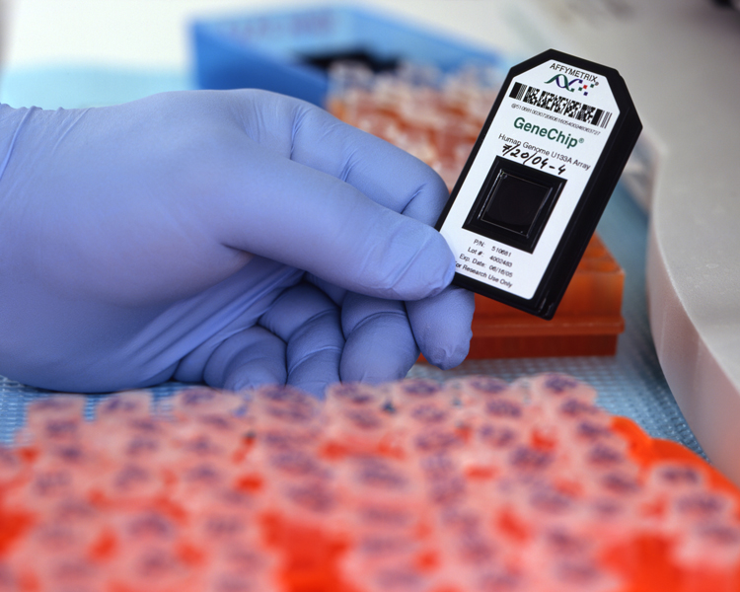
What does SyMBA do for me?
Storage for primary, large-scale data is:
  Long-term
  Protected
  Well-organized
  Easily-accessible
  Searchable
http://commons.wikimedia.org/wiki/Image:Affymetrix_GeneChip.jpg

Slide 17
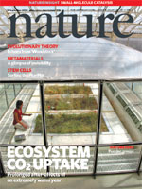
What does SyMBA do for me?
Keeps histories
Promote data sharing through the use of standards
Aids conformance to journal standards of data deposition and description

Slide 18

What does SyMBA do for me?
Open Source
  Code (but not data!) freely available for anyone's contributions
  Could speed development with larger programmer base
Aids fulfilment of BBSRC best practices
PD: commons.wikimedia.org/wiki/Image:Wikimedia_Community_Logo-Commons_from_a_blue_planet.svg

Slide 19
How is SyMBA Used?
  CC-SA-2.0, Tom Murphy VII, commons.wikimedia.org

Slide 20
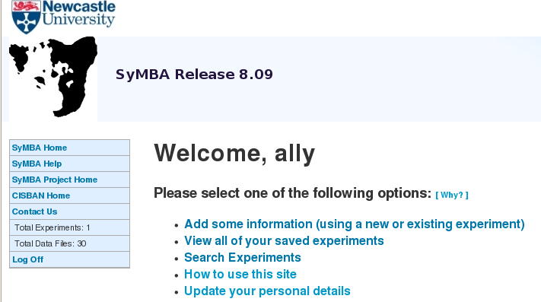
What does SyMBA look like?
To the user, SyMBA is a website
When the design of the website was being developed, the users (you!) said you wanted something quick and simple to use.

Slide 21

How do developers prepare SyMBA for users?
Developers talk with users
Discover what protocols, equipment, and software are used (e.g. answers to MIBBI checklists)
Templates are made
This saves users from entering data multiple times!
GNU: commons.wikimedia.org/wiki/Image:Cyberduck_document.png

Slide 22



Exp. 1
SyMBA
Template
Exp. 2
SyMBA
Exp. 3
Developer-created
Templates
SyMBA
User-created
Experiments
GNU: commons.wikimedia.org/wiki/Image:Cyberduck_document.png

Slide 23
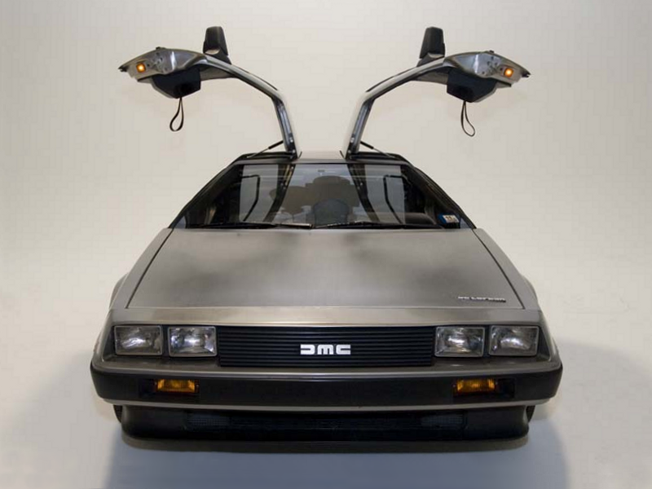
The Future...
Update the interface to make it prettier
Template Creation Wizard
Provide batch loading features
GNU: http://commons.wikimedia.org/wiki/Image:DeLorean_DMC-12_Head_with_doors_open.png

Slide 24
When FuGE is more extensively used...
EBI plans on having databases that understand FuGE
This could mean automatic upload from SyMBA to EBI
If other research groups store data using the FuGE format, then we could share experimental information much more easily

Slide 25
Credits
Programmers
  Allyson Lister, Olly Shaw, Frank Gibson, Joerg Servos, Rainer Schopf
Bioinformatics Support Unit, Newcastle Uni
  Dan Swan, Simon Cockell
Ideas People
  Matt Pocock, Neil Wipat, Jen Hallinan, Phil Lord, Andy Jones
Tom Kirkwood and all at CISBAN for all their testing and more

Slide 26

Thank You. Questions?
GNU: http://commons.wikimedia.org/wiki/Image:Thank_you_trashcan.jpg

Slide 27
More information
Developed mainly at: http://www.cisban.ac.uk
Project documentation: http://symba.sf.net
Mailing list: symba-devel@lists.sourceforge.net
Sandbox (playground) installation: http://www.cisban.ac.uk/symba-sandbox

Slide 28
Small Print
Anything marked with a CC-SA-2.0 is under the Creative Commons Attribution – Share Alike 2.0 Generic license. Details here: http://creativecommons.org/licenses/by-sa/2.0/
Anything marked with a CC-NC-2.0 is under the Creative Commons Non-Commercial 2.0 license. Details here:http://creativecommons.org/licenses/by-nc/2.0/uk/
Anything marked with a GNU is under the GNU GPL version 2 or later. Details here:http://en.wikipedia.org/wiki/GNU_General_Public_License
PD: Public Domain, no restrictions

Slide 29
Incentives for Stewardship
pressure from, and recognition through, journals (Nature 455, 1)
Nature 455, 47-50:
  Why should researchers contribute metadata?
    Improvement in academic reputation or impact
    New insight in their research area
    Annotation as a natural extension of the publication process
    www.wikiprofessional.org
    Still a long way to go

