Slide 1
Introduction « informatique »
Pr Pascal BONNET
Pierre-Yves LIBOUBAN
XiaoJun Mao

Slide 2




Technologies utilisées pour les cours Chimie-informatique sous Python

Slide 3
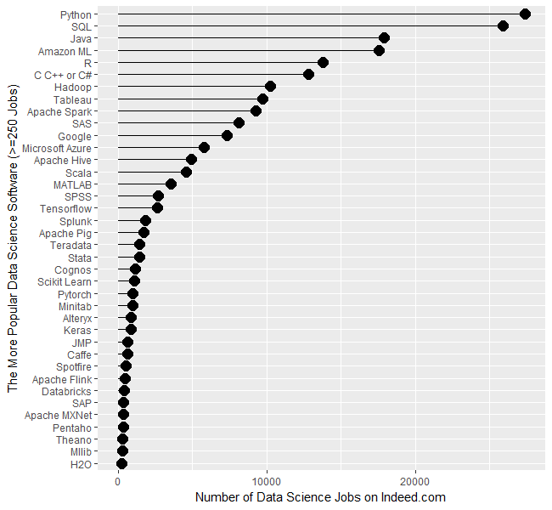
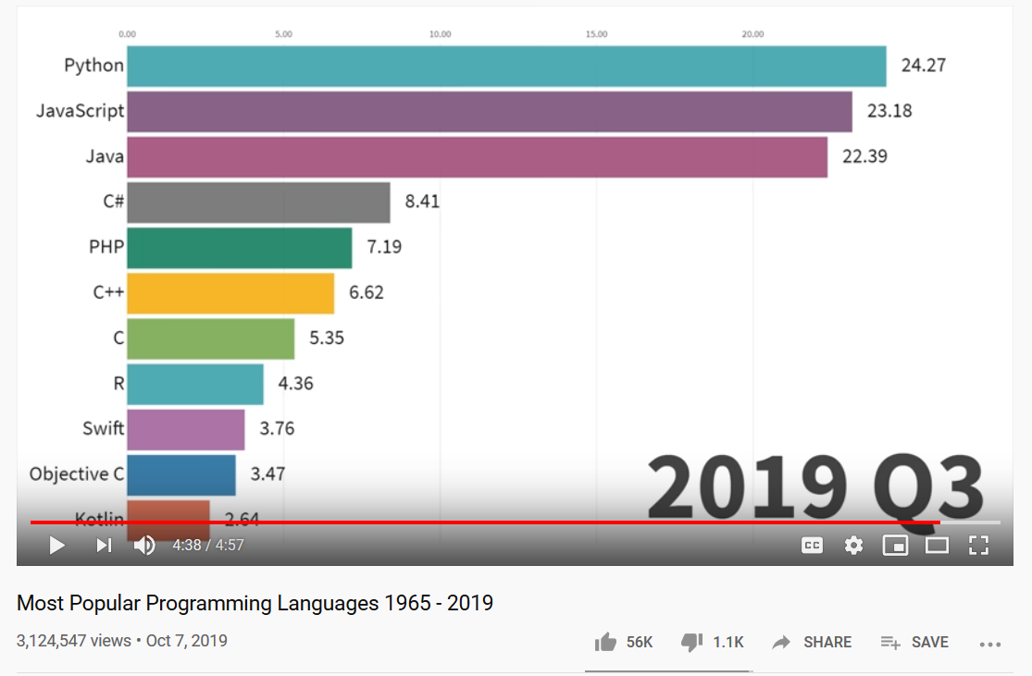
Number of data science jobs for the more popular software.
https://youtu.be/Og847HVwRSI
https://www.kdnuggets.com/2019/06/data-science-jobs-report.html

Slide 4
Beautiful is better than ugly
Explicit is better than implicit
Simple is better than complex
Readability counts
Langage de programmation orienté objet
Langage de haut niveau
facilement compréhensible par les humains
Langage interprété
pas besoin de compiler le code avant son exécution
Très utilisé en datascience

Slide 5
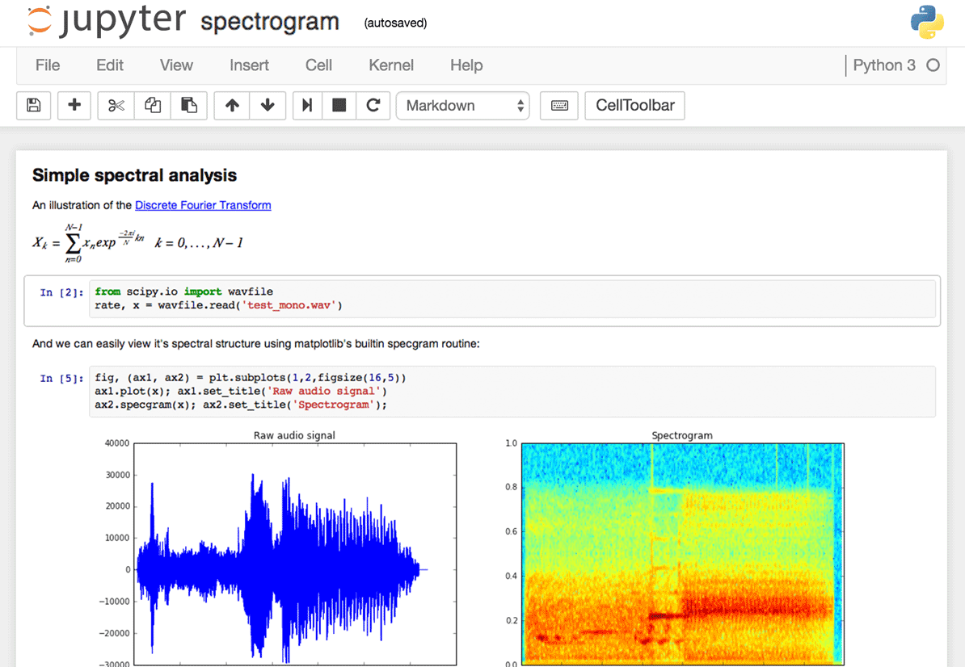
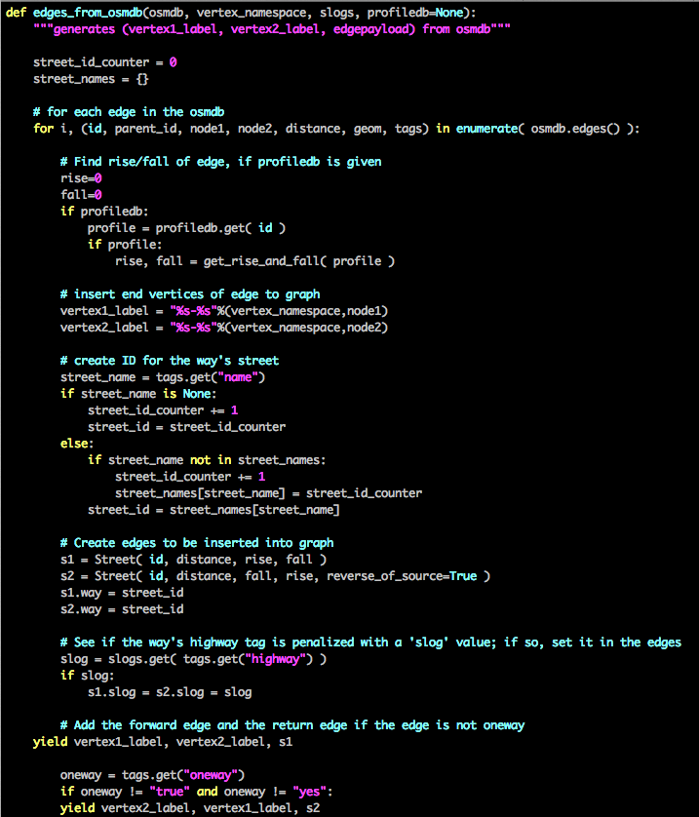
Jupyter notebook
or R, julia, ect ...

Slide 6



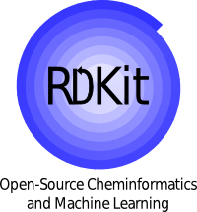














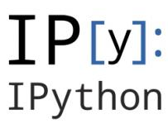



Integration of heterogeneous data
Bio & Chemo-informatics
Web & Storage
BLAST+
Seaborn
Visualisation
Scientific Computing
Machine Learning

Slide 7
Integration of heterogeneous data
Web & Storage
mySQL
Bio & Chemo-informatics
sqlite
mySQL
sqlite
C C++ Perl Python
Python
C C++ Fortran Python
Visualisation
Scientific Computing
CUDA
Machine Learning

Slide 8


... And anaconda allow portability, reproductibility, and sustainability
mySQL
sqlite
mySQL
sqlite
C C++ Perl Python
.exe
.sh
Python
C C++ Fortran Python
Freeze
CUDA

Slide 9
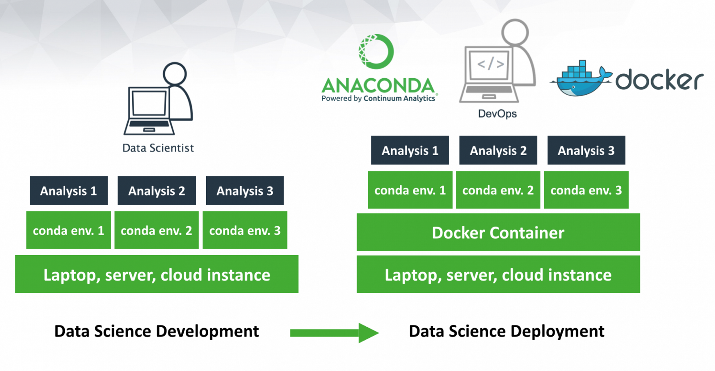
Anaconda - virtual environment
A virtual environment is a named, isolated, working copy of Python that maintains its own files, directories, and paths so that you can work with specific versions of libraries or Python itself without affecting other Python projects
Virtual environmets make it easy to cleanly separate different projects and avoid problems with different dependencies and version requiremetns across components

Slide 10
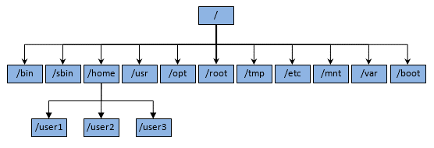

Anaconda
/bin/python
/opt/anaconda3

Slide 11
Anaconda
/opt/anaconda3
/bin/python
py3.4
py2.7
py3.5
py2.7

Slide 12
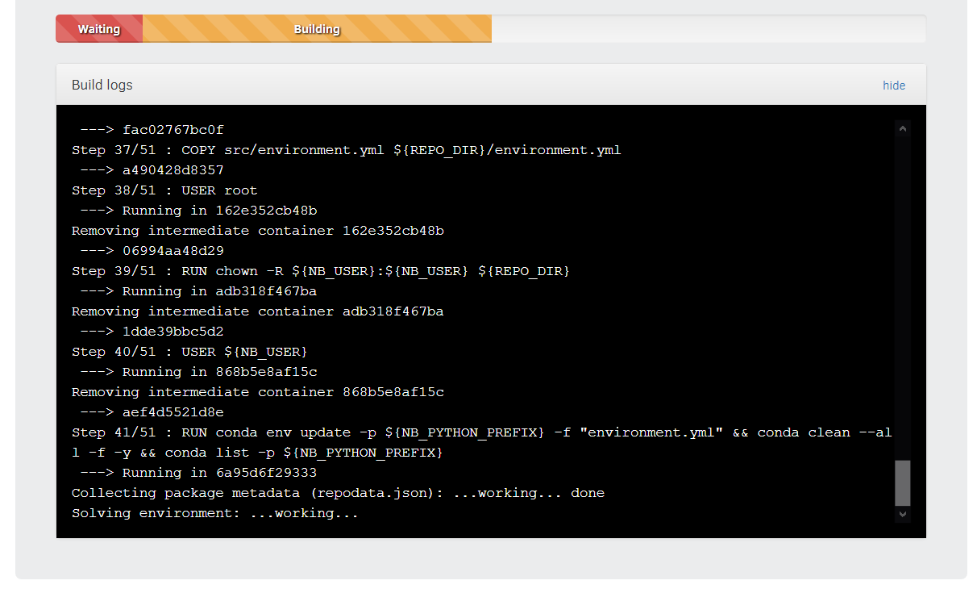
Pour les cours GSON
Environnement de travail déjà configuré
En utilisant GitHub, Anaconda, Docker et Binder, les notebooks sont accessibles via un navigateur internet à l’adresse :
https://mybinder.org/v2/gh/ICOA-SBC/GSON-cheminformatics/master

Slide 13
Remerciements
Dr Fabrice Carles
Dr Colin Bournez

