Slide 1
Molecular Similarity
Module Chimie informatique GSON
(Graduate School Orléans Numérique)
Pierre-Yves Libouban, XiaoJun Mao, Pascal Bonnet

Slide 2
What is similar?

Slide 3
Different "spaces", classified by:
Shape
Colour
Size
Pattern

Slide 4
16 diverse aldehydes...

Slide 5
...sorted by common scaffold

Slide 6
...sorted by functional groups

Slide 7
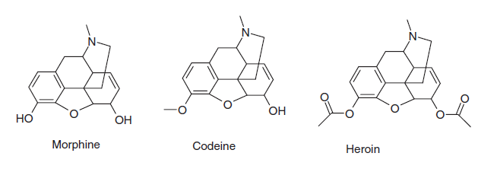
The "Similarity Principle" : Structurally similar molecules are assumed to have similar biological properties
Compounds active as opioid receptors

Slide 8
Key features in similarity/diversity calculations:
Properties to describe elements (descriptors, fingerprints)
Distance measure ("metrics")

Slide 9
N-Dimensional Descriptor Space
descriptor_{n}
Each chosen descriptor adds a dimension to the reference space
Calculation of n descriptor values produces an n-dimensional coordinate vector in descriptor space that determines the position of a molecule
molecule M_{i}
= (descriptor₁(i), descriptor₂(i), …, descriptor_{n}(i))
descriptor₂
descriptor₁
descriptor₃

Slide 10
Distance in chemical space
If two molecules have comparable values in all the n descriptors in the space, they are located close to each other in the n-D space.
how to define “closeness“ in space as a measure of molecular similarity? => distance metrics
distance AB (DAB)
The similarity between A and B, SAB, is negatively correlated with the distance DAB
shorter distance ~ more similar molecules
in the case of normalized distance (within value range [0,1]), similarity = 1 – distance
Distance in chemical space is used as a measure of molecular “similarity“ and “dissimilarity“
“Molecular similarity“ covers only chemical similarity but also property similarity including biological activity
descriptor_{n}
B
D_{AB}
descriptor₂
A
descriptor₁
descriptor₃

Slide 11
Popular Similarity/Distance Coefficients
Distance metrics:
Euclidean distance
Manhattan distance
Hamming distance
Soergel distance
Similarity metrics:
Tanimoto coefficient
Dice coefficient
Cosine coefficient

Slide 12
Distance metrics

Slide 13
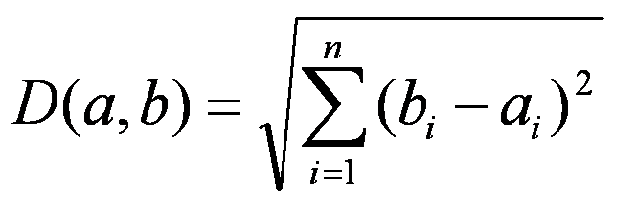
Euclidean Distance in n-D Space
Given two n-dimensional vectors, A and B
A = (a1,a2,...an)
B = (b1,b2,...bn)
Euclidean distance DAB is defined as:
Example:
A = (3,0,1); B = (5,2,0)
DAB = = 3
descriptor_{n}
D_{AB}
B
A
descriptor₂
descriptor₁
descriptor₃

Slide 14
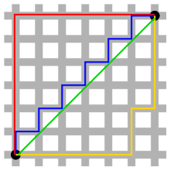
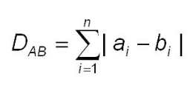
Manhattan Distance in n-D Space
Given two n-dimensional vectors, A and B
A = (a1,a2,...an)
B = (b1,b2,...bn)
Manhattan distance DAB is defined as the sum of the absolute differences of Cartesian coordinates :
Example:
A = (3,0,1); B = (5,2,0)
DAB = |3 - 5| + |0 - 2| + |1 - 0| = 5
descriptor_{n}
D_{AB}
B
A
descriptor₂
descriptor₁
descriptor₃

Slide 15
Similarity metrics

Slide 16

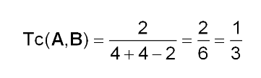


Tanimoto Coefficient (Tc)
binary
B
Definition:
value range: [0,1]
Tc is the most popular similarity coefficient
Tc is also known as Jaccard coefficient
The Jaccard similarity coefficient, J, is given as
The Jaccard distance, dJ, is given as
A
C
A
B
a = 4, b = 4, c = 2

Slide 17
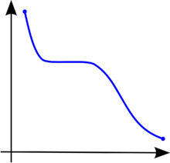
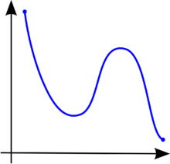
Dice Coefficient
Definition:
value range: [0,1]
monotonic with the Tanimoto coefficient
a monotonic function ⬄ preserves or reverses the given order.
A monotonically decreasing function
A function that is not monotonic

Slide 18
Cosine Coefficient
Definition:
Properties:
value range: [0,1]
correlated with the Tanimoto coefficient but not strictly monotonic with it

Slide 19
Application of molecular similarity
Example :
Similarity search
Clustering
Diversity picking

Slide 20
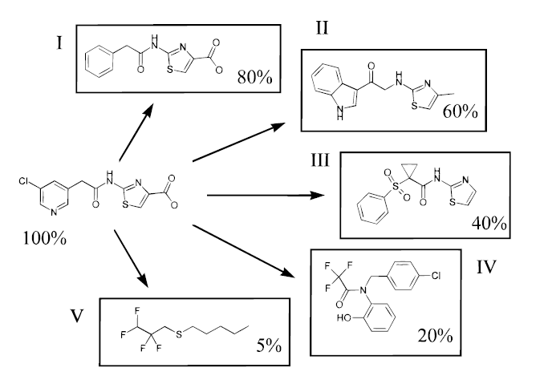
1.Similarity search
Query
Chemical Database
D.R. Flower, J. Chem. Inf. Comput. Sci., Vol. 38, No. 3, 1998, pp. 379-386

Slide 21
2.Clustering

Slide 22
Clustering in chemistry
Classification without labels (“unsupervised learning”)
Clustering is the separation of a set of objects into groups such that items in one group are more like each other than items in a different group

Slide 23
Strategy
Select descriptors
Generate descriptors for all items
Scale descriptors
Define similarity measure (« metrics »)
Apply appropriate clustering method to group the items on basis of chosen descriptors and similarity measure
Analyse results

Slide 24
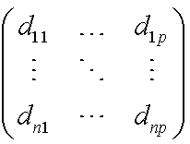
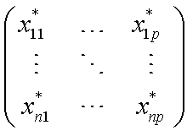
Data Presentation
descriptors
molecules
molecules
molecules
dataframe of descriptors
distance matrix
Library contains n molecules,
each molecule is described
by p descriptors
dii = 0; dij = dji

Slide 25
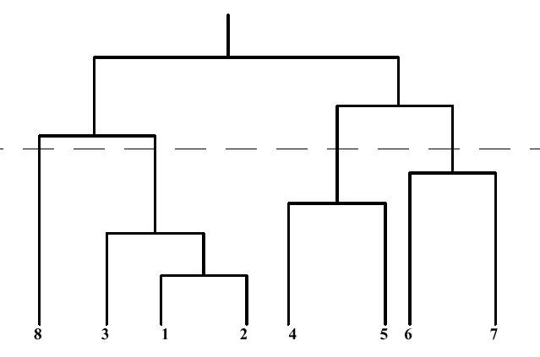
Example : Hierarchical Clustering
How many clusters are in the data ?
Where should be the dendrogram be cut ?
Which of two partitions fit the data better ?
Does partitioning match the categories ?
divisive
agglomerative
A dendrogram representing an hierarchical clustering of 7 compounds

Slide 26
3.Diversity picking
Example : Libraries design
Goal: Select a representative subset from a large database

Slide 27
Chemical Space
Overlapping similarity radii
Redundancy
"Void" regions
Lack of information

Slide 28
Chemical Space
Overlapping similarity radii
Redundancy
"Void" regions
Lack of information

Slide 29
Chemical Space
Overlapping similarity radii
Redundancy
"Void" regions
Lack of information
Optimally diverse compound library

Slide 30
Acknowledgement
Dr Fabrice Carles
Dr Colin Bournez

