Slide 1
Introduction to SQL and the Relational Model
ICOS Big Data Summer Camp
June 2, 2015
Mike Anderson
(slides from Mike Cafarella)
Notes:
DML = “Data Manipulation Language”

Slide 2
Relational Databases
The most common kind is a relational database
The software is called a Relational Database Management System (RDBMS)
  Oracle, IBM’s DB2, Microsoft’s SQLServer, MySQL, SQLite, etc
Your dataset is “a database”, managed by an RDBMS
AID | Name | Country | Sport
1 | Mary Lou Retton | USA | Gymnastics
2 | Jackie Joyner-Kersee | USA | Track
3 | Michael Phelps | USA | Swimming

Slide 3
Relational Databases
A relational database is a set of “relations” (aka tables)
Each relation has two parts:
  Instance (a table, with rows (aka tuples, records), and columns (aka fields, attributes))
    # Rows = cardinality
    # Columns = degree / arity
  Schema
    Relation name
    Name and type for each column
    E.g., Student (sid int, name varchar(128), gpa real)

Slide 4
Instance of Athlete Relation
AID | Name | Country | Sport
1 | Mary Lou Retton | USA | Gymnastics
2 | Jackie Joyner-Kersee | USA | Track
3 | Michael Phelps | USA | Swimming
What is the schema?
(aid: integer, name: string, country: string, sport:string)
Cardinality & Degree?
Cardinality = 3, Degree = 4

Slide 5
Relational Query Languages
An RDBMS does lots of things, but mainly:
  Keeps data safe
  Gives you a powerful query language
Queries written declaratively
  In contrast to procedural methods
RDBMS is responsible for efficient evaluation
  System can optimize for efficient query execution, and still ensure that the answer does not change
Most popular query language is SQL
Notes:
9
What’s the difference between declarative and procedural?

Slide 6
Creating Relations in SQL
CREATE TABLE Athlete
(aid INTEGER,
name CHAR(30),
country CHAR(20),
sport CHAR(20))
Create the Athlete relation
  Type constraint enforced when tuples added or modified
Create the Olympics relation
Create the Compete relation
CREATE TABLE Olympics
(oid INTEGER,
year INTEGER,
city CHAR(20))
CREATE TABLE Compete
(aid INTEGER,
oid INTEGER)

Slide 7
The SQL Query Language
Find all athletes from USA:
AID | Name | Country | Sport
1 | Mary Lou Retton | USA | Gymnastics
2 | Jackie Joyner-Kersee | USA | Track
3 | Michael Phelps | USA | Swimming
SELECT *
FROM Athlete A
WHERE A.country = ‘USA’
Print only the names and sports:
SELECT A.name, A.sport
FROM Athlete A
WHERE A.country = ‘USA’
Name | Sport
Mary Lou Retton | Gymnastics
Jackie Joyner-Kersee | Track
Michael Phelps | Swimming

Slide 8
Querying Multiple Relations
What does the following query compute?
SELECT O.year
FROM Athletes A, Olympics O, Compete C
WHERE A.aid = C.aid AND O.oid = C.oid
AND A.name = ‘Michael Phelps’
Find the years when Michael Phelps competed in the Olympics

Slide 9
Adding & Deleting Tuples
Can insert a single tuple using:
INSERT INTO Athlete (aid, name, country, sport)
VALUES (4, ‘Johann Koss’, ‘Norway’, ‘Speedskating’)
Can delete all tuples satisfying some condition (e.g., name = Smith):
DELETE
FROM Athlete A
WHERE A.name = ‘Smith’
Notes:
10

Slide 10
Destroying & Altering Relations
DROP TABLE Olympics
Destroys the relation Olympics.
(Schema information and tuples are deleted)

Slide 11
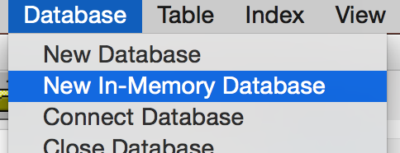
Hands-On #1
Open Firefox SQLite Manager and select New In-Memory Database
from the Database menu.
Click “Execute SQL”.
In another window, go to web.eecs.umich.edu/~michjc/players.txt
Copy the text into the “Enter SQL” box and click “Run SQL”
Data Boot Camp!
Notes:
Positions #s
Schema:
playerID, year, gameNum, gameID, teamID, lgID, GP, startingPos
('ortizda01', 2012, 0, 'ALS201207100', 'BOS', 'AL', 1, 0),

Slide 12
Hands-On #1
Write queries to find:
  Names of all the players in the database
  All info for all players from Detroit
  Names and teams of the first basemen (Position ID: 3)
Data Boot Camp!

Slide 13
Hands-On #1
Names of all the players in the database
SELECT playerID FROM Allstars
All info for all players from Detroit
SELECT *
FROM Allstars
WHERE teamID = "DET"
Names and teams of the first basemen
SELECT playerID, teamID
FROM Allstars
WHERE startingPos = 3
Data Boot Camp!

Slide 14
Basic SQL Query
Attributes from input relations
Optional
List of relations
SELECT [DISTINCT] attr-list
FROM relation-list
WHERE qualification
Attr1 op Attr2
OPS: <, >, =, <=, >=, <>
Combine using AND, OR, NOT
(Conceptual) Evaluation:
1. Take cross-product of relation-list
2. Select rows satisfying qualification
3. Project columns in attr-list
(eliminate duplicates only if DISTINCT)

Slide 15
Example of Basic Query
Schema:
  Sailors (sid, sname, rating, age)
  Boats (bid, bname, color)
  Reserves (sid, bid, day)
Find the names of sailors who have reserved boat #103
SELECT S.sname
FROM Sailors S, Reserves R
WHERE S.sid = R.sid AND R.bid = 103

Slide 16
Example of Basic Query
Reserves
Sailors
sid | bid | day
22 | 101 | 10/10
58 | 103 | 11/12
sid | sname | rating | age
22 | dustin | 7 | 45
58 | rusty | 10 | 35
31 | lubber | 8 | 55
Reserves x Sailors
sid
bid
day
sid
sname
rating
age
22
101
10/10
22
dustin
7
45
22
101
10/10
58
rusty
10
35
22
101
10/10
31
lubber
8
55
58
103
11/12
22
dustin
7
45
58
103
11/12
58
rusty
10
35
58
103
11/12
31
lubber
8
55

Slide 17
Example of Basic Query
SELECT DISTINCT sname
FROM Sailors S, Reserves R
WHERE S.sid = R.sid AND R.bid = 103
What’s the effect of adding DISTINCT?

Slide 18
Another Example
Schema:
  Sailors (sid, sname, rating, age)
  Boats (bid, bname, color)
  Reserves (sid, bid, day)
Find the colors of boats reserved by a sailor named rusty
SELECT B.color
FROM Sailors S, Reserves R, Boats B
WHERE S.sid = R.sid AND R.bid = B.bid AND S.sname = 'rusty'

Slide 19
Note on Range Variables
Needed when same relation appears twice in FROM clause
SELECT S1.sname, S2.sname
FROM Sailors S1, Sailors S2
WHERE S1.age > S2.age
What does this
Query compute?
Good style to always use range variables anyway…

Slide 20
Hands-On #2
SQLite Manager 

In another window, go to web.eecs.umich.edu/~michjc/teams.txt
Copy the text, Run SQL, etc.
In addition to Allstars table, Teams table:
  yearID, lgID, teamID, franchID, name, park, attendance, BPF, PPF, teamIDBR, teamIDlahman45, teamIDretro
Data Boot Camp!

Slide 21
Hands-On #2
Write queries to find:
  Team names for all teams with attendance more than 2,000,000
  Player ID and home stadium for all Allstars
  TeamID, attendance for teams that had an all-star player
Data Boot Camp!

Slide 22
Hands-On #2
Team names for all teams with attendance more than 2,000,000
SELECT name
FROM Teams
WHERE attendance > 2000000
Player ID and home stadium for all Allstars
SELECT playerID, park
FROM Allstars A, Teams T
WHERE A.teamID = T.teamID
Data Boot Camp!

Slide 23
Hands-On #2
TeamID, attendance values for teams that had an all-star player
One answer:
  SELECT A.teamID, attendance
  FROM Teams T, Allstars A
  WHERE T.teamID = A.teamID
A better answer:
  SELECT DISTINCT A.teamID, attendance FROM Teams T, Allstars A
  WHERE T.teamID = A.teamID
Data Boot Camp!

Slide 24
ORDER BY clause
Most of the time, results are unordered
You can sort them with the ORDER BY clause
Attribute(s) in ORDER BY clause must be in SELECT list.
Find the names and ages of all sailors, in increasing order of age
Find the names and ages of all sailors, in decreasing order of age
SELECT S.sname, S.age
FROM Sailors S
ORDER BY S.age [ASC]
SELECT S.sname, S.age
FROM Sailors S
ORDER BY S.age DESC

Slide 25
ORDER BY clause
SELECT S.sname, S.age, S.rating
FROM Sailors S
WHERE S.age > 20
ORDER BY S.age ASC, S.rating DESC
What does this query compute?
Find the names, ages, & ratings of sailors over the age of 20.
Sort the result in increasing order of age.
If there is a tie, sort those tuples in decreasing order of rating.

Slide 26
Hands-On #3
Use the database loaded last time
A twist:
  Find TeamID and attendance values for teams that had an all-star player ORDERED BY ATTENDANCE
Data Boot Camp!

Slide 27
Hands-On #3
Find TeamID and attendance values for teams that had an all-star player
ORDERED BY ATTENDANCE
SELECT DISTINCT A.teamID, attendance
FROM Teams T, Allstars A
WHERE T.teamID = A.teamID
ORDER BY attendance DESC
Data Boot Camp!

Slide 28
Aggregate Operators
COUNT (*)
COUNT ( [DISTINCT] A)
SUM ( [DISTINCT] A)
AVG ( [DISTINCT] A)
MAX (A) Can use Distinct
MIN (A) Can use Distinct
SELECT COUNT (*) FROM Sailors S
SELECT COUNT (DISTINCT S.name)
FROM Sailors S
single column
SELECT AVG (S.age)
FROM Sailors S
WHERE S.rating=10
SELECT AVG ( DISTINCT S.age)
FROM Sailors S
WHERE S.rating=10
SELECT S.sname FROM Sailors S
WHERE S.rating= (SELECT MAX(S2.rating) FROM Sailors S2)
Notes:
Significant extension of relational algebra.

Slide 29
Hands-On #4
Use our previous Allstar and Teams DB
Find:
  Average attendance for all teams
  Average attendance among teams that had an all-star player
Data Boot Camp!

Slide 30
Hands-On #4
Average attendance for all teams
SELECT AVG(attendance)
FROM Teams
Average attendance among teams that had an all-star player
SELECT AVG(DISTINCT attendance)
FROM Teams T, Allstars A
WHERE T.teamID = A.teamID
Data Boot Camp!

Slide 31
GROUP BY
Conceptual evaluation
  Partition data into groups according to some criterion
  Evaluate the aggregate for each group
Example: For each rating level, find the age of the youngest sailor
SELECT MIN (S.age), S.rating
FROM Sailors S
GROUP BY S.rating
How many tuples in the result?

Slide 32
GROUP BY and HAVING
SELECT [DISTINCT] target-list
FROM relation-list
WHERE qualification
GROUP BY grouping-list
HAVING group-qualification
Target-list contains:
Attribute names (subset of grouping-list)
Aggregate operations (e.g., min(age))
Conceptual Evaluation:
Eliminate tuples that don’t satisfy qualification
Partition remaining data into groups
Eliminate groups according to group-qualification
Evaluate aggregate operation(s) for each group
Notes:
Go to Page 154-155 to see information about what can go into the GROUP BY and HAVING lists.
The SELECT CLAUSE can include cloumn names and aggregates.
The GROPU BY CLAUSE must contain every column name from SELECT. This is to force there to be just one unique value per group. How else will we know?
The HAVING must have just one value per GROUP.

Slide 33
Hands-On #5
With our same old database, first try a simple one:
  Show all teamIds that had an all-star, along with number of all-star players
Data Boot Camp!

Slide 34
Hands-On #5
Show all teamIds that had an all-star, along with number of all-star players
SELECT teamID, COUNT(*)
FROM Allstars
GROUP BY teamID
Data Boot Camp!

Slide 35
Hands-On #5
Harder:
  Show all team names that had an all-star, along with number of all-star players
Data Boot Camp!

Slide 36
Hands-On #5
Show all team names that had an all-star, along with number of all-star players
SELECT name, COUNT(A.playerID)
FROM Allstars A, Teams T
WHERE A.teamID = T.teamID
GROUP BY T.name
Data Boot Camp!

Slide 37
Hands-On #5
Even Harder:
  Show all team names that had an all-star, along with number of all-star players,
  SORTED IN DESCENDING ORDER BY NUMBER OF ALL-STARS
Data Boot Camp!

Slide 38
Hands-On #5
Show all team names that had an all-star, along with number of all-star players, SORTED IN DESCENDING ORDER BY NUMBER OF ALL-STARS
SELECT name, COUNT(A.playerID) AS playerCount
FROM Allstars A, Teams T
WHERE A.teamID = T.teamID
GROUP BY name
ORDER BY playerCount DESC
Data Boot Camp!

Slide 39
Hands-On #5
Hardest:
  Show all team names that had an all-star, along with number of all-star players,
  SORTED IN DESCENDING ORDER OF NUMBER OF ALL-STARS
  AND: only show teams with at least 2 players
Data Boot Camp!

Slide 40
Hands-On #5
Show all team names that had an all-star, along with number of all-star players, SORTED IN DESCENDING ORDER OF NUMBER OF ALL-STARS
AND: only show teams with at least 2 players
SELECT name, COUNT(A.playerID) AS playerCount
FROM Allstars A, Teams T
WHERE A.teamID = T.teamID GROUP BY name
HAVING playerCount >= 2
ORDER BY playerCount DESC
Data Boot Camp!

Slide 41
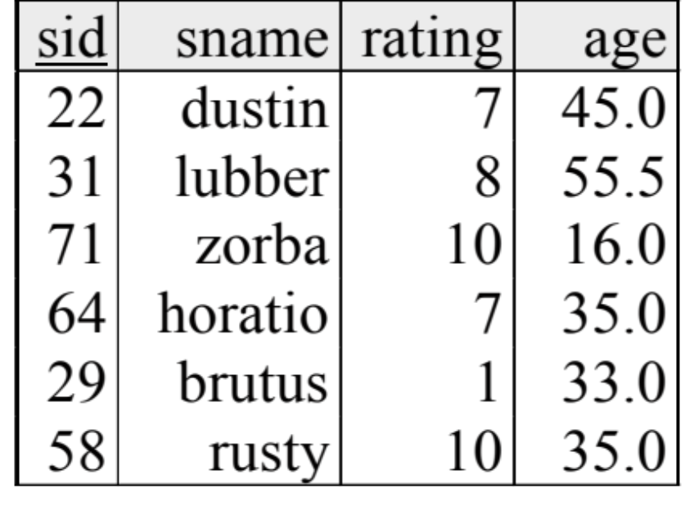
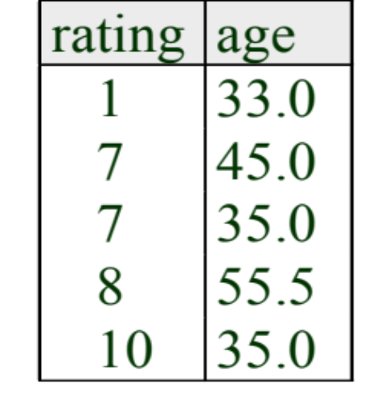
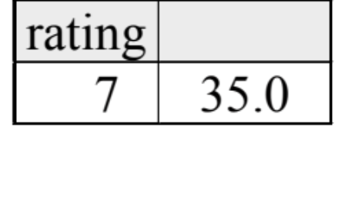
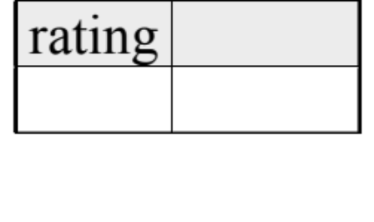
Find the age of the youngest sailor with age >= 18, for each rating with at least 2 such sailors
SELECT S.rating, MIN (S.age)
FROM Sailors S
WHERE S.age >= 18
GROUP BY S.rating
HAVING COUNT (*) >= 2
Answer relation

Slide 42
NULL Values in SQL
NULL represents ‘unknown’ or ‘inapplicable’
Query evaluation complications
  Q: Is (rating > 10) true when rating is NULL?
  A: Condition evaluates to ‘unknown’ (not T or F)
What about AND, OR connectives?
  Need 3-valued logic
WHERE clause eliminates rows that don’t evaluate to true
p | q | p AND q | p OR q
T | T | T | T
T | F | F | T
T | U | U | T
F | T | F | T
F | F | F | F
F | U | F | U
U | T | U | T
U | F | F | U
U | U | U | U

Slide 43
NULL Values Example
What does this query return?
SELECT sname
FROM sailors
WHERE age > 45
OR age <= 45
sailors
sid | sname | rating | age
22 | dustin | 7 | 45
58 | rusty | 10 | NULL
31 | lubber | 8 | 55
Notes:
Yes, it returns just dustin and lubber!

Slide 44
NULL Values in Aggregates
NULL values generally ignored when computing aggregates
  Modulo some special cases (see textbook)
sailors
SELECT AVG(age)
FROM sailors
sid | sname | rating | age
22 | dustin | 7 | 45
58 | rusty | 10 | NULL
31 | lubber | 8 | 55
Returns 50!

Slide 45
For each red boat, find the number of reservations for this boat*
SELECT B.bid, COUNT (*) AS scount
FROM Sailors S, Boats B, Reserves R
WHERE S.sid=R.sid AND R.bid=B.bid AND B.color=‘red’
GROUP BY B.bid
SELECT B.bid, COUNT (*) AS scount
FROM Sailors S, Boats B, Reserves R
WHERE S.sid=R.sid AND R.bid=B.bid
GROUP BY B.bid Would this work?
HAVING B.color = ‘red’ note: one color per bid
Notes:
No, SQL disallows this! Even though HAVING shows a single value per group, the HAVING clause is limited to an aggregated value OR must be in the grouping list.
What if we drop Sailors & the condition involving S.sid?

