Slide 1
Be Not Afraid

Slide 2
We’re All Charlatans
Computer science: not a science
Few “natural laws” because it is a human construction
Exception: “This sentence is false.” (1/3 of EECS 376)
Software engineering: not an engineering discipline
Engineering: static/dynamic modeling, safety margins, etc.
Software: “Recovery-oriented computing” (1/5 of EECS 582)
A culture of decentralized collaborative tinkering
Facebook: likely the most successful company run this way

Slide 3
MOVE FAST AND BREAK THINGS
Facebook Rule #1

Slide 4
Don’t be afraid to make a mistake
Everyone makes mistakes!
I make programming mistakes all the time
Students who actually do things make mistakes as well
Professional staff at Facebook do too (obviously!)
Fundamental to the process
These are formal languages (vs. natural)
Mortals aren’t inherently great at this

Slide 5
Stay focused and keep shipping
Facebook Rule #2

Slide 6
Don’t Wait to Find Your Mistakes
Build a little, test a little
“You keep using that word. I do not think it means what you think it means.”
--Inigo Montoya
You have an important advantage!
CS students believe they are really good at this
But, no one is really good at this, just shades of bad

Slide 7
Done is better than perfect
Facebook Rule #3

Slide 8
Never Fly Solo
Two people per keyboard, always
Everyone is bad at this, but in different ways
Only one of you needs to see the problem
Trade hands-on-keyboard frequently
It’s tempting to let one person “do the work”
You lose much of the benefit this way
Talk about what you are doing as you do it
Forces you to reveal hidden assumptions
Catch some mistakes even before you make them

Slide 9
Fortune favors the bold
Facebook Rule #4

Slide 10
Practical tips
There are no new problems under the sun
Check Google
Ask your physical neighbors
Ask your virtual neighbors
Steal, do not invent!
Large community with a strong culture of sharing
Before writing something, see if someone else has
Keep versions of things around: your Lab Notebook
Explains how you got there
In case you have to “go backwards”
In case you accidentally delete tons of work

Slide 11
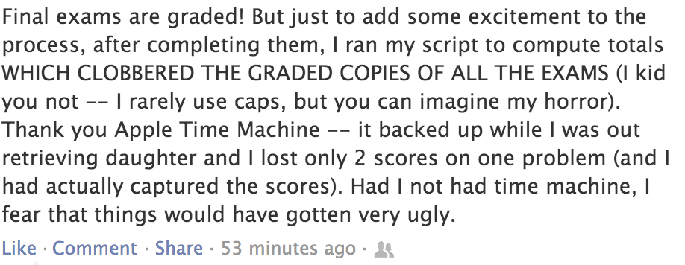
CS Professor (at another institution)

Slide 12
What would you do if you were not afraid?
Facebook Rule #5

Slide 13
A Few Caveats
You can do almost anything, but should you?
Intellectual property restrictions on code
Terms of Service restrictions on data providers
Lots of personally-identifiable information (IRB)
Computers allow you to make bigger mistakes more quickly
What is “science” vs. “stuff I saw somewhere”
Our group brought campus-wide storage to its knees
Zakir’s group routinely gets nastygrams for scanning
Get a sense for how this work is received elsewhere
Michigan rewards non-standard methods in standard fields
Maybe not everyone does, check with advisor(s)

