Slide 1
The Big Data Camp Challenge

Slide 2
Use the techniques you are practicing here to collaboratively demonstrate one plausibly true thing about a topic that interests you.
Reflect on the process of demonstrating that thing
Present your finding, your process and the fruits of your reflection to the group on FRIDAY 06/09.

Slide 3
Here are our expectations
Form groups
Articulate a topic or question of shared interest
Identify and gather relevant data
Create a dataset through scraping, API utilization, and/or merging existing datasets
Run queries, statistical analyses and/or visualizations using your data to demonstrate your one true thing
Prepare a presentation that describes your question, your process, your findings, and what doing this taught you about working with “big data”
Have Fun

Slide 4

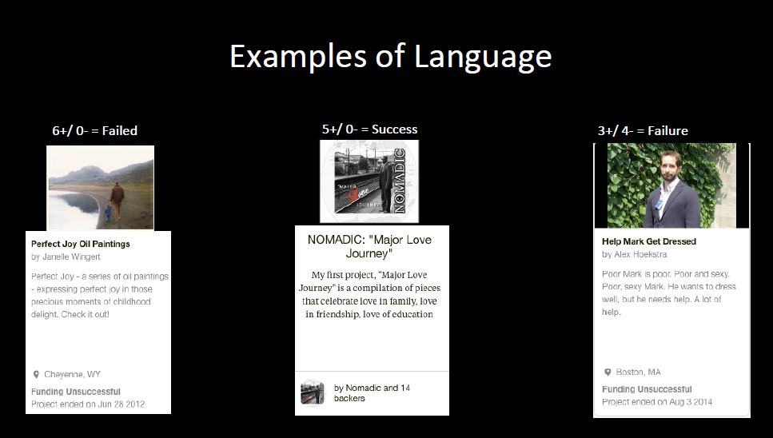
Finding success on Kickstarter: Being too positive or too negative results in not getting funded

Slide 5
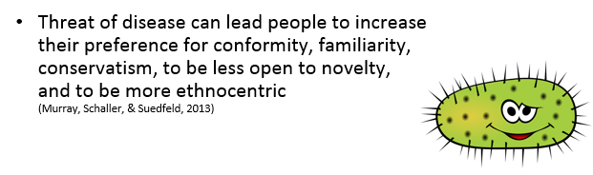
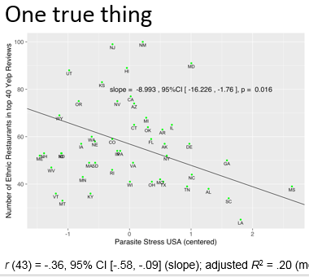

Higher pathogen prevalence in a region is associated with fewer non-American restaurants in the top 40 rated restaurants on Yelp.

Slide 6
Presentation Parts
Group Members
Our motivating question was…
Why this question was interesting to us
Process of dataset construction
Here is our fact: ___________________
Our preliminary findings or results
How you did what you did
What you would do with more time

Slide 7
Presentation Parts (2)
Slides of some sort – Powerpoint, pdf
Presentation should be about 7 minutes
At the very end of the presentation provide one to two tweets that summarize your project
PLEASE KEEP AND SHARE YOUR CODE WITH TEDDY - this is helpful for future camps

Slide 8
How to come up with ideas? THE SEVEN WHATS!
What is a question floating around your field that people are having trouble answering?
What is an old fundamental question or idea in your field that is incomplete?
What is an interesting dataset that is under –explored?
What are several massive datasets that I can connect?
What resources are on the Github site?
What do the other campers have to say?

Slide 9
Go forth and do interesting stuff.

Slide 10
WAIT! You need teams.

Slide 11
Team Formation (1)
Objectives
Self select into teams around the topics that enflame your passions
Cross disciplinary teams less than or equal to six
Go through a series of steps to make teams
Notes:
We are going to take a series of steps, the end goal of which is to get these teams for the duration of Data Camp. There won’t be team switching, so you are going to have to do some negotiation within your team to arrive at a topic everyone is okay working on intensely through Friday

Slide 12
Team Formation (2)
Education/Education Policy
Networks
Family Relationships
Rankings and Ratings
Social Movements
Elites
Emotions
Race
Politics
Healthcare
Firm Performance
Notes:
The ten most voted on topics on the survey were these. With these in mind, take an index card. I want you to write three questions. They can all be ablout the same topic if you know what you want. They can be probing, trying to get the brain flowing. They can be technical - trying to understand how to get the resources. They can be a call for resources - do you know anyone that has these expertise. Also write down three data sorurcees - APIs, website archival that ou think could be interesting to explore. I am going to give you 6 minutes to do this.

Slide 13
Three Questions, Three Data Sources
Notes:
Okay. Now we are going to do some more probing. These topics have been posted around the room. Grab a snack, and a drink. Then make your way over to the topic area. Once there find someone who is not in your area/discipline, introduce yourselves and have a conversation about the material on your card. Then migrate over to a different area and repeat this exercise. You will have about 20 minutes to do this

Slide 14
Cross-Disciplinary Conversations
Notes:
Okay. Now that you know a little bit about each other and what you are interested in. Migrate over to one of these topic areas and form a team of no more than six people. If a topic has come up that you want to explore and none of these really fit it, come talk to me and we will had a new topic area. Move to a new topic area and repeat this process. On the third time around, go to your favorite topic area and talk again. See if you can arrive on a topic idea that a team of no more than six wishes to collaborate on. Again the final teams should have no more than six people. You also cannot all be in the same discipline. You will have about 20 minutes to do this.

Slide 15
1.Send one person to get a sheet. 2.Go some place and chat. 3.Come up with a preliminary idea. 4.Return the sheet filled out in this room at 4:45.
Notes:
Okay. Now that you know a little bit about each other and what you are interested in. Migrate over to one of these topic areas and form a team of no more than six people. If a topic has come up that you want to explore and none of these really fit it, come talk to me and we will had a new topic area. I will circulate. Again the final teams should have no more than six people. You also cannot all be in the same discipline.

